Slide 1
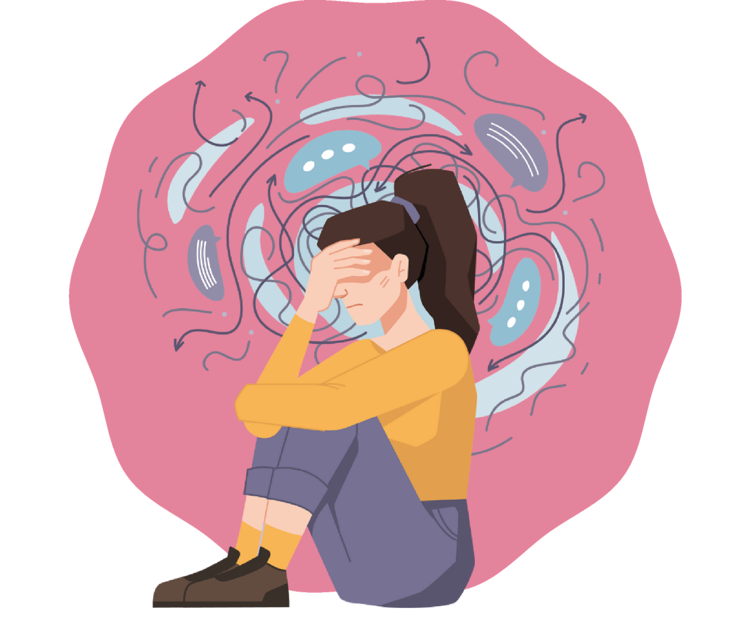
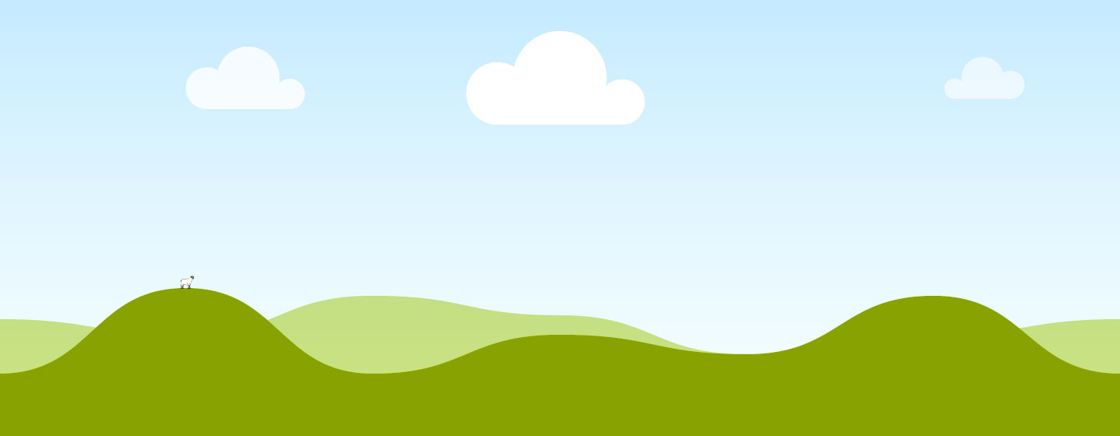
Module 2
Stress and Strategies for Managing It
Secondary School

Slide 2
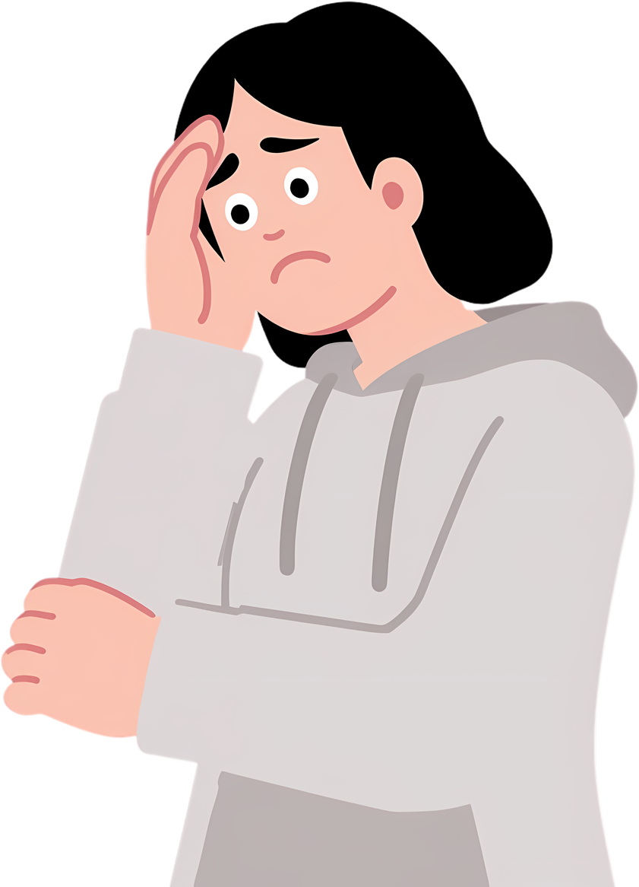
Why are we talking about this in this module?
Because everyone – truly everyone – experiences stress.
Exams, assignments, timetables.
Friendships, arguments, expectations.
Notifications, social media, social pressure.
Stress is not something “bad” … it is something human.
The most important thing is to understand it in order to manage it.

Slide 3
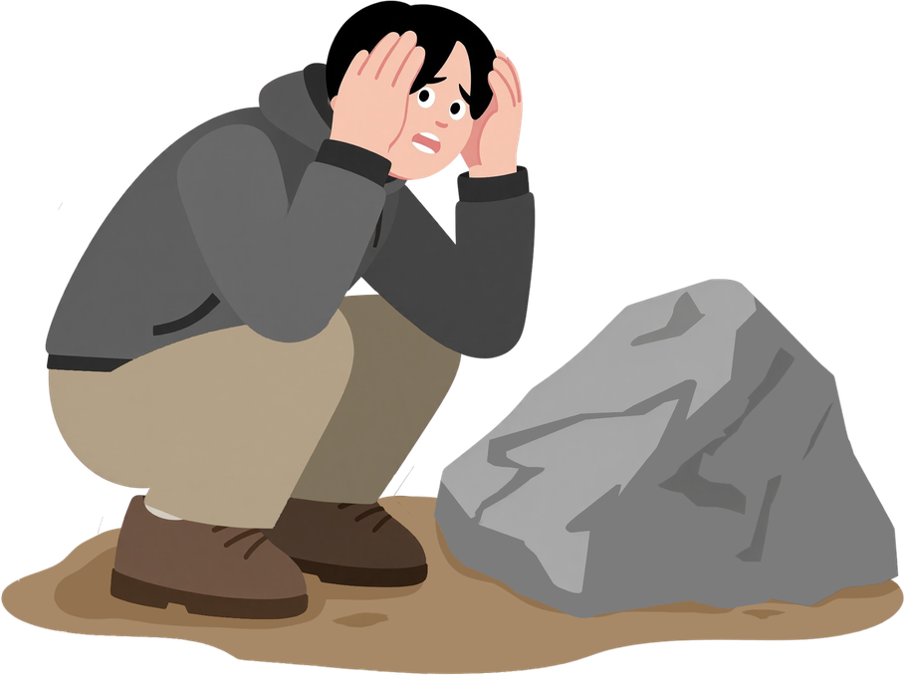

What actually is stress?
Stress is the way your body and mind respond when they perceive pressure or a challenge.
Sometimes it helps (it activates you)
Sometimes it overwhelms you (it blocks you).
Your body does not distinguish between:
  an exam
  an argument
  too many assignments
  a message that worries you
  or … an angry bear attacking you
We will understand how stress works, why it arises and what you can do about it.

Slide 4
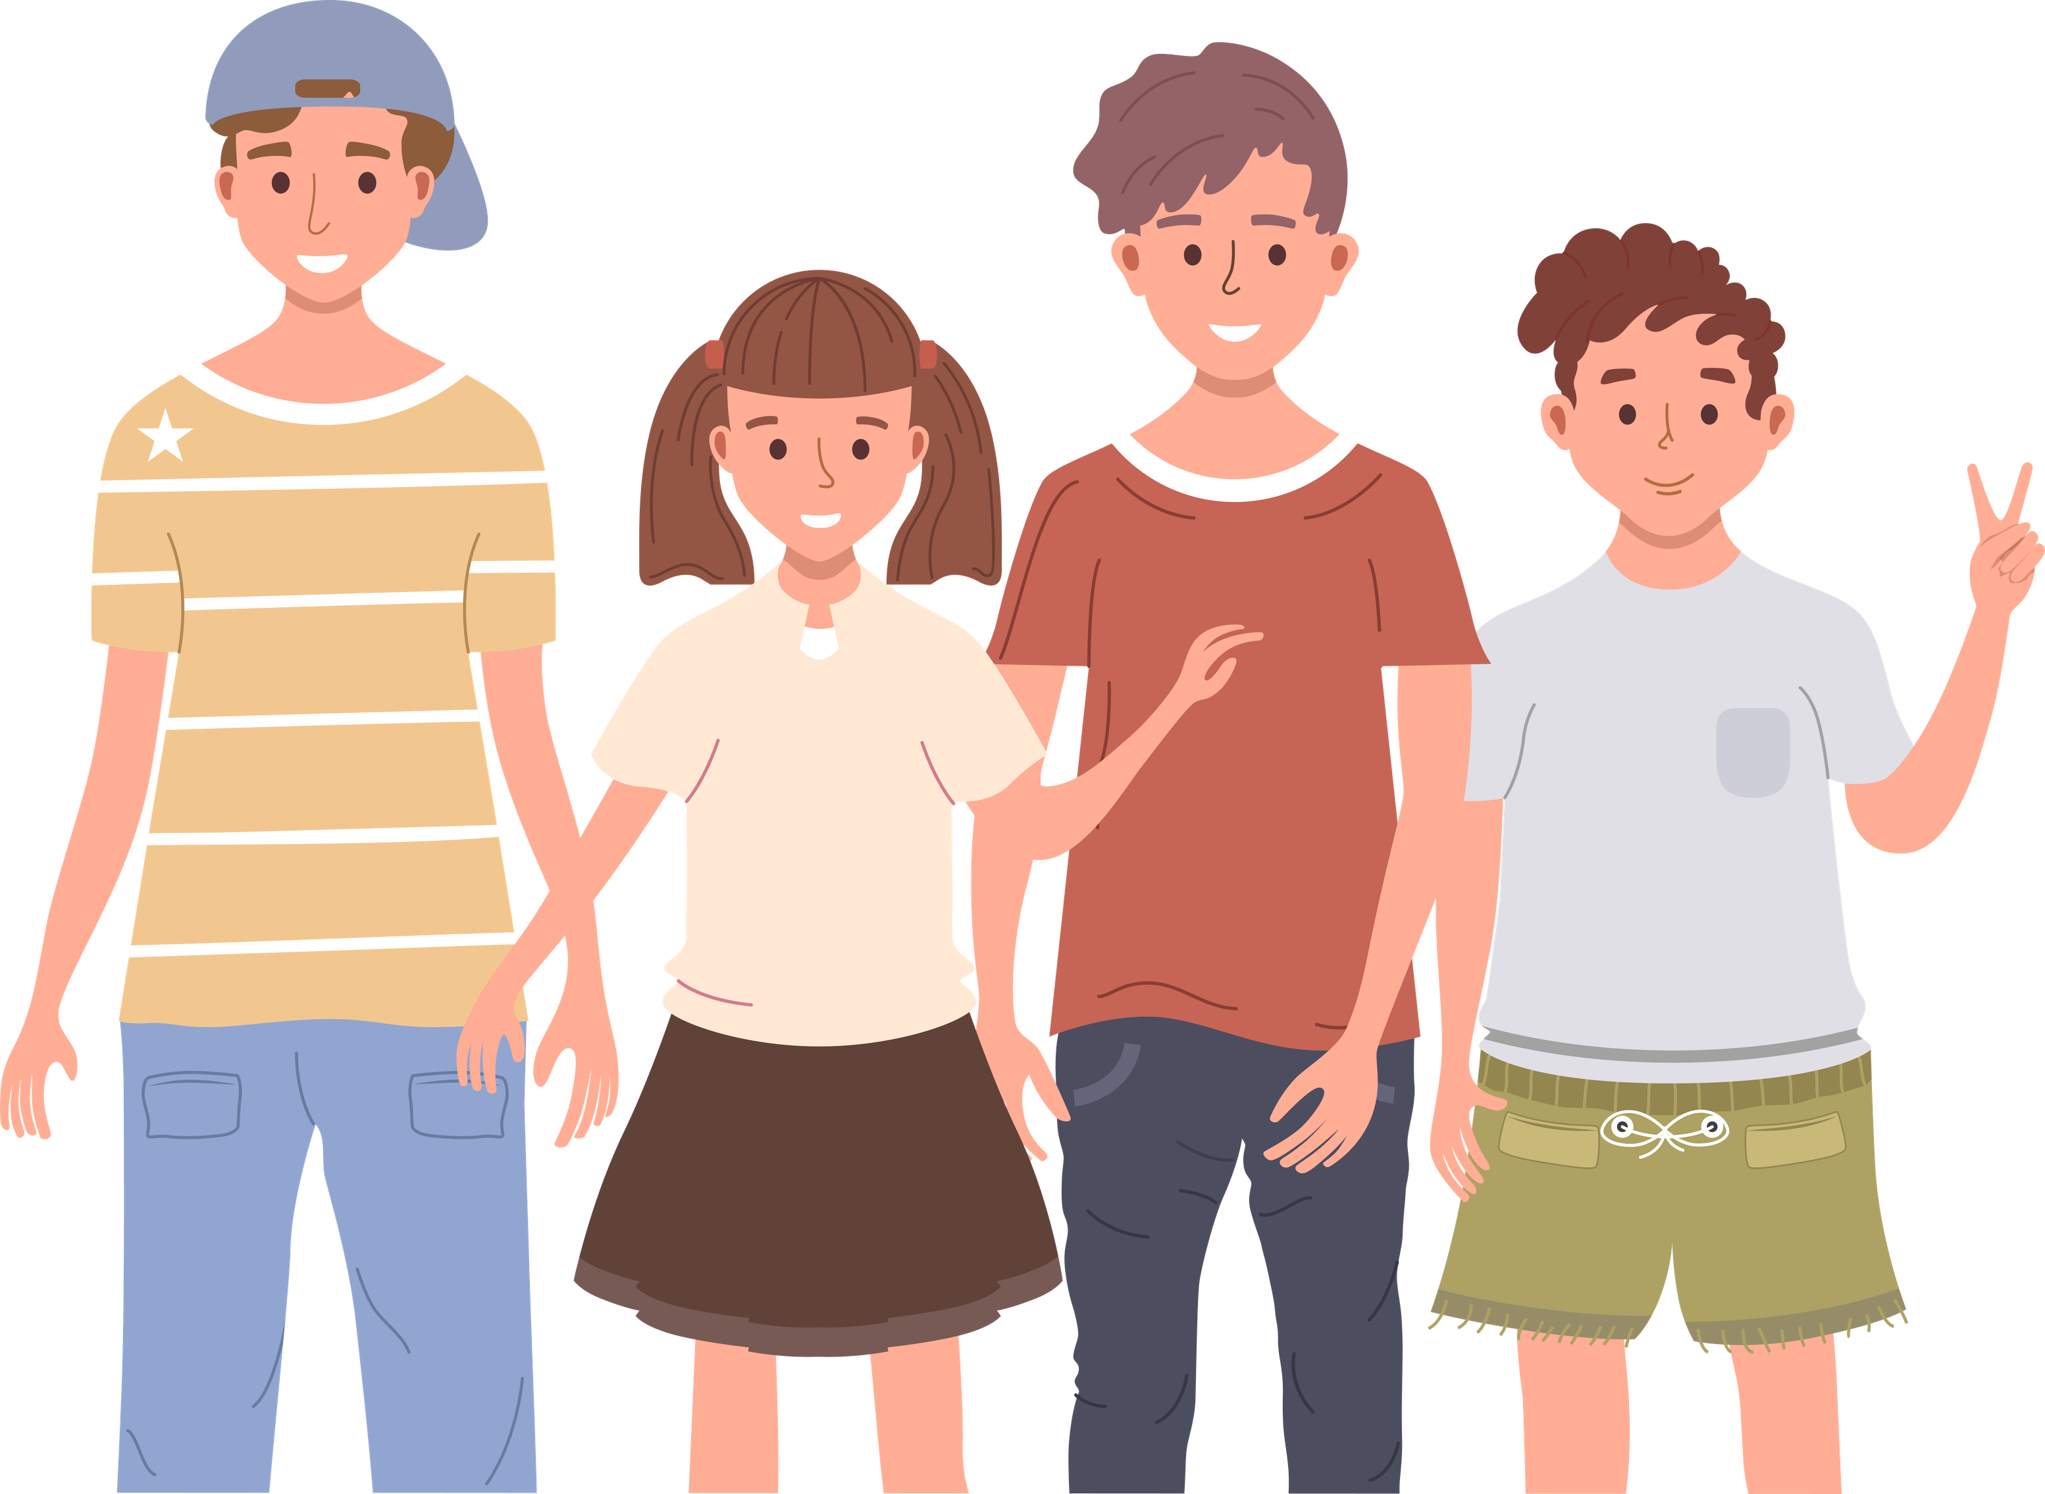
Important things before we begin
01
Respect
02
We only share what we want to share
03
We talk about general experiences
04
There are no “wrong” answers
05
Everyone participates in the way that works for them

Slide 5
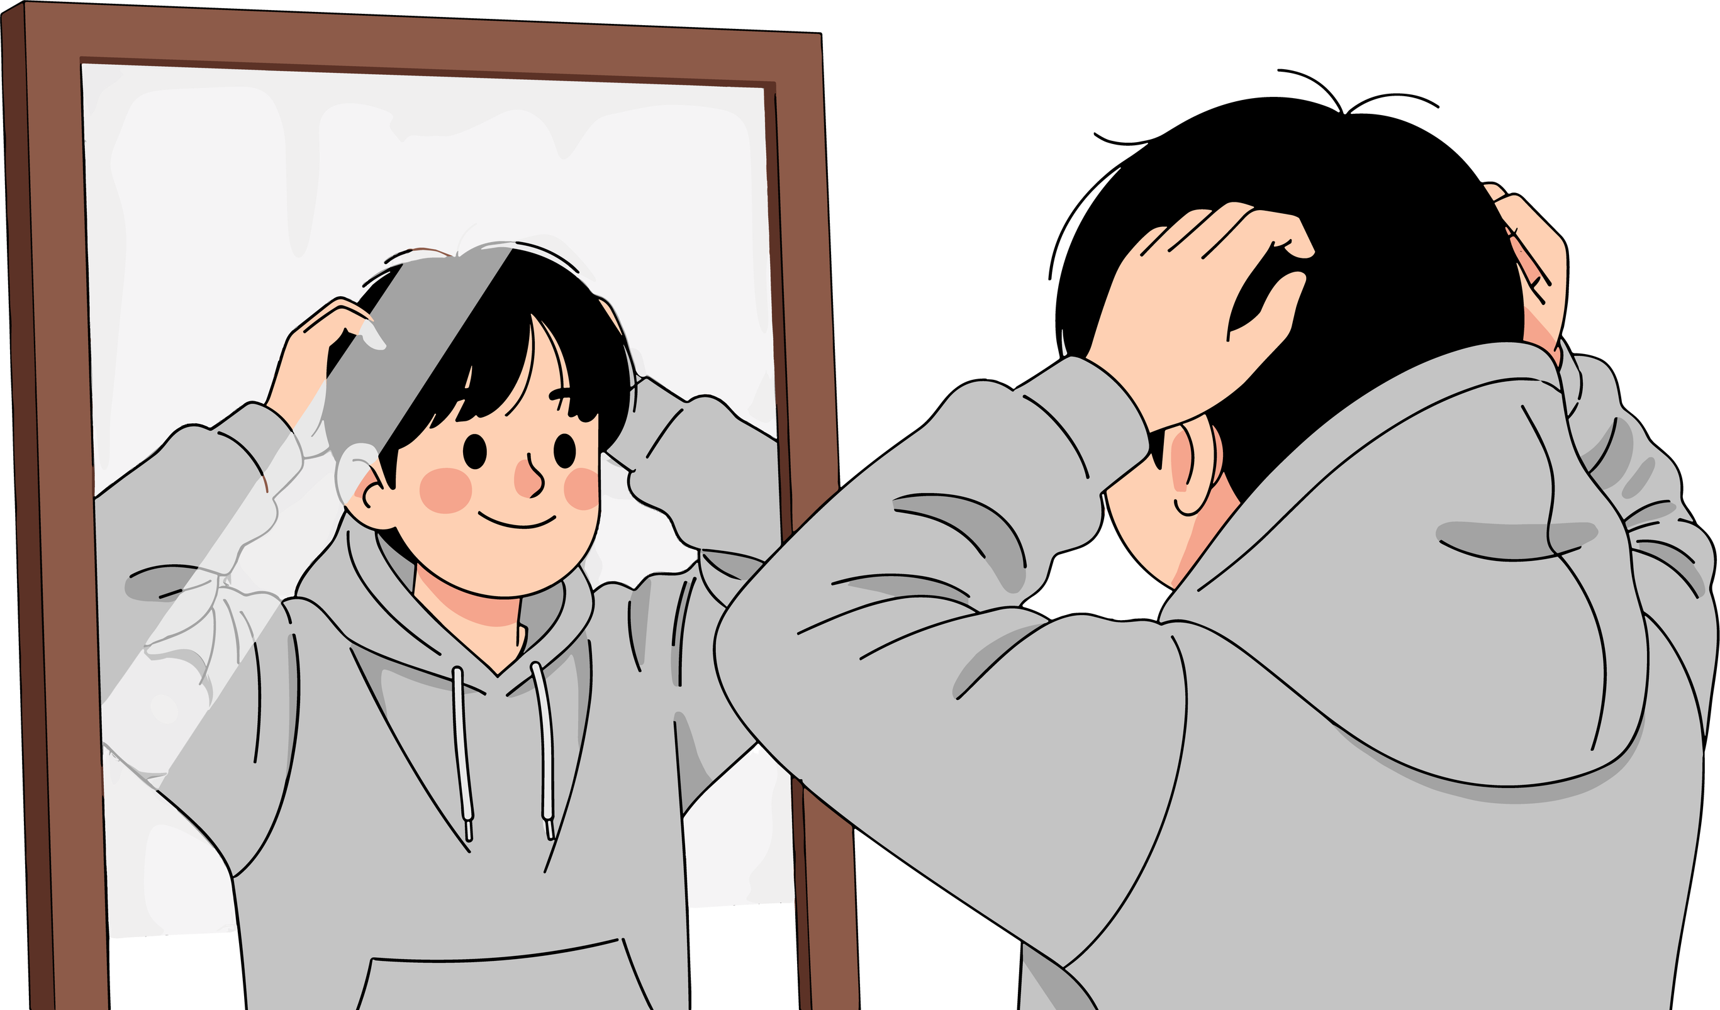
What will we do in this module?
01
Understand how your body works when it experiences stress
02
Identify which things activate you the most
03
Learn quick tools to calm yourself down
04
Learn to fill your emotional “tank”
05
Develop your own strategies against stress
06
Take part in games, activities and short reflections

Slide 6
Day 1: Recognising stress and its signals
Activity 1.1
Introduction and first activation
“When I think about stress …”

Slide 7
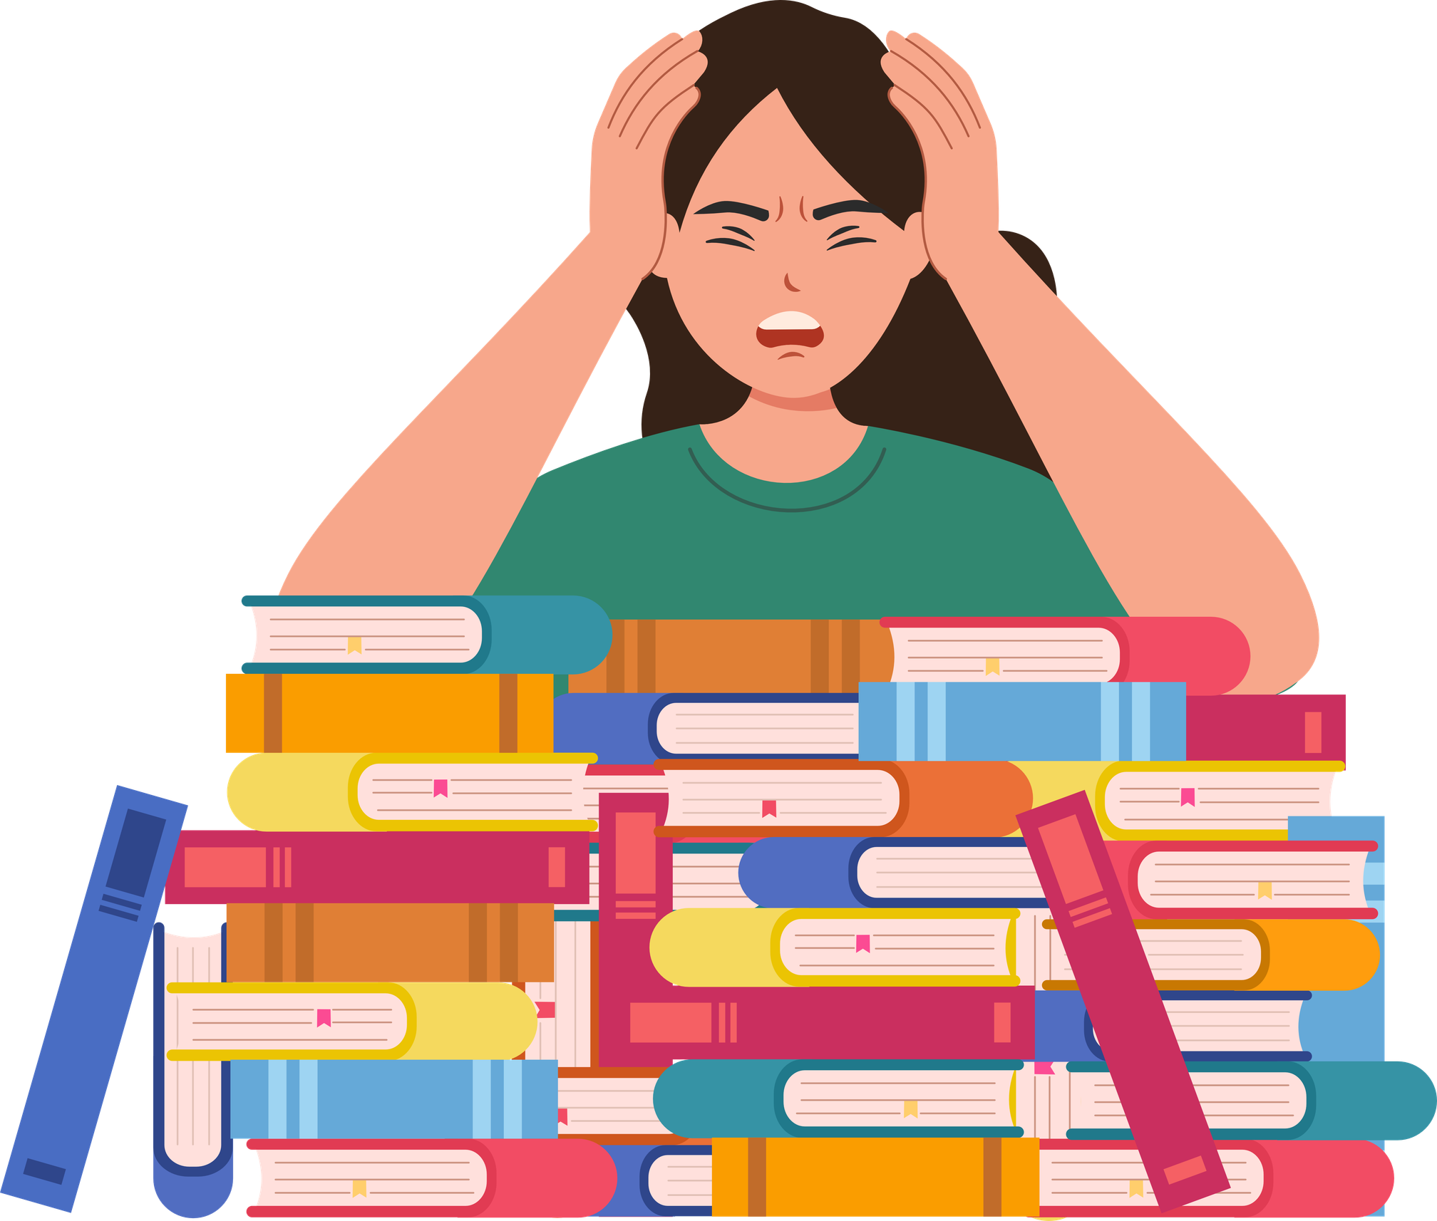
Materials
  Chairs in a circle
  Blackboard (optional)
What will we do?
  We talk about what comes to mind when we hear the word “stress”.

Slide 8
“When I think about stress, I think about …”
  Pressure
  Tiredness
  Exams
  Noise
  Blockage
  Tension
  Not finishing on time
Remember:
  Do not talk about specific personal cases
  Only share individual words or short phrases
  Everyone listens without interrupting
There are no right or wrong answers.
The most important thing is to share and listen.

Slide 9
Activity 1.2
Stress scale 1–10

Slide 10
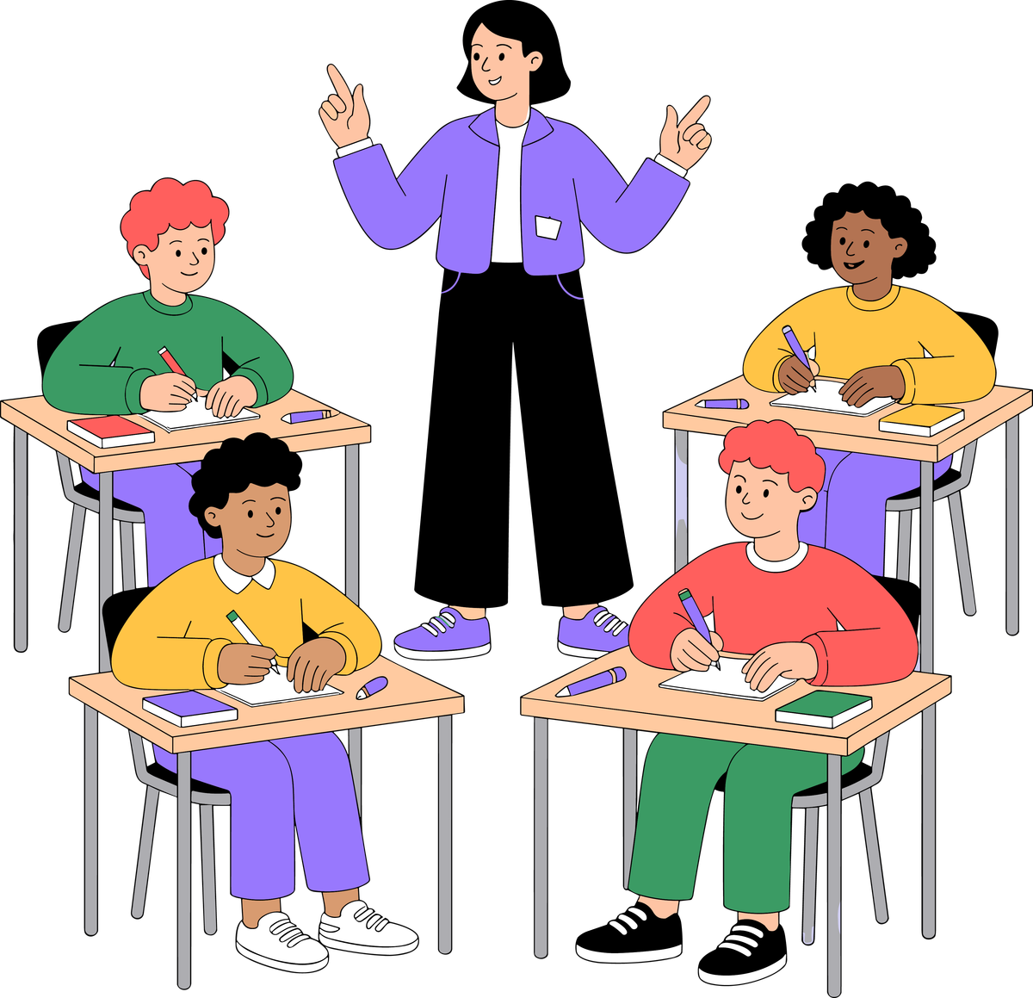
Materials
  Classroom in a circle, no additional materials needed
What will we do?
  We take a moment to check in on our current stress level.

Slide 11
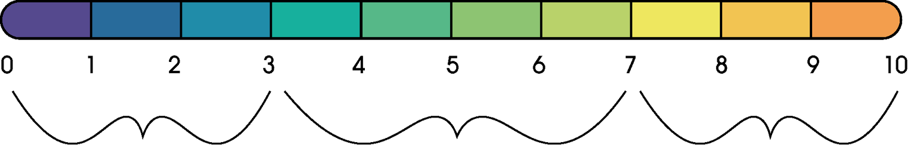
From 1 to 10: How stressed do I feel right now?
We show the number with our fingers for 2–3 seconds.
The individual numbers will not be shared out loud.
Calm
Somewhat tense, activated
Very tense, worried or blocked
This is not a competition or an assessment.
The scale is there to observe, not to judge.

Slide 12
Activity 1.3
What is stress? + Story “The Heart of the Hunter”

Slide 13
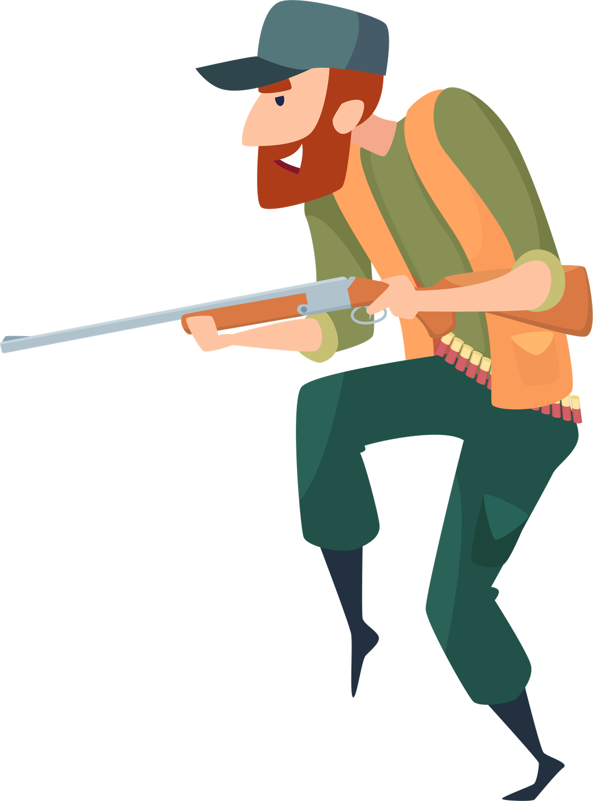
Materials
  Blackboard or flip chart
  Printed or digital copy of the text “The Heart of the Hunter”
What will we do?
  We talk about what stress really is and how the body responds.

Slide 14

What is stress?
Stress is the reaction of the body and brain to something perceived as a threat, pressure or challenge.
01
Stress is normal and necessary.
It helps us react, concentrate and protect ourselves.
02
The body constantly evaluates situations.
It decides whether something is:
  safe
  neutral
  or dangerous
03
The brain does not always distinguish clearly between real and perceived threats
Examples:
  an exam
  an argument
  a message that worries you
  a loud noise
These can activate the same neural networks as a real danger
04
Difference between eustress and distress
  Eustress: helpful activation, concentration, performance.
  Distress: overload, blockage, anxiety.

Slide 15
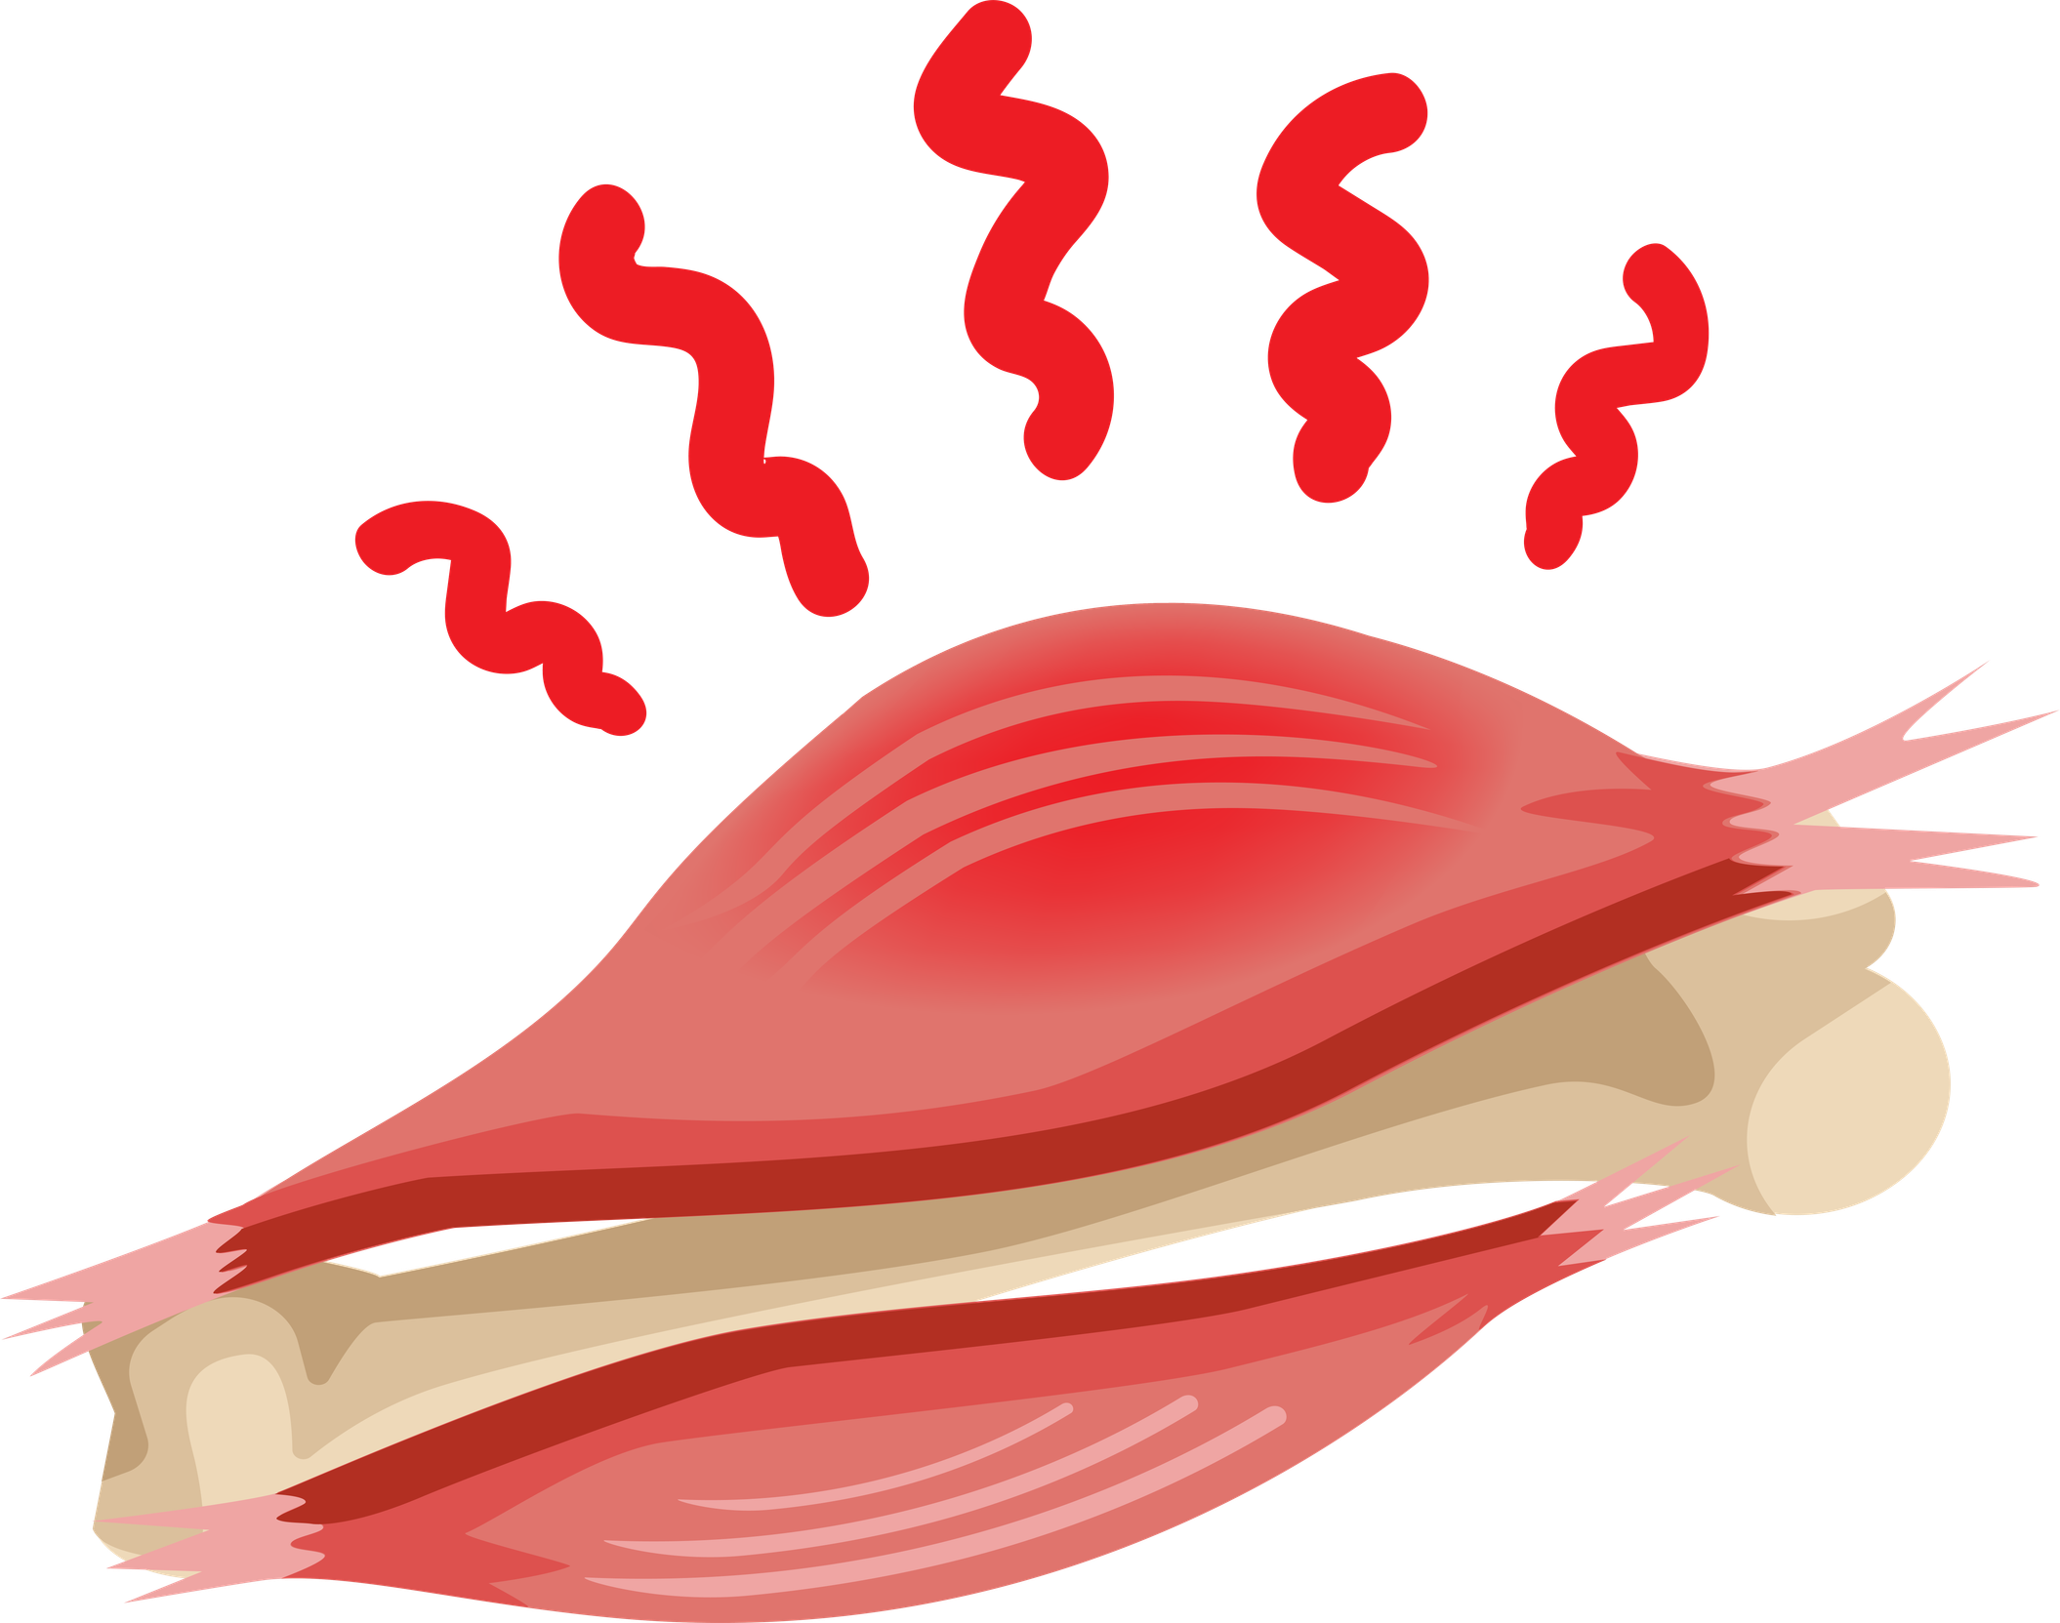
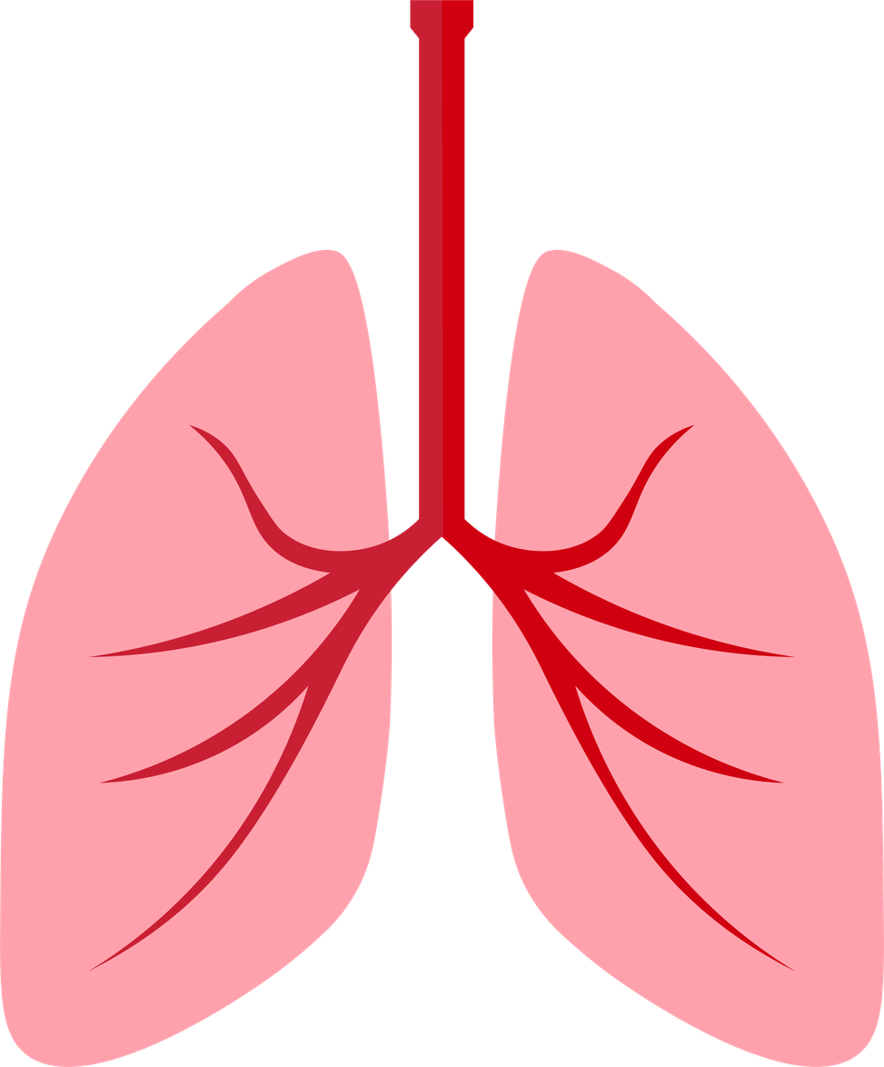
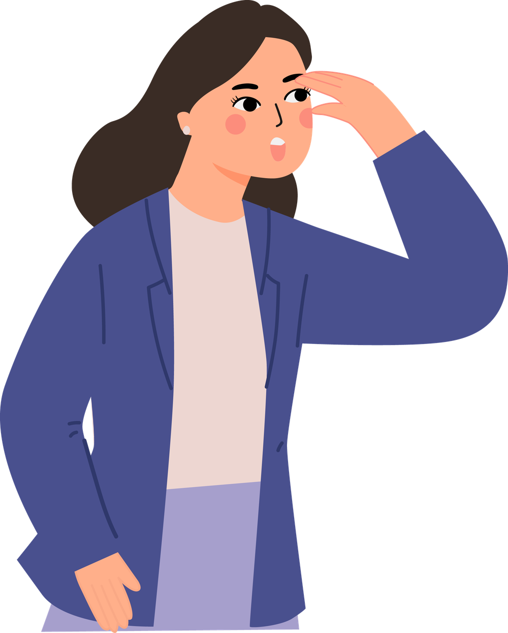
Story “The Heart of the Hunter”
It shows us how the body goes into survival mode, just as it used to when encountering a predator, and how it then needs time to calm down again.
The heart beats faster
The muscles tense up
Digestion slows down
Adrenaline and cortisol are released
Alertness increases
Breathing speeds up
Brain
Signal
Body
Activation

Slide 16

Story “The Heart of the Hunter”
Story: “The Hunter’s Heart”
The hunter’s heart beats strongly. His brain and senses are working at full speed to anticipate his enemy’s plan. He notices every slight movement of his enemy thanks to his keen senses. His muscles receive maximum blood flow; all organs not essential for survival are in a state of rest. His blood sugar levels rise to enable peak muscular performance.
Blood clotting is activated so that, should he be wounded, he does not lose too much blood. For this reason, blood flow to his hands and feet is reduced: the hands holding the spear are cold. He is unsure whether to fight or flee; the bear could kill him with a single blow. But winter is long, and he and his family urgently need meat and a warm shelter. He risks everything and thrusts the spear with all his might into the bear’s chest.

Slide 17
Story “The Heart of the Hunter”
A mighty roar is heard, and with a cry the hunter lunges at the bear and plunges his knife into its chest. He feels the bear’s breath and smells its sweat. A searing pain shoots through his body as the bear’s claws tear at his back. The bear lifts him effortlessly into the air, and the hunter prepares to deliver the final blow. But the spear and the knife have done their work; with a groan, the bear falls and collapses to the ground. The fight is over.
Back in the safety of the cave, the hunter tells his family about the dangerous fight, and only then does he begin to feel the pain of the many wounds the bear has inflicted on him. But his immune system is working at full capacity, and within a few days the wounds have healed. Shortly after the fight, his heart rate returns to normal, his blood pressure drops, and a deep sense of relaxation washes over him.
Remember:
Stress is a normal reaction, helpful in some situations.
The key is learning to regulate it.

Slide 18
Activity 1.4
Game “The Weight of Stress”

Slide 19
Materials
  Small water bottles (500 ml) or light weights (one per student)
  Open space to stand
We don’t need strength …
We only observe what happens when we hold something too long.
What will we do?
  We carry out a small experiment to understand what it feels like to carry stress for a long time.

Slide 20
With this activity we will:
01
Understand that stress does not only depend on how intense something is, but also on how long it lasts.
02
Feel in the body the idea of “emotional weight”.
03
Connect what we feel with what we have learned about stress.
04
Learn the importance of letting go, resting and asking for help.

Slide 21
Has anything changed since we started?
Is the object heavier now than before?
In reality …
The weight is the same.
What changes is the time, the effort and the accumulated tension.
The same happens with stress. Sometimes it is nothing big.
It might be a small thing, but if we keep it in our minds all day…
it becomes a real burden.

Slide 22
In life it is similar:
When we let go, rest, ask for help or change our approach, our body can feel lighter.
It doesn’t matter how strong you are.
If you never let go of the weight, your arm will get tired.
How do you notice when you are carrying too much?
What signals does your body give you?

Slide 23
Activity 1.5
“Modern Times” — Chronic stress and how it affects us

Slide 24

Materials
  Short video clips from the film “Modern Times”
  Projector or screen
What will we be doing?
  We will look at scenes from modern life to identify situations that cause constant stress:
    Multitasking
    Time pressure
    Noise
    Interruptions
    Screen use
    Sensory overload
  We will then discuss which of these elements are similar to our daily lives.
Today stress does not always appear in short “spikes” as it used to.
Sometimes it stays for a long time without a break.

Slide 25


Slide 26
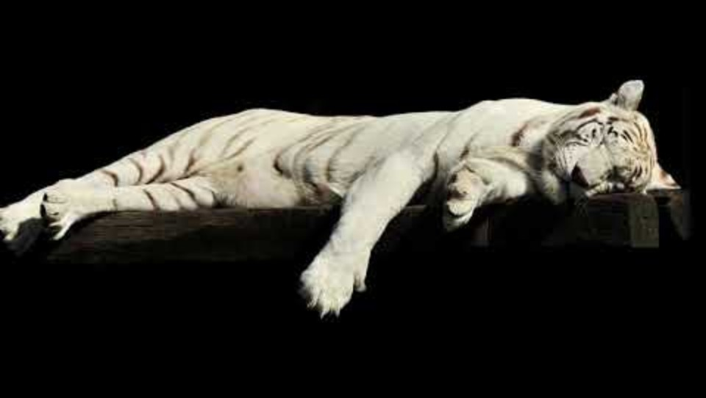

Slide 27
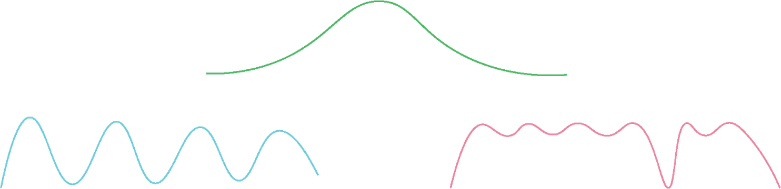
Sawtooth pattern
Healthy stress rises and falls like a sawtooth.
I complete the task
I activate myself
I relax
However, when there are no breaks, stress stays high all the time.
Wavy line that rises and falls (healthy stress).
Line that only rises and stays up (chronic stress).

Slide 28
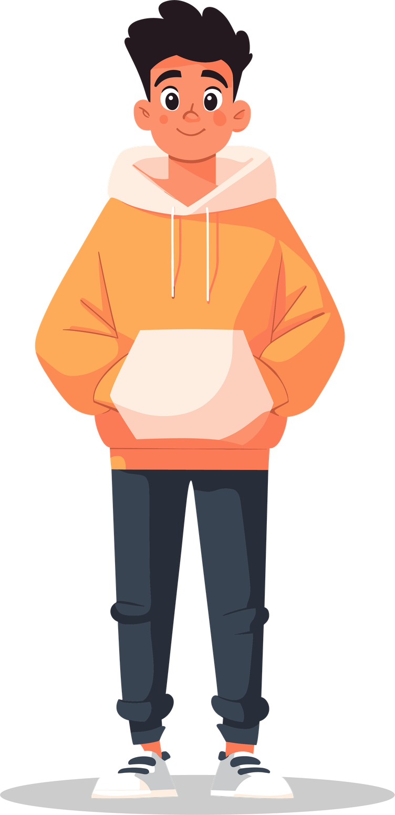
Which everyday situations do you think generate this kind of chronic stress in young people?
What is the difference between the hunter’s stress and modern stress?
What signals tell you that your stress is not easing?
Remember:
The problem is not getting activated …
The problem is not being able to stop.

Slide 29
Activity 1.6
What causes stress for me? — Metaplan cards

Slide 30
Materials
  Cards or post-its
  Markers
  Blackboard or wall to attach them
What will we do?
  We identify general situations that cause stress in daily life.
Exams
Social media

Slide 31
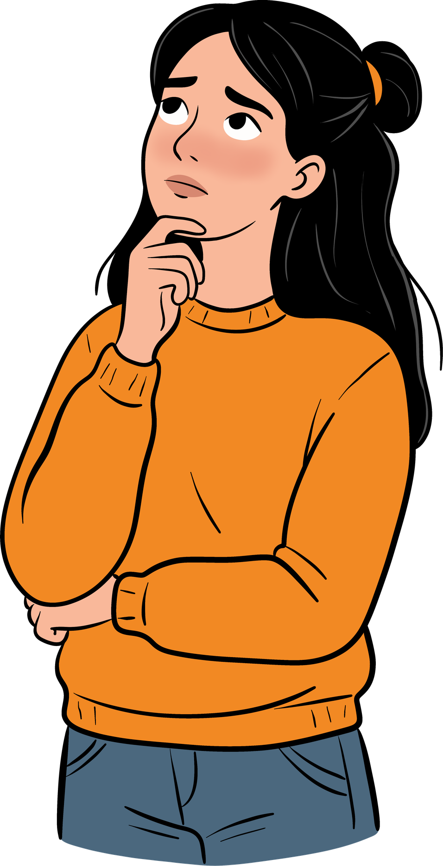
Examples of categorization
Academic
Social
Family
Personal
  Feeling pressure to get good grades
  Lots of homework or accumulated work
  Not understanding the subject matter
  Arguing with friends
  Feeling like you don’t fit in with a group
  Fear of being left out or losing a friendship
  Arguments at home
  Parents placing very high demands on grades
  Lack of family communication or support
  Low self-esteem
  Doubt about who you are or who you want to be
  Fear of not meeting expectations

Slide 32
Examples of categorization
Digital
Physical and health
Self-demand / Perfectionism
  Comparing yourself to others on social media
  Feeling pressure to get lots of “likes”
  Fear of missing out (FOMO)
  Physical changes during adolescence
  Not getting enough sleep
  Accumulated tiredness
  Poor diet
  Thinking everything has to be perfect
  Feeling like it is never enough
  Being very self-critical

Slide 33
Which stress categories came up most often?
Do you think young people in other classes would have similar cards?
Which situations do you think can be managed with simple strategies?
Remember:
Many stressors are shared within the group.
This helps us realise that we are not alone and that stress can take many forms.

Slide 34
Activity 1.7
“Stress reactions” — How my body, emotions and behaviour respond

Slide 35
Materials
  Blackboard or flip chart divided into three columns:
  Body — Emotions — Thoughts / Behaviour
What will we do?
  We brainstorm how the body and mind respond to stress.

Slide 36
When someone is stressed (not necessarily yourselves), what often happens?
Body
Emotions
Thoughts / Behaviour
  Tension in the neck or shoulders
  Stomachache
  Breathing speeds up
  Headache
  Fatigue
  Irritability
  Nervousness
  Frustration
  Feeling blocked
  Overwhelm
  Fear of failure
  “I can’t cope”
  Difficulty concentrating
  Constantly overthinking
  Avoiding tasks
  Reacting impulsively
  Procrastinating

Slide 37
Which physical signals do you think appear first when someone is stressed?
Which behaviours often show that stress is increasing?
Which of these three levels (body, emotions, behaviour) is hardest for you to recognise in yourself?
Remember:
Stress can show up in the body, in emotions or in thoughts.
Recognising it is the first step to regulating it.

Slide 38
Activity 1.8
Counter-programmes — The power of thoughts + Training the smile muscle

Slide 39
Materials
  None needed (just a quiet space)
What will we do?
  We learn two quick techniques to help reduce activation.

Slide 40
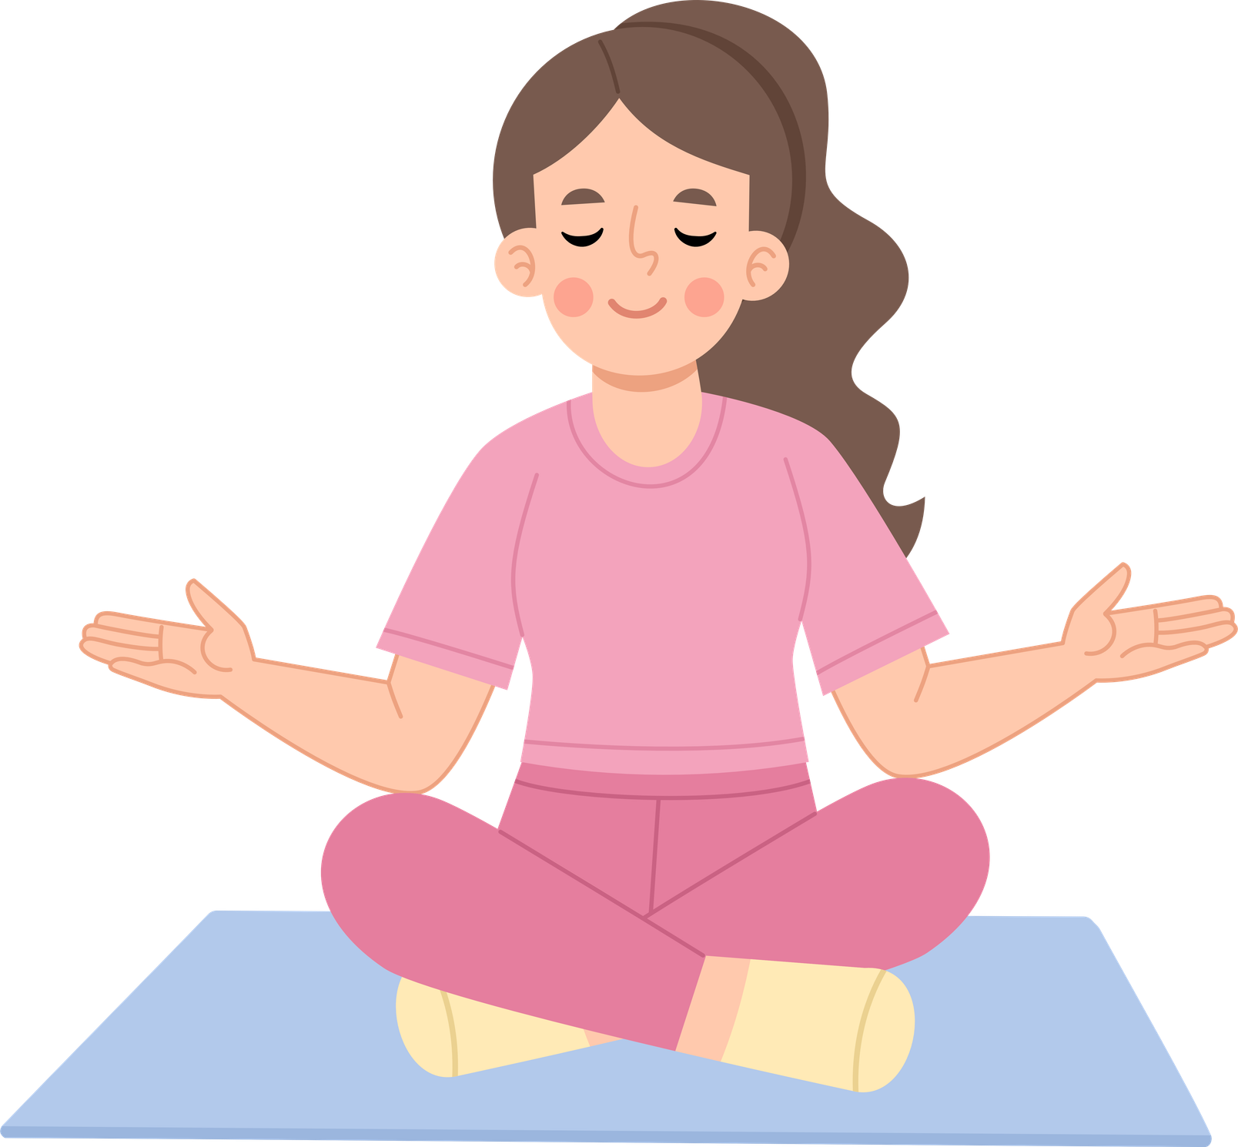
The power of thoughts
Imagine something that brings you peace: a place, a memory, a sensation.
What has changed in your body?
Your breathing? Your tension? Your posture?
Thoughts can either agitate or calm the body.
We can choose thoughts that help us in times of stress.
It’s not about avoiding problems, but about regulating ourselves so that we can think clearly.

Slide 41
Training the smile muscle
Our facial expressions are linked to the nervous system.
When we activate the muscles involved in smiling, even just slightly, we send signals to the brain indicating that we are safe.
Now try smiling very slightly, almost imperceptibly.
Do you notice any change in your body?
It’s not about smiling to hide your emotions,
but about using a physical strategy to reduce the activation of the stress response.

Slide 42
Which exercise was easier for you: thoughts or smiling?
In which situation can you imagine using them?
Did you notice any real changes in your body?
Do you think something so small can make a difference?
Remember:
Body and mind are connected.
Sometimes it is easier to tell the body first.

Slide 43
Activity 1.9
End of Day 1 — Integration and rest

Slide 44
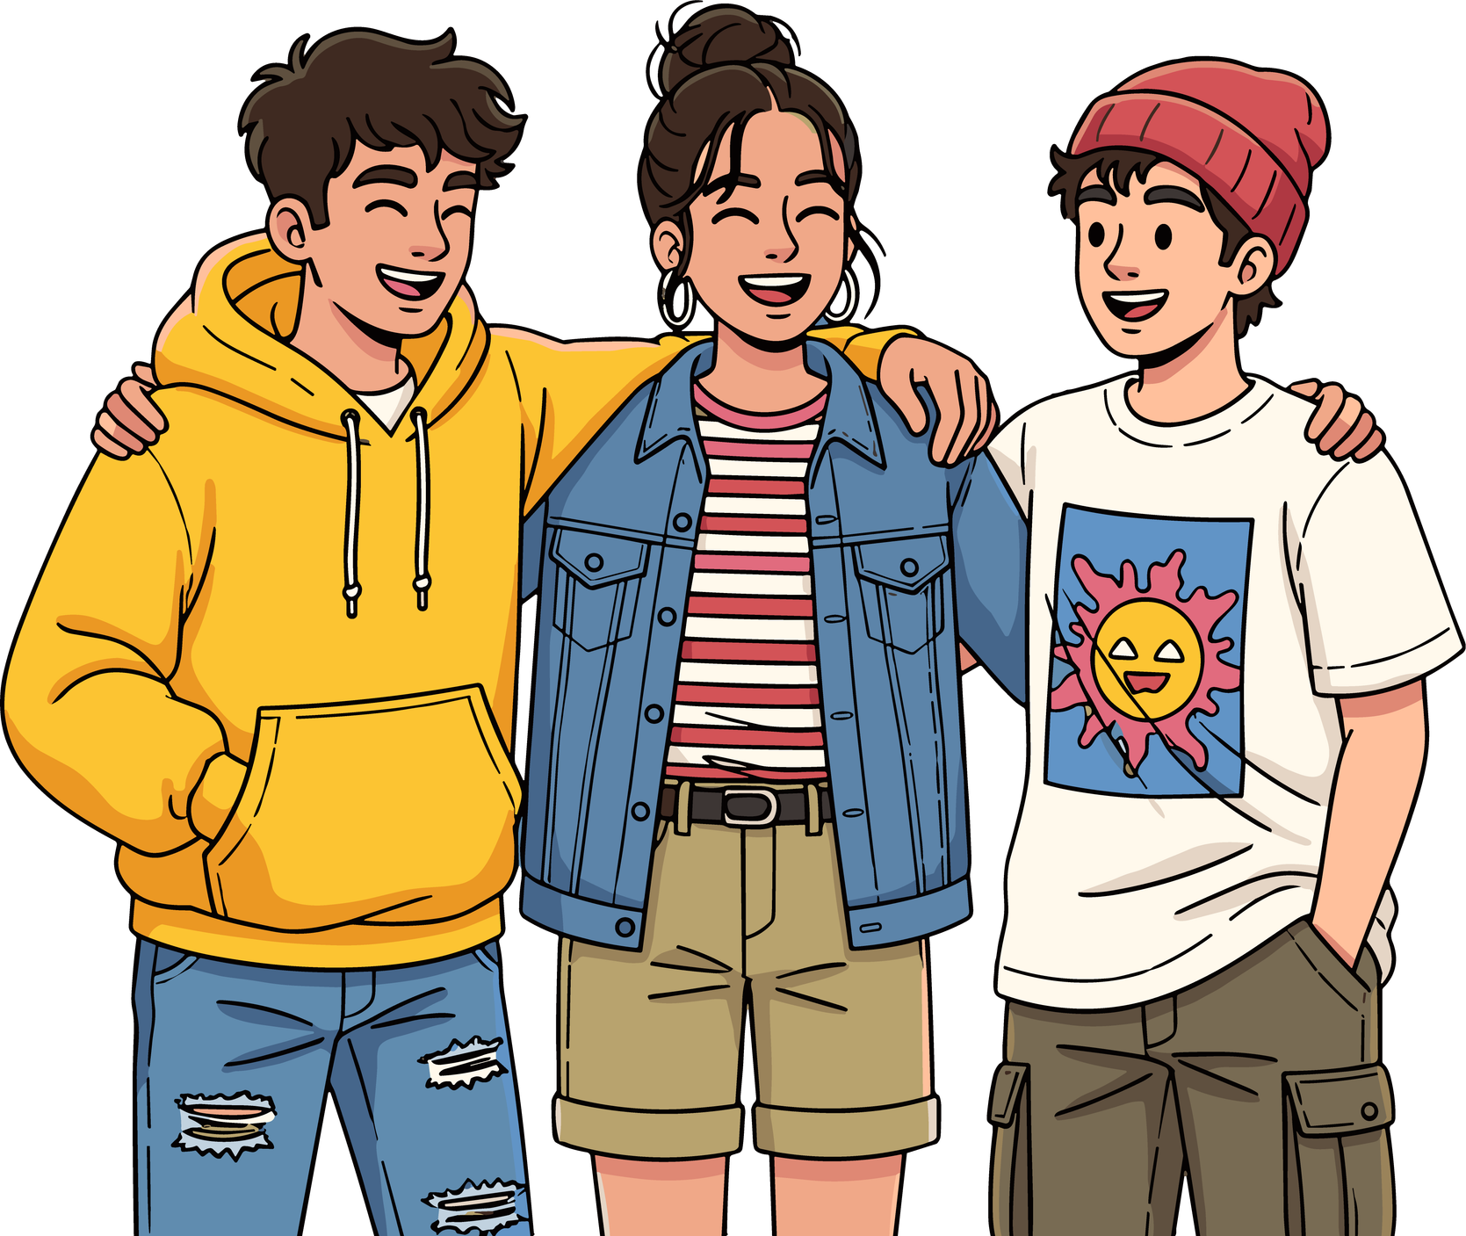
We close today’s session by sharing a short idea about what we are taking with us.
In one word or a short sentence: what idea are you
taking away today?
Remember:
Today we have seen that stress can take many forms, that the body reacts quickly, and that there are simple techniques to help manage it.
Tomorrow we will learn more practical strategies for better managing stress in everyday life.

Slide 45
Day 2: Learning to regulate myself and take care of myself
Activity 2.1
Welcome and review of Day 1

Slide 46
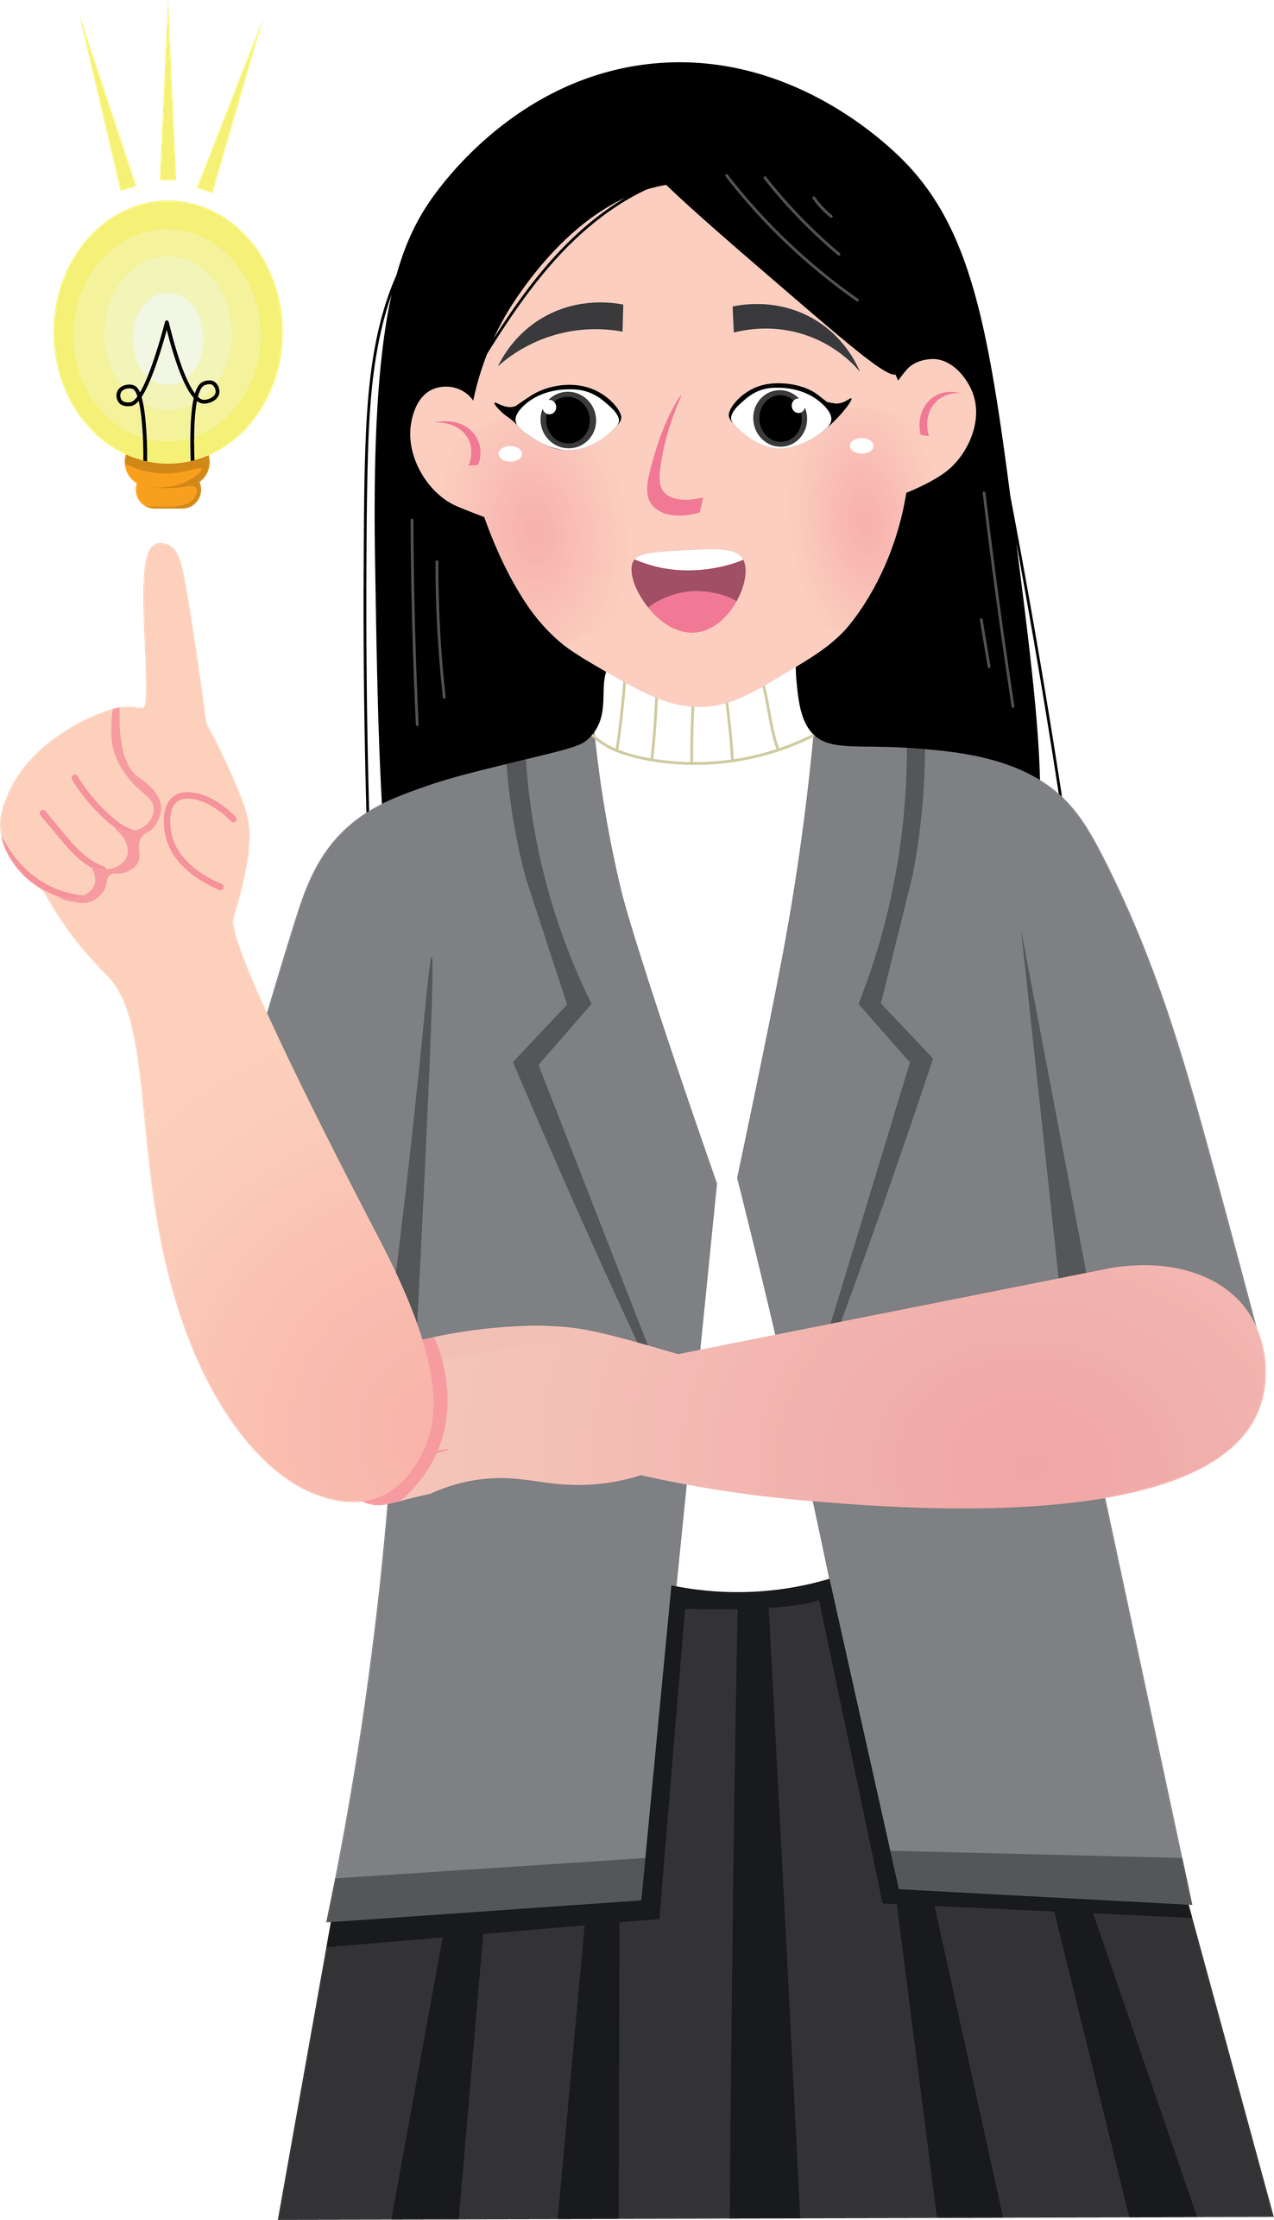
Materials
  Chairs in a circle
  Blackboard (optional)
What will we do?
  We return to the circle to recall the most important things from the previous session.

Slide 47
01
Yesterday we saw that stress can take many forms.
02
We learned how the body responds.
03
We tried out quick techniques to lower activation.
04
There are no “wrong” answers.
Remember:
Today we’ll be learning practical tools for managing stress, understanding the brain’s emergency response, and learning how to replenish our emotional reserves.

Slide 48
Activity 2.2
The brain’s emergency programme — How and why we freeze

Slide 49
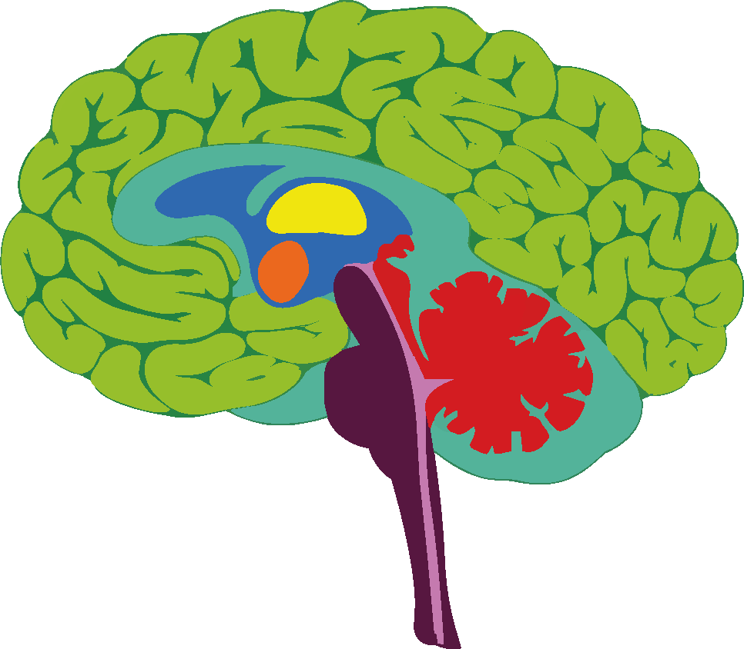
Materials
  Blackboard or flip chart with a brain divided into three levels
  Coloured markers
What will we do?
We will find out how the brain works when stress levels get too high, and why it is sometimes difficult to think, concentrate or remember things.

Slide 50
The three levels of the brain
01
Survival: impulses, fight / flight / freeze
02
Emotion: evaluates whether something is safe or not
03
Thinking: memory, attention, decisions
Do you know where they are located?
When stress rises:
Your mind goes blank, your body acts automatically, and it becomes difficult to think clearly.

Slide 51
Die drei Ebenen des Gehirns
01
Survival: impulses, fight / flight / freeze
(Reptilian brain or brainstem)
  Fight, flight or freeze response
  Automatic reaction
  Priority: staying safe
  Does not allow for conscious thought
It is the autopilot of fear.

Slide 52
The three levels of the brain
02
Emotion: evaluates whether something is safe or not
(Middle brain / limbic system)
  Triggers intense emotions
  Interprets threats
  Decides whether something is safe or not
  May exaggerate dangers
Emotion decides whether we remain in emergency mode.

Slide 53
The three levels of the brain
03
Thinking: memory, attention, decisions
(Upper brain / cortex)
  Plans
  Organises
  Stores information
  Concentrates
  Makes decisions
  Thinks critically
When stress rises too high,
this level shuts down!
Remember:
It’s not that you don’t want to concentrate… your brain is in emergency mode.
To start thinking clearly again, your body needs to calm down first.

Slide 54
Has it ever happened to you that you knew the answer, but stress blocked you?
What signals tell you that your brain is going into “emergency mode”?
Why do you think it helps more to regulate the body than to just think your way through it?

Slide 55
Activity 2.3
Coping strategies — Strategies for managing stress

Slide 56
Materials
  Strategy cards (printed or projected)
  Blackboard
  Markers
Venting / complaining
What will we do?
We will explore practical tools to help us manage stress more effectively in our daily lives.
We will categorise these strategies into three types:
Going to sleep earlier
Working harder
Meditating
Playing sport
01
Body-based strategies
02
Thought-based strategies
03
Action-based strategies

Slide 57
Body-based strategies
Emotional / Thought-based strategies
Cognitive Strategies
To reduce physiological arousal
To regulate or identify emotions
To interpret the situation differently or to find solutions
  Slow breathing
  Stretching exercises
  Going for a walk
  Drinking water
  Muscle relaxationg
  Talk to someone
  Write down how I feel
  Listen to soothing music
  Take short breaks
  Ask for support
  Break tasks down
  Make a plan
  Remind myself that this is only temporary
  Challenge catastrophic thoughts
  Set priorities
There’s no need to choose ‘the best’ strategy; everyone needs several.
We’re not discussing personal situations – we’re speaking in general terms.
Remember:
The more strategies you know, the easier it will be to choose one when stress levels rise.

Slide 58
Activity 2.4
“Tank Model” — The emotional tank model

Slide 59
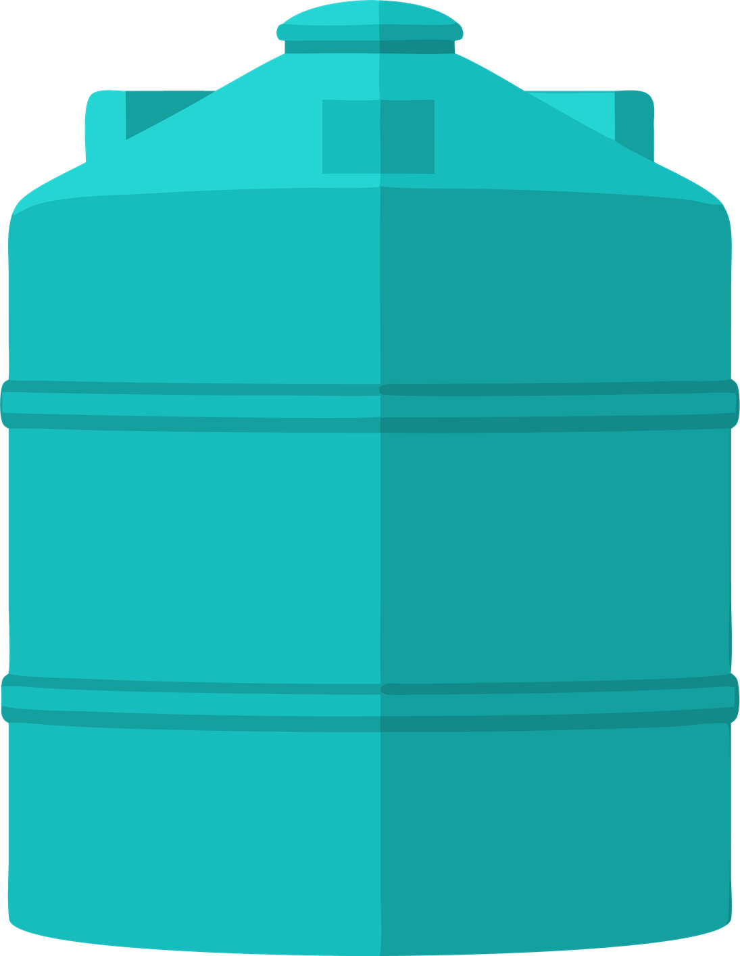
Materials
  Cardboard or blackboard
  Markers
What will we do?
  Draw a large tank
  Write down what fills it and what empties it

Slide 60
What fills your tank?
What fulfils you gives you energy.
Friends
Playing
Music
Support
Nature
Family
Free time
Sleeping well
Feeling understood
Laughing

Slide 61
What drains your energy?
What empties you takes your energy.
Arguments with friends
Being tired
Academic pressure
Too many assignments
Poor grades
Sudden changes
Arguments
Problems at home
Feeling alone

Slide 62
What can “holes” be?
When the tank has holes, it empties quickly – no matter how hard you try to fill it.
Not setting boundaries
Setting overly high expectations for yourself
Constant anxiety
Perfectionism
Not asking for help
Overthinking
Fear of disappointing others

Slide 63
Depending on the day, the tank can be very empty or very full.
Remember:
When your tank is full, it’s easier to manage stress.
When it’s empty, everything feels much harder.
Knowing this will help you decide what you need right now.
What do you think empties young people’s tank the most today?
What is the difference between something that empties the tank and a hole in the tank?
Was würde passieren, wenn wir den Tank nie auffüllen?

Slide 64
Activity 2.5
“Help System” + Guided Relaxation
(Guided imagery / Body scan / PMR)

Slide 65
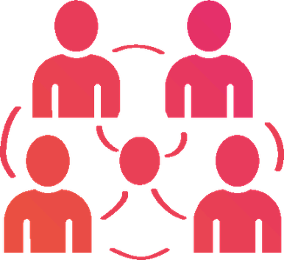
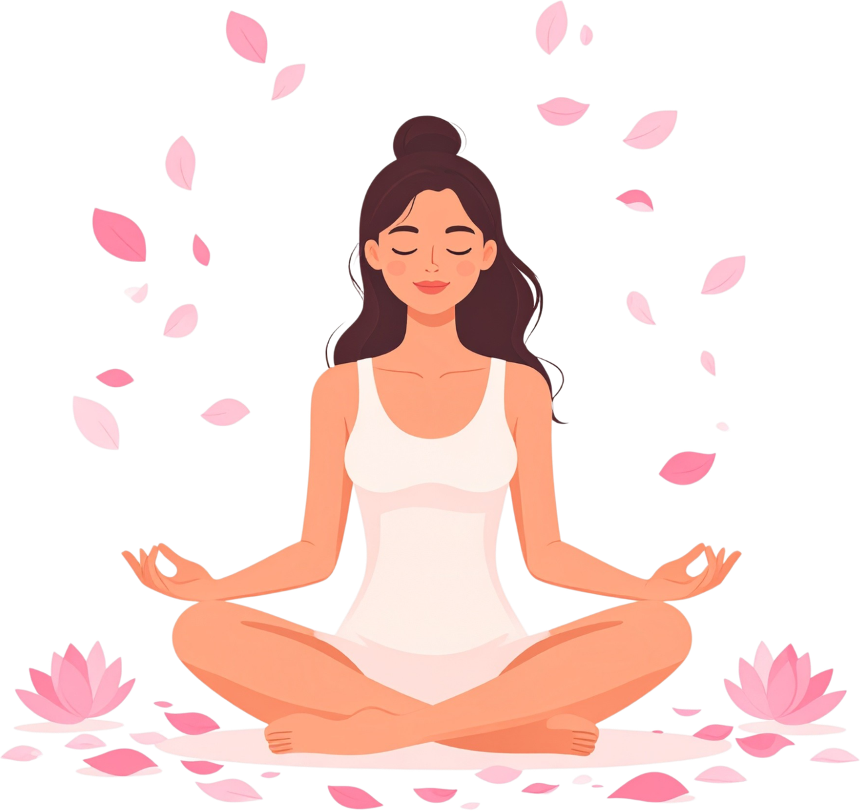
Materials
  A quiet room
  Comfortable chairs
  Soft music (optional)
  Space to relax
What are we going to do?
  Identify my support network (‘Help System’)
  Do a guided relaxation exercise

Slide 66
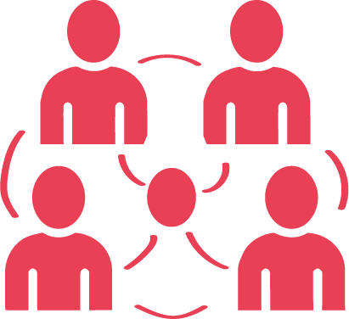
Help system
Who can I turn to if I'm feeling stressed?
Someone who makes you feel safe
Someone who can advise or support you
Someone who does not judge
Someone who listens

Slide 67
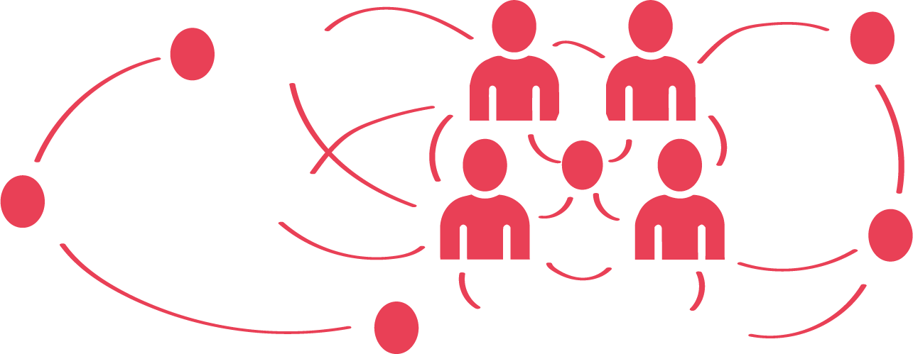
Help system
Who or what is part of your support network?
School counselling service
Tutor / Class teacher
Coach
Common room / safe space at school
Activities that help you relax

Slide 68

Guided relaxation
Let’s start with your breathing… Breathe in gently… and breathe out slowly.
Feel your feet on the floor… relax them.
Now your legs… your stomach… your shoulders… your jaw… your forehead…
(Short pause)
Now imagine a place where your body can find peace:
a forest, the beach, your room, a quiet place…
In this place, there is no rush.
You can let go of the day’s burdens.
Breathe there for a few seconds…
(Final pause)
And gradually return to the room…
move your fingers… stretch gently…
and open your eyes when you are ready.

Slide 69
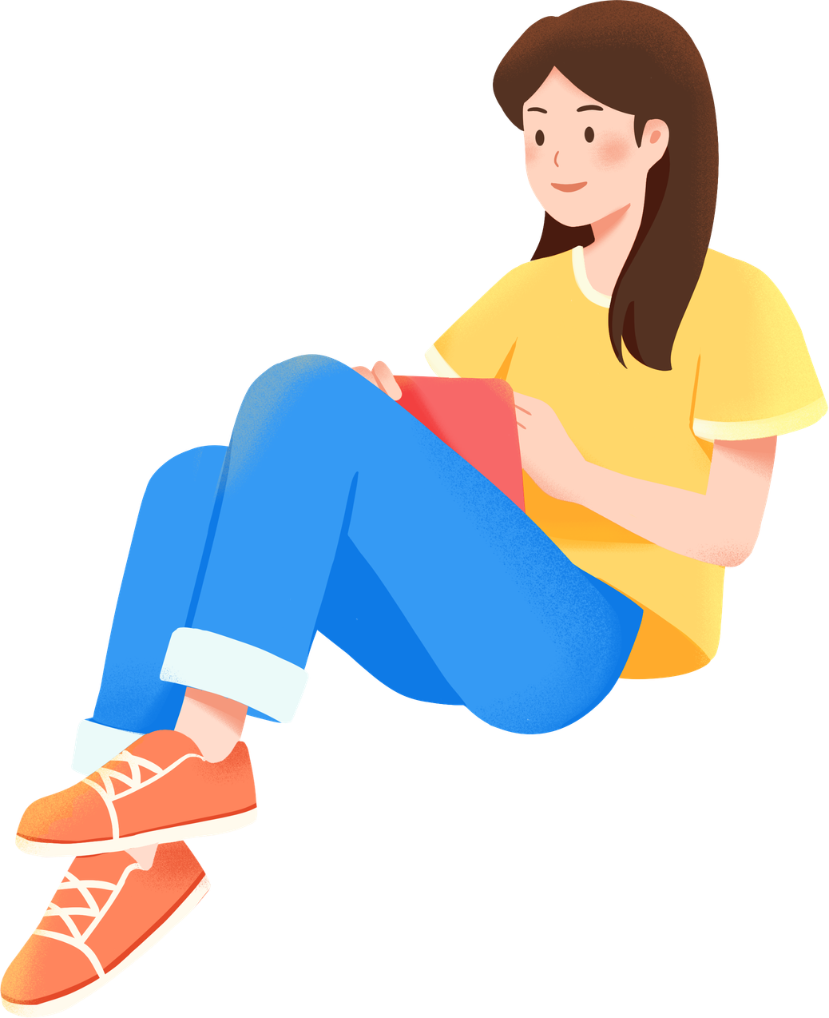
What helped you relax the most: your breathing, the body scan, or visualising the place?
What qualities should someone who is part of your ‘Help System’ have?
Which strategy would you like to keep in mind for the future?
Remember:
Asking for help is also a way of managing stress.
You don’t have to do everything on your own.

Slide 70
Activity 2.6
Game “1–7” — Sudden stress and decision-making

Slide 71
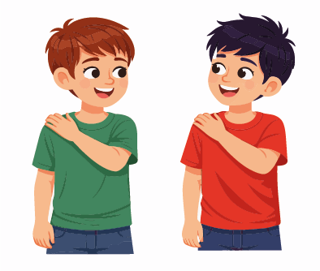
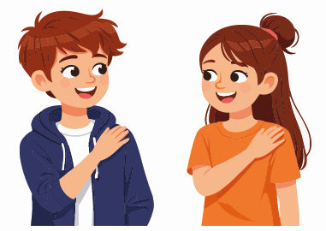
Materials
  Enough space to stand in a circle
What shall we do?
  We’re going to play a quick signal game where you have to react to a rhythm.

Slide 72
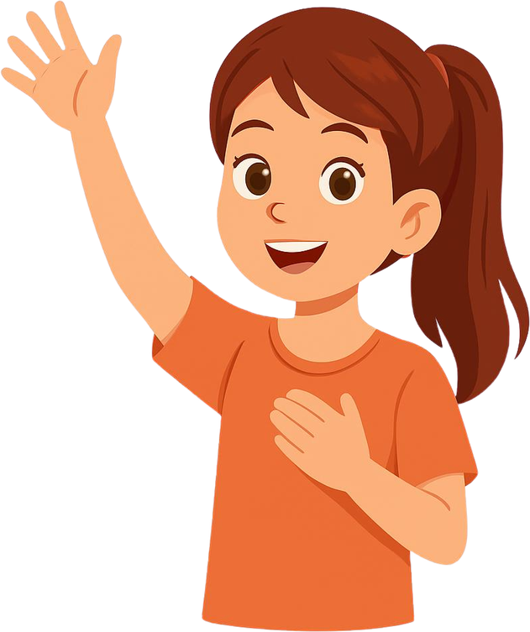
Left hand on the right shoulder
Right hand on the left shoulder
7
The signal continues to the right.
The signal continues to the left.
1, 2, 3, 4, 5, 6…
1, 2, 3, 4, 5, 6…

Slide 73
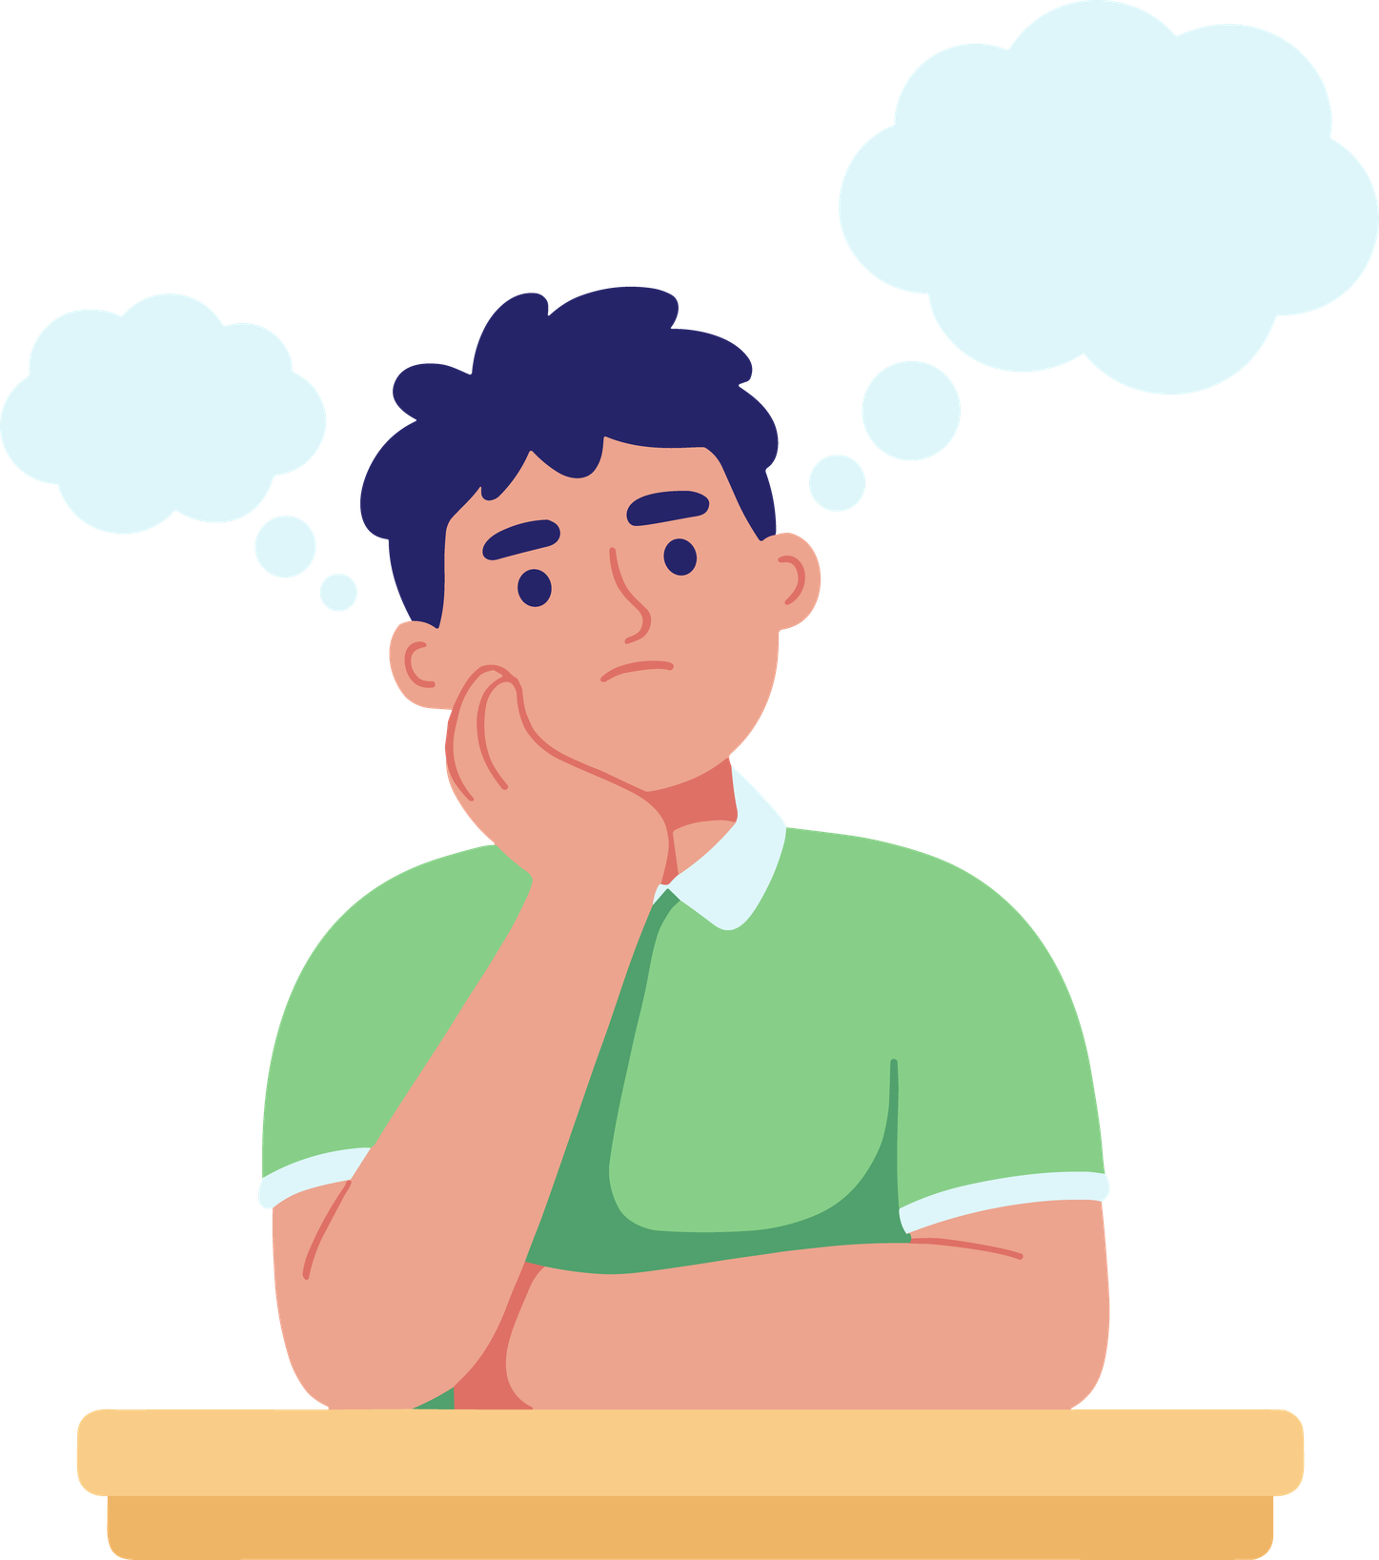
What happened when we tried to be quick?
Did you find it harder to think when the '7' came up?
What strategies did you use to help you concentrate?

Slide 74
Activity 2.7
Completion of the module — Integration and final reflection

Slide 75
We’ll wrap up the module by sharing a brief reflection on what we’ve learnt in these two sessions.
In a word or a short sentence: What key takeaway do you take away from these modules?
Over the last few days, we have seen:
01
What stress is
02
How the body and the brain react
03
What things motivate us
04
How to top up your emotional reserves
05
How to use strategies to regulate yourself
06
Who can help us and how we can look after our wellbeing

Slide 76
We’ll wrap up the module by sharing a brief reflection on what we’ve learnt in these two sessions.
In a word or a short sentence: What key takeaway do you take away from these modules?
Remember:
Stress is a part of life.
The important thing is to learn to recognise it and know what you need when it strikes.
You’re not alone: you have tools and support.

Slide 77
Additional activities
Activity 3.1
The Stress Traffic Light — Quickly identify your stress level

Slide 78
Materials
  Red, yellow and green card
  Markers
  Traffic light template (optional)
  Whiteboard
What are we going to do?
  Learn about the three stress levels: green, yellow and red.
  Recognise what we feel at each level.
  Learn specific strategies to manage each level.
  Create a personal mini traffic light (optional) that you can use all year round.
  Learn specific strategies to manage each level.
  Create a personal mini traffic light (optional) that you can use all year round.

Slide 79
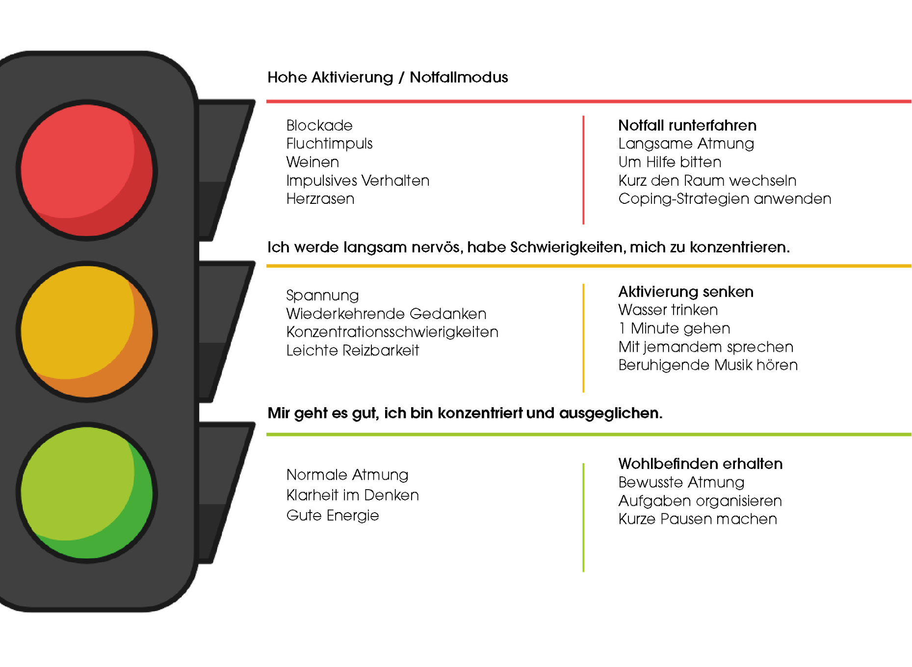
Examples for each level
What can I do if I'm feeling all over the place?

Slide 80
What colour are you feeling today?
What signs tell you that you’re in the yellow zone?
What do you do when you're in the red?
What helps you get back to nature?
Remember:
Recognising the emotional state you’re currently in is the first step towards regulating yourself.

Slide 81
Activity 3.2
Emotional First Aid Kit

Slide 82
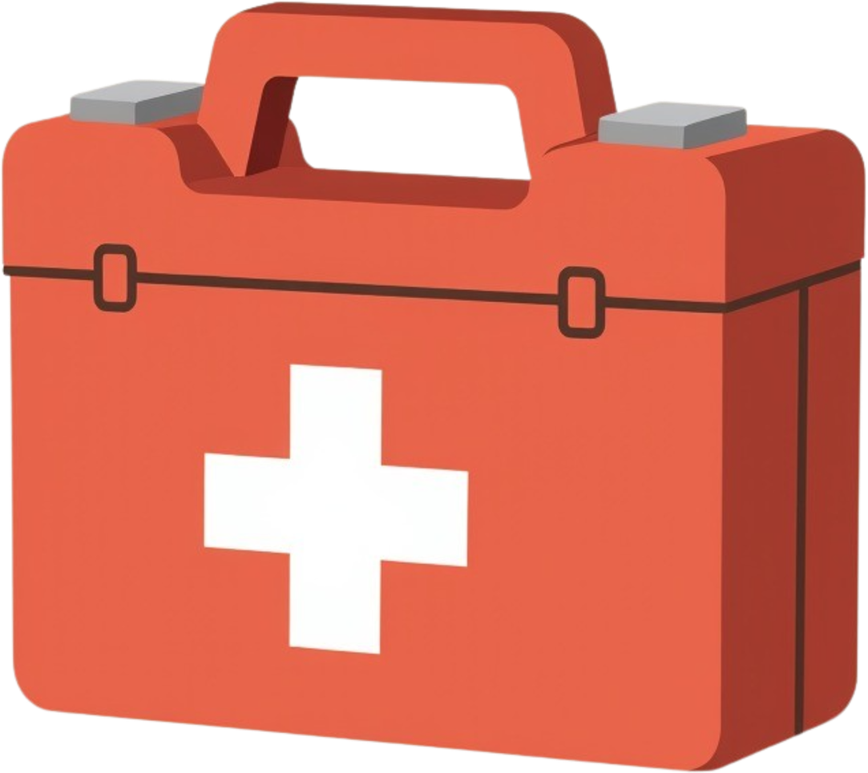
Materials
  Small box or envelope
  Strips of paper or cards
  Felt-tip pens
  Optional decorations (stickers, paints)
What are we going to do?
  Put together a little ‘emotional first-aid kit’.
  Write down some quick ways to calm yourself down.
  Turn abstract strategies into concrete memories.

Slide 83
Just as there are first-aid kits for injuries, we also need one for stress.
This kit will help you when you feel overwhelmed.
It’s personal: you don’t have to share it with others.
Remember:
Sometimes physical reminders are more helpful than trying to remember everything.
What helps you to calm down when you're feeling very stressed?
What phrase would you like to keep in mind during a difficult moment?
What would you like to find in your box when you're feeling down?

Slide 84
Stress is a part of life, but you have the tools to cope with it.
Every time you use a coping strategy, take a deep breath, ask for help or listen to your body, you’re looking after yourself and becoming stronger.
You already know that today
01
You can’t avoid all stress…
but you can learn to cope with it.
Take a break. Breathe. Decide what you need.
What stresses you out
02
How it works in your body and brain
03
What causes stress
04
How your emotional tank fills up or empties
05
How you can use strategies to regulate yourself
06
Who can help you
07
How you can look after your well-being

Slide 85


