Slide 1
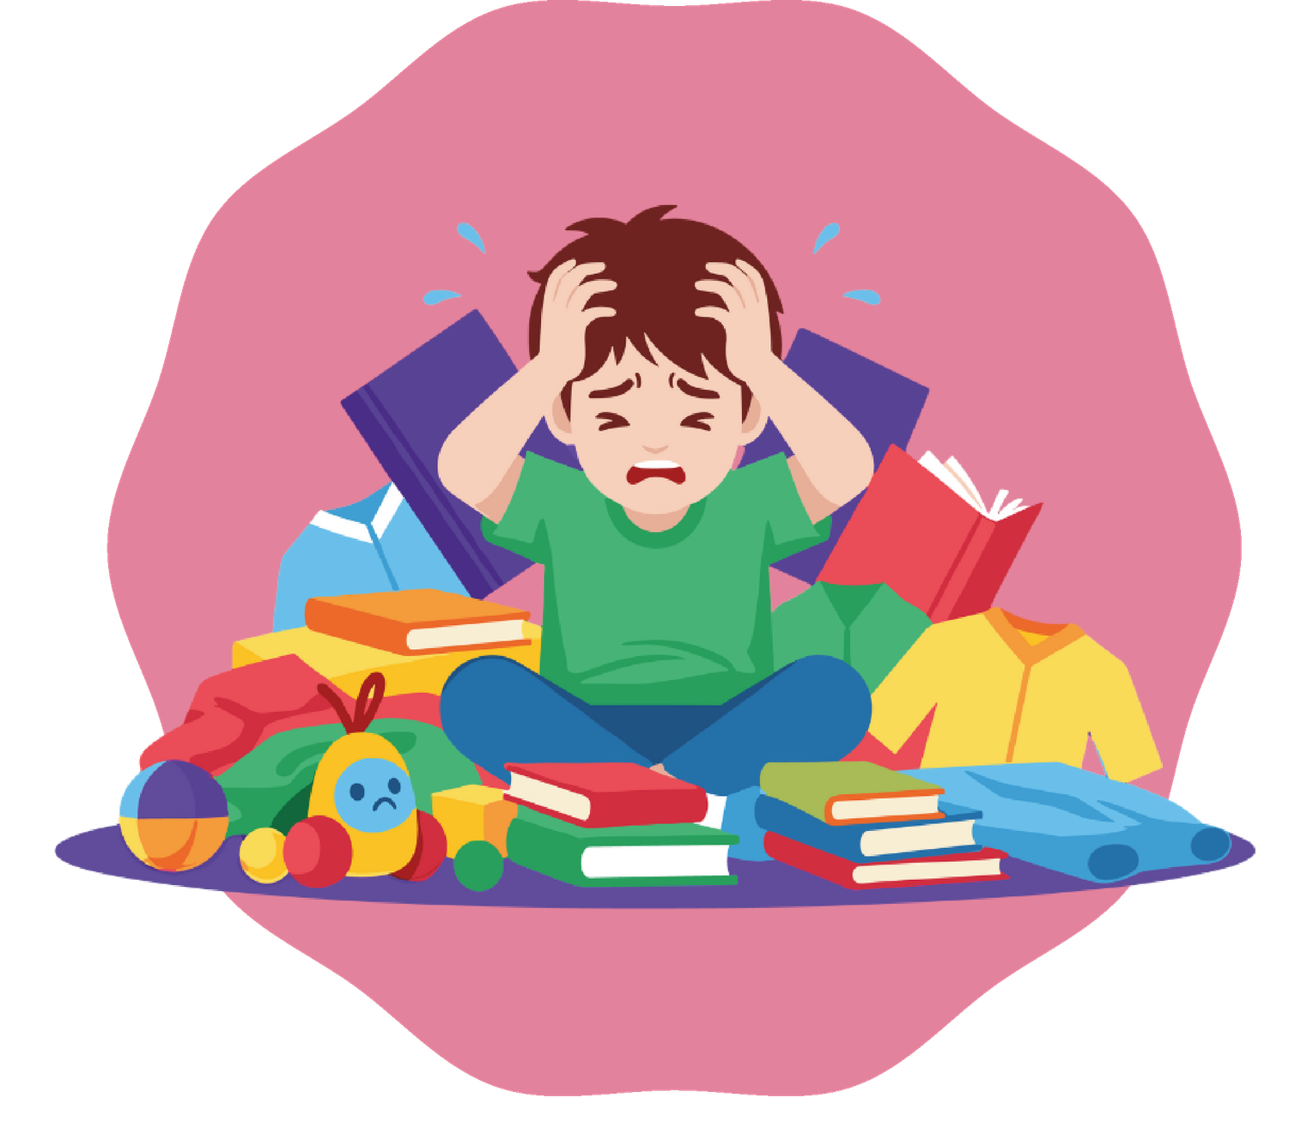

Module 2
Stress and strategies
to manage it
Activities for Primary School

Slide 2
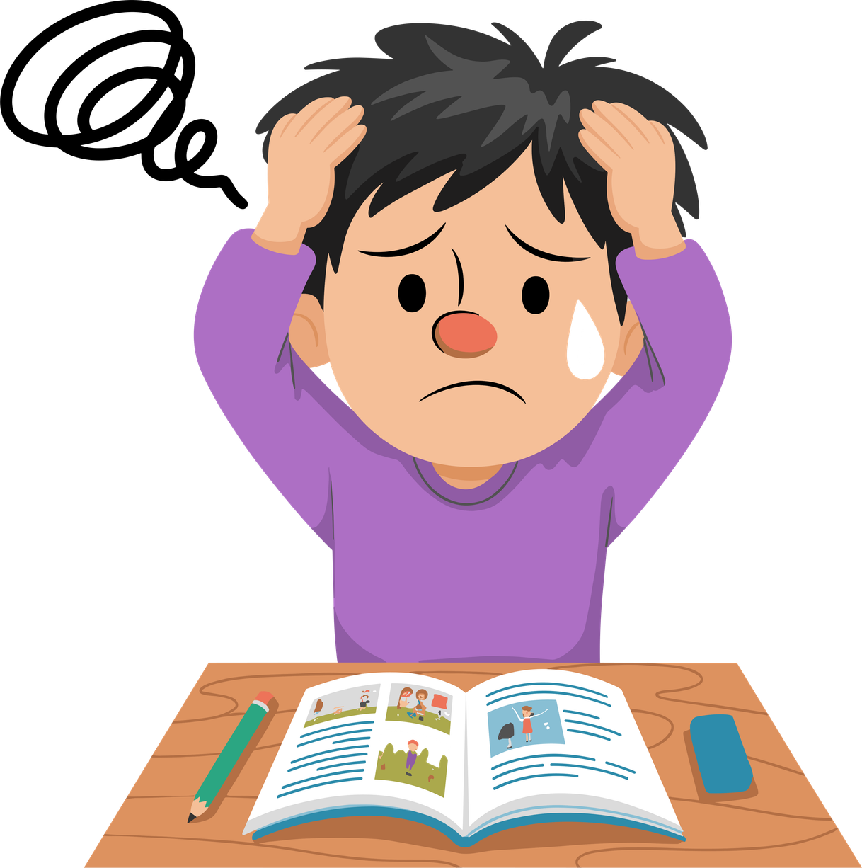
Why are we talking about this in this module?
Stress is a frequent feeling: tests, homework, discussions, changes, responsibilities...
Sometimes it activates us and helps us, but when it lasts too long it can block us.
In this module we will learn what stress is, how it works and what we can do when we feel it.
What stresses you the most during the week?

Slide 3
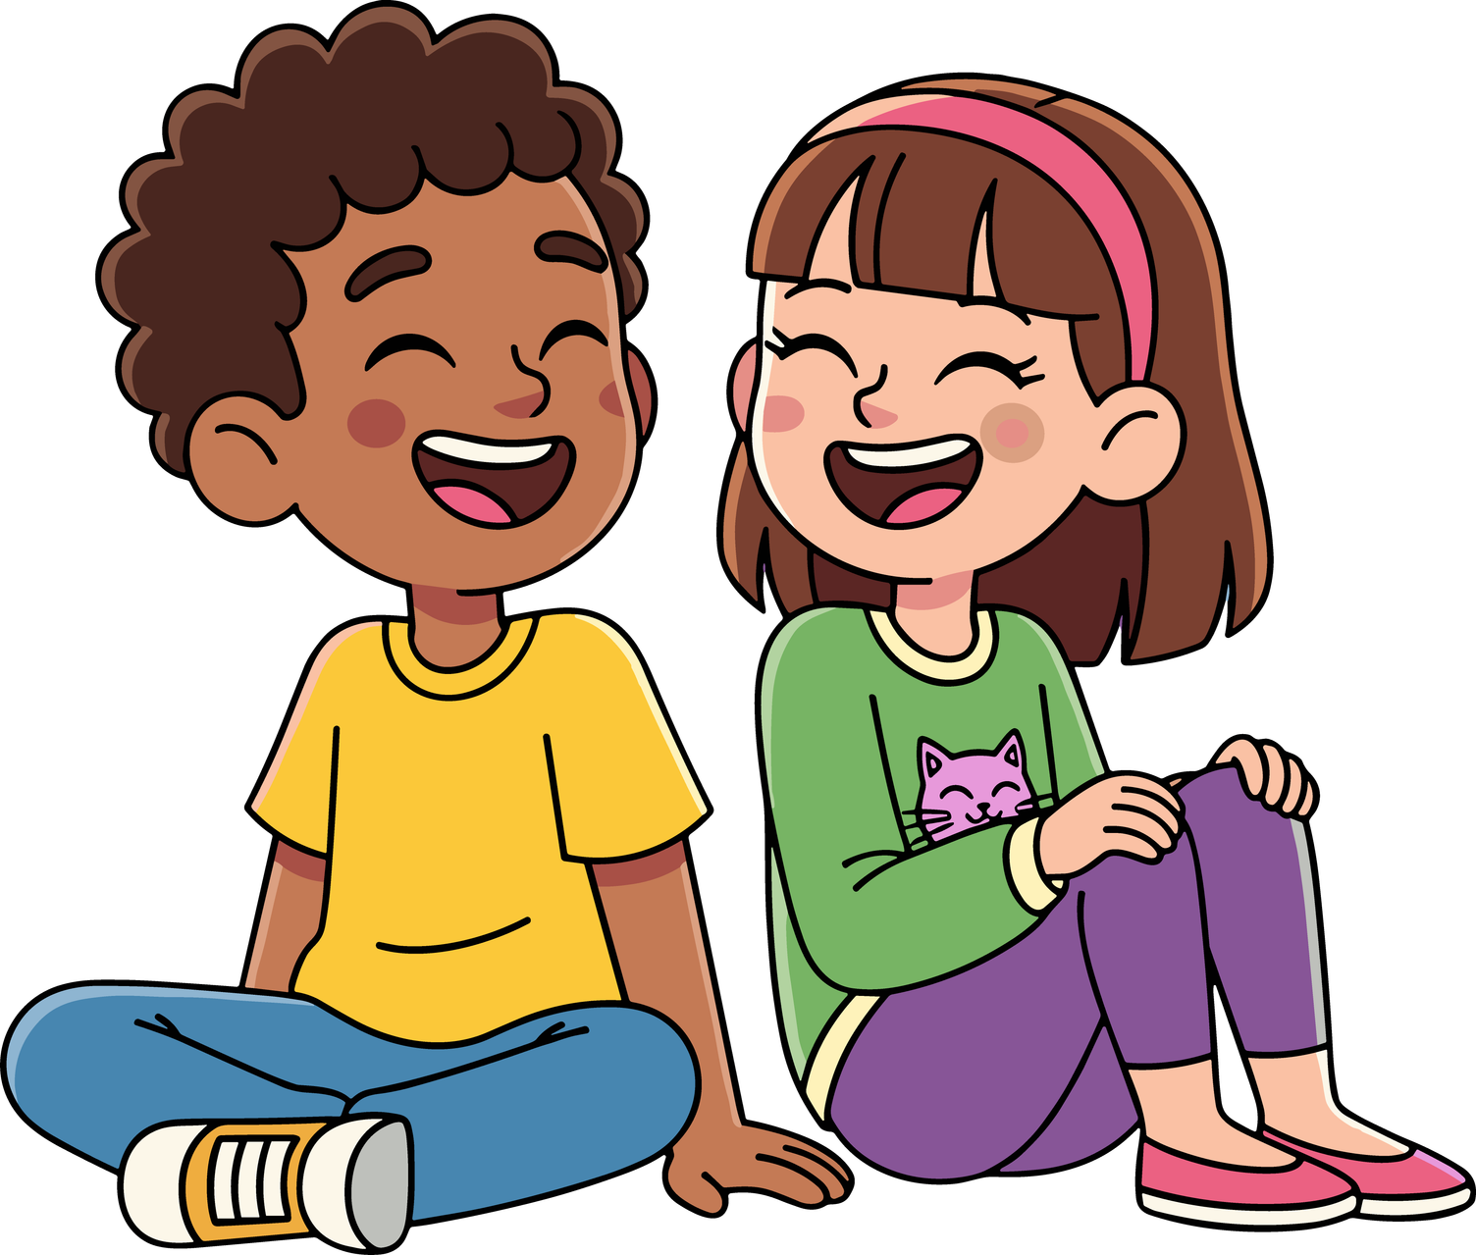
Module objectives
01
Understand what stress is and how it works
02
Recognize situations that cause tension or stress
03
Recognize the signals of the body and mind
04
Learn practical self-regulation strategies
05
Know when to ask for help
06
Develop personal tools for regulation

Slide 4
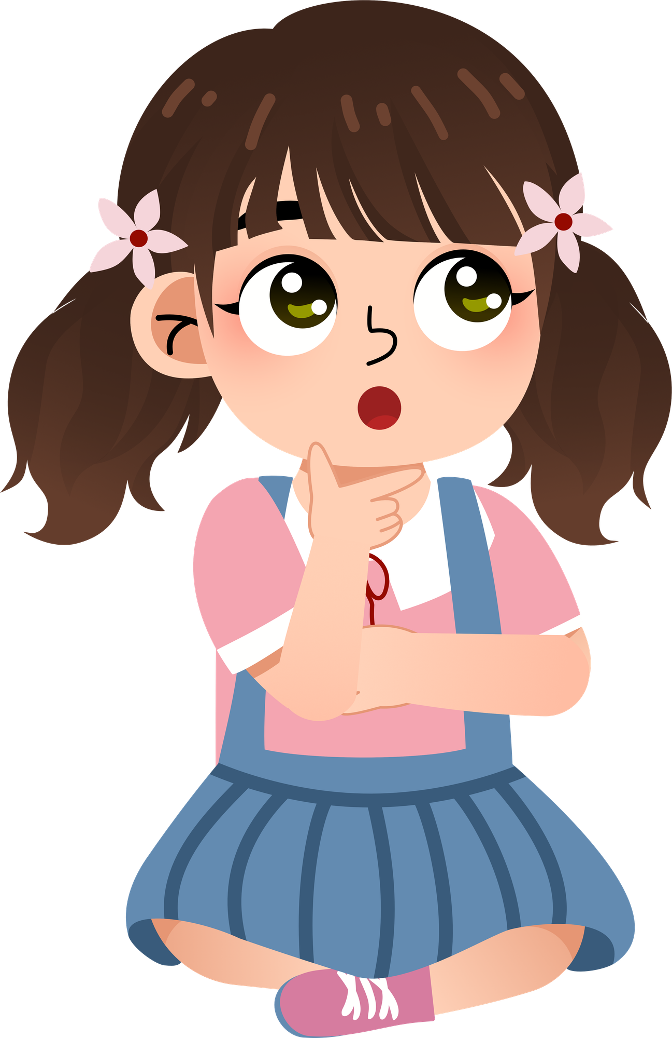
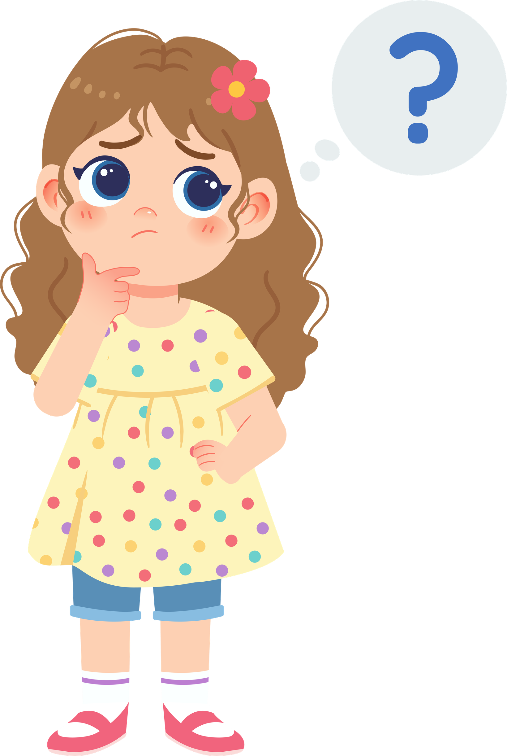
What is stress?
01
Stress is a normal body reaction.
02
Sometimes it helps us, sometimes it blocks us.
What is stress for you?
How do you realize you are stressed?

Slide 5
Day 1. What stresses me and
how do I notice it?
Activity 1.1
Introduction to the workshop
and round of introductions in a circle

Slide 6
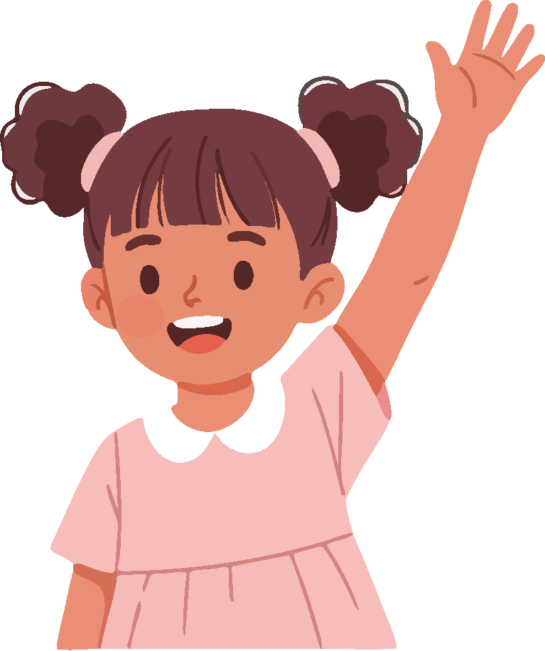
Materials
  Chairs arranged in a circle
  Open space
What will we do?
  We sit in a circle so we can all see each other.
  We introduce ourselves by sharing our name and one word that describes how we feel right now.

Slide 7
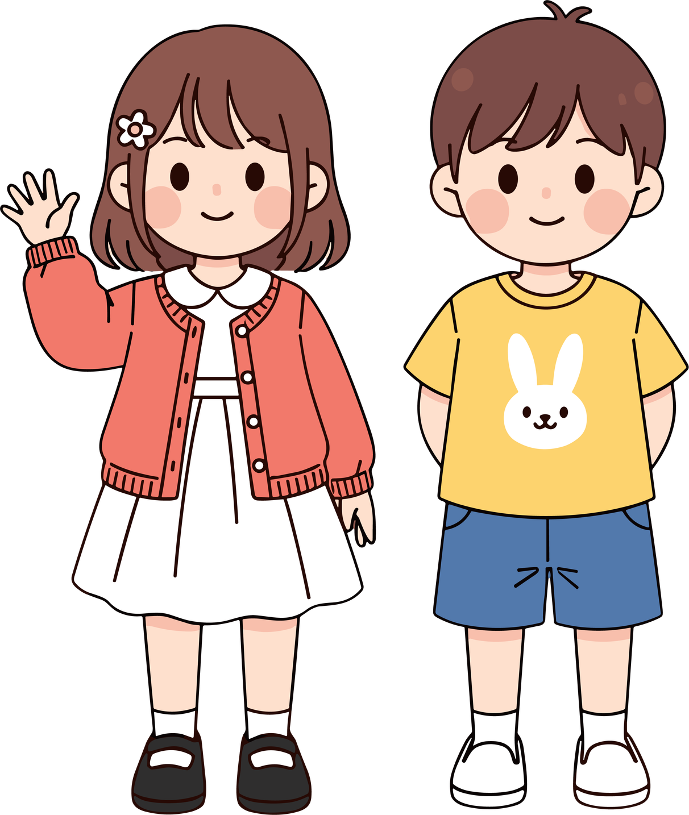
Today we will talk about something we have all experienced at least once: stress.
Every emotion you feel is valid.
“My name is ___ and today I feel ___.”
“Hi ___, how are you feeling?___”
What emotion do you bring to the workshop today?
Do you think emotions can change during the day?

Slide 8
Activity 1.2
Emotional monsters

Slide 9
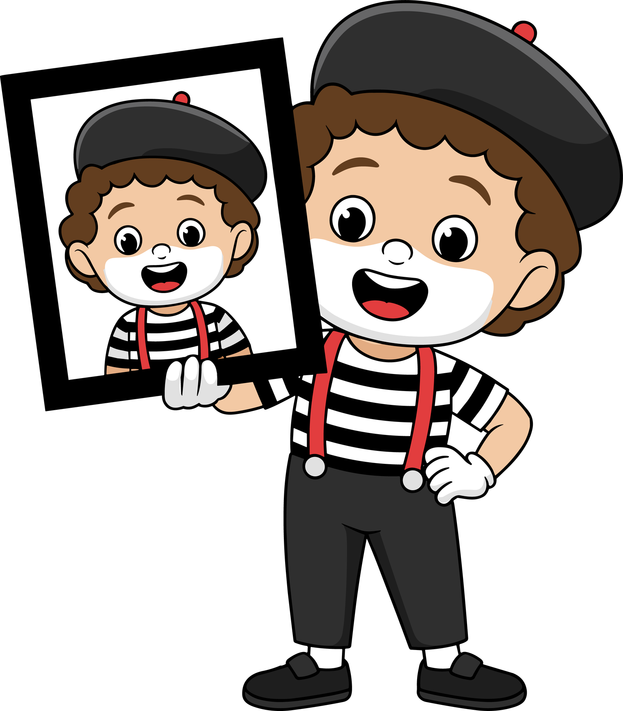
Materials
  Cardboard or paper (optional)
  Markers or pencils
  Blackboard, to collect examples
What will we do?
  Represent or create emotions as "emotional monsters".
  Use body, gestures, or drawing to give each emotion a shape.

Slide 10
Emotions can be expressed through gestures, body postures, and movements.
This is symbolic and very useful for understanding how we feel.
Every emotion manifests in the body differently.
Let's explore emotions together.

Slide 11
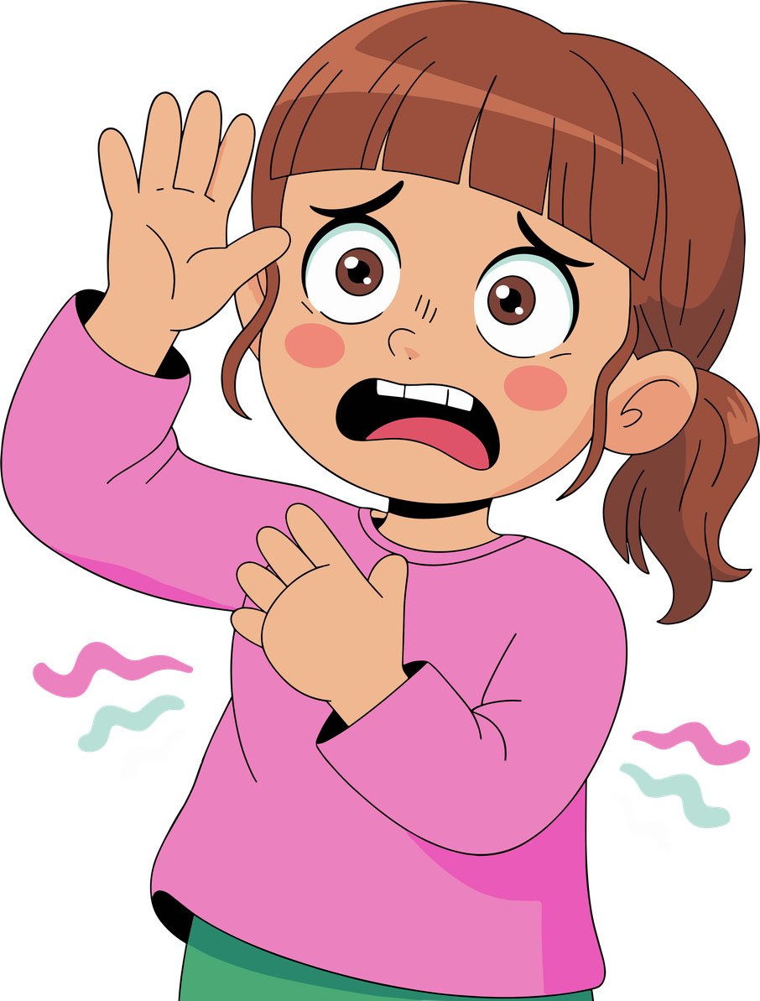
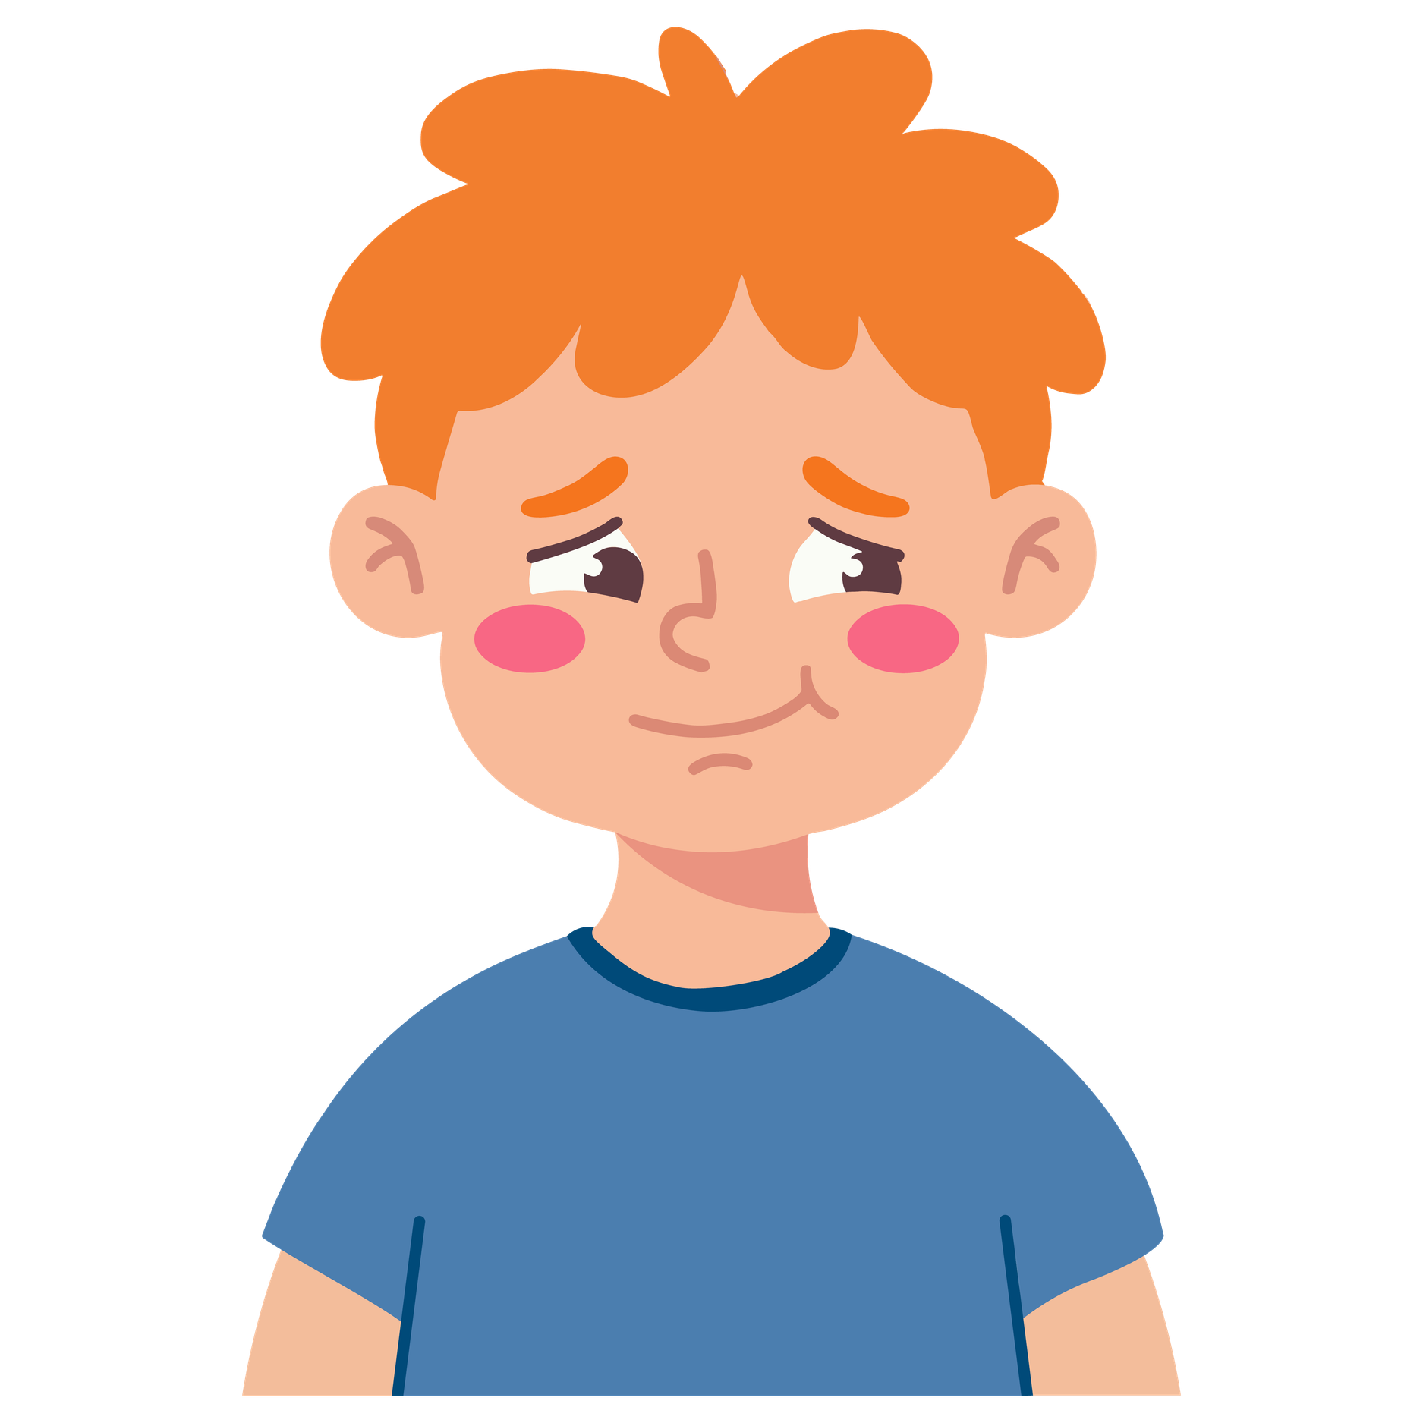
How is this emotion felt in the body?
Do you think emotions can change quickly?
Fear
Shame

Slide 12
How is this emotion felt in the body?
Do you think emotions can change quickly?

Slide 13
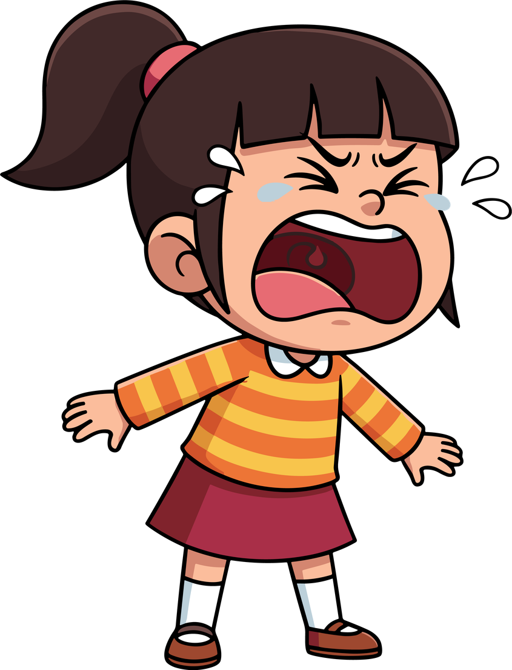
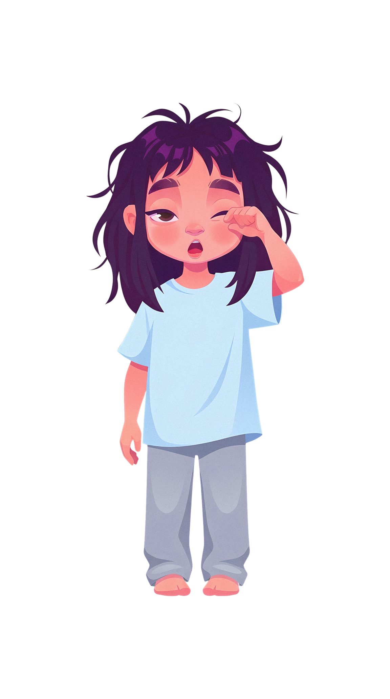
How is this emotion felt in the body?
Do you think emotions can change quickly?
Anger
Fatigue

Slide 14
How is this emotion felt in the body?
Do you think emotions can change quickly?

Slide 15
Activity 1.3
Game: “Everyone who…”

Slide 16

Materials
  Chairs arranged in a circle (one fewer chair than participants)
  Open space to move
What will we do?
  We will do a movement game to recognize common emotions.
  We will change places when we feel involved.
  We will observe how many experiences we share without discussing personal cases.

Slide 17
Let's change places...
Everyone who was nervous about a test this week...
Everyone who sleeps worse when they have many worries...
Everyone who would have wanted to take a break, but could not...

Slide 18
Let's change places...
Everyone who got angry because something didn't go the way they wanted...
Everyone who felt pressure to finish their tasks...

Slide 19
Have you noticed how many things we have in common?
What surprised you about this game?

Slide 20
Activity 1.4
"Head Picture" – What stresses me?

Slide 21
Materials
  Large sheet for poster
  Markers
  Drawing of a head (or draw it directly on the blackboard)
We will not talk about personal stories,
but about general situations that many people experience.
Everyone can participate:
there are no right or wrong answers.
What will we do?
  Draw a large "head / brain" on a poster.
  Fill it with what we think about most when we are stressed.

Slide 22
What things often stress children your age?
Problems with friends
School / study
Tests
Noise or very chaotic environments
Fights
Little rest or poor sleep

Slide 23
How many of these things happen to you too?
Problems with friends
School / study
Tests
Noise or very chaotic environments
Fights
Little rest or poor sleep

Slide 24
Activity 1.5
"Body Picture" – How do I feel stress in my body?

Slide 25
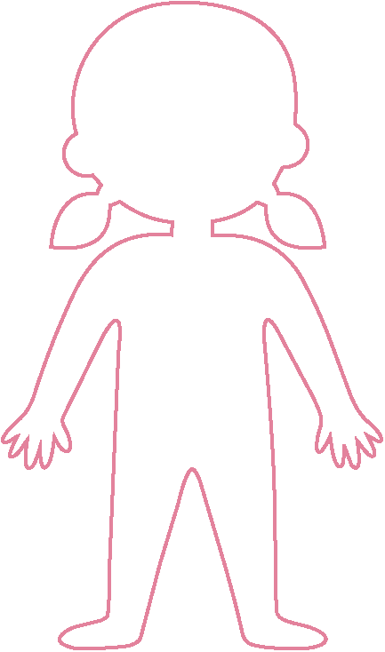
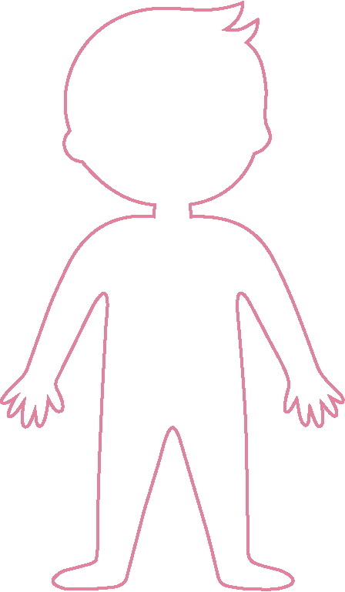
Materials
  Large body outline
  Markers
  Post-it notes (optional)
What will we do?
  Mark on a body outline the points where we feel stress in the body.
  Name the physical sensations: tension, pain, heat, breathing...

Slide 26
What do you notice in your body when you are stressed?
Headache
Lump in throat
Accelerated heartbeat
Stomach pain
Cold or sweaty hands

Slide 27
What are the most frequent signals during class?
Headache
Lump in throat
Accelerated heartbeat
Stomach pain
Cold or sweaty hands
The body speaks. Sometimes it notices before the mind.
All signals are fine — every body is different.

Slide 28
Activity 1.6
Key concepts of stress

Slide 29
Stressful situations
Materials
  Cards with the three concepts
  Blackboard or floor space to arrange them
Stress response
What will we do?
  Explore three fundamental ideas:
    Situations that cause stress
    Body reactions to stress
    Things that help (anti-stress)
Things that help
Stress is not always negative: sometimes it helps us react.
Each person gets stressed about different things.

Slide 30
Stressful situations
Stress response
Things that help
What stresses you?
What do you notice in your body when something worries you?
What things usually help you?
  A surprise test.
  Having too much homework.
  Arguing with a friend.
  Not being understood.
  Feeling excluded.
  Having too many responsibilities.
  Take several deep breaths.
  Talk with a friend, a teacher or a family member.
  Take a short break.
  Do something you enjoy.
  Write down or draw how you feel.
  Stomach pain or headache.
  Become nervous or upset.
  Become quickly angry.
  In a test suddenly not remember anything.
  Difficulty concentrating.
  Wanting to avoid the situation.

Slide 31
Activity 1.8
The "emotional tank" model

Slide 32

Materials
  Large sheet for poster or blackboard
  Markers
What will we do?
  Draw a large tank.
  Write what fills it and what empties it.

Slide 33
What fills your tank?
What fills it gives you energy.
Friends
Play
Music
Support
Nature
Family
Free time
Sleep well
Feeling understood
Redo

Slide 34
What empties it?
What empties it drains your well-being.
Fights with friends
Fatigue
Too many tasks
Pressure for school performance
Sudden changes
Bad grades
Family concerns
Fights
Feeling alone

Slide 35
Activity 1.9
"Pizza massage" – A body strategy to reduce stress

Slide 36
Materials
  Chairs in pairs
  Calm music (optional)
  Small balls or rollers (optional)
What will we do?
  Do partner massage, imagining preparing pizza.
  Learn to relax the body through respectful contact.
The massage must be gentle and respect the other person's space.
If someone doesn't feel comfortable, they can say "stop" at any time.

Slide 37
01
Imagine that the back is the base of a pizza.
First we "clean the table": gently brush with the palms from top to bottom.
02
With our fingertips we pretend to sprinkle the flour, so the dough doesn't stick: very light touches.
03
We make small circular movements or a gentle pressure, as if we were kneading the dough.
04
We push our hands outward, from the center to the sides, as if we were stretching the dough.
05
Now let's add the ingredients:
  Tomato: gentle taps with closed fists
  Salami: gently press with the palm of the hand
  Paprika: short lines with a finger
  Mushrooms: gentle pressure with the thumb
  Onions: circles with the fingers
  Cheese: very light touches with the fingertips

Slide 38
Step 1
Step 2
Step 3
Put the pizza in the oven
Warm up the pizza
Take the pizza out of the oven
We slowly slide our hands from bottom to top,
as if we were putting the pizza in the oven.
We rub our hands to warm them
and gently place them on the shoulders or upper back
(not on the spine).
We gently slide the hand downward
to end the massage.

Slide 39
Which part of the massage relaxed you the most?
What did you feel before and after?

Slide 40
Activity 1.10
Guided journey to your "inner place of strength"

Slide 41
Materials
  Calm music (optional)
  Calm environment
What will we do?
  Guide a visualization to a personal safe and relaxing place.

Slide 42

Let’s find a place where you feel really at ease.
It could be a real place you know — for example, a wood, a house, a beach or your own room.
Or it could be an imaginary place that exists only in your imagination.
Imagine you’ve arrived at this place.
You can walk, fly, take a train or a boat — whichever you prefer.
When you arrive, look around:
  What do you see?
  What colours are there?
  Is there light, shade, sunshine or clouds?
Listen carefully:
  What sounds are there in your place?
  Is it quiet?
  Can you hear water, wind or music?
Notice the temperature:
• Is it warm, cool or just right?

Slide 43
Think about what makes you feel good in this place.
It can be a memory, an object, a landscape, or a scent — something that gives you security and peace.
This place belongs only to you.
No one can enter it without your permission.
Here you can rest, reflect, breathe, or simply be.
How do you feel now?
Which part of the visualization calmed you the most?

Slide 44
Activity 1.11
Conclusion of day 1

Slide 45
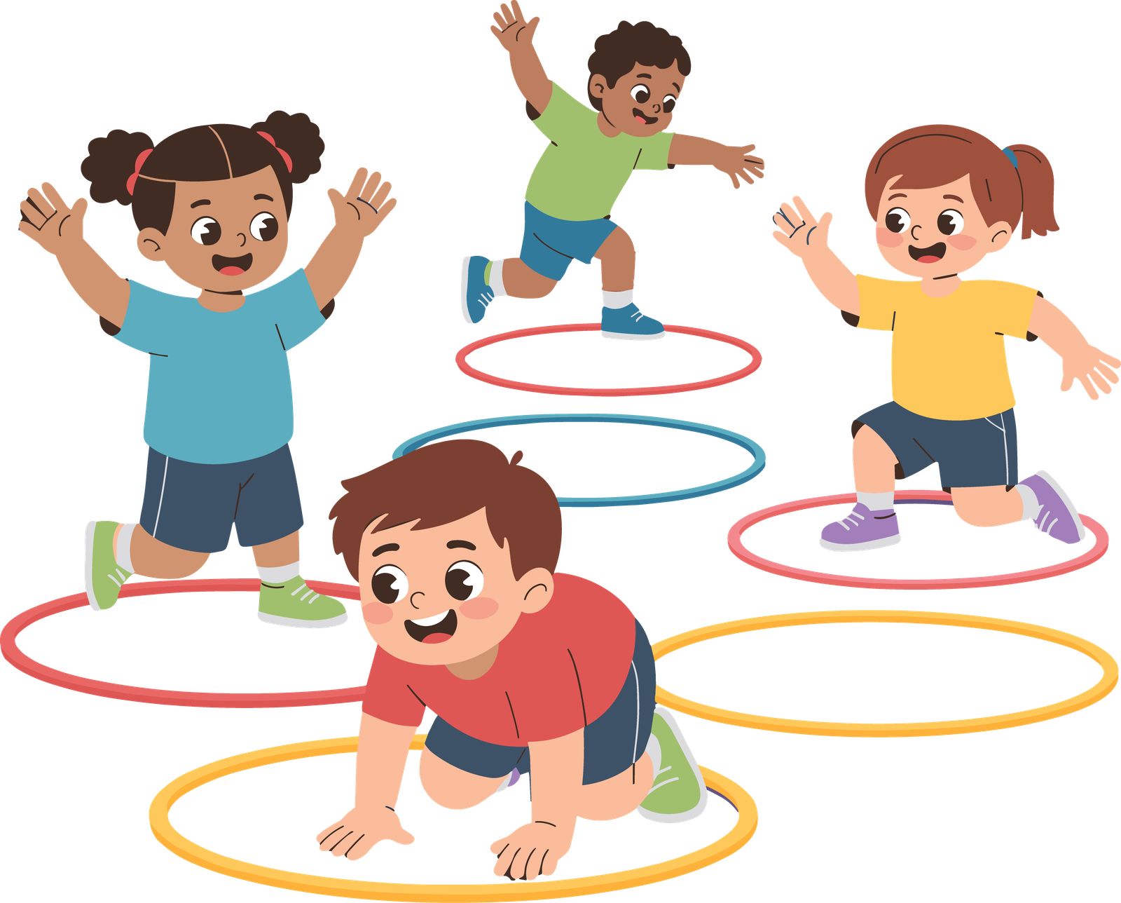
What will we do?
  Summarize the most important discoveries of the day.
  End the day with a feeling of calm.

Slide 46
Today we discovered
what stresses us, how the body perceives stress,
and how we can relax.
Remember: all feelings are valid.
What helped you the most today?

Slide 47
Day 2 – What can I do and
who can help me?
Activity 2.1
Welcome back
and review of day 1

Slide 48
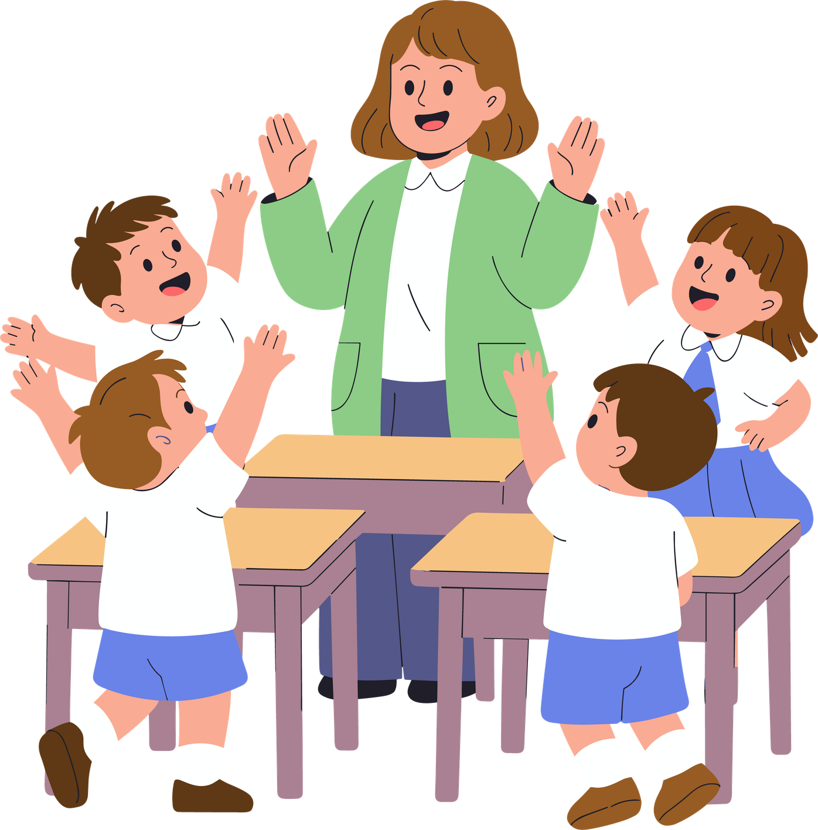
Materials
  Chairs arranged in a circle
  Blackboard (optional)
  Day 1 poster visible (optional)
What will we do?
  Return to the opening circle.
  Briefly recall the previous day.
  Share one thing each person remembers from the last session.

Slide 49
What do you remember from the last workshop?
We have seen what stresses us, how the body perceives stress, and what we can do to relax.
Today we learn other tools to deal with stress.
Everyone learns at their own pace — there are no wrong answers.

Slide 50
What things stress you the most during the week?
What signals does your body give when stress begins?
Do you remember the emotional tank model?

Slide 51
Activity 2.2
"Lifting weights" – The weight of stress

Slide 52
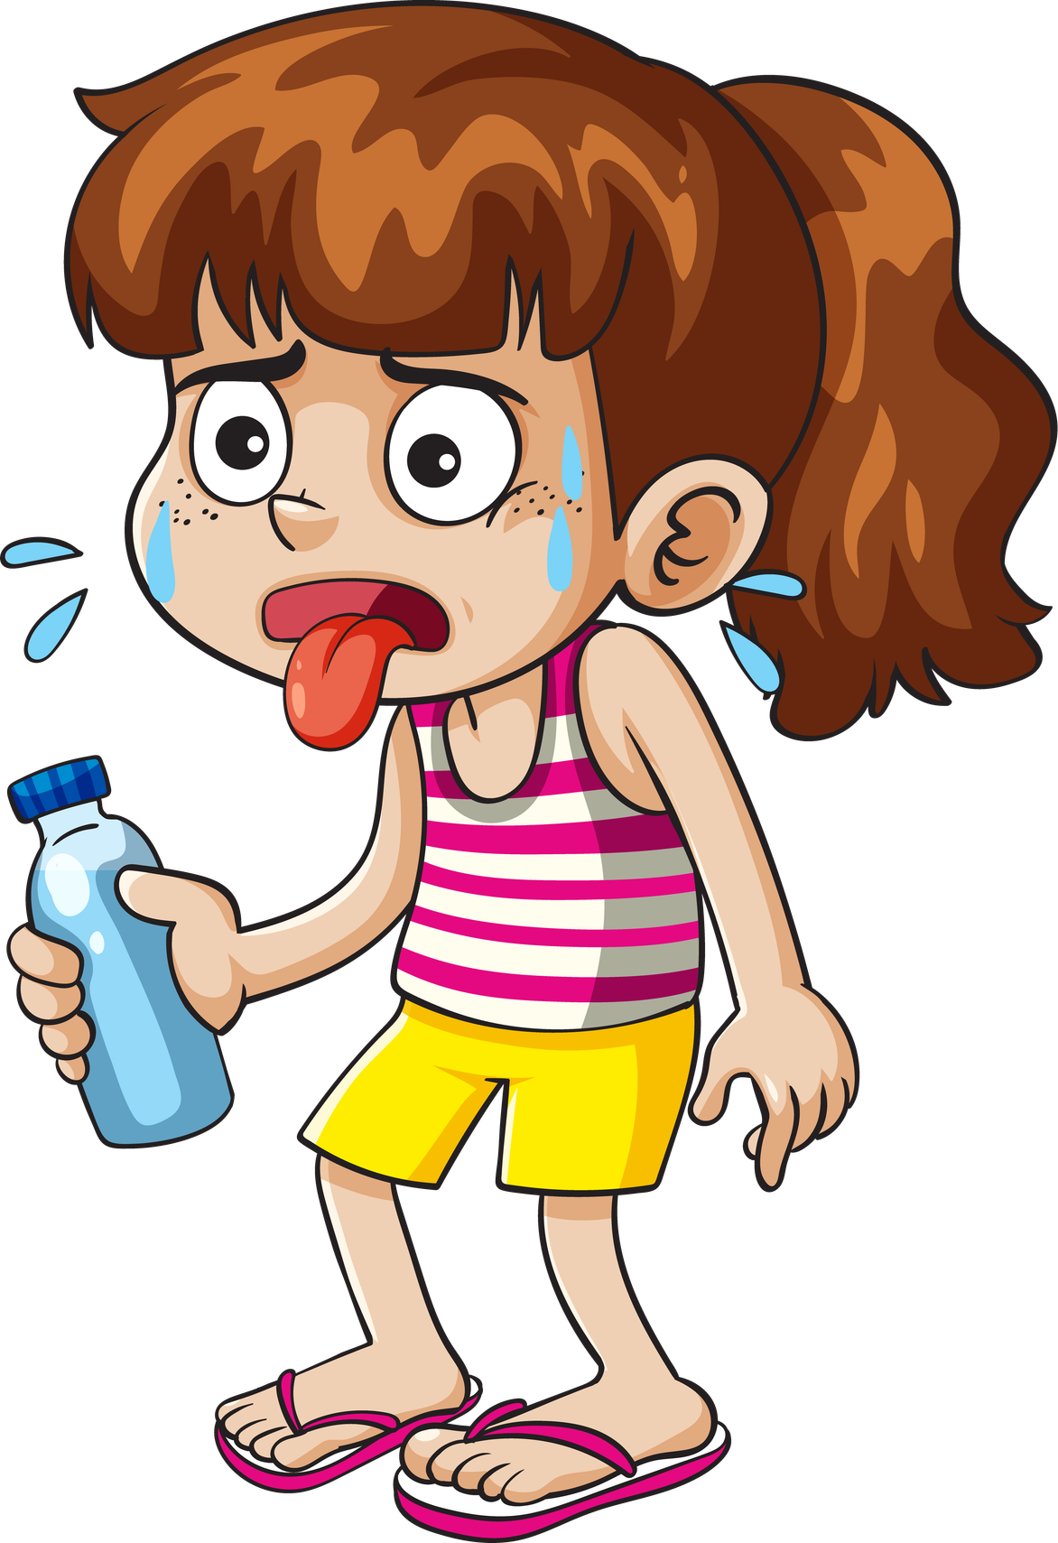
Materials
  Small water bottles (one per person)
  Enough space to spread out
What will we do?
  Hold a small weight with arm extended.
  Perceive how the sensation changes over time.
  Connect arm fatigue to accumulated stress.
  Understand that stress becomes heavy when held too long.

Slide 53
Let's see what happens when we hold the weight for a while…
The weight doesn't change, but our perception of it does.
Stress works the same way: the longer we carry it alone, the heavier it feel
You don’t have to carry this burden on your own. You can let it go.
How does your arm feel now compared to a minute ago?

Slide 54
What things in your life could be like this weight you are holding?
What could help you "let go" of this weight?

Slide 55
Activity 2.3
Strategies to deal with stress

Slide 56
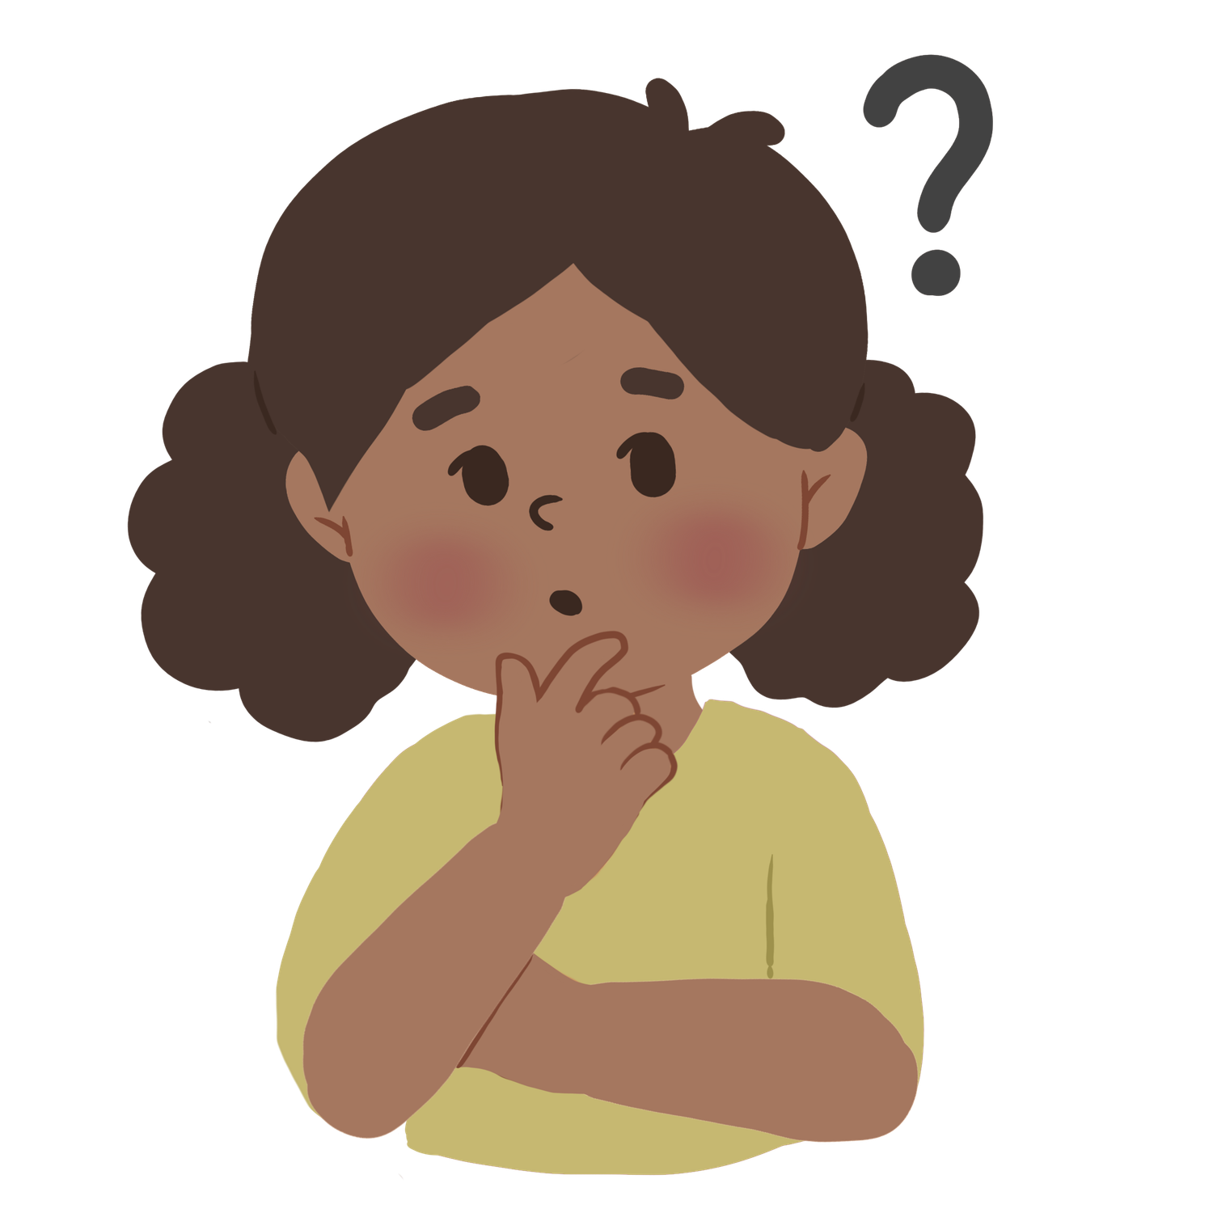
How can I let go of the weight of stress?
Materials
  Cards for the three-finger method
  Coping skills cards
  Help cards
What will we do?
  Explore practical tools for letting go of stress.
  Develop a small mental guide for difficult situations.
  Find strategies that work for each person.

Slide 57

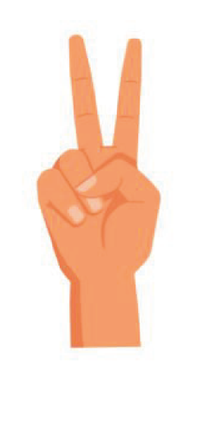

The three-finger method
Finger 1 — STOP:
What is the problem?
Finger 2 — SOLUTIONS:
What can I do?
Finger 3 — TRY:
Did it work?
First I stop for a moment and ask myself:
I think about more possibilities.
Even small steps count.
I choose a possibility, try it,
and then I ask myself if it helped.
  What is happening now?
  What am I worried about?
Examples:
  Tomorrow I have a test.
  I argued with a friend.
  I have too many things to do.
  I feel overwhelmed.
Examples:
  Ask the teacher something
  Ask a classmate for help
  Take a short break
  Breathe deeply
  Talk to someone I trust
If it doesn't work:
  I look for another option. It's okay to need more than one try.
  I can always ask for help.

Slide 58
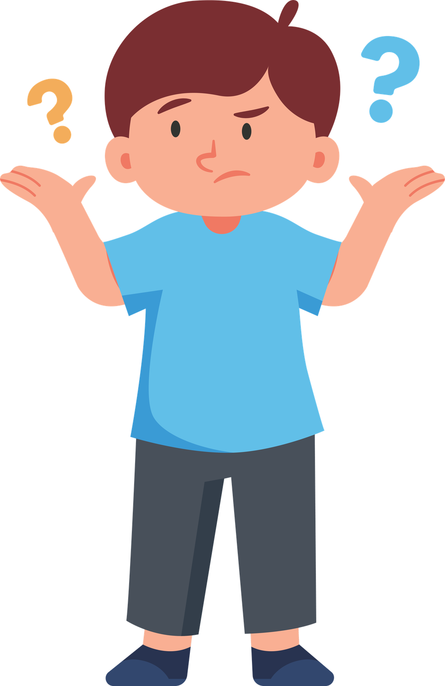
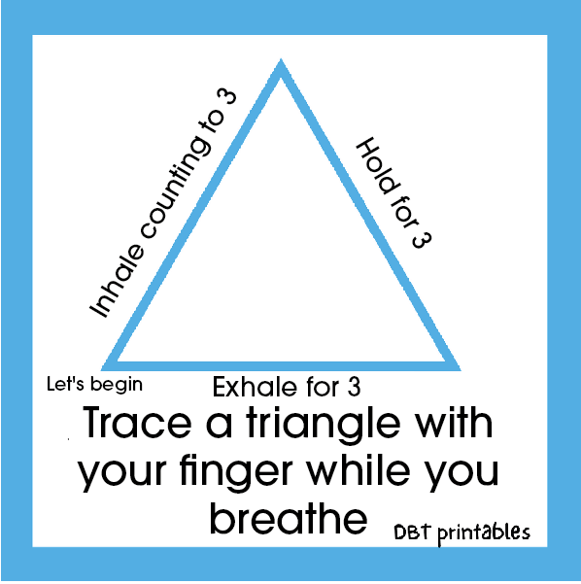
Stress management strategies
01
02
03
Stress management strategies
Healthy distraction / brief break
Realistic positive thinking
  Triangle breathing
  Take 3 deep breaths (inhale and exhale)
  Take a break
  Drink water
  Listen to music
  Draw or color
  Brief activity
  Stretch
  I have already overcome more difficult situations.
  I can ask for help.
  It is only temporary.

Slide 59
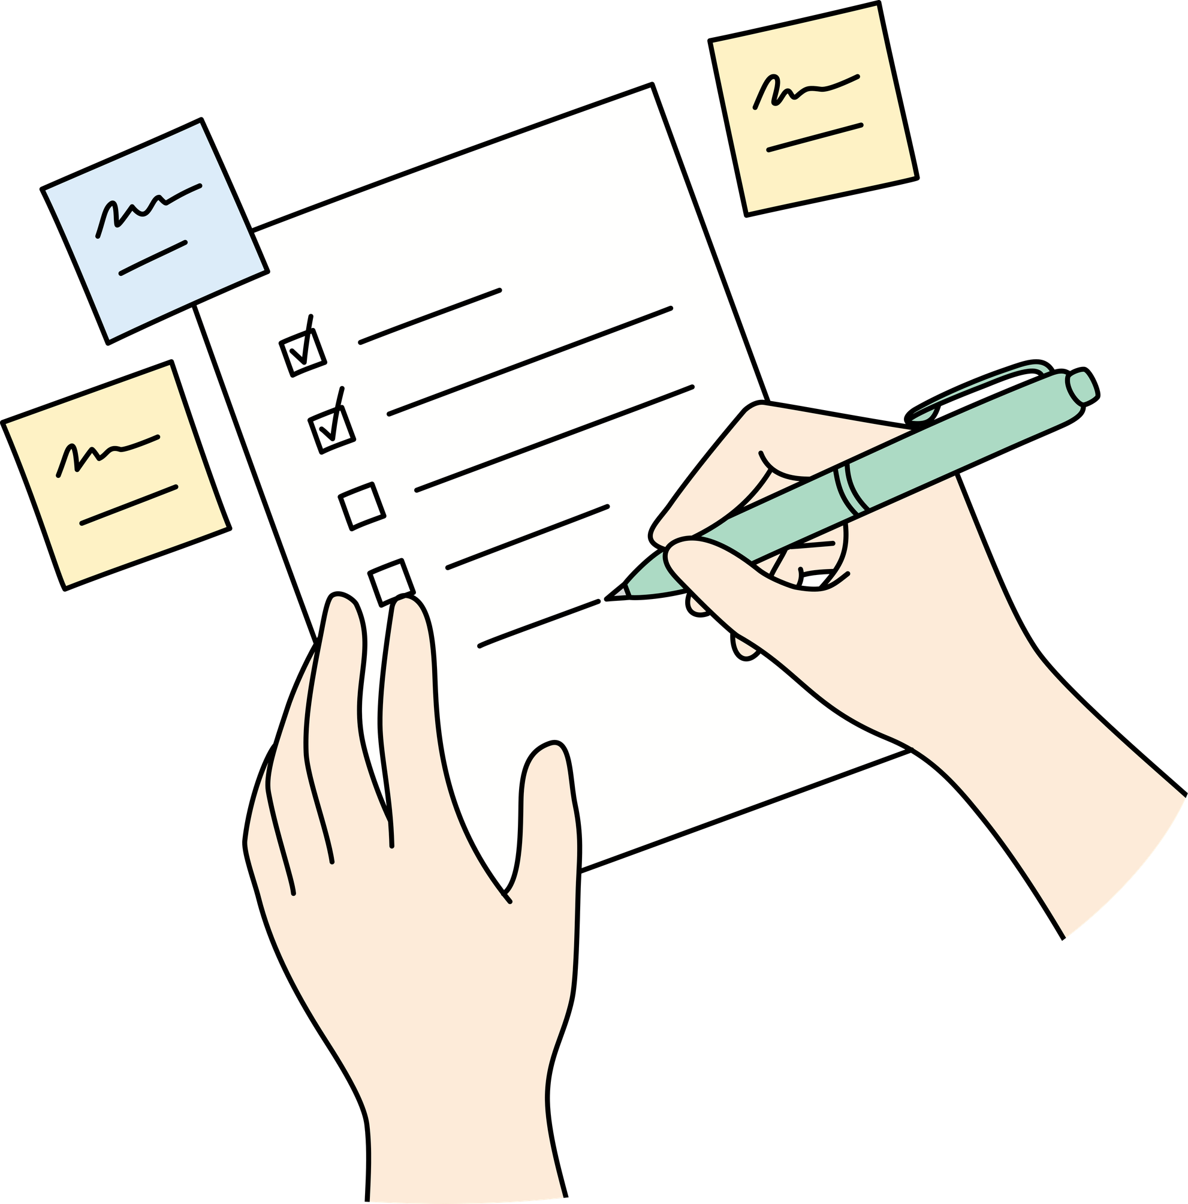
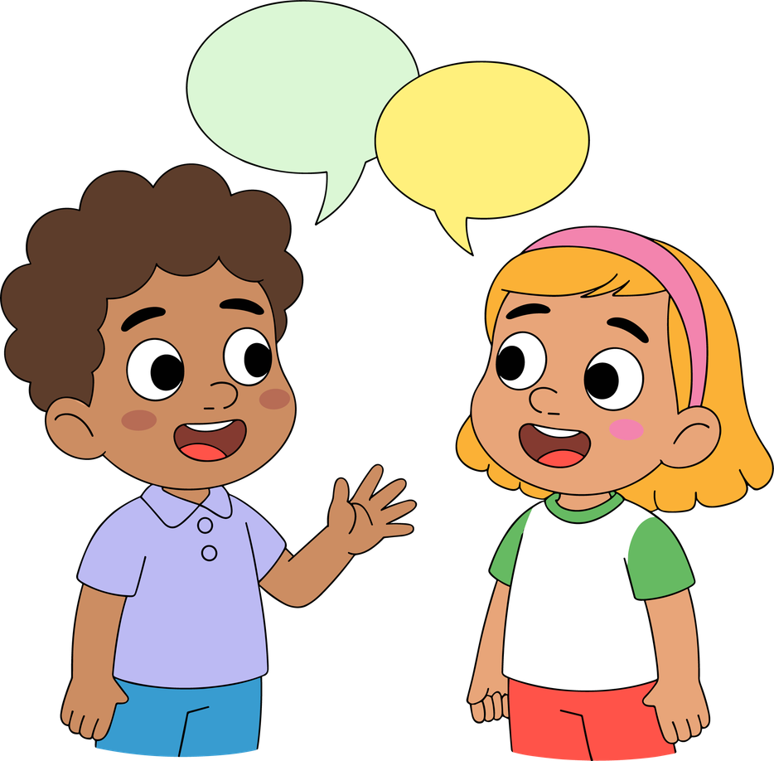
Coping Skills
04
05
Planning
Talk to someone
  Divide tasks
  Make a list
  Organize time
  Express your concerns
  Ask for advice
  Ask for support

Slide 60
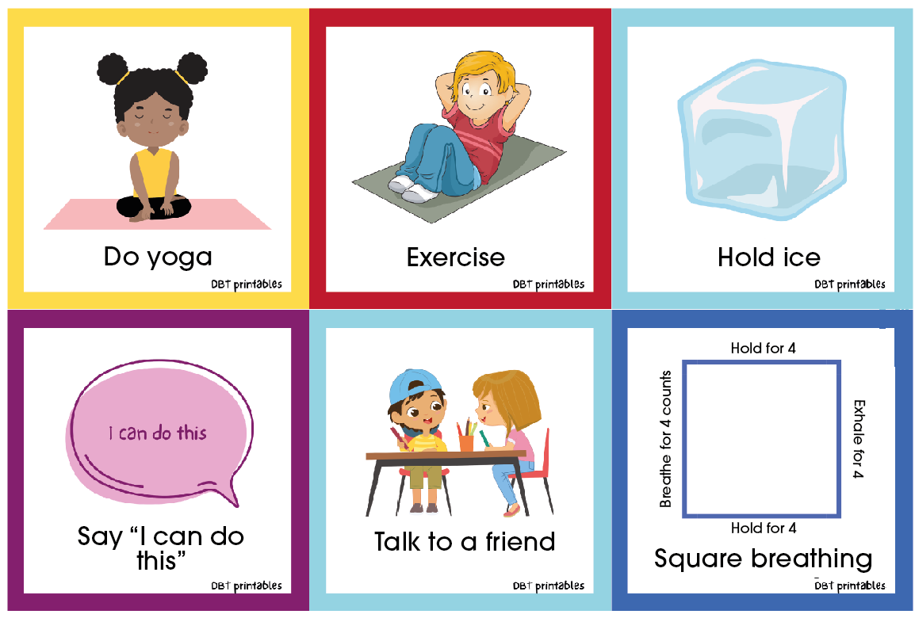
Help cards
Who helps me when I feel bad?
Asking for help is not a sign of weakness, but of strength and emotional intelligence.

Slide 61
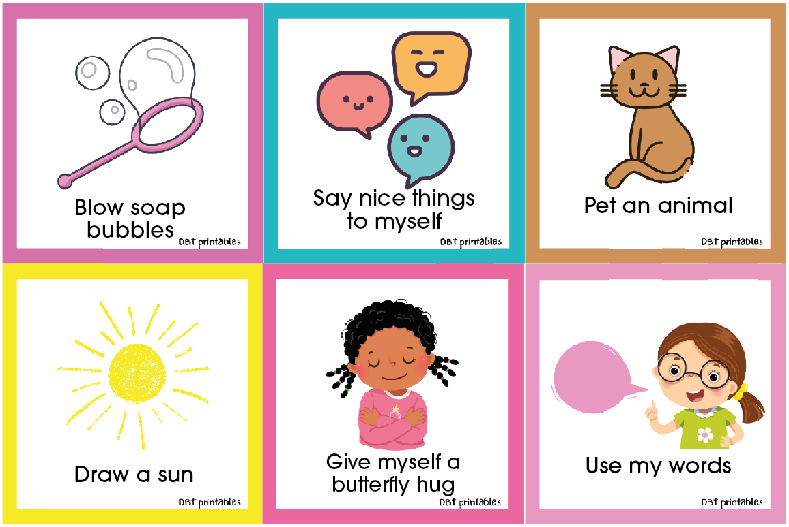

Slide 62
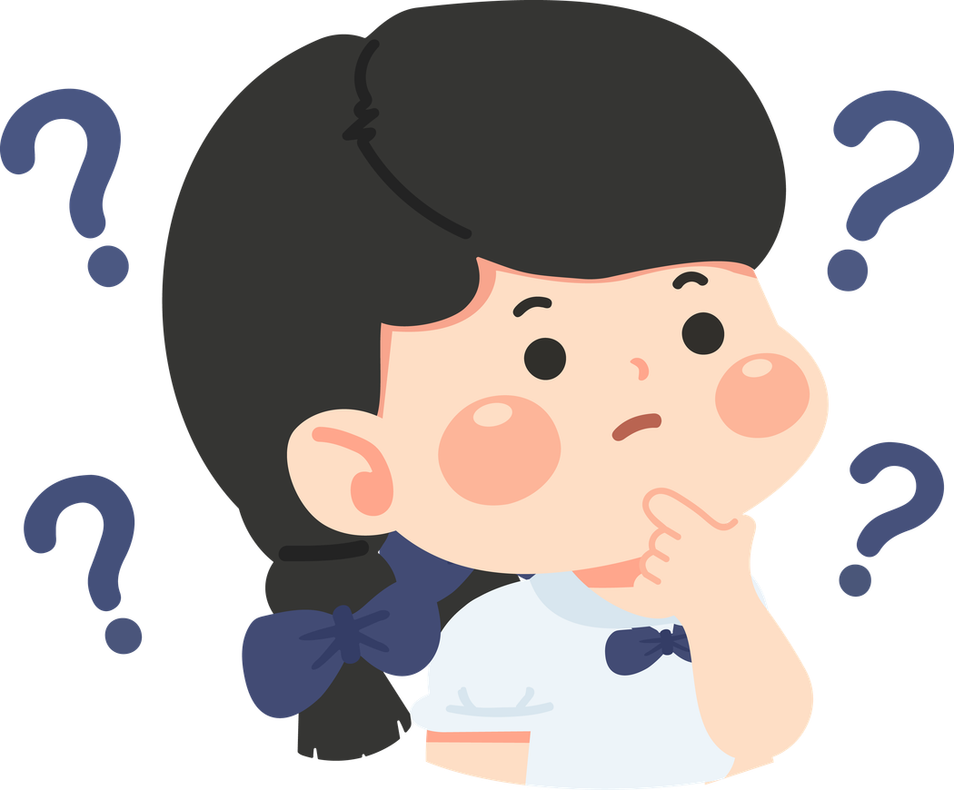
Everyone needs different tools.
It is important to understand what helps each person.
Which tools help you the most?
Who can you ask for help when you need it?
What strategy can you try when you realize you are stressed?

Slide 63
Activity 2.4
Game “1–7”

Slide 64
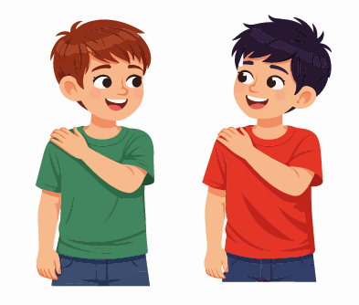
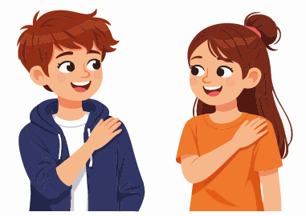
Materials
  Large space
  Large circle
  No additional materials needed
What will we do?
  Follow quick movement instructions
  Count from 1 to 7 and react according to the rules
  Observe how sudden stress develops
  Practice attention, reaction, and self-control

Slide 65
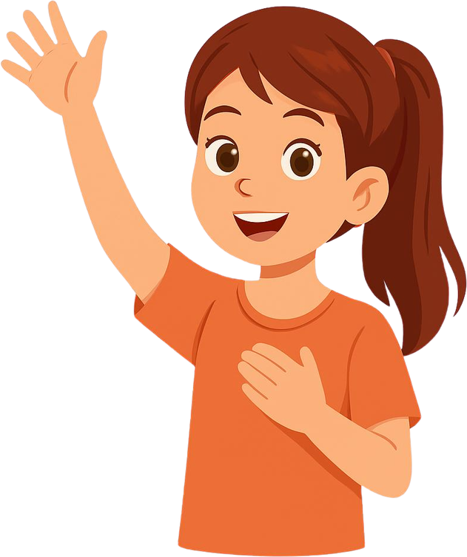
This is a game with light and controlled stress.
Making mistakes is part of the game.
Do your best — it doesn't have to be perfect.
7
1, 2, 3, 4, 5, 6...
1, 2, 3, 4, 5, 6...

Slide 66
Did you feel a bit under pressure?
Was it harder to think when you went faster?
What happens when we are in a hurry and have no plan?
How can you help yourself in sudden stress situations?

Slide 67
Activity 2.5
Making the ‘treasure box of emotions’

Slide 68
Materials
  Template for the treasure box
  Scissors
  Glue
  Markers / colors
  Stickers
What shall we do?
  Make a paper treasure box.
  Write down the ‘treasures’ that help: people, activities, phrases, places, strategies.
  Keep personal resources in the box for when times are tough.

Slide 69
Questa scatola conserva cose che ti aiutano quando non ti senti bene.
I tuoi tesori sono personali.
Non devi condividere nulla se non vuoi.
What things help you when you are stressed?
Quale persona ti dà un senso di sicurezza?
What phrase do you want to remember when you are nervous?
Che cosa vuoi mettere nella scatola che ti aiuta davvero?

Slide 70
Activity 2.6
My poster on stress

Slide 71
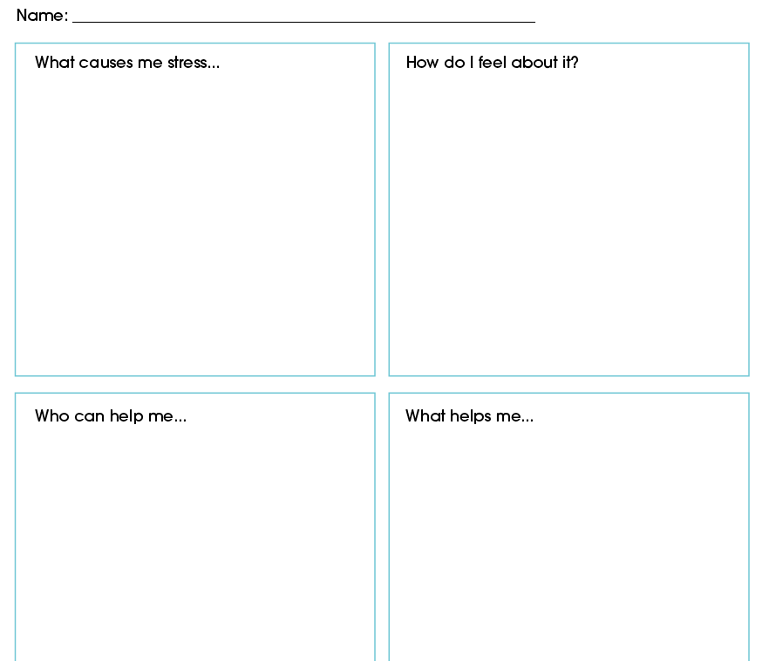
Materials
  Poster template
  Colours, scissors, glue
  The treasure box next to it as inspiration
What are we going to do?
• Create a poster divided into four sections:
    What causes me stress
    How do I recognise it
    What helps me
    Who helps me
  This poster will serve as a personal tool throughout the course.

Slide 72
It doesn’t have to be nice — it has to be useful.
This poster reminds you of your resources.
What helps you might not help other people — and that’s perfectly normal.
What stresses you out the most?
What signals is your body sending?
Who can you turn to for help?
Which strategy works best for you?

Slide 73
It doesn’t have to be nice — it has to be useful.
This poster reminds you of your resources.
What helps you might not help other people — and that’s perfectly normal.
  Challenges
  Conflicts with friends
  Too much homework
  Pressure to do everything perfectly
  Sudden changes
  Rapid heartbeat
  Tense shoulders
  Stomach ache
  Feeling like crying
  Rapid breathing
  Family
  Teacher
  A friend or someone you trust
  School counsellor / learning support staff
  Coach
  Take a deep breath
  Go for a walk
  Ask for help
  Listen to music
  Make a list
  Go to a quiet place

Slide 74
Activity 2.7
“My Planet” — an anti-stress exercise and creative visualisation

Slide 75
Materials
  Calm music (optional)
  Stickers or a coloured dot (optional)
What shall we do?
  Imagine your own personal planet, where you decide what stays and what goes.
  Link this visualisation to stress management.
  Choose a symbol or a word again.

Slide 76

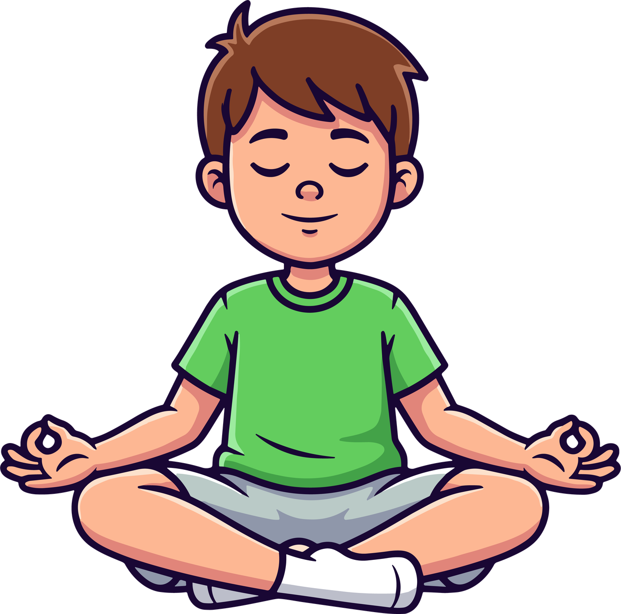
Imagine you have your own planet. You can call it whatever you like.
This planet belongs only to you, and it’s up to you to decide what it’s like.
Look around you:
  What is the surface like?
  Are there mountains, water, forests, cities, clouds or lights?
  What colours do you see?
Now listen:
  What sounds are there on your planet?
  Is it quiet?
  Can you hear the wind, music or soft voices?
Important decisions
Things you like may appear on your planet.
But sometimes things that stress you out may also appear: difficult emotions, thoughts, situations or feelings.
Remember: “You decide what you let in and what you don’t.”
When something you don’t like appears, you can say:
“Thank you for bringing this to my attention, but I don’t need you here. You can go.”

Slide 77
And then you gently push it out of your planet.
“Everything that’s good for you can stay. Everything that’s bad for you can go.
You don’t need to get angry — it’s simply up to you to decide.”
A reminder or “anchor” for your planet
  “To remind yourself of this planet when you’re feeling stressed, think of a small symbol or a word that represents it. It could be: a star, a colour, a short phrase or the name of your planet.”
Gentle return
Take a deep breath. Feel your body, how you’re sitting here.
And when you’re ready, slowly open your eyes.

Slide 78
Activity 2.8
End of Module 2

Slide 79
Materials
  Chairs arranged in a circle
  Posters and treasure boxes visible in the room
What shall we do?
  Share a closing word or phrase.
  Summarise what we have learnt.
  Reinforce our personal tools.

Slide 80
You already have plenty of tools to help you cope with stress.
Stress is normal. Learning to manage it is part of growing up.
You’re not alone: you can ask for help.
What’s the first thing you can do when you realise you’re feeling stressed?
Which instrument are you likely to use most often?
What have you taken away from this module?

Slide 81
Additional activities
Activity 3.1
“The Stress Traffic Light” — A quick tool for self-regulation

Slide 82
Materials
  Red, yellow and green paper or card
  Marker pens
  Traffic light template (optional)
  Whiteboard
What will we be doing?
  Learn about the three levels of stress: green, yellow and red.
  Recognise how you feel at each level.
  Learn practical strategies for managing each level.
  Create your own little traffic light system (optional), to use throughout the year.

Slide 83
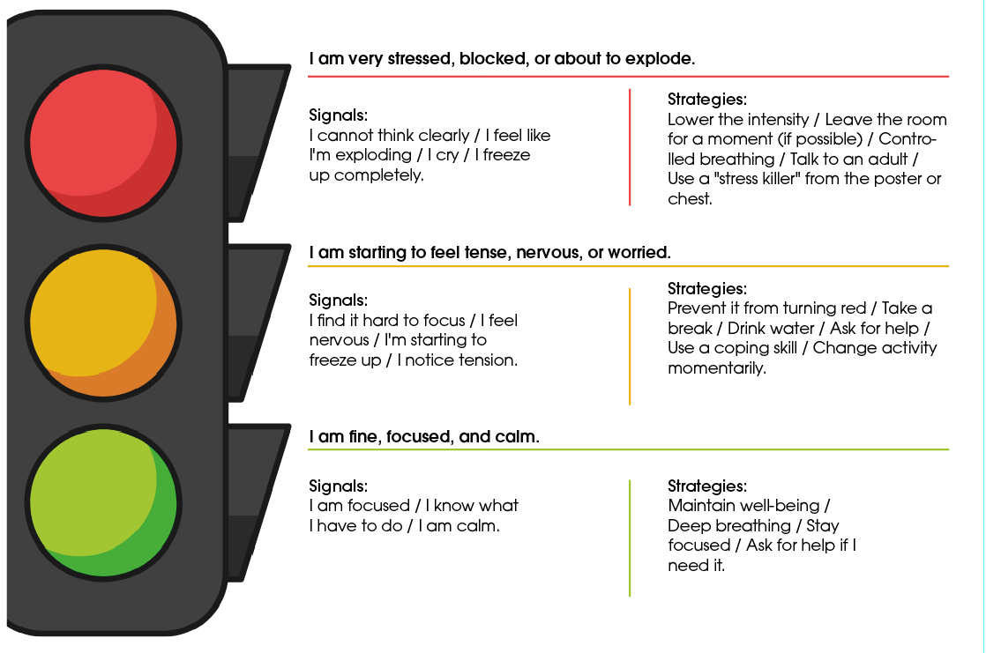
Examples for each level
What should I do when I find myself in each colour?

Slide 84
What colour are you in right now?
What are the signs that you’re in trouble?
What do you do when you're in the red?
What helps you get back in the black?

Slide 85
Activity 3.2
Emotional First Aid Kit

Slide 86
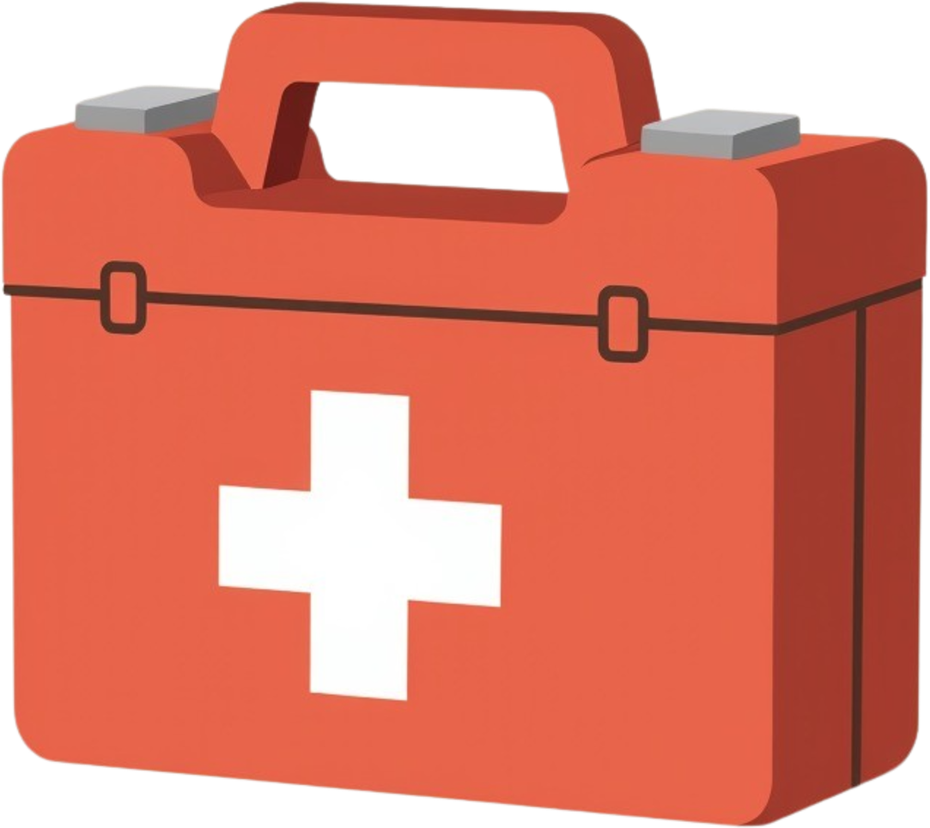
Materials
  Small box or envelope
  Strips of paper or card
  Markers
  Optional decorations (stickers, paints)
What are we going to do?
  Create a little ‘emotional first-aid kit’.
  Write down quick strategies for calming down.
  Turn abstract strategies into practical reminders.

Slide 87
Just as there are first-aid kits for physical injuries, we also need one for stress.
This kit is there to help you when you feel overwhelmed.
It’s personal — you don’t have to share it with anyone else.
What helps you calm down when you're feeling very stressed?
What phrase would you like to remember in difficult times?
What would you like to find in your box when you’re feeling under the weather?

Slide 88
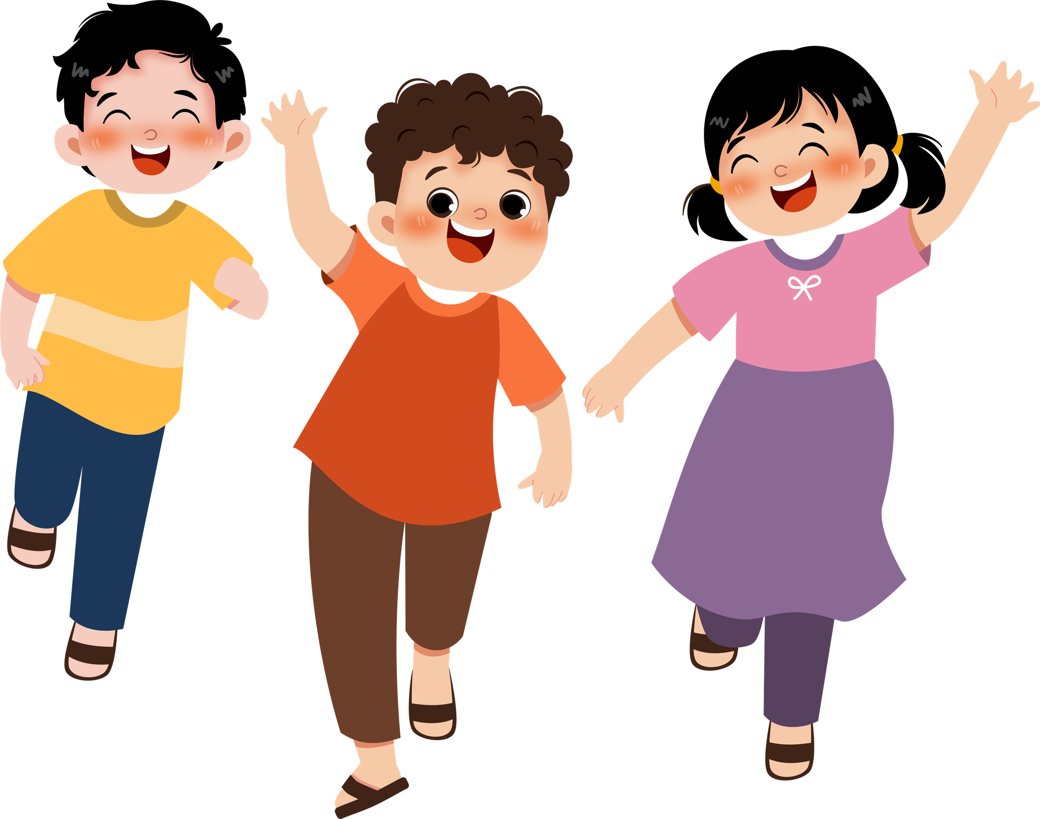
Stress is a part of life, but you have the tools to cope with it.
Every time you use a coping strategy, take a deep breath, ask for help or listen to your body, you are looking after yourself and becoming stronger.
What have you learnt in this module?
01
What stresses you out?
02
How your body perceives stress
03
Ways to calm down
04
People who can help you
05
Your treasure box and your stress poster
06
Your inner world: a place to find peace

Slide 89
Stress is a part of life, but you have the tools to cope with it.
Every time you use a coping strategy, take a deep breath, ask for help or listen to your body, you are looking after yourself and becoming stronger.
Remember
01
You are not alone
02
Your feelings matter
03
You can ask for help
04
You can calm down
05
You can take a break
06
You can start again

Slide 90


