Slide 1
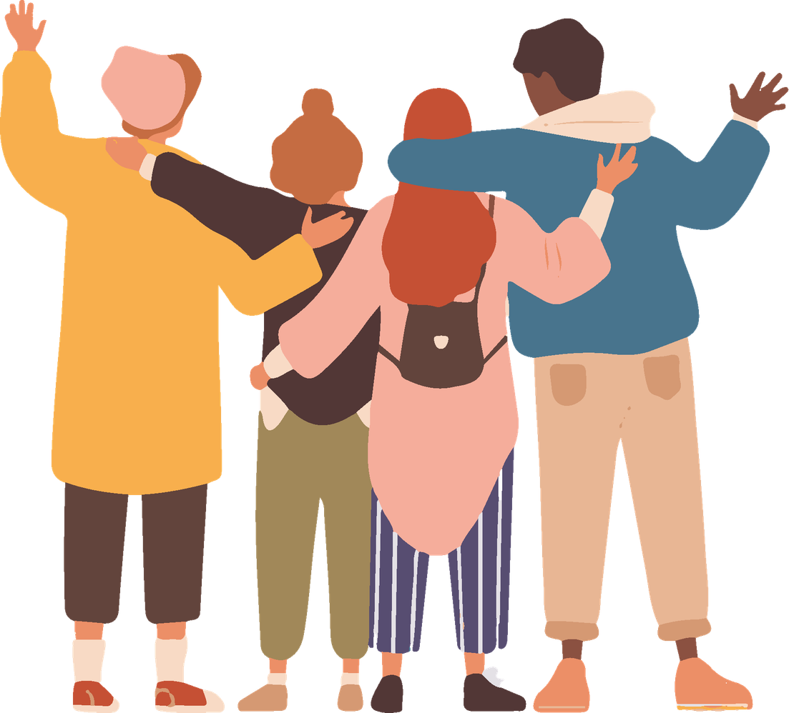

Module 3
Mental Health and Self-Care
Activities for secondary school

Slide 2
Mental health is a fundamental part of your wellbeing, just like physical health.
It affects how you think, how you feel, how you relate to others and how you respond to what happens around you.
During adolescence it is normal to feel more pressure:
tests, social media, relationships, expectations…
That is why it is important to learn to take care of your mind, understand emotions and recognise when you need support.

Slide 3
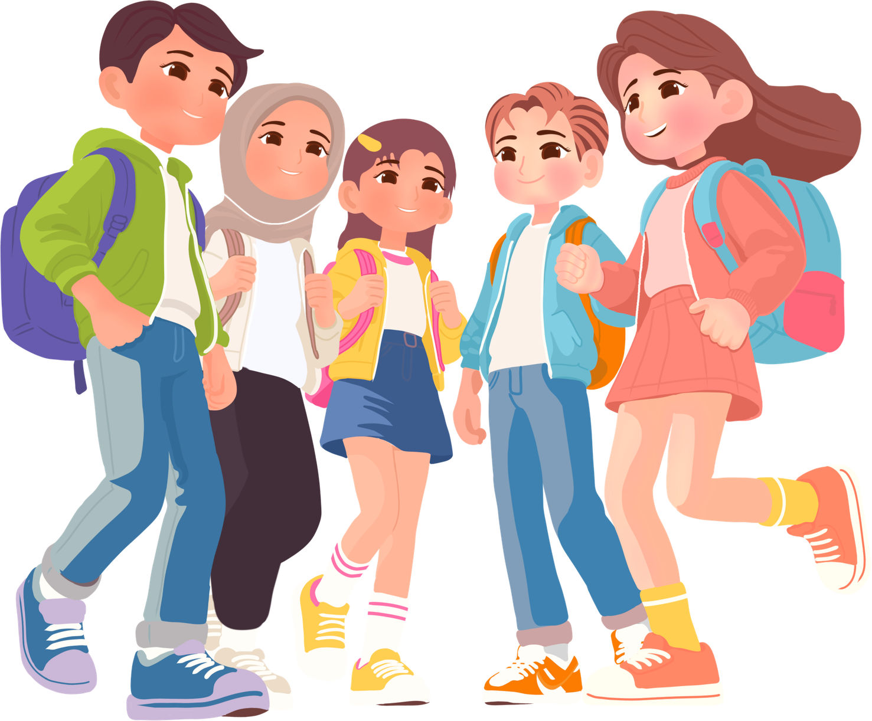
Why are we talking about this?
Because your mental health affects:
01
How you make decisions
02
How you manage stress
03
How you talk to yourself
04
How you relate to others
05
How you live your life
Taking care of it is not optional. It is essential.

Slide 4
Goals
01
Understand what mental health really is and how it affects daily life
02
Identify emotions (including more complex ones such as guilt, rejection, fear or frustration)
03
Talk about self-care, meaning what you can do to feel better when something overwhelms you
04
Normalise asking for help when you don't know how to manage your emotions
05
Learn practical strategies to regulate yourself mentally and emotionally, organise yourself and take care of yourself

Slide 5
Taking care of your mental health is just as important as taking care of your body.
It is not weakness.
It is not an exaggeration.
It is self-care.

Slide 6
Activity 1.1
Introduction to mental health

Slide 7
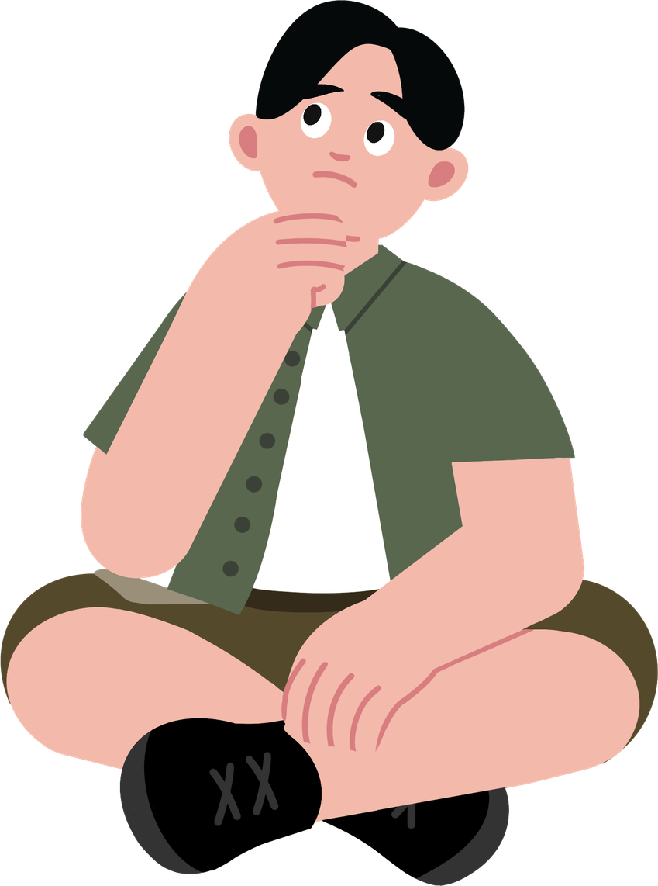
What is mental health?
Mental health affects how you think, how you feel and how you relate to others.
It is just as important as physical health. During adolescence it is normal to experience stress, fear, pressure or frustration.
What does being mentally healthy mean to you?

Slide 8
Let's talk about how we feel.
Common emotions:
Taking care of yourself is not weakness:
01
Stress
01
Sleeping well
02
Guilt
02
Setting boundaries
03
Fear / worry
03
Talking to someone
04
Fear of rejection
04
Switching off / disconnecting

Slide 9
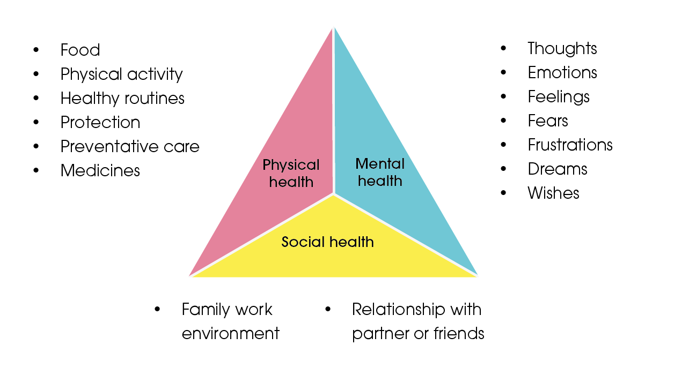
Let's talk about how we feel.
What do you do when you feel overwhelmed?

Slide 10
Let's talk about how we feel.
What do you do when you feel overwhelmed?
  I listen to music to relax.
  I talk to a trusted person about what I am going through.
  I go for a walk or get some fresh air.
  I play video games or do something I enjoy.
  I do sport to release tension.
  I write my emotions in a notebook.
  I breathe deeply and try to calm down.
  I talk to my family (a parent, sibling or relative).
  I draw or listen to music to distract myself.
  I take some time to reflect.

Slide 11
Activity 1.2
The wellbeing tree

Slide 12
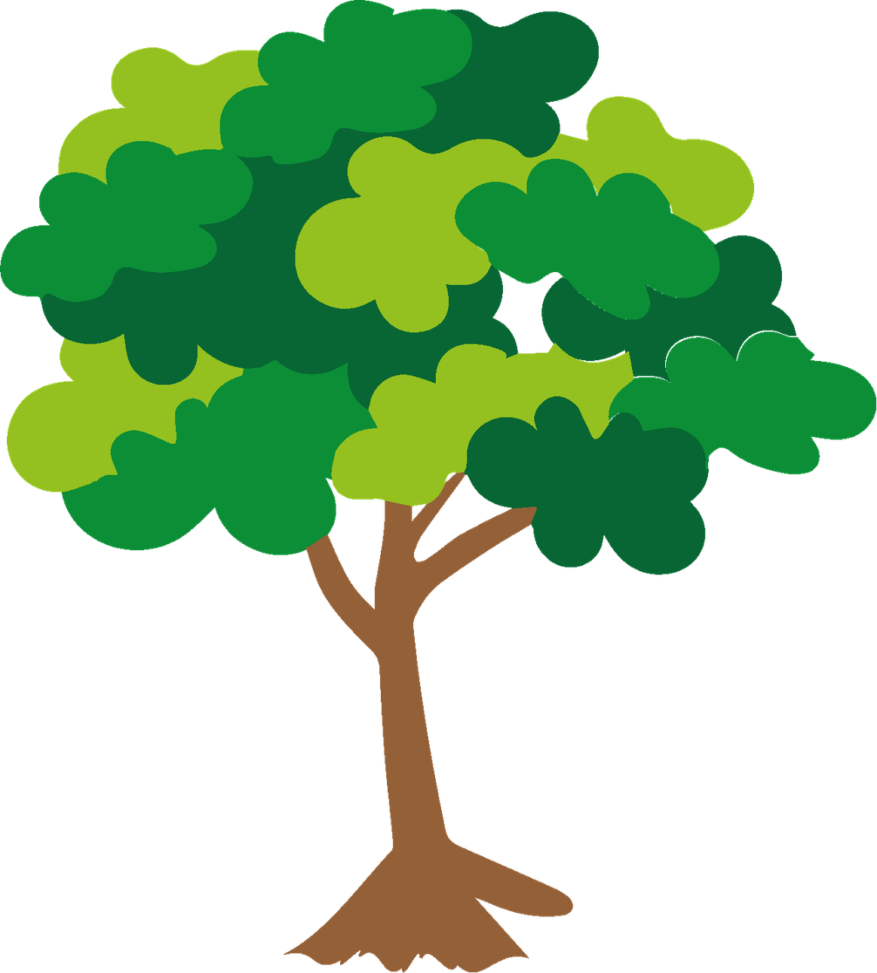
Materials
  Large sheet or blackboard to draw the tree.
  Leaf-shaped paper cutouts (or post-its).
  Markers, colours.
What will we do?
  Create a wellbeing tree with ideas and actions that help us feel better, when we are sad, anxious or worried.

Slide 13
Just as a tree needs water and sunlight to grow, we also need care to be well.
Listening to music
Which actions work best for your wellbeing?
Breathing deeply
Asking for help
What can you do today to take a little better care of yourself?
Doing sport
Talking to a trusted person
Drawing
This tree reminds us that we can support each other and take care of one another.

Slide 14
Activity 1.3
My support circle

Slide 15
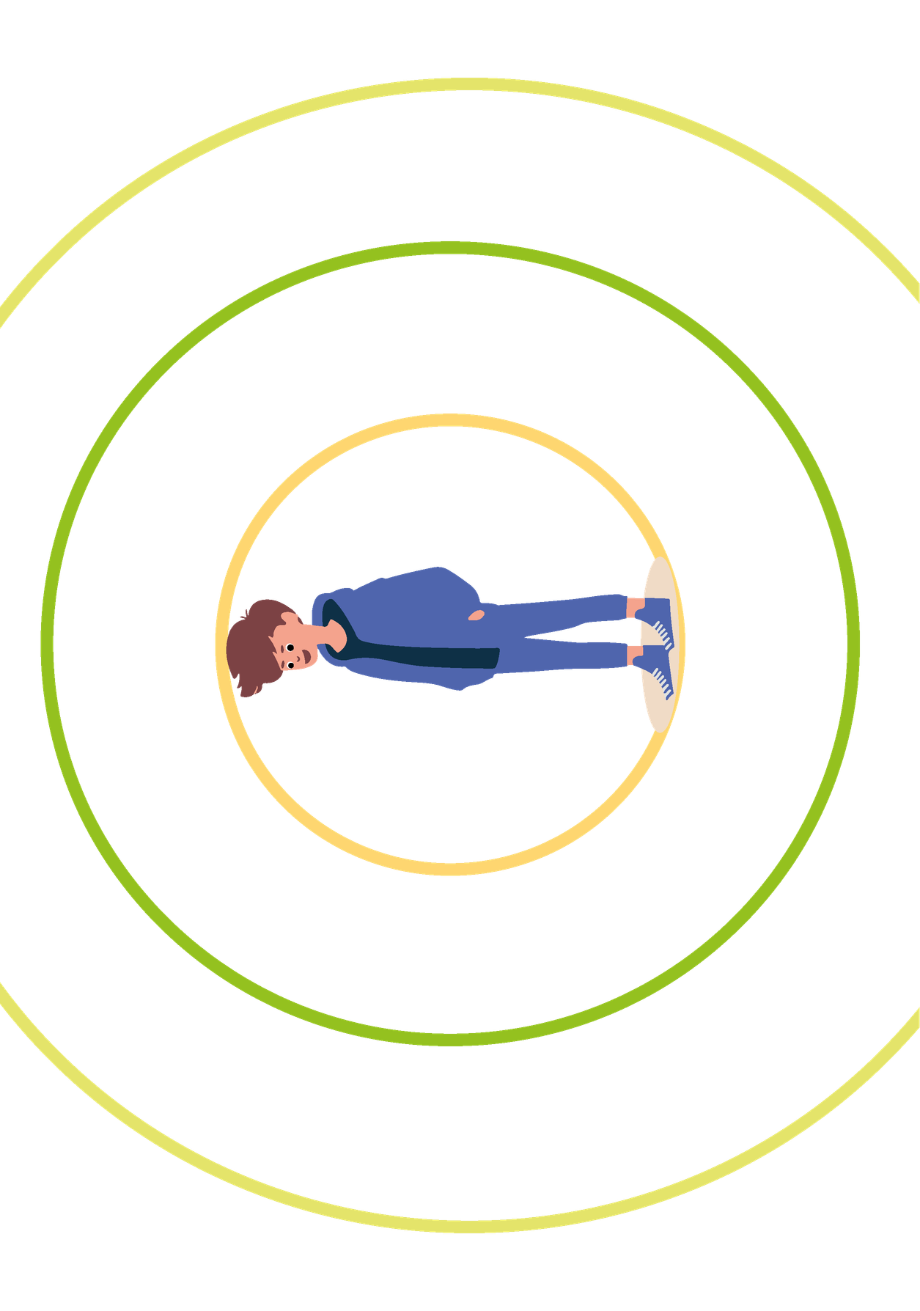
Materials
  Concentric circles template for each student.
  Markers or pens.
What will we do?
  Identify the people in your life who are part of your emotional support network and reflect on the importance of these relationships.

Slide 16
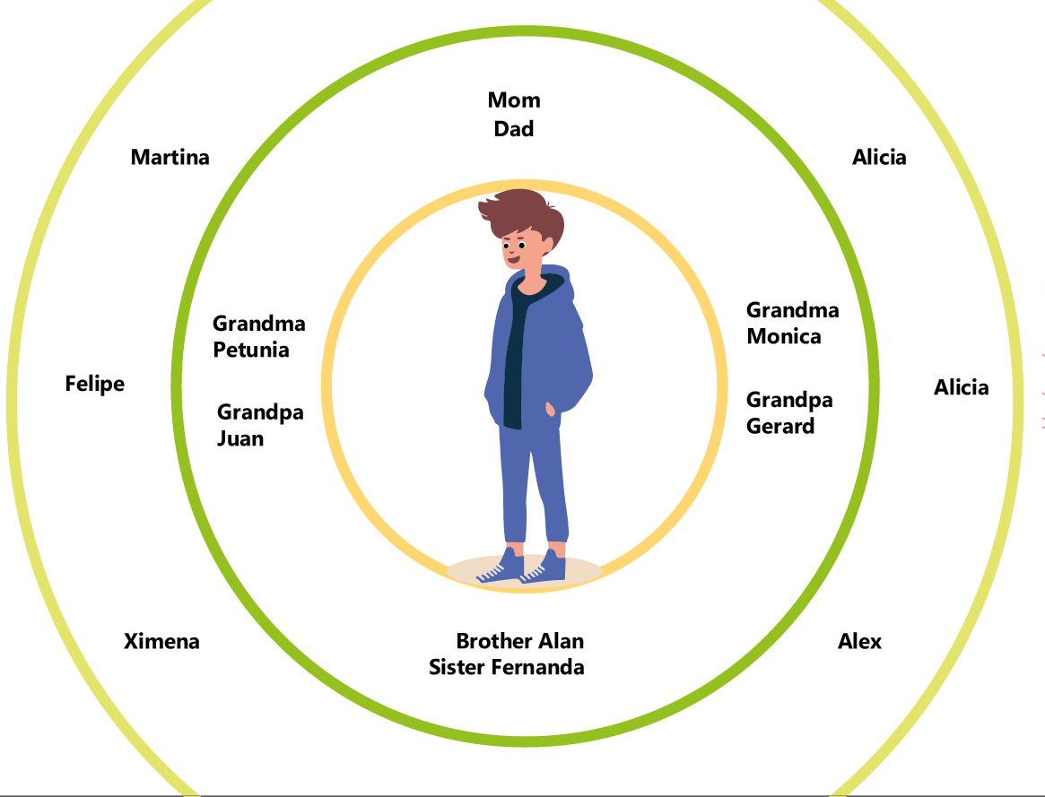
We all have people we can turn to when we need help, want to talk or need to express ourselves.
This group is our support circle.
Who helps you when you are stressed or going through a difficult time?
At the centre is you.
The circles around represent the people who support you: family, friends, teachers, coaches and mentors.

Slide 17
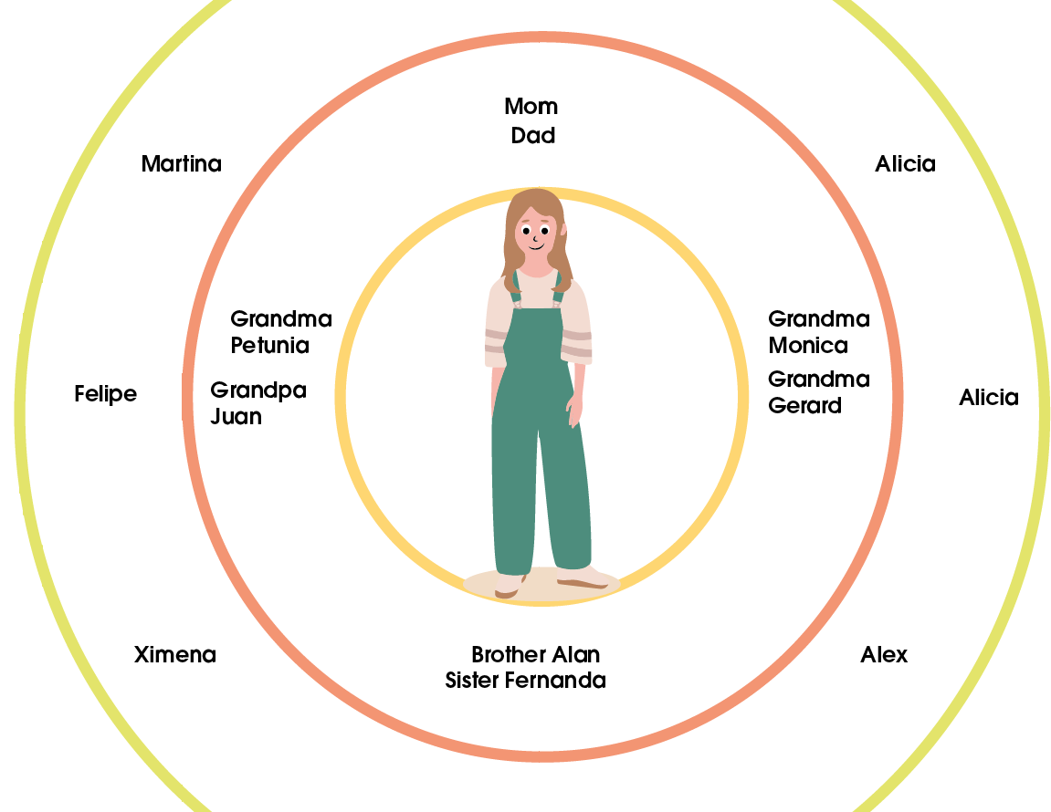
Who is in your circle?
Write in each circle the names of people who offer you:
  Emotional support
  Advice
  A listening ear
  Safety
  Company
Who truly supports you?
Who do you turn to when you have a problem?
How can you also be a support for others?

Slide 18
Additional Activities
Activity 2.1
Emotional Toolbox

Slide 19
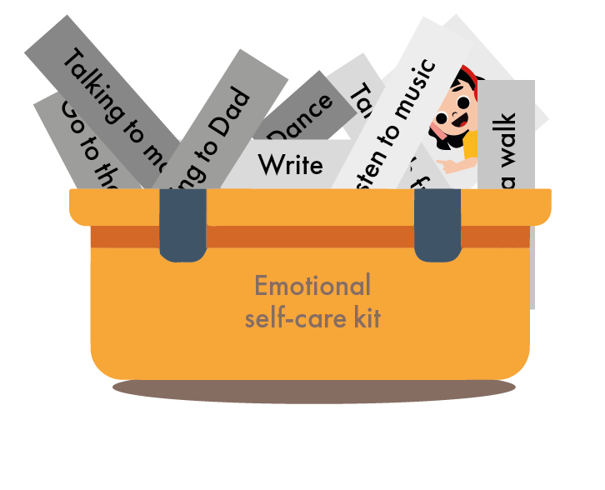
Materials
  A box or envelopes for the personal set.
  Cards or small sheets.
  Markers, highlighters and colours.
  Optional materials for personalisation (stickers, ribbon, etc.).
What will we do?
  Identify practical tools and collect them in a way that helps manage emotions and promote emotional wellbeing.

Slide 20
Just as we use tools to fix things, we also have tools to manage our emotions.
What do you do when you are stressed, overwhelmed or after an argument?
Each person receives a card to write or draw a strategy that helps them calm down:
  Listening to music
  Doing sport
  Talking to someone
  Disconnecting from social media
  Writing or drawing
  Going for a walk

Slide 21
Which tool will you use next time you are not feeling well?
Remember: asking for help and taking care of yourself is part of self-care.

Slide 22
Activity 2.2
What kind of tree are you?

Slide 23
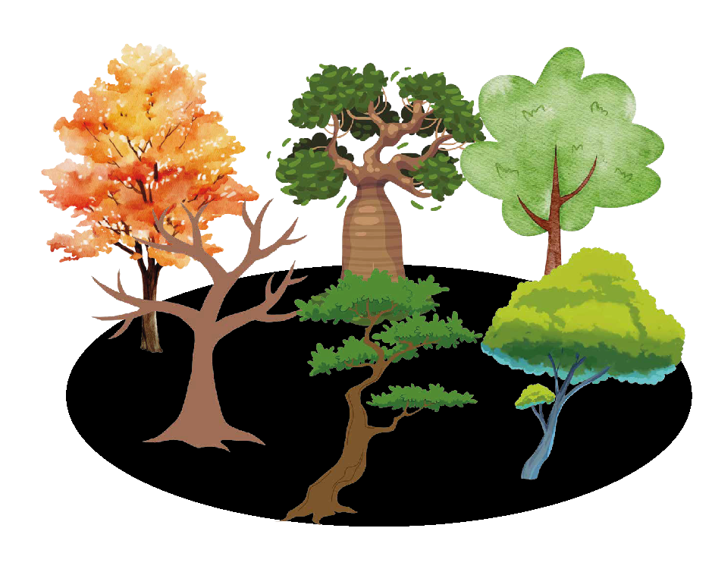
Materials
  Images of trees
  White sheets
  Pencils and markers
What will we do?
  We will discover what kind of tree you are today and what this tree says about your emotions, your values and yourself.

Slide 24
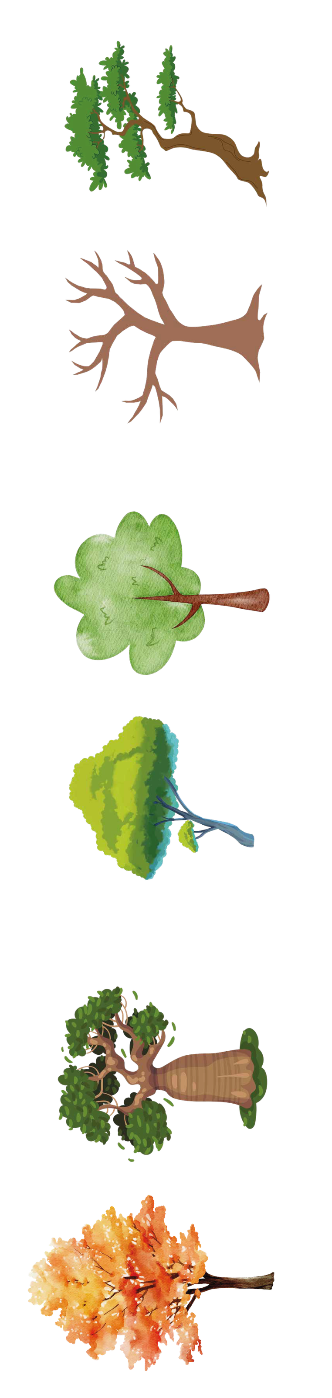
Choose your tree
Every tree has a different shape, strength and rhythm.
Just like people.
Look at the images of different trees and choose the one that:
  You like the most.
  Represents you.
  Looks like how you feel today.
There are no right or wrong answers. It is your choice.
Which part of the tree represents how you feel right now?
Why this part? What does it mean to you?
What strengths does your tree reflect?

Slide 25
Which part of the tree represents how you feel right now?
“My tree represents me because…”
When I feel sad or insecure, I remind myself of my qualities and the things that make me special, like my family, my friends and the things I care about, which make me feel good.
Why this part? What does it mean to you?
What strengths does your tree reflect?

Slide 26


