Slide 1
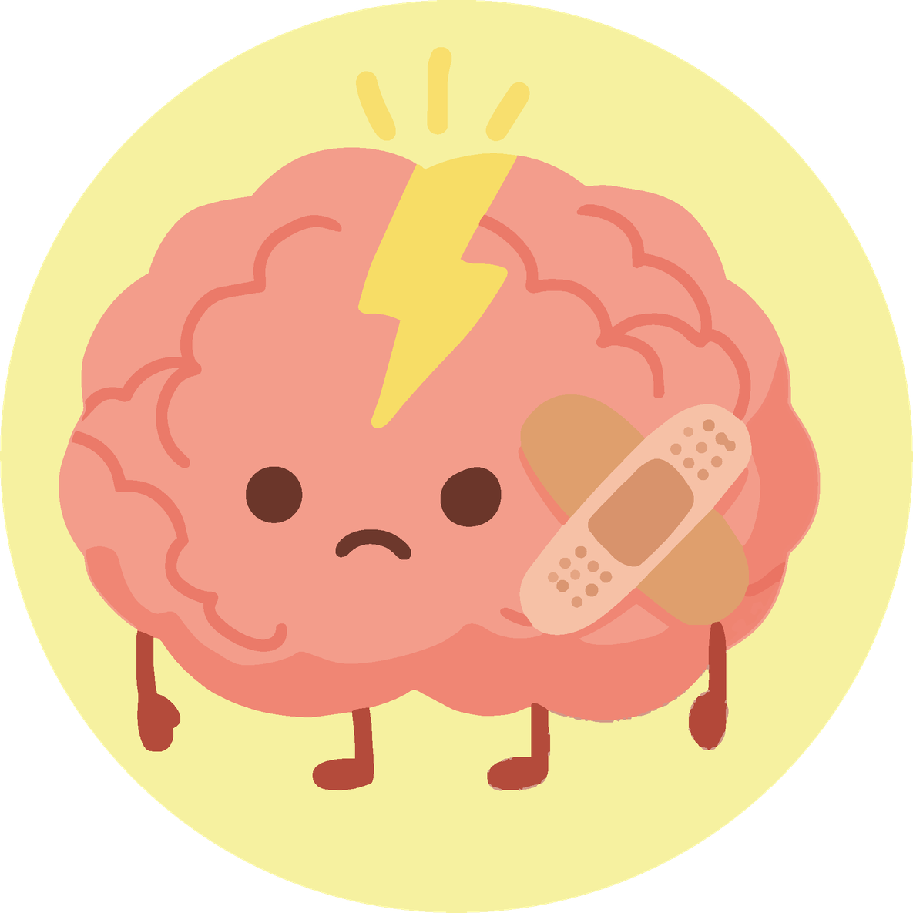

Module 4
Mental Health
Understanding our emotions and learning to take care of ourselves
Activities for primary school

Slide 2
Why do we talk about mental health?
How we feel influences:
01
How we think
02
How we act
03
Our concentration and learning
04
How we relate to other people
Everyone has good days and difficult days. Talking about this helps us understand each other better.

Slide 3
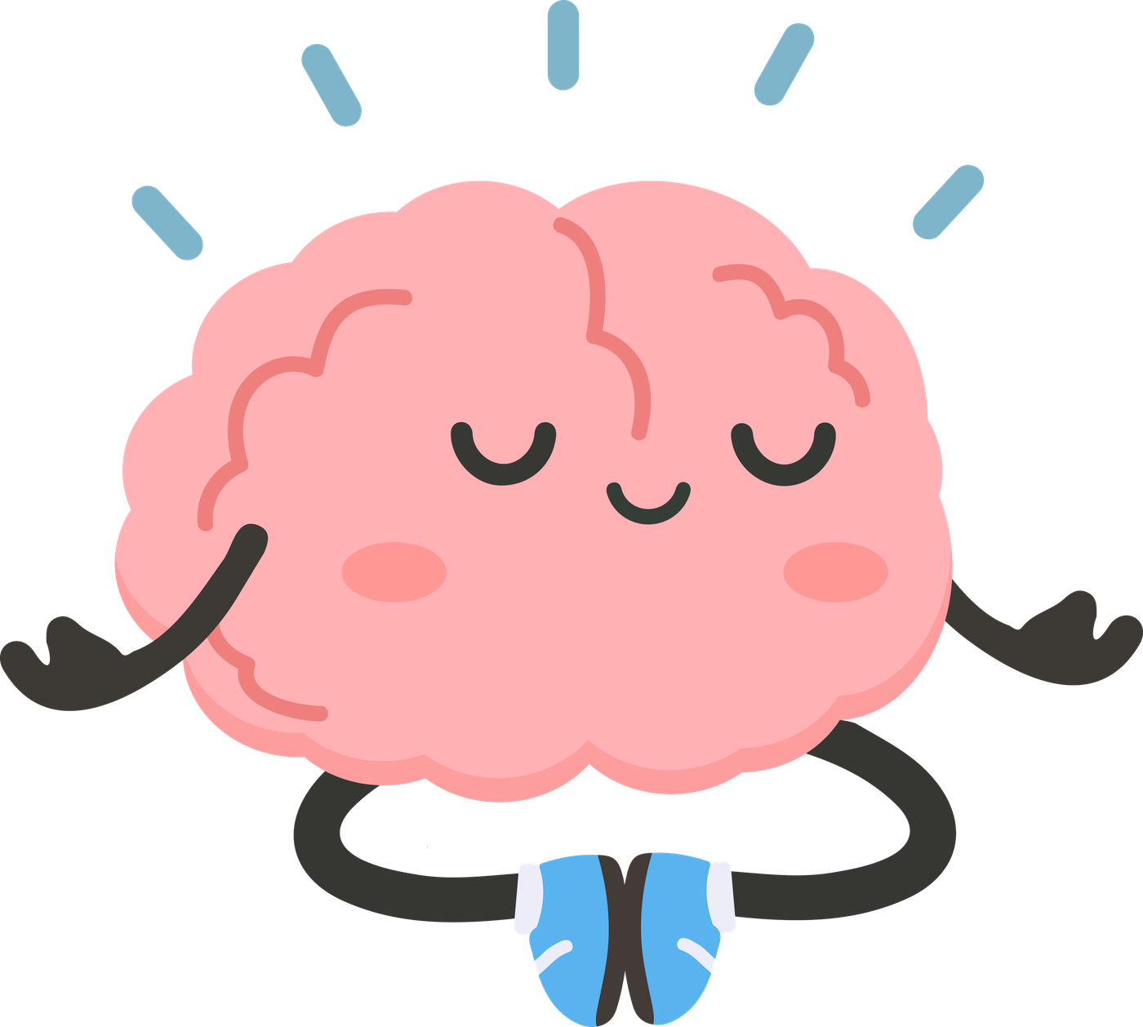
What is mental health?
How we feel influences:
01
How we think
02
How we act
03
Our concentration and learning
04
How we relate to other people
It doesn't mean “always being happy”. It means knowing what we need and how to ask for help.

Slide 4
Today we will...
01
Understand what mental health is.
02
Learn the difference between “feeling stressed” and a mental health problem.
03
Recognize the body's signals, emotions and thoughts.
04
Learn exercises to calm down and feel better.
05
Get to know our “emotion reservoir” and understand how we can fill it.
06
Discover who can help us.
07
Promote self-care and empathy in the group.

Slide 5
Before we start, remember:
We respect everyone.
Everyone participates as they can.
We only share what we want.
There are no right or wrong answers.
We talk about general situations, not personal things.
What matters:
We want this to be a safe, calm and welcoming space for everyone.

Slide 6
Day 1.
Activity 1.1
What is mental health?

Slide 7
Materials
  Blackboard or screen
What will we do?
• We will reflect together on mental health.

Slide 8
What does mental health mean to you?
Does it affect the way
you think or feel?
Is it only about problems?
All people have mental health, and we must take care of it.

Slide 9
Activity 1.2
What influences my mental health?

Slide 10
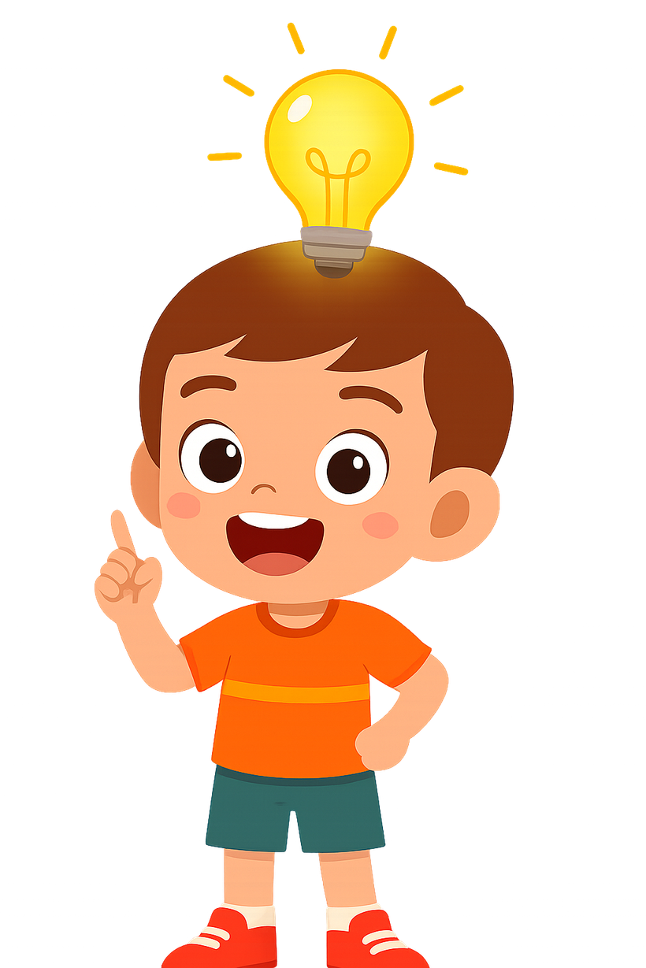
Materials
  Blackboard
  Markers
  (optional) post-its
What will we do?
  Identify things that support our wellbeing and things that make it harder.

Slide 11
Support factors
Factors that make it harder
  School stress
  Too much screen time
  Conflicts with friends
  Bullying or exclusion
  Lack of sleep
  Feeling lonely
  Performance pressure
  Family conflicts
  Getting enough sleep
  Friendships and feeling part of a group
  Movement / sport
  Talking to a trusted person (family, teachers, friends)
  Time outdoors / in nature
Mental health depends on many factors, not just one.

Slide 12
Activity 1.3
Factors that influence mental health

Slide 13
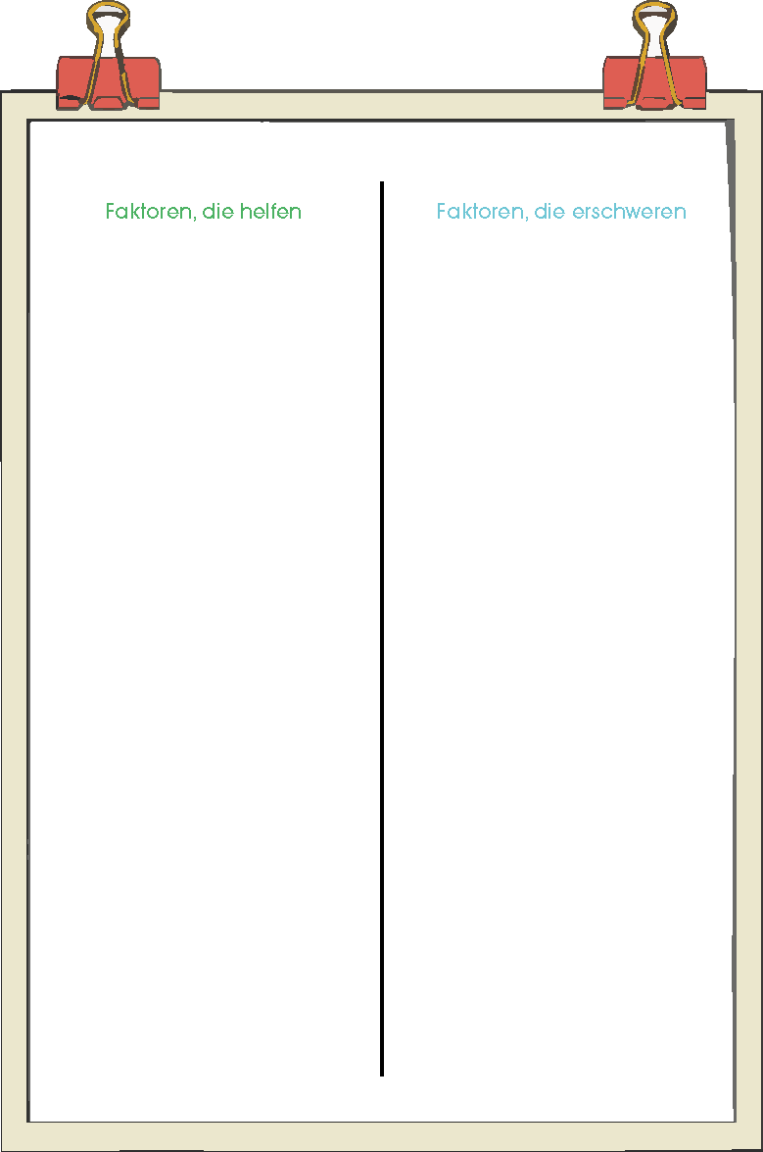
Materials
  Cardstock
  Colors / colored pencils
  Tables in groups
  Getting enough sleep
  Friendships and feeling part of a group
  Movement / sport
  Talking to a trusted person (family, teachers, friends)
  Time outdoors / in nature
  School stress
  Too much screen time
  Conflicts with friends
  Bullying or exclusion
  Lack of sleep
  Feeling lonely
  Performance pressure
  Family conflicts
What will we do?
  We will create in groups a poster about mental health.
We're not looking for a “beautiful” poster, just clear ideas.

Slide 14
Activity 1.4
End of Day 1

Slide 15
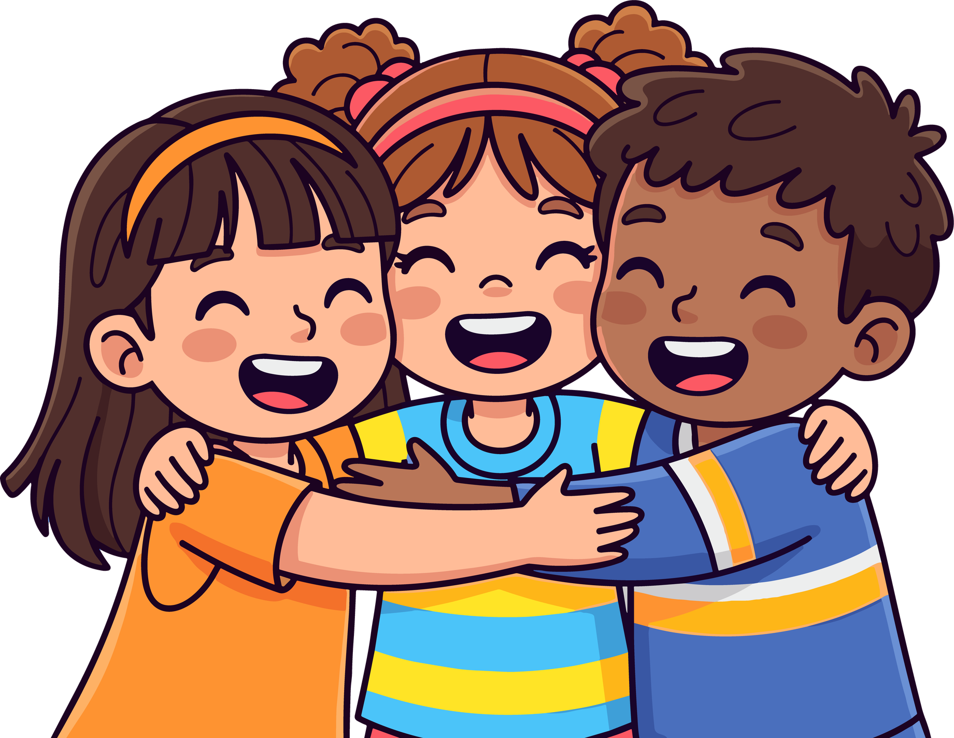
What important idea are you taking away today about mental health?
Taking care of the mind is as important as taking care of the body.

Slide 16
Day 2.
Activity 2.1
How do I feel?

Slide 17
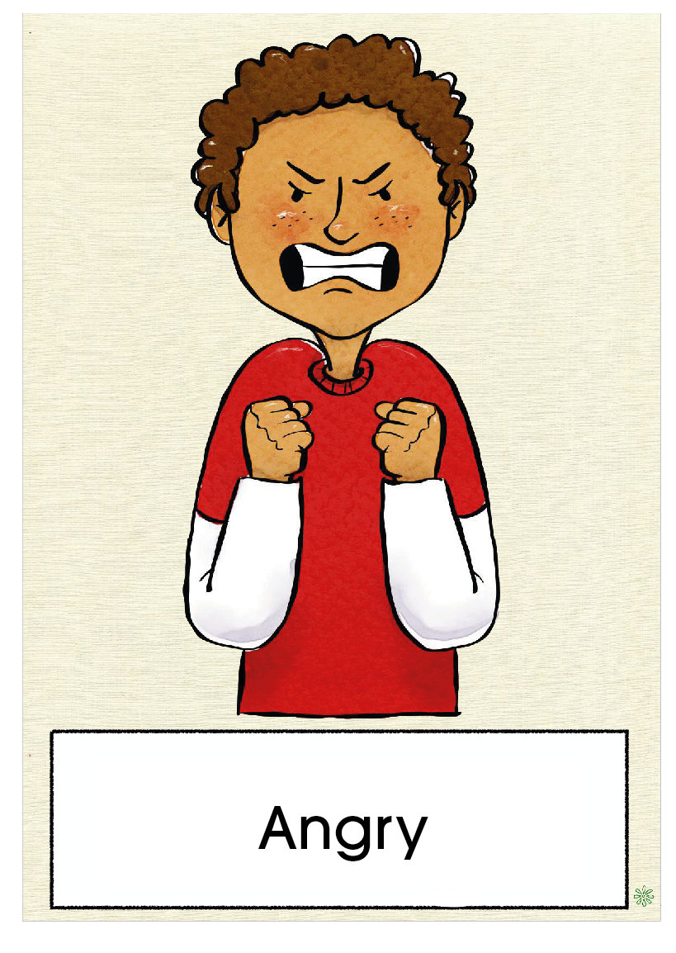
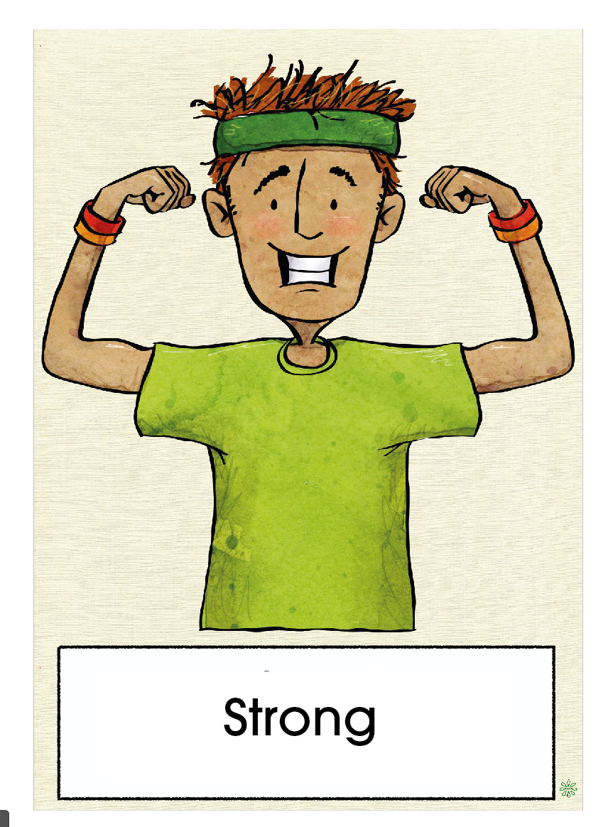
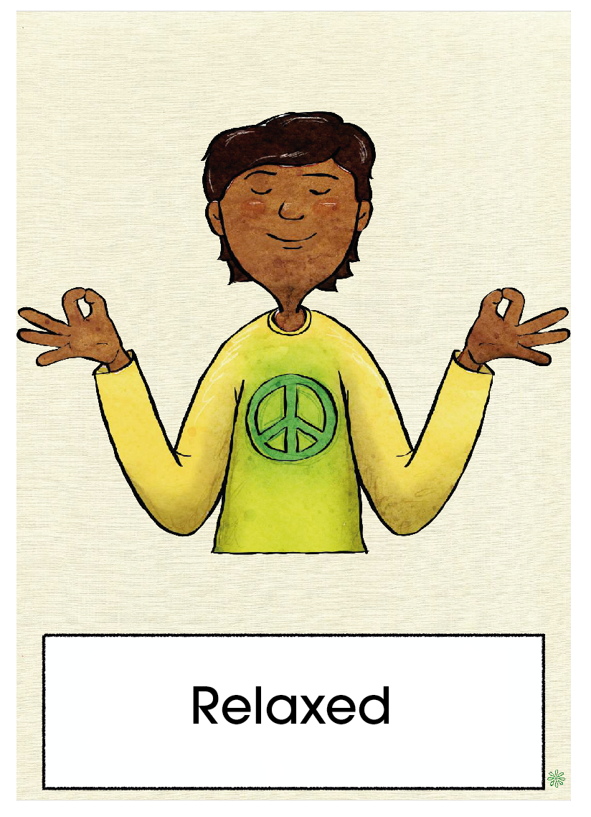
Materials
  Emotion cards (optional, highly recommended)
  Meditation text A2.1
  Chairs in a circle
What will we do?
  We will reflect on how we feel.
  We will use our emotions as a compass.
  We will do a brief meditation.
Remember that all emotions are normal

Slide 18
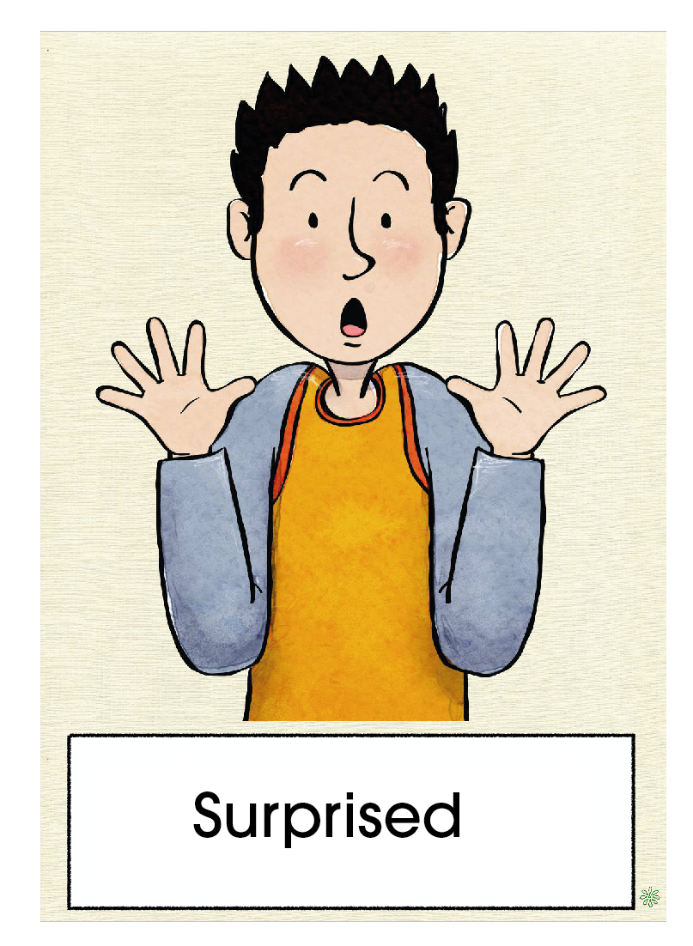
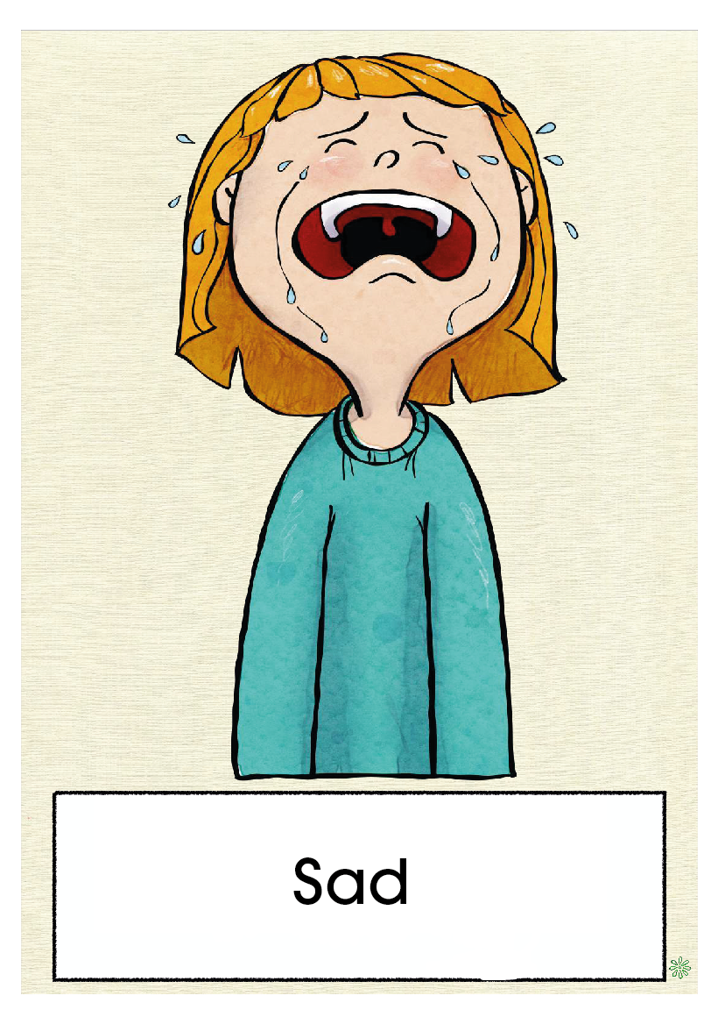

Slide 19
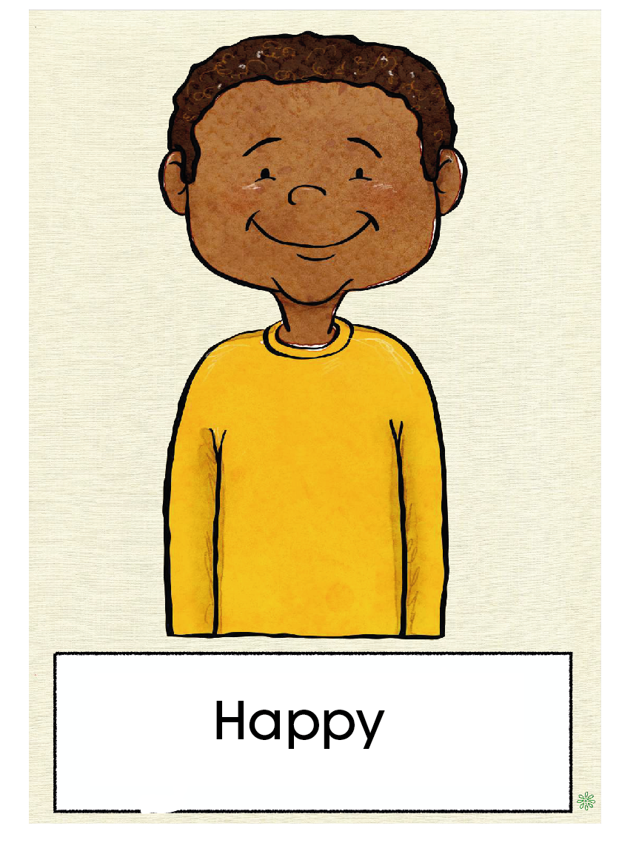

Slide 20
Activity 2.2
How might other people be feeling?

Slide 21
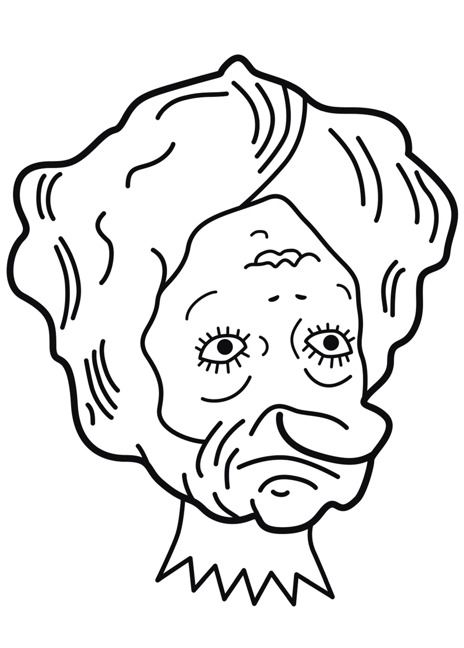
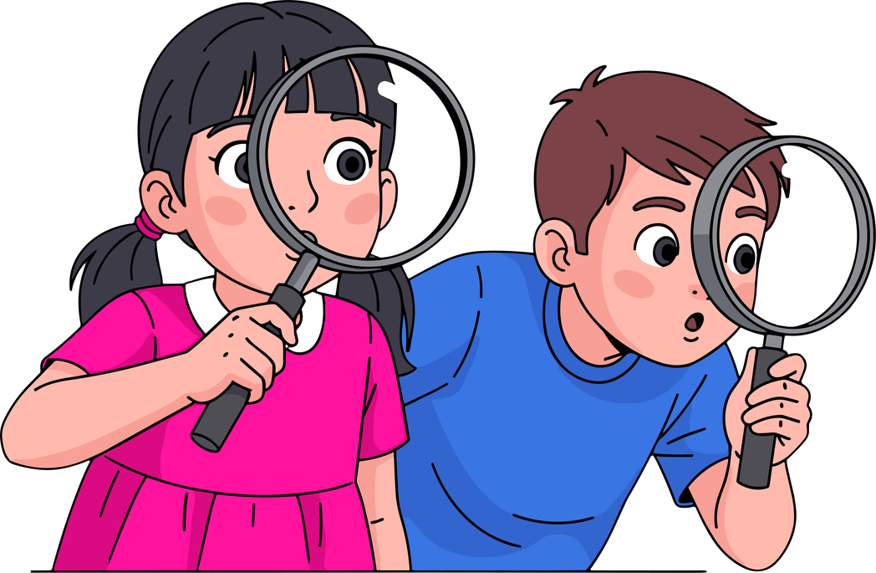
Materials
Drawing A2.2
What will we do?
  We will observe a drawing and try to interpret how the figure feels.

Slide 22
What do you see in the drawing?
Do we always know how other people are doing?
Do we sometimes get it wrong?
Reflecting with respect is also a form of care.

Slide 23
Activity 2.3
Why do I sometimes feel bad?

Slide 24
Reflection
Share with a classmate
Share in the group
Reflect in silence
  “I felt bad when I argued with a friend and said things I didn’t mean.”
  “I felt sad and needed some company.”
  “I was nervous and needed someone to calm me down.”
  “Sometimes we feel sad and need to talk with someone.”
  “When we feel bad, we sometimes need help from adults.”
  “Many people have said that experiencing these feelings is part of life.”
When was the last time you felt bad?
What did you need in that moment?

Slide 25
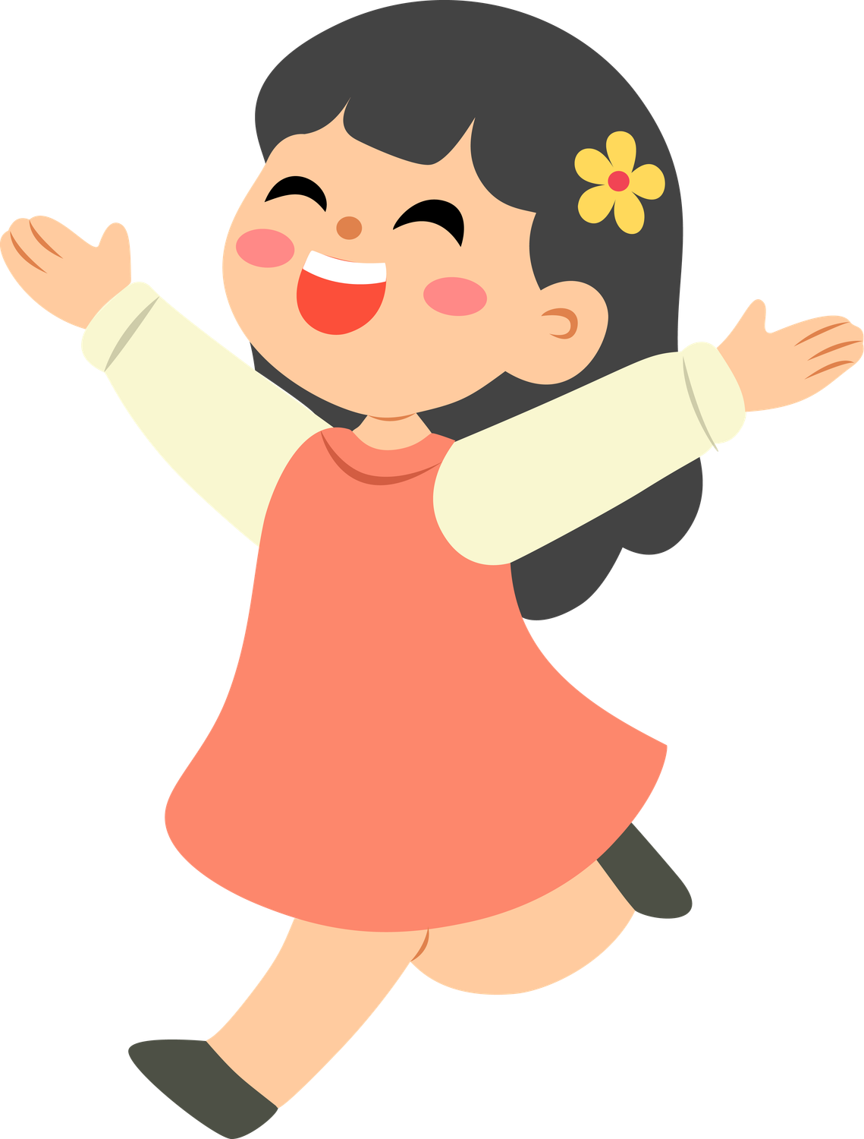
Feeling bad is normal. Knowing what we need helps us.
When was the last time you felt bad?
What did you need in that moment?

Slide 26
Day 3.
Activity 3.1
Who can help me?

Slide 27
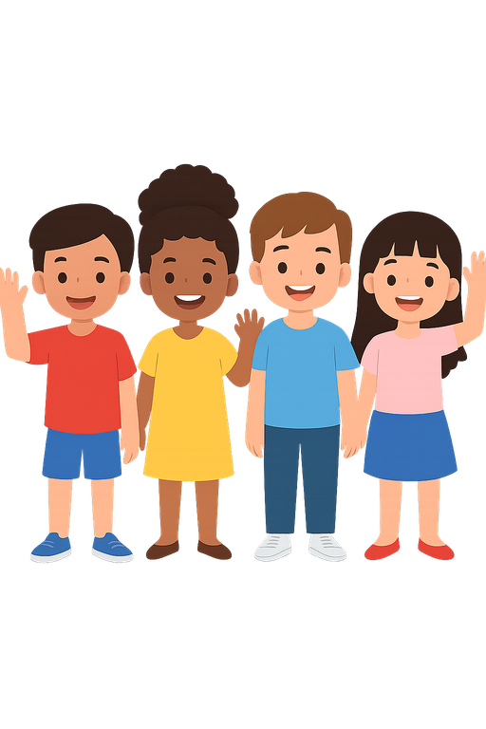
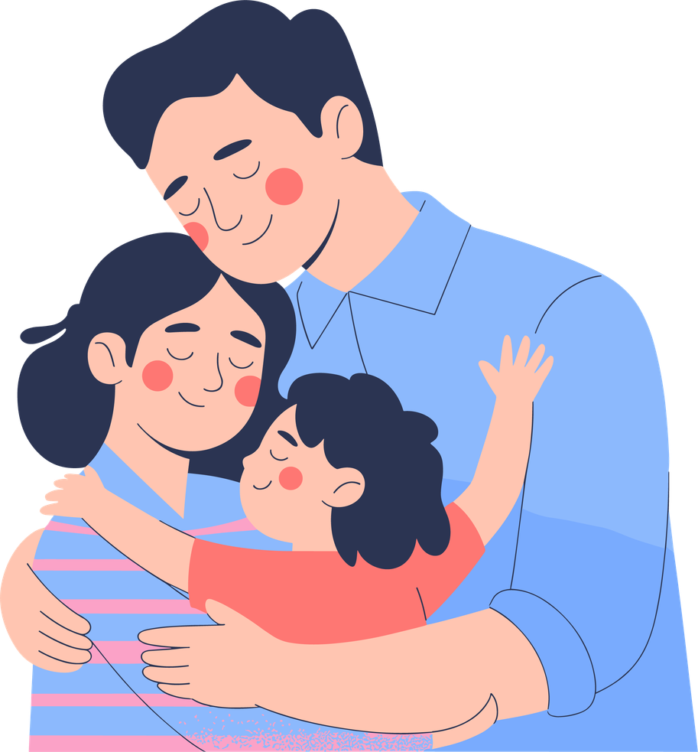
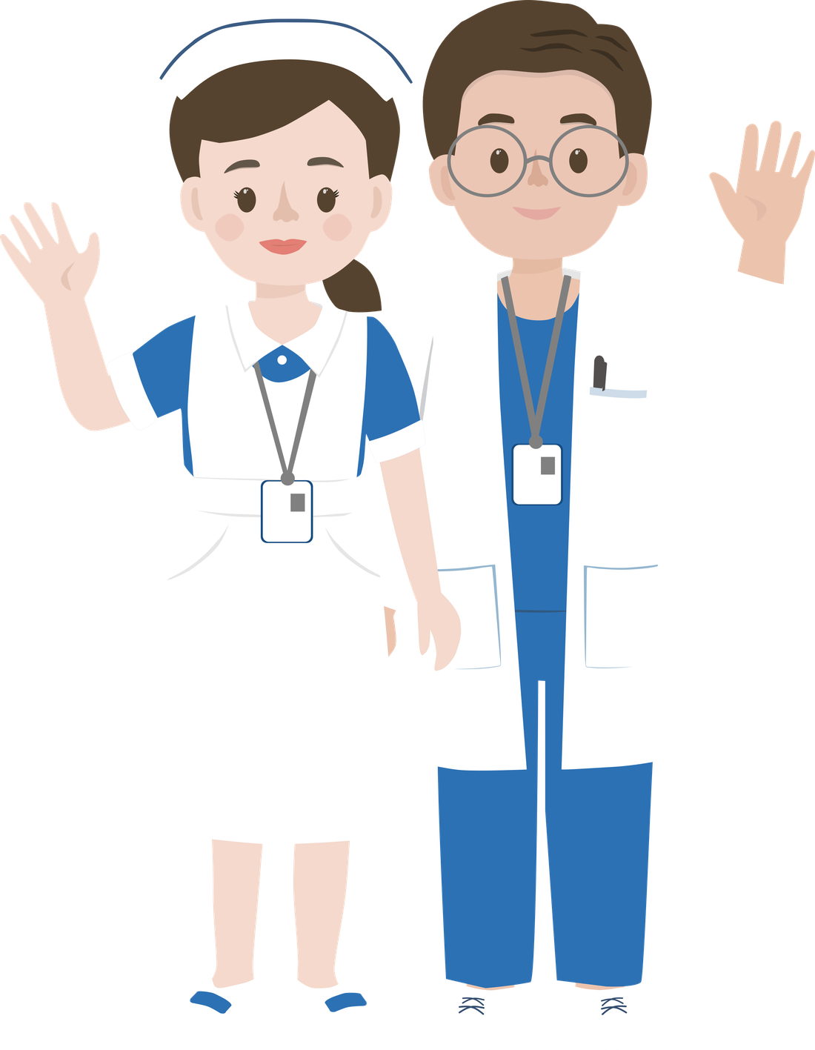
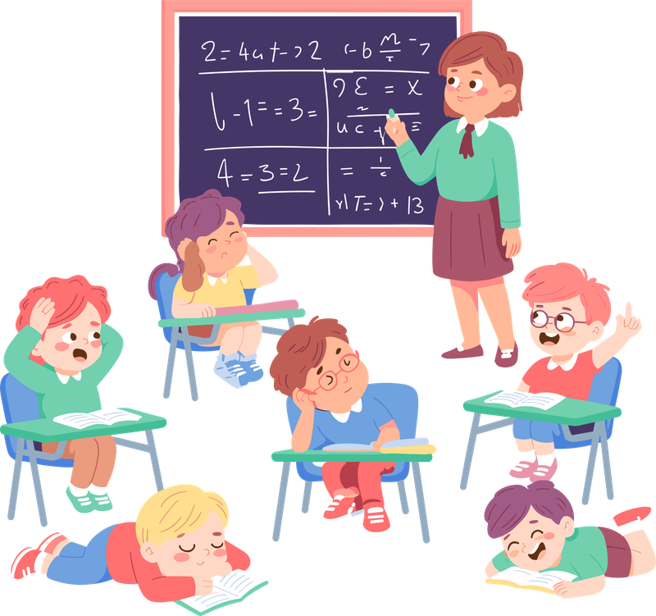
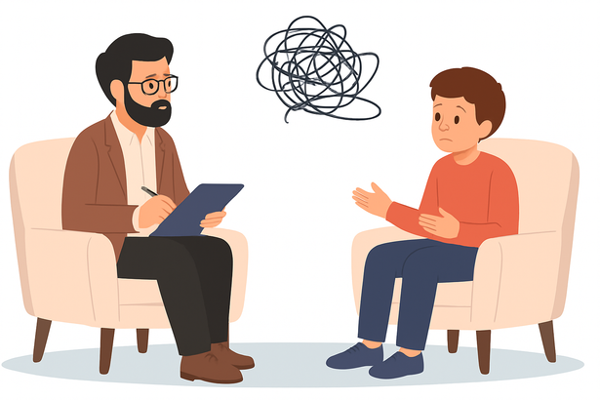
Let's reflect on who helps us.
Who helps when the body hurts?
There are many types of help and all are valid.

Slide 28
Activity 3.2
My support network

Slide 29
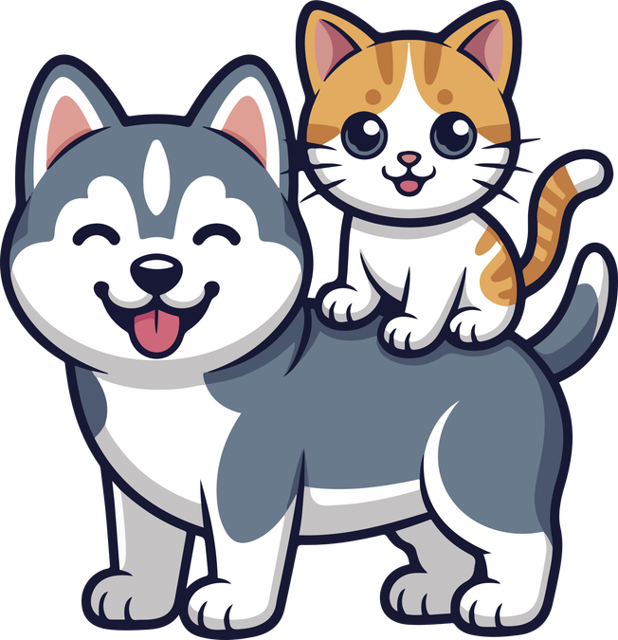
We will create cards to help us remember.
Who helps when the body hurts?
Remember: everyone has a different network and it is completely normal.

Slide 30
Activity 3.3
How do we help someone who is not doing well?

Slide 31
Let's reflect together on how to support someone with respect.
When can a trusted person help?
When is it better to inform an adult?
What does not help?
01
What can I do if I see that someone feels lonely?
02
How can I support someone when they feel scared or worried?
03
How can I help someone who is afraid of making a mistake?
Remember: a child can support someone, but cannot solve all problems.

Slide 32
Activity 3.4
Role play – Let’s practise helping

Slide 33
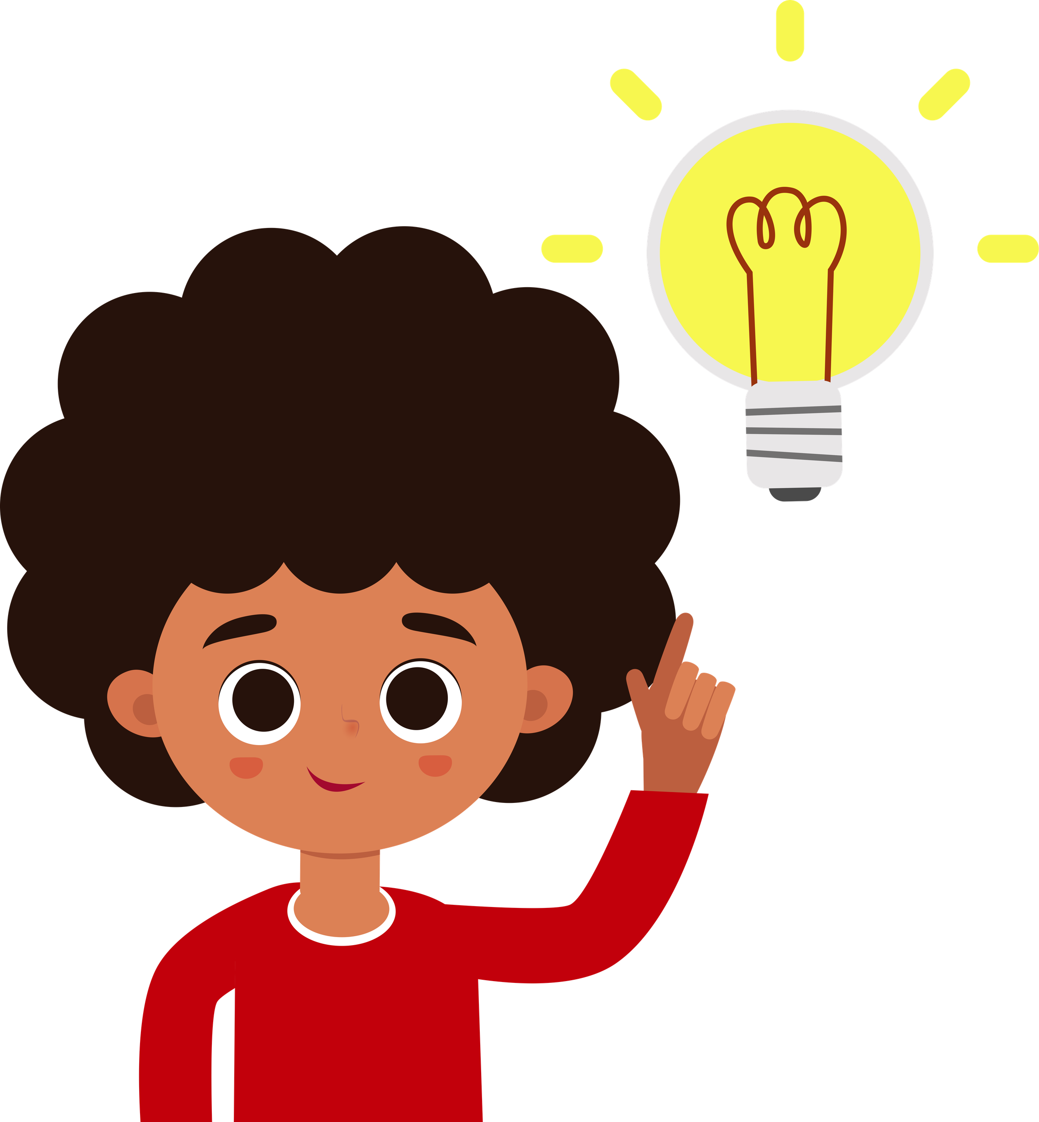
We will act out and develop real helping situations.
Someone is crying after the break. How can you help?
A child gets angry and walks away from the group. What would you do?
Two friends argue and both feel hurt. What do you do to help them resolve the conflict?
Helping means listening and, if necessary, asking an adult for help.

Slide 34
We will act out and develop real helping situations.
Two friends argue and both feel hurt. What do you do to help them resolve the conflict?
Someone is crying after the break. How can you help?
A child gets angry and walks away from the group. What would you do?
Helping means listening and, if necessary, asking an adult for help.

Slide 35
We will act out and develop real helping situations.
A child gets angry and walks away from the group. What would you do?
Two friends argue and both feel hurt. What do you do to help them resolve the conflict?
Someone is crying after the break. How can you help?
Helping means listening and, if necessary, asking an adult for help.

Slide 36
Remember
01
Everyone has mental health
02
Asking for help means taking care of yourself
03
We are not alone
Your wellbeing matters. Talking about it is also a form of self-care.

Slide 37


