Slide 1
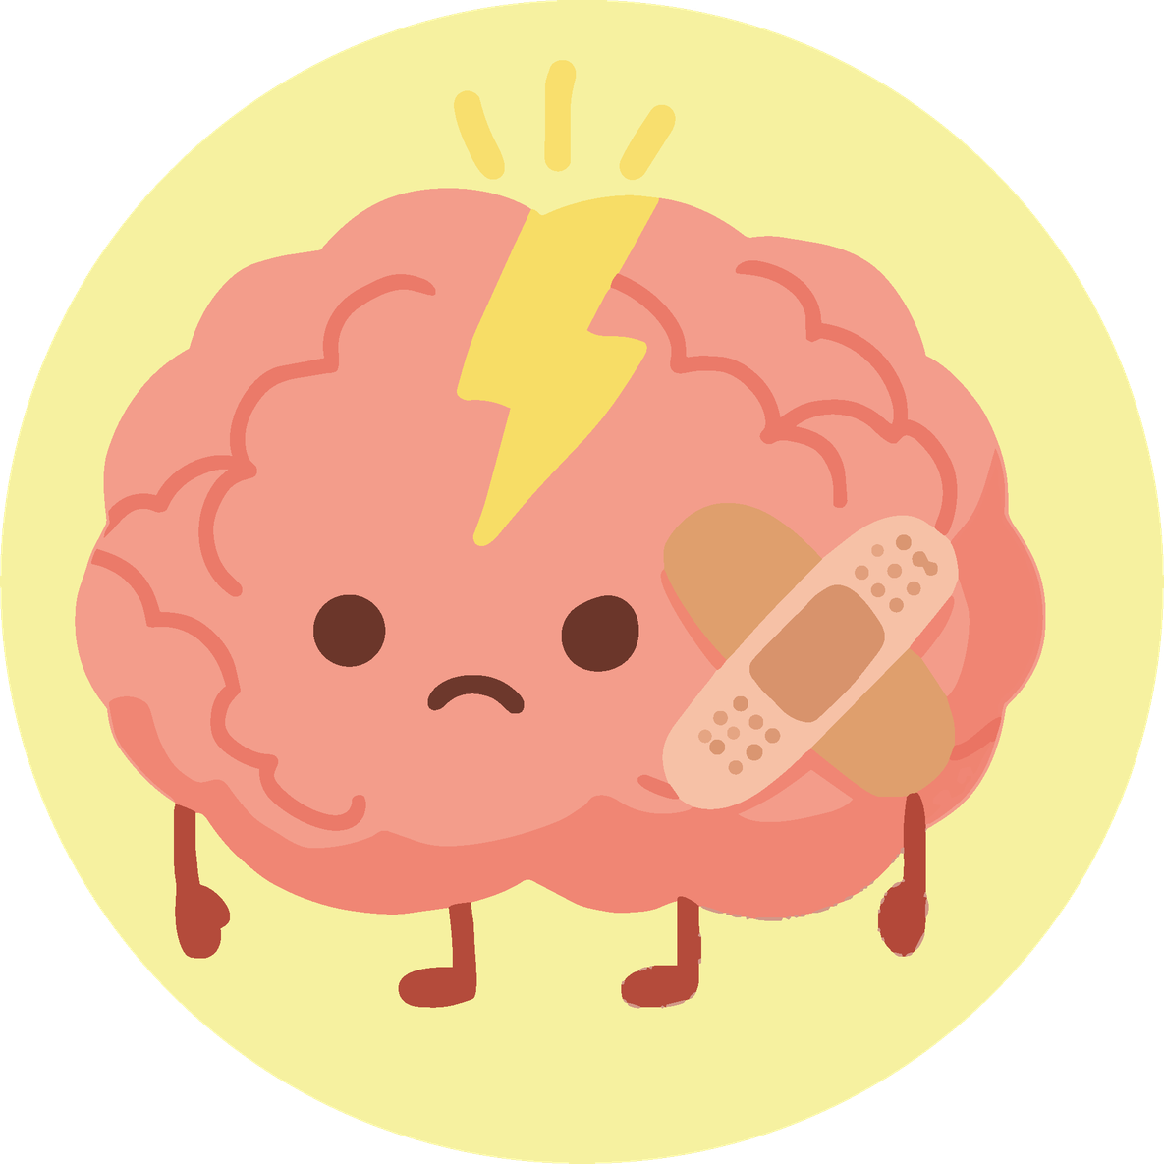

Module 4
Mental Health
Understanding what we feel and learning to take care of ourselves
Activities for secondary school

Slide 2
Why do we talk about mental health?
We will explore:
01
What mental health means
02
How our thoughts and emotions influence our well-being
03
What we can do when we feel overwhelmed
04
How to take care of ourselves and others
05
Who can help us and when
Mental health is something that all people have and that we can take care of.

Slide 3
Why do we talk about mental health?
Because it influences how we feel inside:
01
How we think
02
How we act
03
How we learn
04
How we relate to other people
All people have difficult days, and that's normal. Learning tools helps us feel more confident and more self-assured.

Slide 4
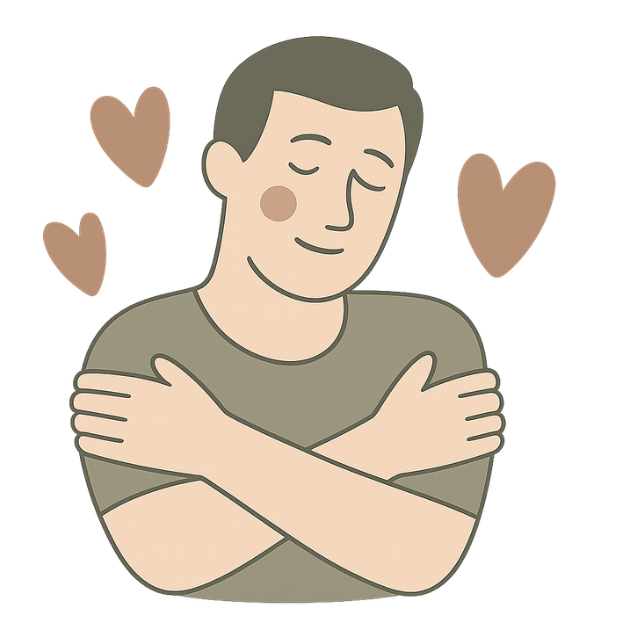
It's not about "always being happy". It's about understanding what happens inside us and what helps us feel better.
Before we begin:
01
We act with respect
02
We share only what we want
03
We talk about general experiences
04
There are no right or wrong answers
05
Everyone participates as they can

Slide 5
Day 1. Introduction to mental health
Activity 1.1
What is mental health? – Introduction

Slide 6

Materials
  Chairs in a circle
What will we do?
  We will start the workshop in a quiet circle and welcome the group.
  We will explain that mental health will be explored in a simple, clear and respectful way.

Slide 7
What does mental health mean to you?
What things influence the way you think or feel?
Is mental health only about problems?
How can it relate to daily life at school (middle/secondary school)?

Slide 8
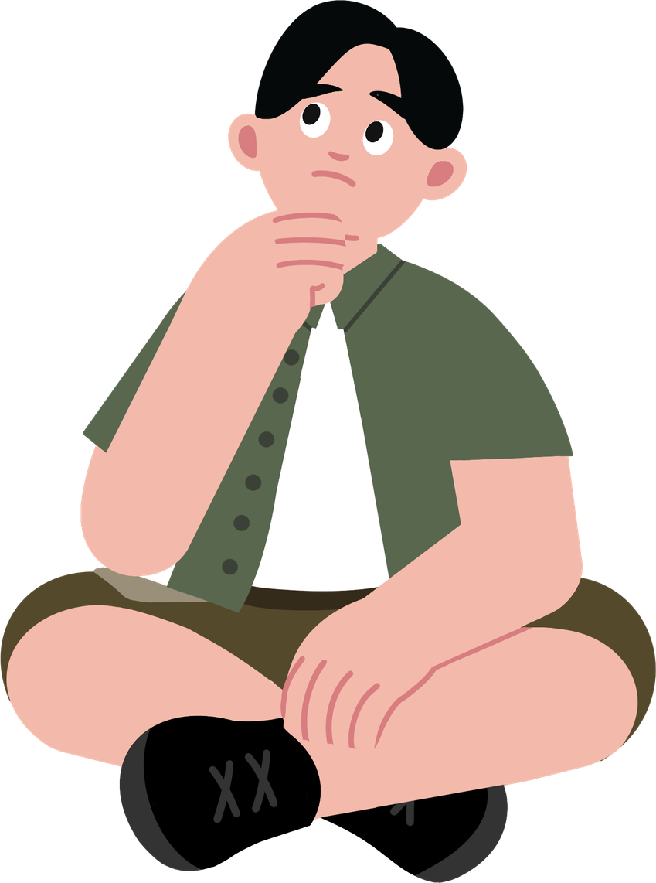
Mental health is part of overall well-being. It influences how we think, how we feel, how we act and how we relate to other people. It's not just about when something goes wrong, but also about managing stress, making healthy decisions and building positive relationships.
Factors that make it harder
Factors that help
  Sleeping little or poorly
  Conflicts at home
  Problems with friends
  Too much homework or school pressure
  Excessive use of social networks
  Comparing oneself with others
  Bullying or exclusion
  Sleeping well
  Physical activity or sport
  Supportive relationships
  Talking to a trusted person (family, teachers, friends)
  Free time (music, drawing, video games with limits, sport)
  Healthy routines
  Feeling part of a group
  Time outdoors
  Learning to ask for help

Slide 9
Activity 1.2
What influences my mental health? – Identifying factors

Slide 10
Deeper exploration of the topic
How or why do they influence mental health?
Factors that make it harder
Factors that help
  Sleeping little or poorly
  Conflicts at home
  Problems with friends
  Too much homework or school pressure
  Excessive use of social networks
  Comparing oneself with others
  Bullying or exclusion
  Sleeping well
  Physical activity or sport
  Supportive relationships
  Talking to a trusted person (family, teachers, friends)
  Hobbies (music, drawing, video games with limits, sport)
  Healthy routines
  Feeling part of a group
  Time outdoors
  Learning to ask for help
Mental health doesn't depend on just one thing, but on a set of elements that we can learn to recognize.

Slide 11
Activity 1.3
Integrating what we have learned about mental health

Slide 12
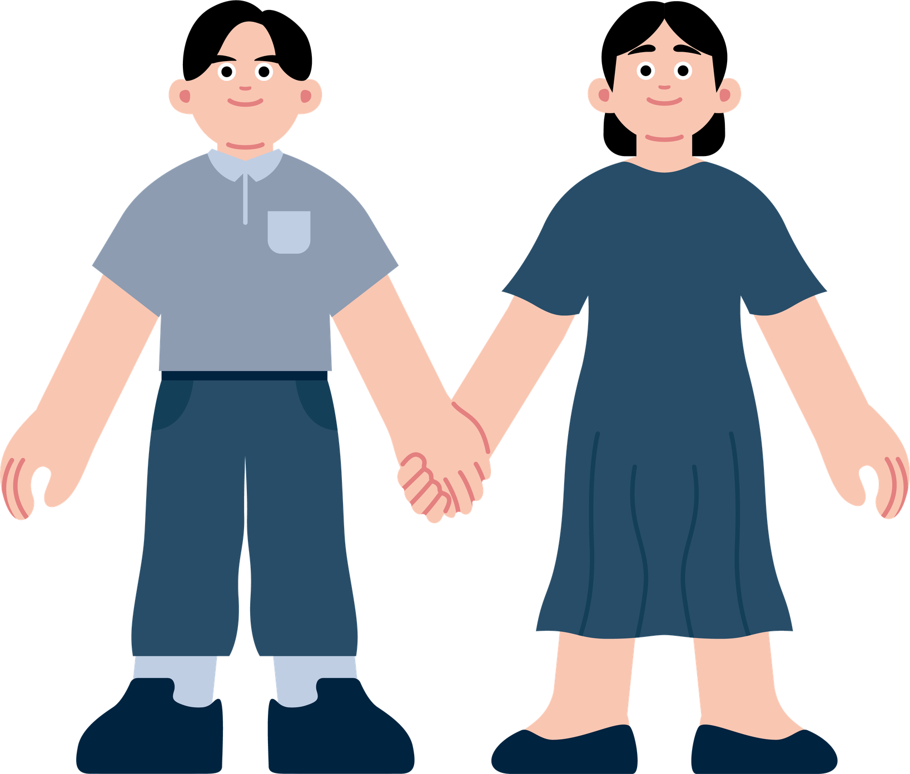
What important thought do you take away on the topic of mental health?
What have you discovered about how mental health influences us?
Is there something you had never thought about before?
Why, in your opinion, is it important to talk about this in secondary school?

Slide 13
Remember...
01
All people have mental health, not only "people with problems".
02
Mental health changes based on our experiences.
03
Talking about these topics is not a sign of weakness, but of care.
04
Taking care of mental health is as important as caring for the body.

Slide 14
Day 2. Self-care and stress management
Activity 2.1
My “well-being tree” – Strategies for self-care and well-being

Slide 15

Materials
  Printed “well-being tree” template
  Pencils, markers, or colors
  Blackboard or screen to show examples
What will we do?
  We will create a tree to identify which habits or things help us take care of ourselves in daily life.

Slide 16

What has helped you this week?
What do you do to recharge your energy?
Who or what supports you when you are stressed?

Slide 17
Leaves: small actions I can take when I am stressed
Branches: activities that nourish me (friends, sport, music...)
Trunk: my strengths (resilience, creativity, humor)
Roots: habits that support me (sleep, eating, routine)
Self-care is an essential part of mental health.

Slide 18
Activity 2.2
Guided reflection – What really helps me feel good?

Slide 19
Materials
  Printed “well-being tree” template
  Pencils, markers, or colors
  Blackboard or screen to show examples
What will we do?
  We will talk together about things we can do to improve our mental health.

Slide 20
Which part of my tree is fullest?
What do I turn to most often when I am stressed?
Which roots (habits) support me the most?
Which leaves (quick actions) really work for me?

Slide 21
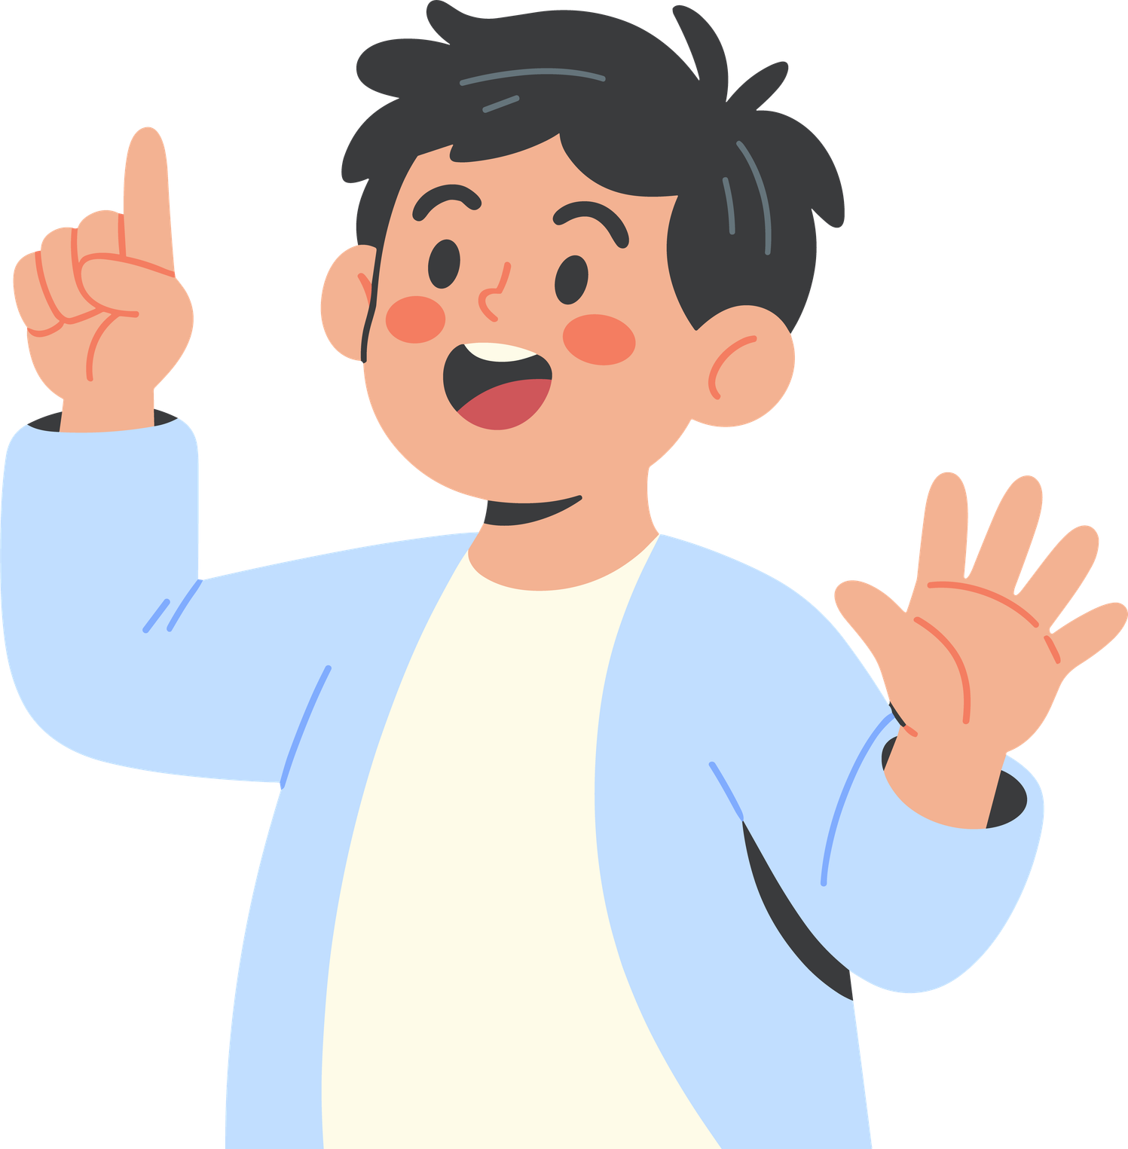
One thing I want to keep doing to take care of myself is...

Slide 22
Day 3. My support network
Activity 3.1
Who can help me? – Discovering my support network

Slide 23
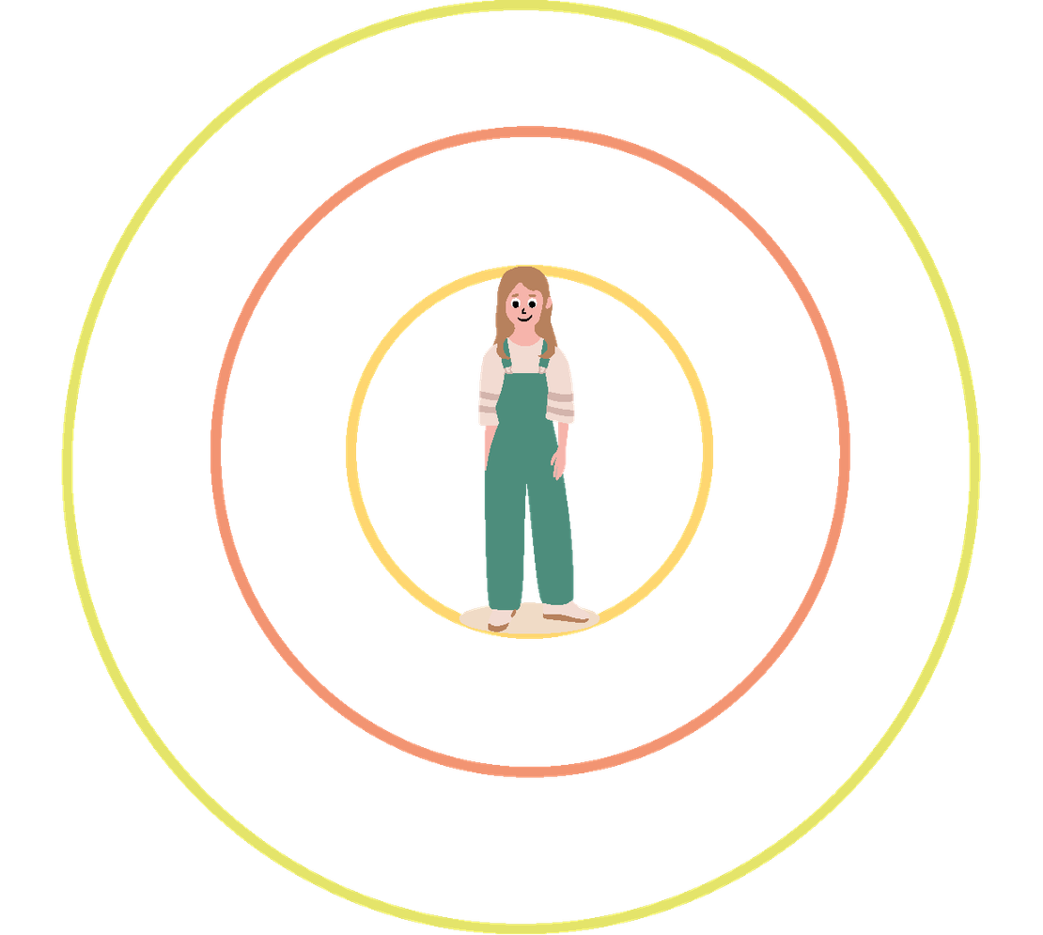
Materials
  Printed “support circle” template, one for each student
  Pencils, markers, or colors
  Flip chart
  Markers
  Chairs in flexible arrangement (circle or work tables)
What will we do?
  Identify people and resources that are part of our emotional support network.

Slide 24
The surrounding circles represent different levels of support:
Who listens to you without judging?
Which adult do you feel comfortable asking for help?
Which professional could help you if you feel very unwell for a longer period of time?

Slide 25
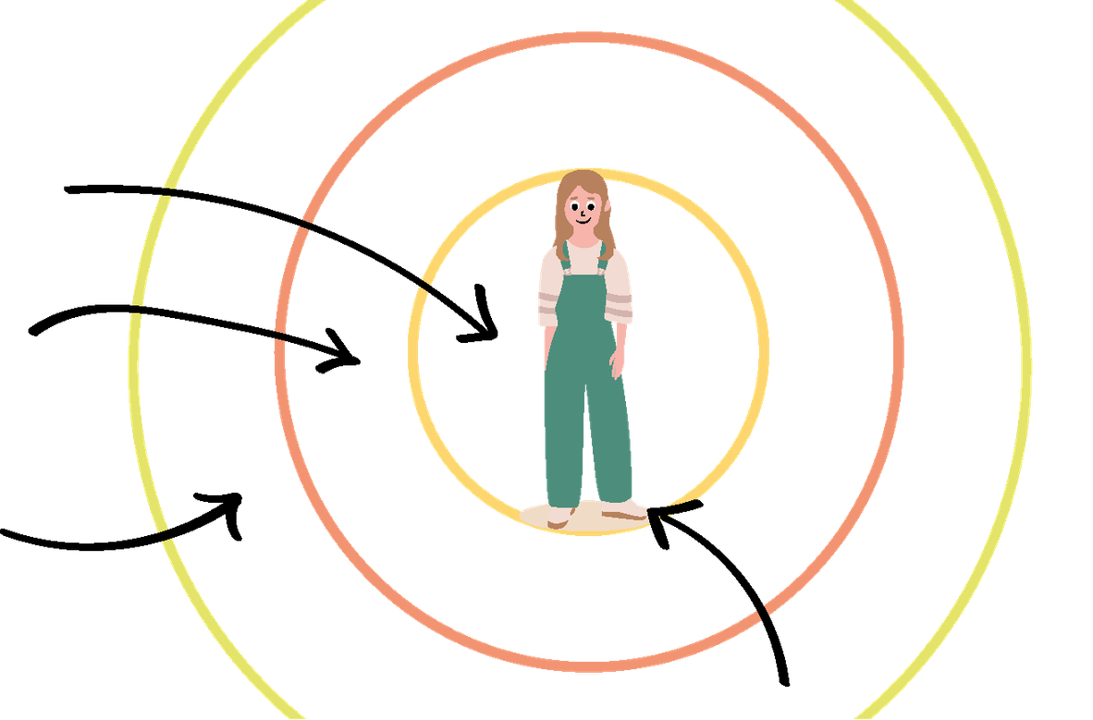
The circles represent different levels of support:
Closest (family, close friends)
Middle (teachers, school counselors, coaches)
Outer (doctors, psychologists, facility services)
There is no “right” number of supports. Every network is different.
At the center of the circle is the person themselves.

Slide 26
Activity 3.2
How do we support someone who needs help?

Slide 27
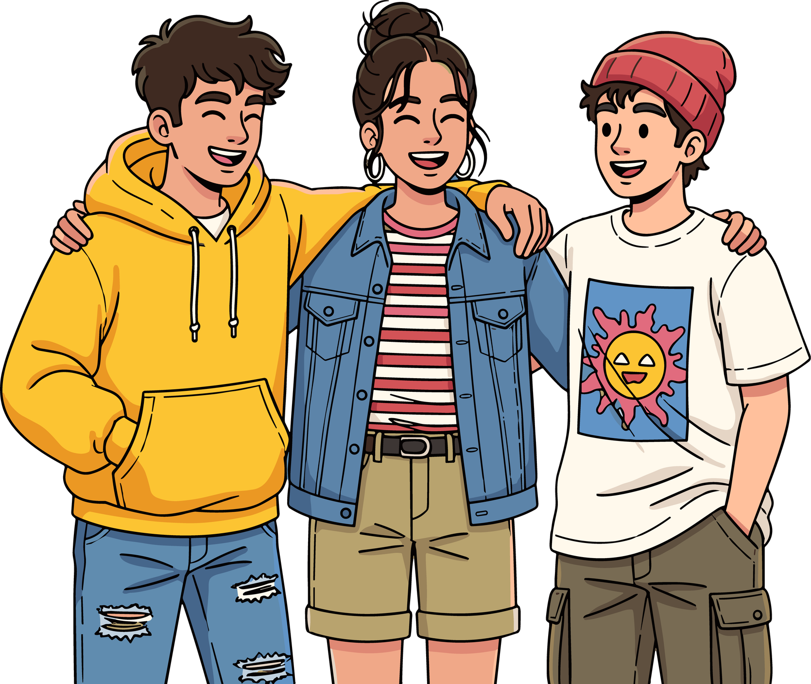
Materials
  Question cards for groups (one per group)
  Sheets or paper to write down ideas
  Markers
What will we do?
  Reflect on appropriate ways to offer help and understand limits, recognizing when it is necessary to seek help.

Slide 28
Signs of needing support
What I can do as a friend
  They are sad or irritable for many days
  They isolate themselves and no longer talk to friends
  They lose interest in activities they used to enjoy
  Behavior changes (becomes very loud or very quiet)
  They have difficulty concentrating in class
  Listening without judging
  Asking how they are doing
  Making time for the person
  Inviting them to do activities together
  Showing that the person matters (a message, asking how they feel)
  Not laughing or minimizing their feelings
How does someone behave who has been sad for a long time?
When to involve an adult
We should support without putting pressure
  When sadness lasts a very long time
  When the person says they want to hurt themselves
  When the person stops going to school
  In case of total isolation
  In case of bullying or serious conflicts
  When the person appears very scared or desperate
  When you don’t know how to help
  Being present, even if the person doesn’t want to talk much
  Saying things like: “I’m here if you want to talk”
  Respecting the person’s pace
  Not trying to fix everything
  Listening more than giving advice
  Avoiding phrases like “it’s not that serious”

Slide 29
Activity 3.3
Let’s practice how to help someone who needs support

Slide 30
Materials
  Scenario cards (one per group)
  Enough space to move around or act out scenes
  Sheets for brief notes (optional)
A friend says they can no longer cope with school pressure.
Someone feels attacked and gets angry when asked how they are.
What will we do?
  Practice peer emotional support skills and learn to respond appropriately to signs of distress.

Slide 31
Helpful phrases
Unhelpful phrases
  Do you want to tell me what’s worrying you?
  I’m here to listen.
  It’s okay to feel this way.
  You don’t have to face it alone.
  If you want, we can think together about what to do.
  We can talk to someone who can help you.
  You can count on me.
  I’m sure we’ll find a solution together.
A friend says they can no longer cope with school pressure.
  It’s not that serious.
  You’ll see, it will pass.
  You just need to try harder.
  Stop thinking about it.
  You’re overreacting.
  Other people have it worse.
  Stop complaining.
  How silly.
When should we ask an adult for help?

Slide 32
Thank you very much for your participation and for respecting this space.
We already know:
I can’t always choose how I feel...
but I can learn to take care of myself.
01
Health is not only physical: it is also mental and social.
02
All people have emotions and needs.
03
Recognizing what I need helps me feel better.
04
I can ask for help when something is difficult.
05
Taking care of myself also means taking care of my mental health.
Remember:
You are not alone.
You have tools, you have support and you can always ask for help.

Slide 33


