Slide 1
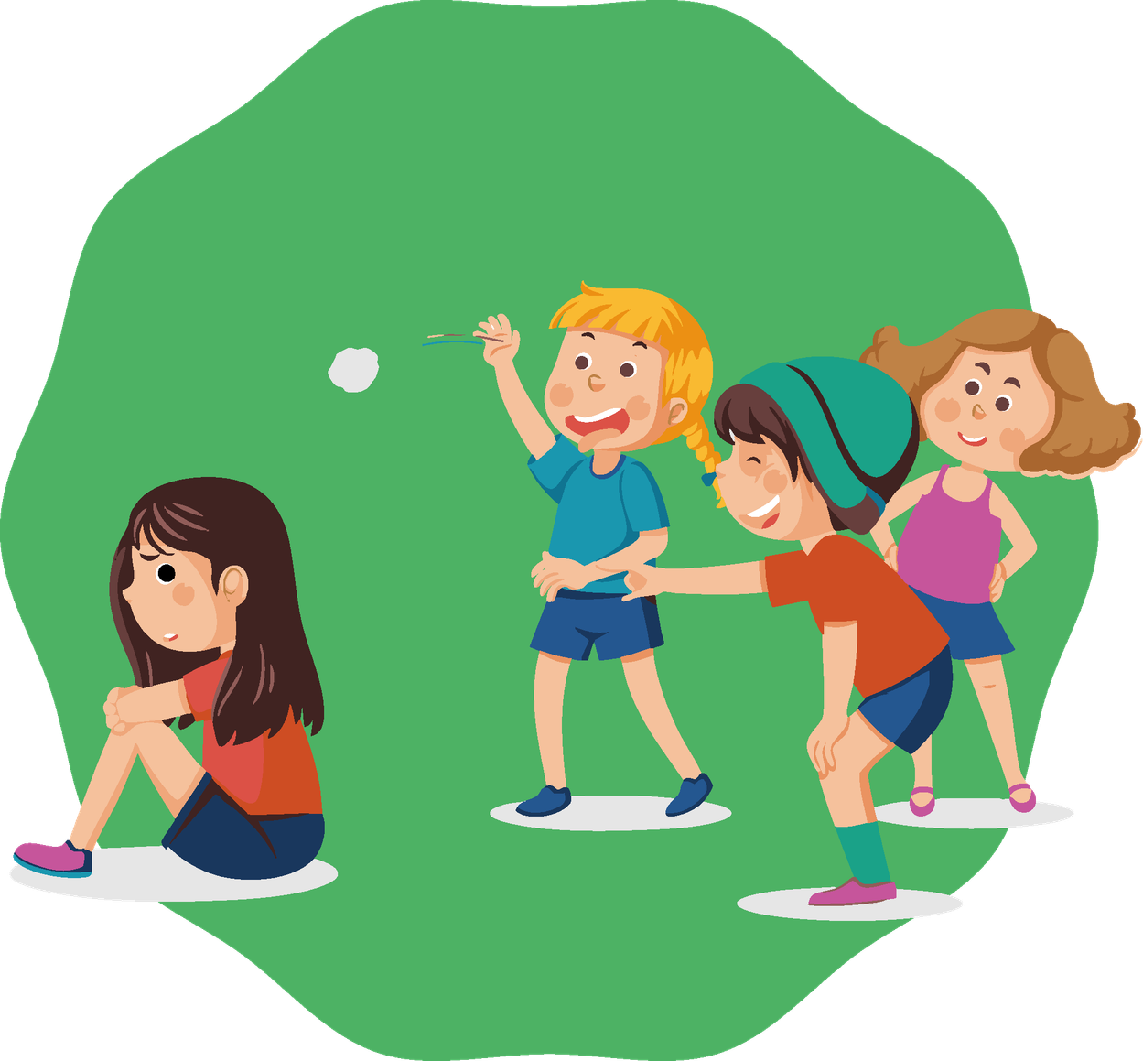

Module 5:
Bullying and Cyberbullying
Primary School

Slide 2
Why this module?​
In this workshop we will learn to recognize it, talk about how it affects us, and what we can do as a group.
The idea is to respect each other, support each other and use our words to build.
Sometimes at school situations happen that hurt teasing, exclusion, fights or insults.
Bullying and cyberbullying affect everyone, not just the victim.

Slide 3
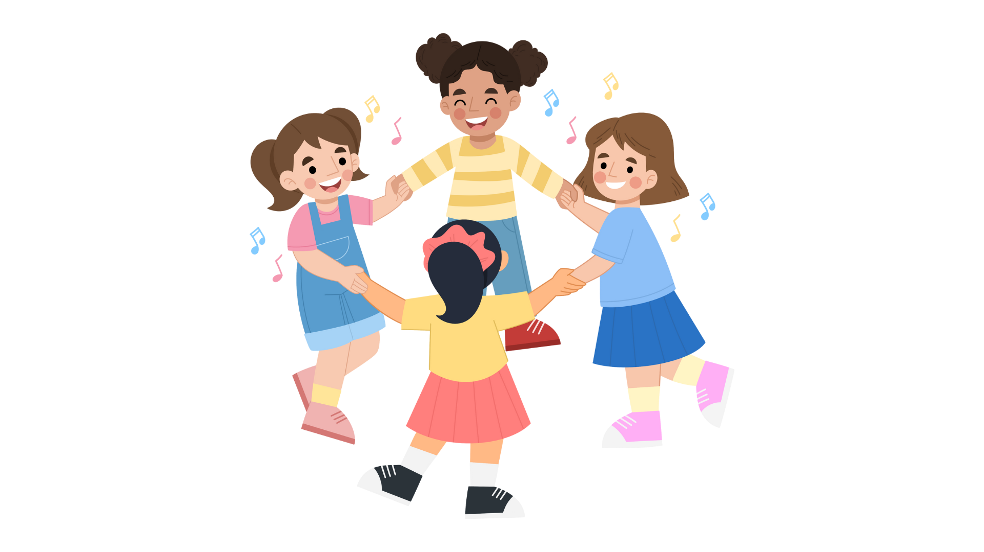
Objectives
01
Understand what bullying is and distinguish it from a punctual conflict
02
Identify roles in a bullying situation
03
Recognize emotions and consequences for everyone involved
04
Learn what cyberbullying is and how to act against it
05
Create prevention strategies and a class pact
06
Promote respect, trust and positive messages

Slide 4
Day 1. Bullying en general
Activity 1.1
Introduction and Presentation

Slide 5
Materials:
  Classroom with chairs arranged in a circle.
  Blackboard/flipchart (optional).
Today we are going to work on how we want to treat each other in the class and what school bullying means.
What we will do:
We will talk about what bullying means and reflect together.

Slide 6
What is school bullying?”
Bullying is when someone suffers repeated negative behaviour, which is sustained over time and where there is an imbalance of power between the victim and the aggressor.
Repetition
It can be physical, verbal, social, or digital.
Repetition
Repetition
Can bullying make you sick?”
Repetition
Remember: there are no right or wrong answers, the important thing is to share and reflect.

Slide 7
Activity 1.2
Introduction Round
Positive Qualities

Slide 8

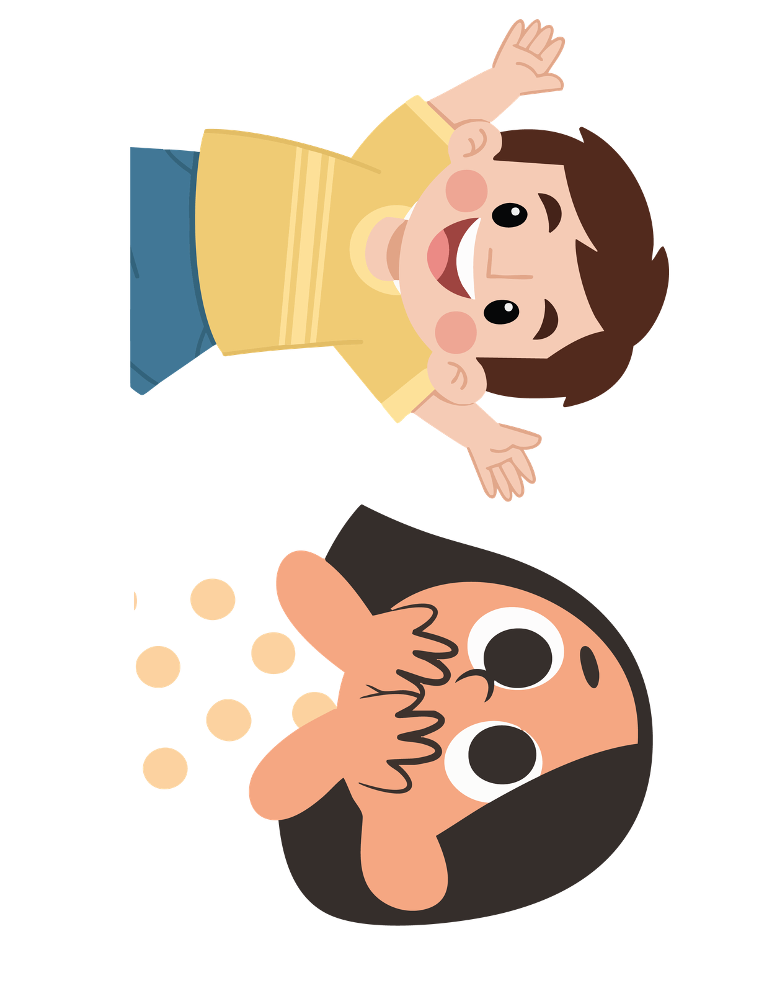
Materials:
  Space to maintain the circle of chairs
“I’m a good friend”
What we will do:
We will say our name and one positive quality. The group will recognize it with a gesture.
“I’m Alan”
Remember: we all have valuable qualities that make us unique.

Slide 9
Activity 1.3
Movement Game
“All Those Who…”

Slide 10
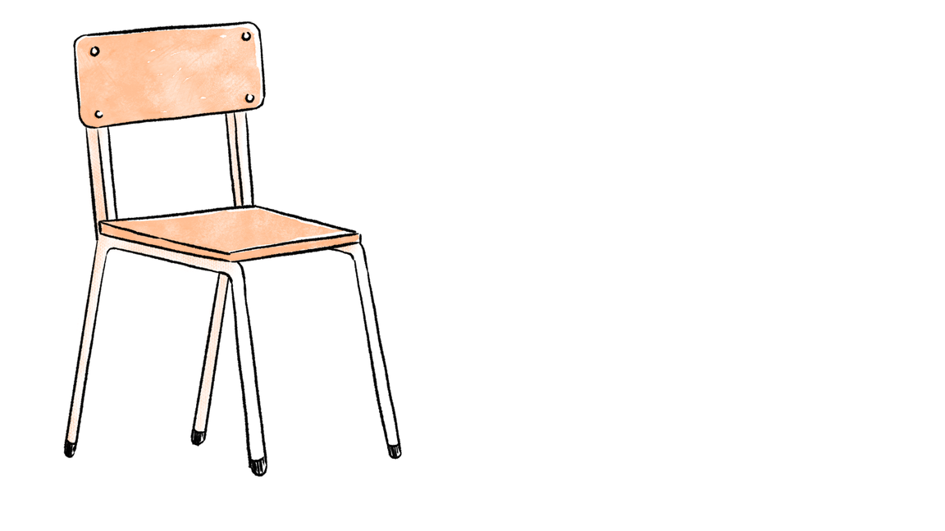
Materials:
  Chairs for all participants (one fewer than the number of students).
  Spacious area to move chairs and form a circle.
What we will do:
One student in the center will say “All those who…” and the others will move to another chair.
Remember: this game helps us discover what we have in common.

Slide 11
Questions
All those who forgot their homework once.
All those who have an older brother.
All those who drink milk for breakfast.
All those who are wearing sneakers today.
All those who like sports
All those who have a favorite teacher.

Slide 12
Activity 1.4
Movement Game
“Yes / No”

Slide 13
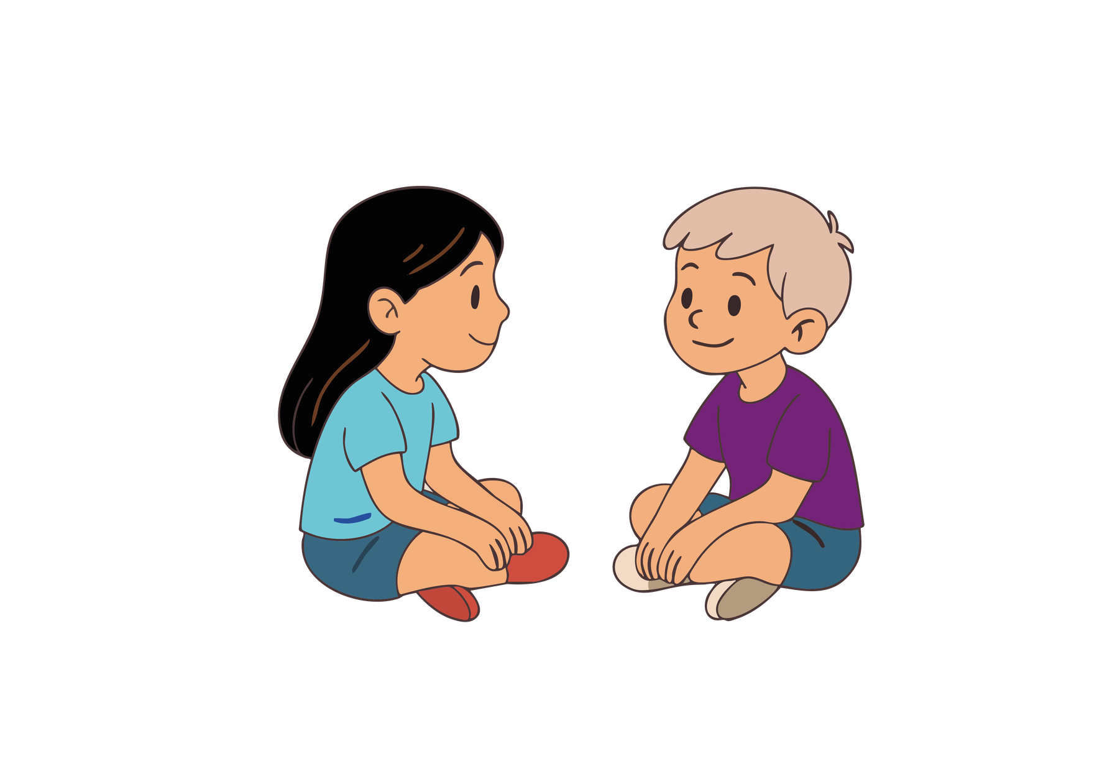
Materials:
  Large sign with “YES.”
  Large sign with “NO.”
  Spacious area in the classroom to move around.
What we will do:
We will listen to sentences and move to the poster according to our opinion.
Our opinions may differ, but what matters is reflecting on which attitudes help us take care of each other as a group and prevent bullying
Remember: it is okay to think differently; the important thing is to respect others.

Slide 14
YES
NO
How could you protect yourself without putting yourself in danger?
If I see another child being made fun of, I'd rather walk away.
Why do you prefer to walk away?
Because you might be teased too?

Slide 15
YES
NO
Asking for help works.
I am afraid I might also be picked on if I help another child.
It’s a common fear
Helping does not mean exposing yourself

Slide 16
YES
NO
If you are a leader; you have the right to disturb others.
What is the true job of a leader?
Who is your leader?

Slide 17
YES
NO
Asking for help: when someone feels bad and needs support.
If someone is always being teased and goes to an adult for help, then they are a tattletale
Tattling: when no one is being harmed.
e.g., someone cheats on homework or chews gum in class

Slide 18
YES
NO
I would talk to my parents or my teacher if I felt uncomfortable or mistreated in class
Who could you turn to if you don’t want to talk to your parents?
e.g., teachers, school support system

Slide 19
YES
NO
I have seen someone in my class being constantly teased or excluded.

Slide 20
Activity 1.5
What is Bullying?

Slide 21
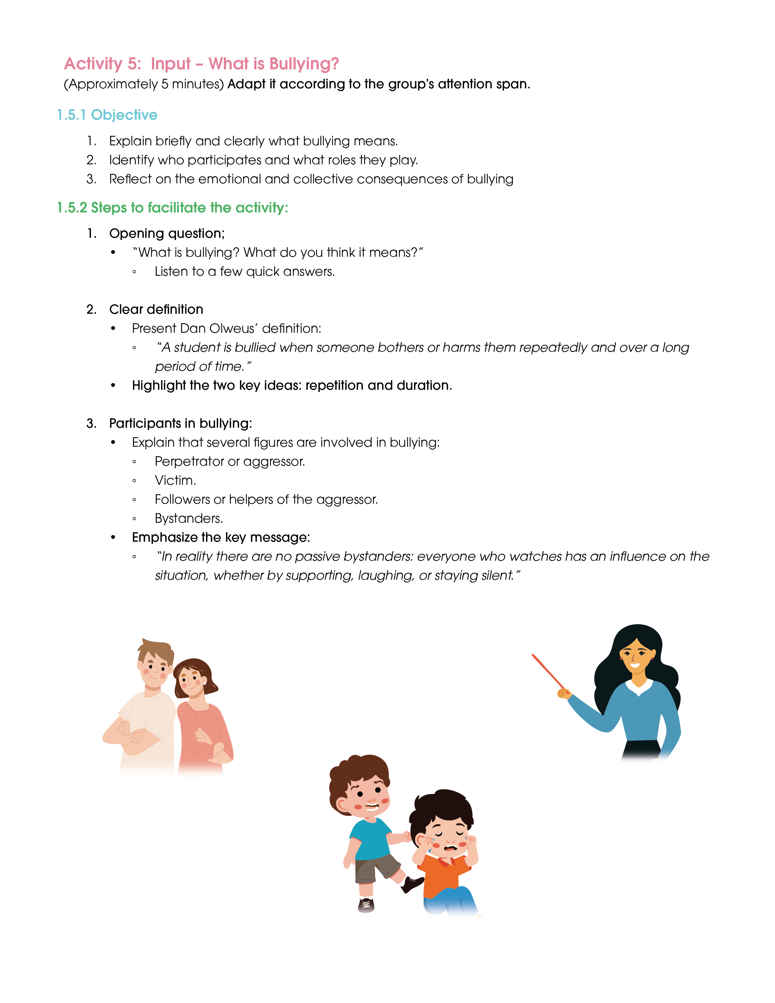
What we will do:
We will define what bullying means and see the roles: victim, aggressor, observers, defenders and class.
Materials:
  Blackboard or flipchart.
  Markers or chalk.
Remember: in bullying there are no passive spectators; everyone influences what happens.

Slide 22
What is bullying?”
Bullying is when someone suffers repeated negative behaviour, which is sustained over time and where there is an imbalance of power between the victim and the aggressor.
Repetition
It can be physical, verbal, social, or digital.
Repetition
A student is bullied when someone bothers or harms them repeatedly and over a long period of time
Repetition
Repetition

Slide 23

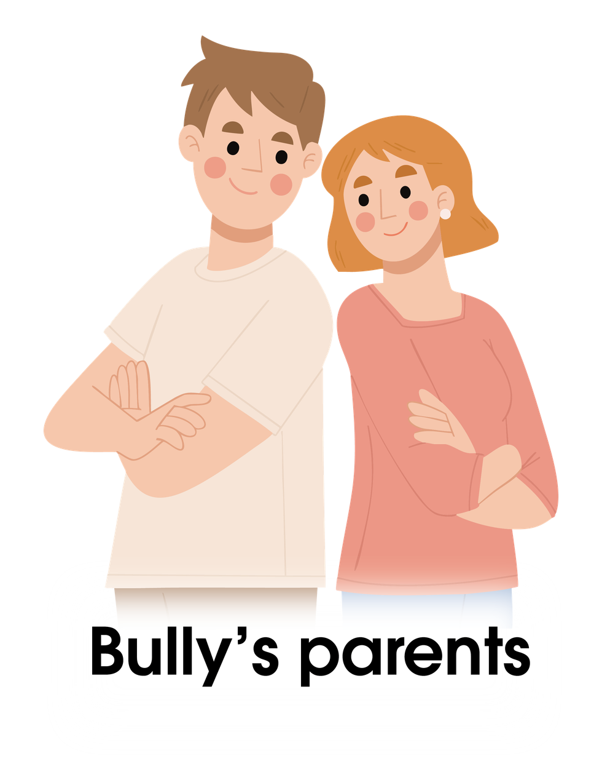

Slide 24
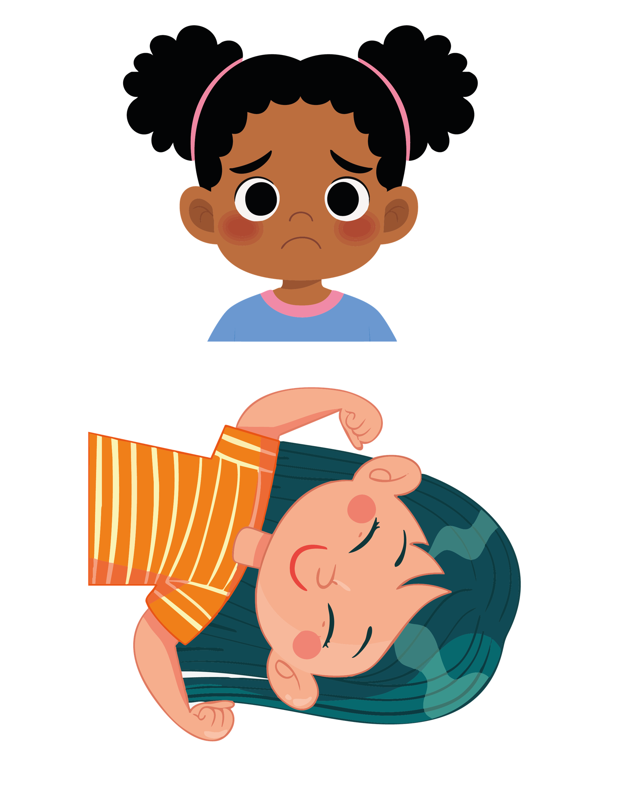
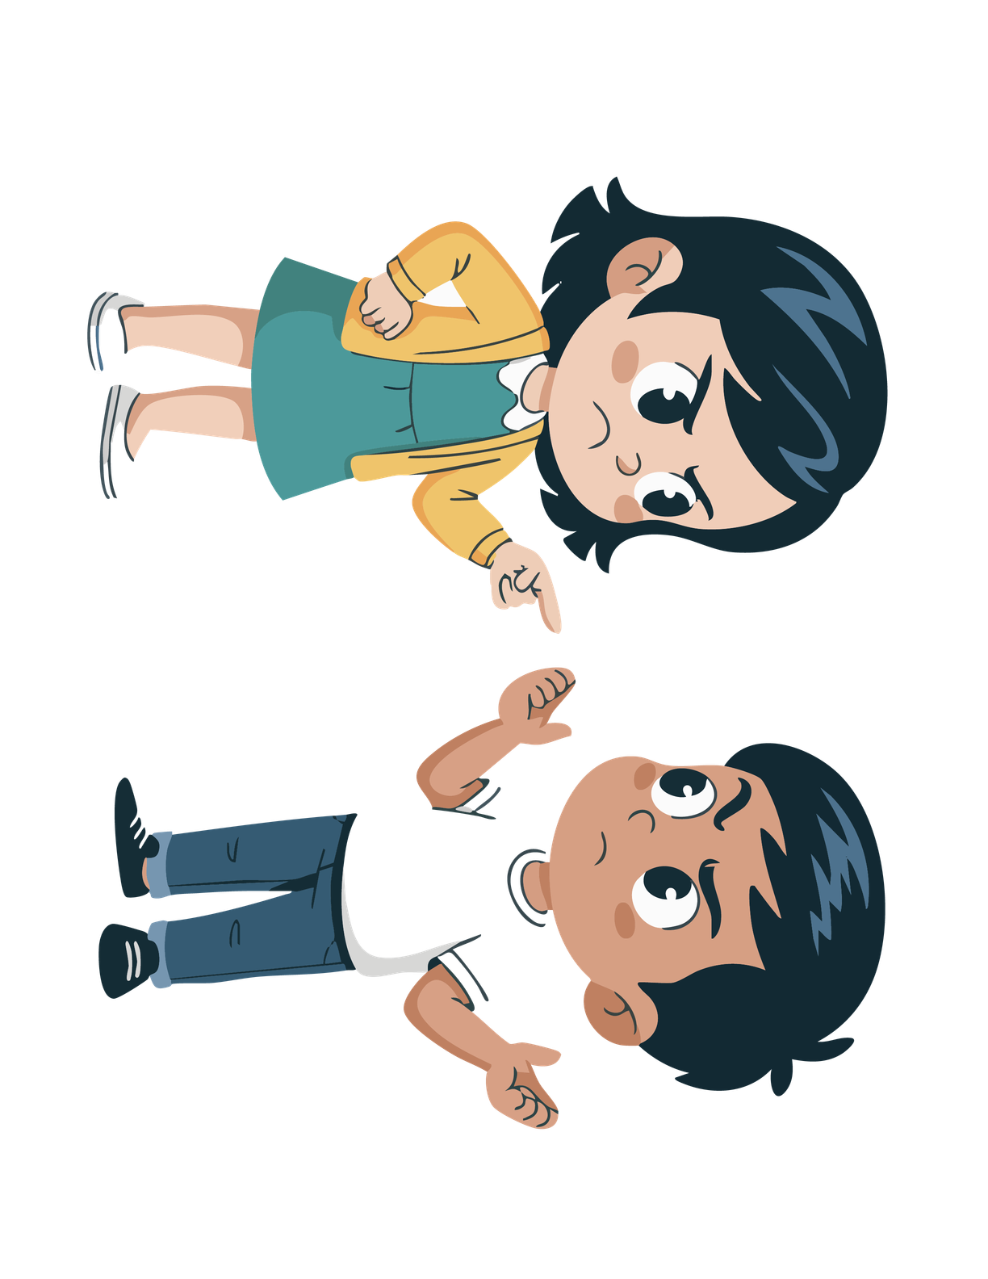
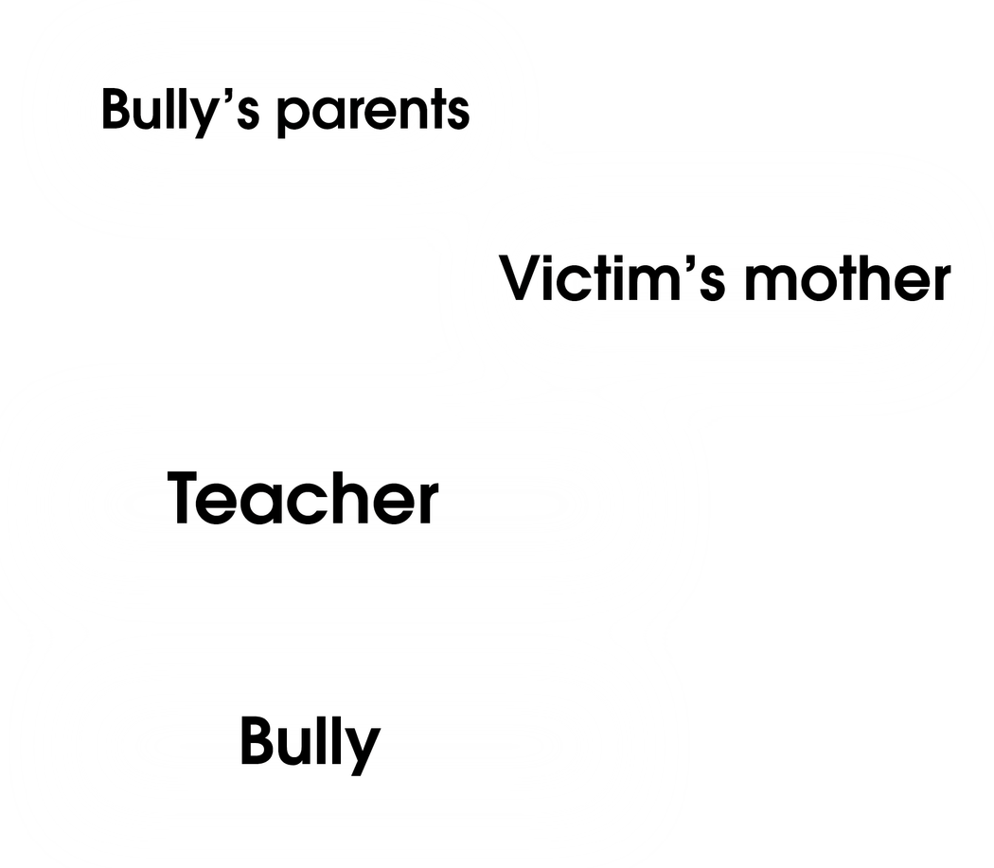
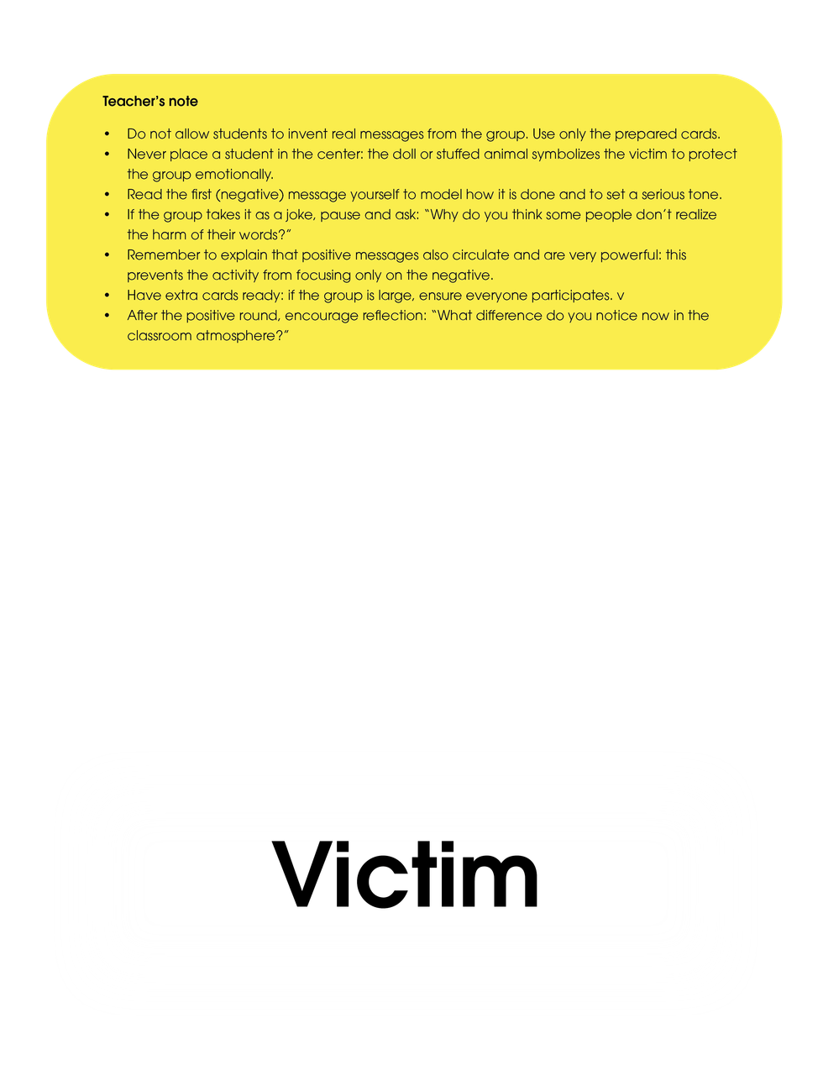

Slide 25
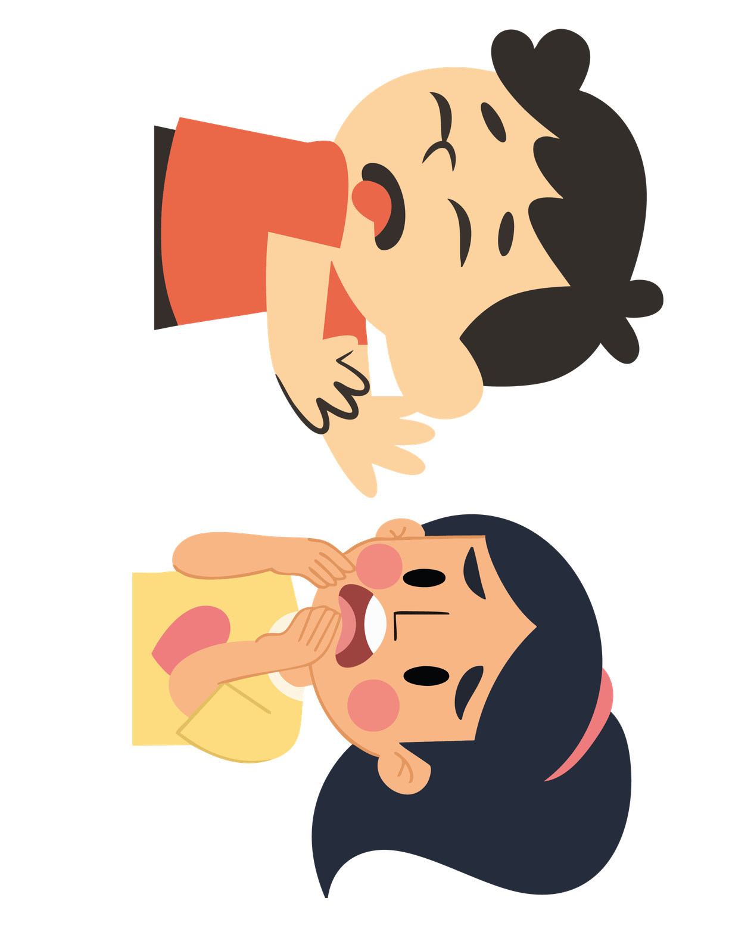
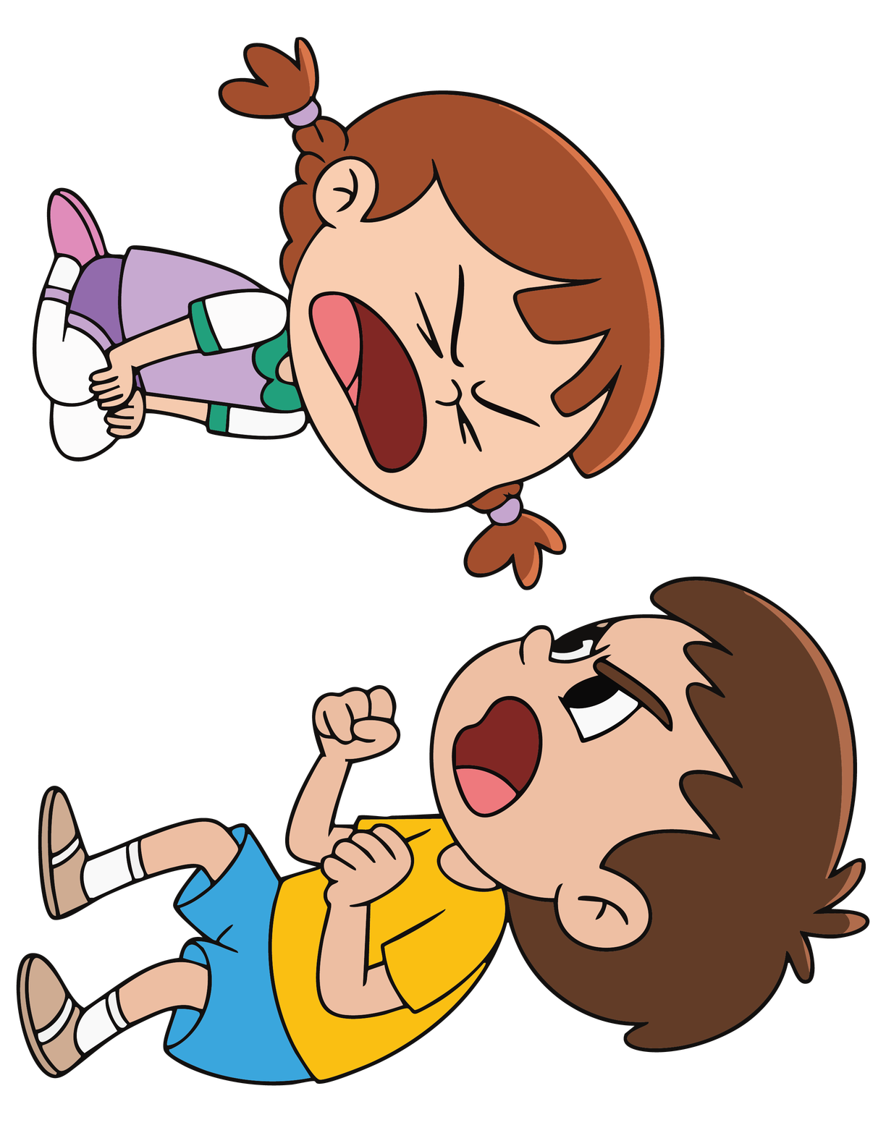
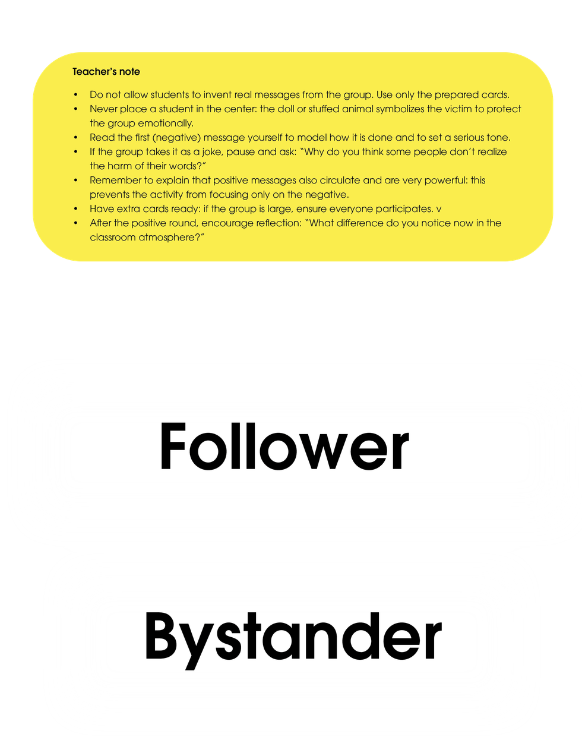

Slide 26
In reality, there are no passive spectators: everyone who observes influences the situation, whether by supporting, laughing or remaining silent.
What effect does a bullying case have on the class?
Why does someone bully?
  Generates stress
  Boredom.
  It worsens the classroom climate and actually
  Attempt to humiliate in order to feel stronger.
  It affects everyone, not just the victim.
  Own problems that he unloads on others.
  False sense of momentary relief.

Slide 27
How does the victim feel?
How does the aggressor really feel?
What about the others watching?
Now that we know what bullying is and how the people involved feel, let’s hear it in a story

Slide 28
Activity 1.6
I don’t want to go on the trip

Slide 29
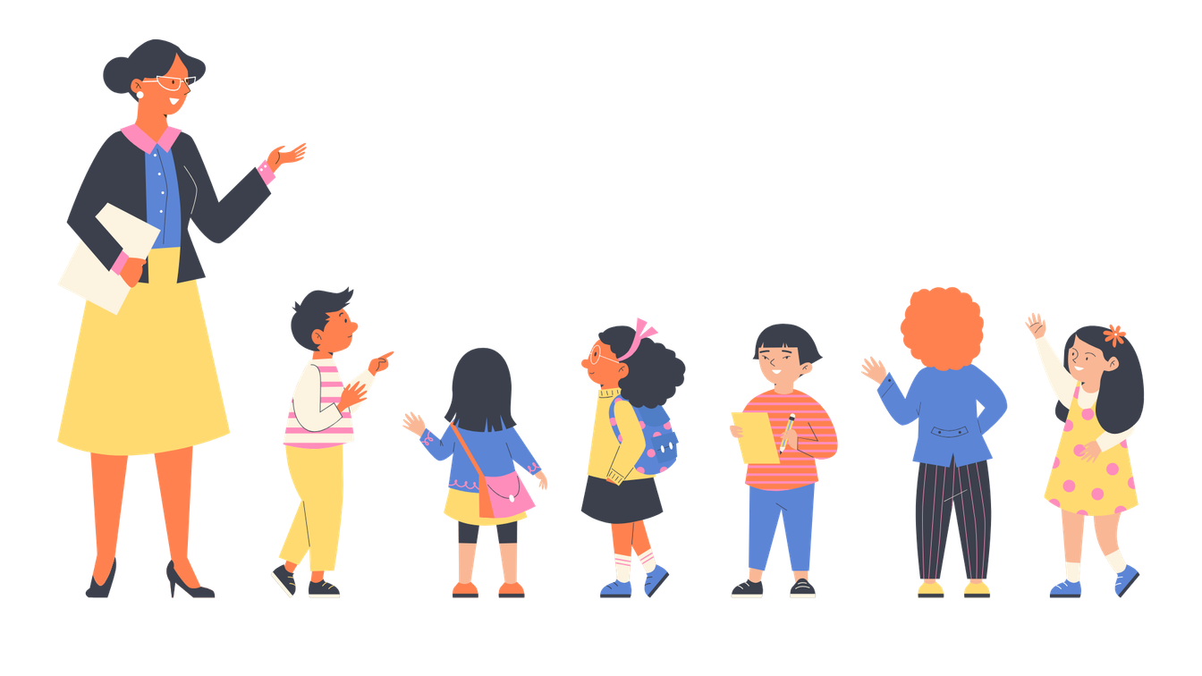
Materials:
  copies of the story
  Sheets and pens
What we will do:
We will read the story of Kim, Malik and Samu, identify roles and think how to act.
Remember: we all have a role in stopping bullying.

Slide 30
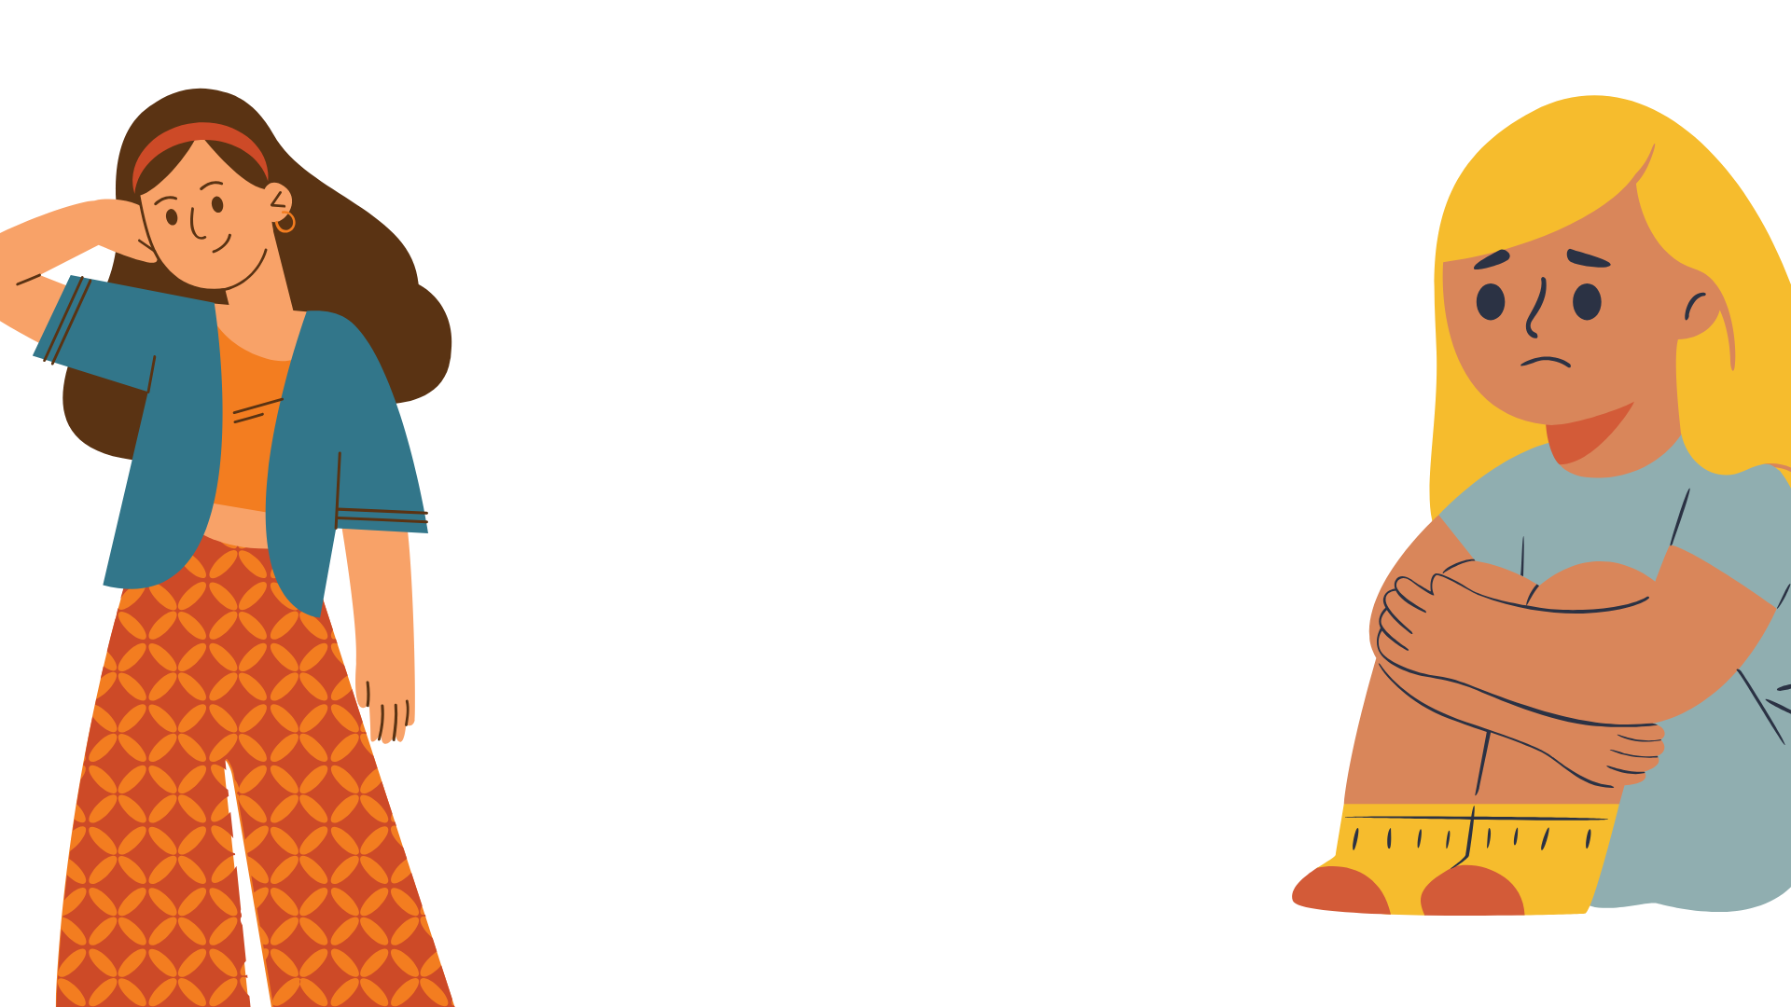
-You're finally here!" Kim's aunt Amina shouts happily. Kim gets to spend the weekend with his favourite aunt, Amina, and normally he is always very happy when he goes to see her. This time, however, he does not hug Aunt Amina as enthusiastically as usual. Kim looks very sad when he approaches his aunt.
-Well, what's wrong?" asks Auntie Amina.
-Oh, nothing," says Kim, but her favourite aunt knows something is wrong.

Slide 31
-No one can help me anyway. I only have problems at school. I used to get on well with everyone. I used to play with Samu and Malik in particular, but they haven't been my friends for a few weeks now. Malik always pushes me and calls me "stinky Kim". I don't even like going to school anymore" - Auntie Amina takes pity on Kim.
-That's so mean! Have you tried talking to Samu about how Malik treats you? -No," says Kim, even sadder, "It's no use. Samu is next to Malik. Maybe he's happy because now he has Malik all to himself...". Now Kim even starts to cry. Aunt Amina takes him in her arms and comforts him.
Kim sobs: "And everyone else in the class already has friends. I'll try to make myself as invisible as possible and hope that Malik forgets about me and doesn't make fun of me again. But you know what the worst thing is? Next week we're going on a class trip. I was really looking forward to it, but now I don't want to go. Maybe I'll get lucky, and I'll get sick".

Slide 32
-It can't be because of Malik and Samu that you won't go on the trip," replies Aunt Amina.
-A trip like this is great! We should tell your parents and your teacher. If you want, I can go with you to school. If they always make fun of someone and exclude them, that's bullying. It's not your fault. And you shouldn't tolerate it under any circumstances.

Slide 33
What happened in this story?
What characters appear and what did they do?
Are Kim, Malik and Samu the only ones involved?
Imagine this story happened in your class… would it have nothing to do with you?

Slide 34
How does Kim feel?
What is Malik looking for with his actions?
What does Samu do and why does he follow Malik?
What could the rest of the class do to change the situation?

Slide 35
“In bullying there is not only a victim and an aggressor. There are also followers, bystanders, and the entire class. Everyone has a role, and everyone can do something to change the situation.”

Slide 36
Activity 1.7
Body Silhouettes
Emotions and Consequences of Bullying

Slide 37

Materials:
  Large paper rolls or poster boards.
  Colored markers.
  Adhesive tape to stick the silhouettes on the wall.
What we will do:
We will draw a silhouette and write emotions and consequences of a role.
Remember: putting yourself in someone else’s shoes helps us understand how they feel.

Slide 38
What did you discover when putting yourself in this role’s shoes?
What emotions are repeated across all characters?
What can you do?”
What consequences can happen if we don’t act against bullying?

Slide 39
Activity 1.8
Letter to Parents
Sharing What We Learned

Slide 40

Materials:
  Sheets of paper or letter templates.
  Pencils or pens.
  (Optional) Envelopes to take the letter home.
What we will do:
You will write a letter to your family telling them what you learned today
Remember: sharing at home what you learned helps us also take care of each other outside school.

Slide 41
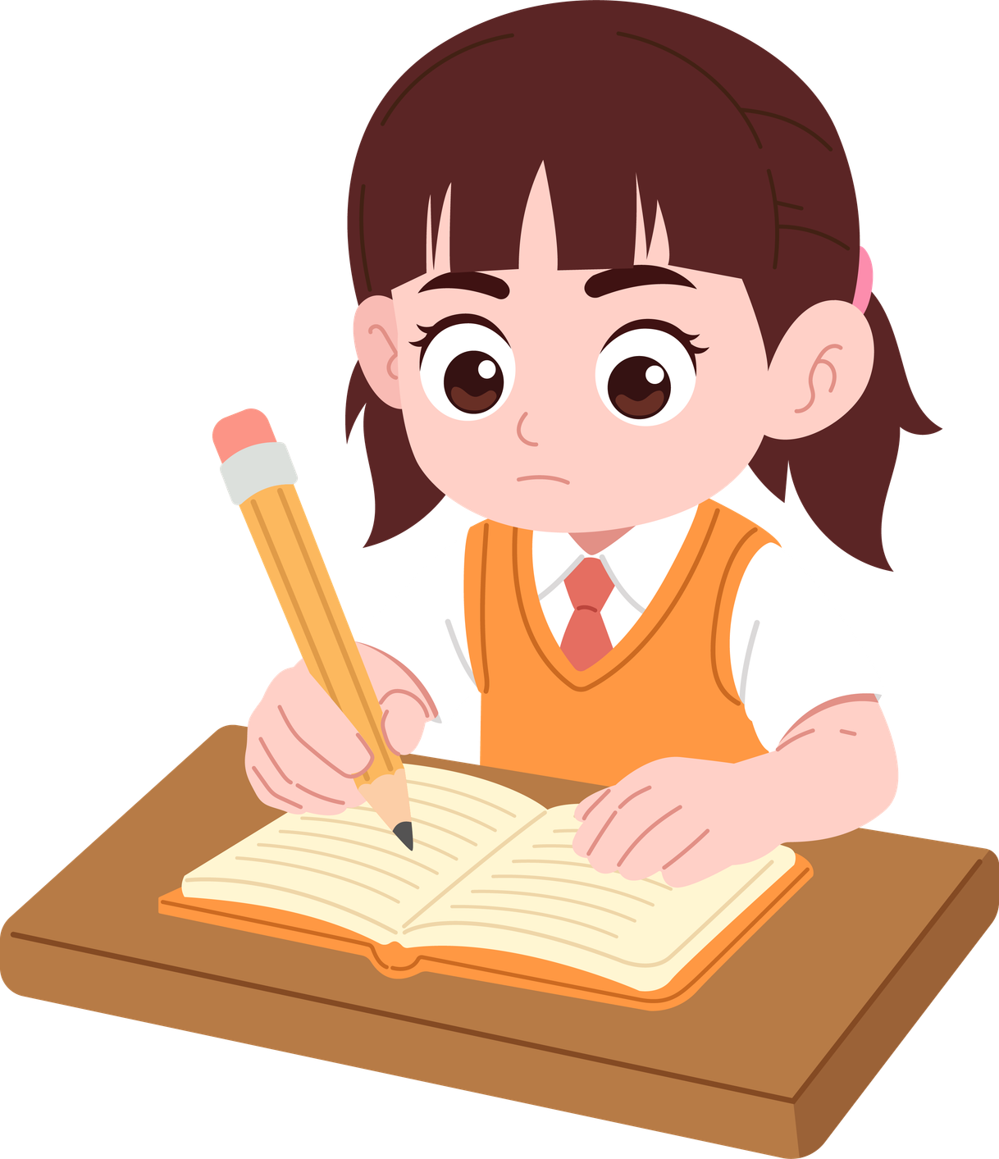
Dear Mum and Dad:
Today in class we learned what bullying is: when one person repeatedly bothers
or excludes another and there is an imbalance of power.
We read a story and talked about how the victim feels and also how
other people feel.
I think it's important to talk about this at home so that we can all help to make sure that no one feels bad at school.
With love, (name)

Slide 42
Day 2. Cyberbullying and support system
Activity 2.1
Review Circle
Remembering the Previous Day

Slide 43
Materials:
  Chairs arranged in a circle.
  Blackboard or flipchart (optional) to note down key words.
What we will do:
We will recall together what we learned yesterday.
Remember: reviewing helps us keep learning.

Slide 44
What is bullying?
What roles exist in a bullying situation?
Let’s remember together what we did yesterday. What do you recall from the stories, games, or reflections?
How did Kim feel in the story about the trip?
What did we learn about the class’s role?

Slide 45
Activity 2.2
Review Circle
Remembering the Previous Day

Slide 46
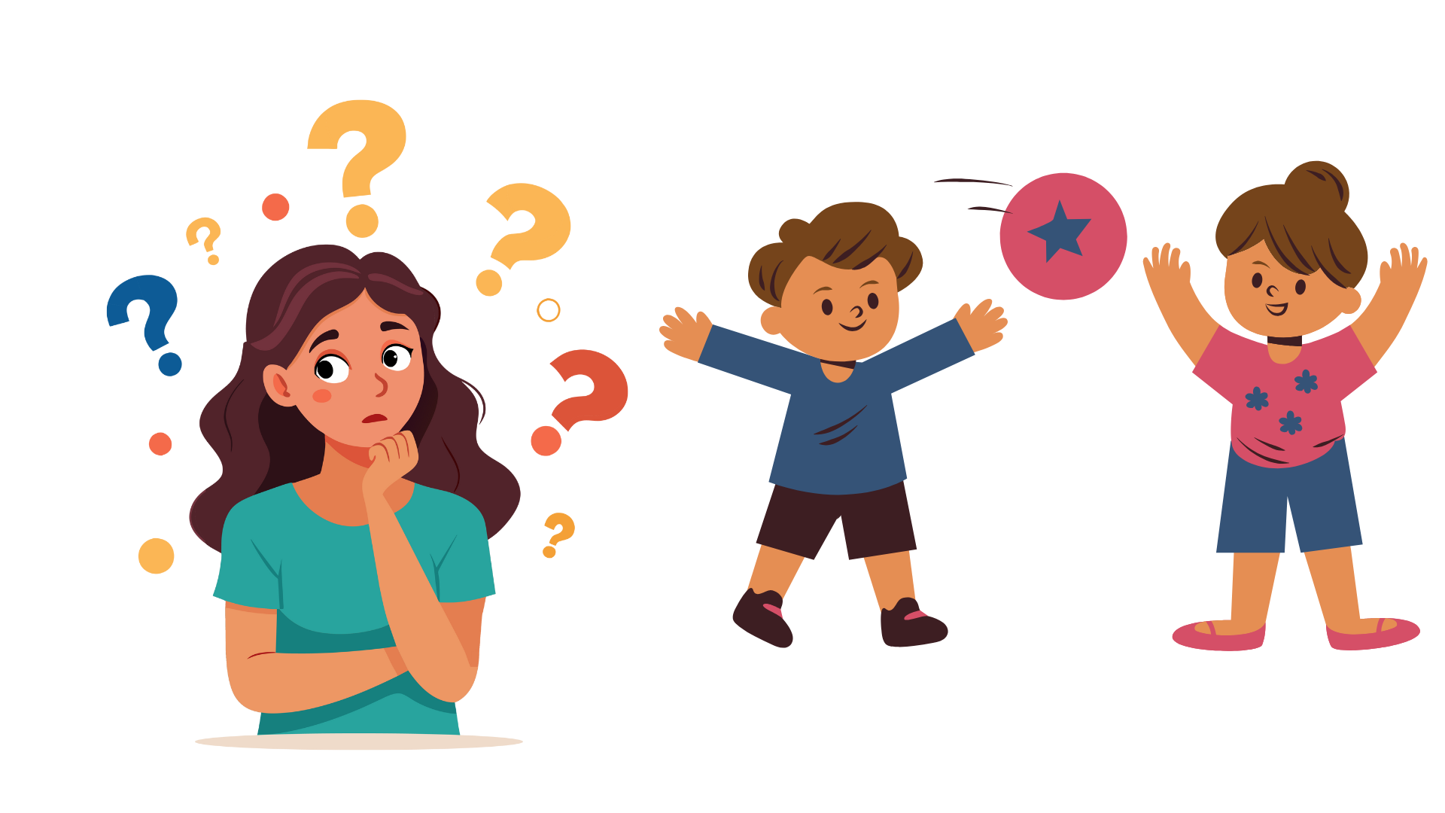
Materials:
  Free space in the circle to play.
  No physical material is needed (the ball is symbolic/imaginary).
What we will do:
We will throw an imaginary ball saying the name of a classmate.
Remember: collaborating and paying attention makes everything work better.

Slide 47
This game reminds us that when we pay attention to others and collaborate, everything flows better. Just like in daily life and in the classroom.

Slide 48
Activity 2.3
Review Circle
Remembering the Previous Day

Slide 49
Materials:
  Results or examples of responses from the questionnaires previously completed by families (if available).
  Blackboard or flipchart to note down key ideas
What we will do:
We will compare what families think with what we think.

Slide 50
To prevent and stop bullying, it is important that both families and students talk about it and share how they see it.
Remember: sharing points of view helps improve communication.

Slide 51
Activity 2.4
What is Cyberbullying?

Slide 52
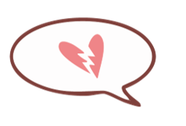

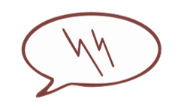

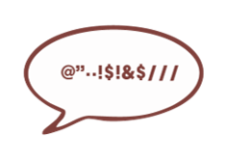
Materials:
  Blackboard or flipchart to note down a conclusion.
What we will do:
We will see what cyberbullying is and what to do when it happens.

Slide 53
Does anyone know what the word cyberbullying means?
Cyberbullying is a type of bullying that happens through cell phones, the internet, online games, or social media.
Just like traditional bullying, it is
Repeated
Repeated
Repeated
Repeated
lasts over time, and there is a power imbalance.

Slide 54

Legal importance:
Cyberbullying is not a trivial offense; it can have serious consequences.
It is also a criminal offense.
That’s why it is always important to talk to someone you trust.
It is also useful to take screenshots or save files (messages, photos, videos) to use in case of reporting.
Key characteristics:
  Can happen anytime
  Spreads quickly to many people
  Can be anonymous
  Leaves a trace (messages, photos, videos)
  Invades even at home

Slide 55
The most dangerous aspec
Anonymity
Availability
Reach
Simplicity
you don’t always know who is behind it.
it can happen at any time of the day.
many people see it very quickly
it is easy to cause harm with just one click.
Why do you think it is important to talk about cyberbullying?
Cyberbullying is just as harmful as in-person bullying, and sometimes even more dangerous.
That’s why we need to recognize it, talk about it, keep evidence, and ask for help to stop it.
Remember: cyberbullying should always be told to a trusted adult.

Slide 56
Activity 2.5
Game
“Common Messages”

Slide 57
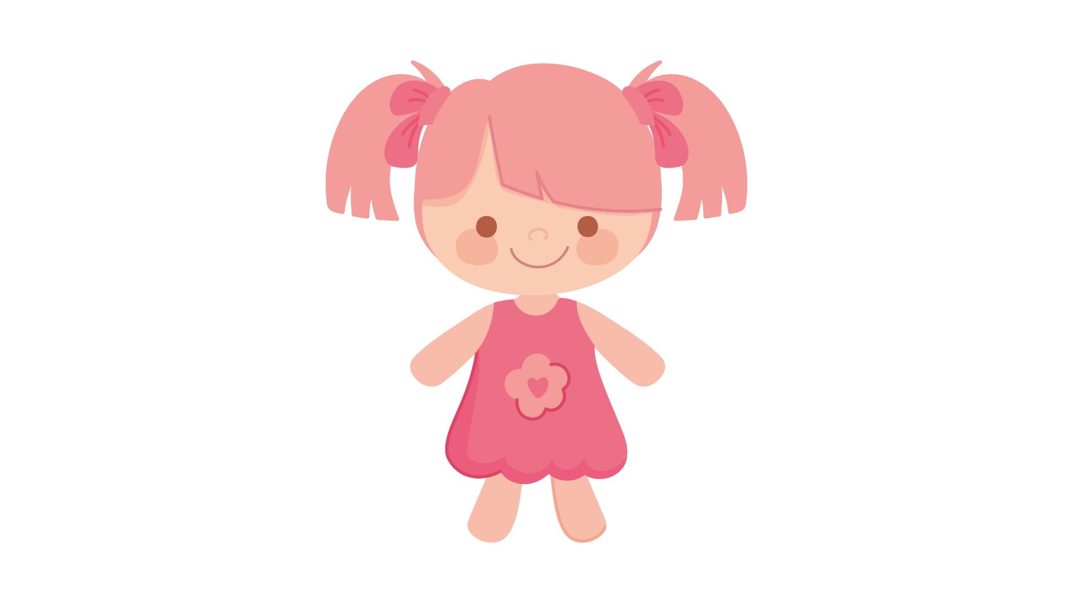
Materials:
  A doll or stuffed animal representing the person receiving the messages.
  Mobile phone cards with messages (preferably laminated).
  Some messages are negative (e.g., insults, mockery, exclusion).
  Others are positive (e.g., support, encouragement, recognition).
What we will do:
We will read negative messages and change them to positive ones.

Slide 58
Let’s imagine this doll had a bad day, is alone in their room, and picks up the phone. Suddenly, they start receiving messages… some unpleasant and others that may help.

Slide 59
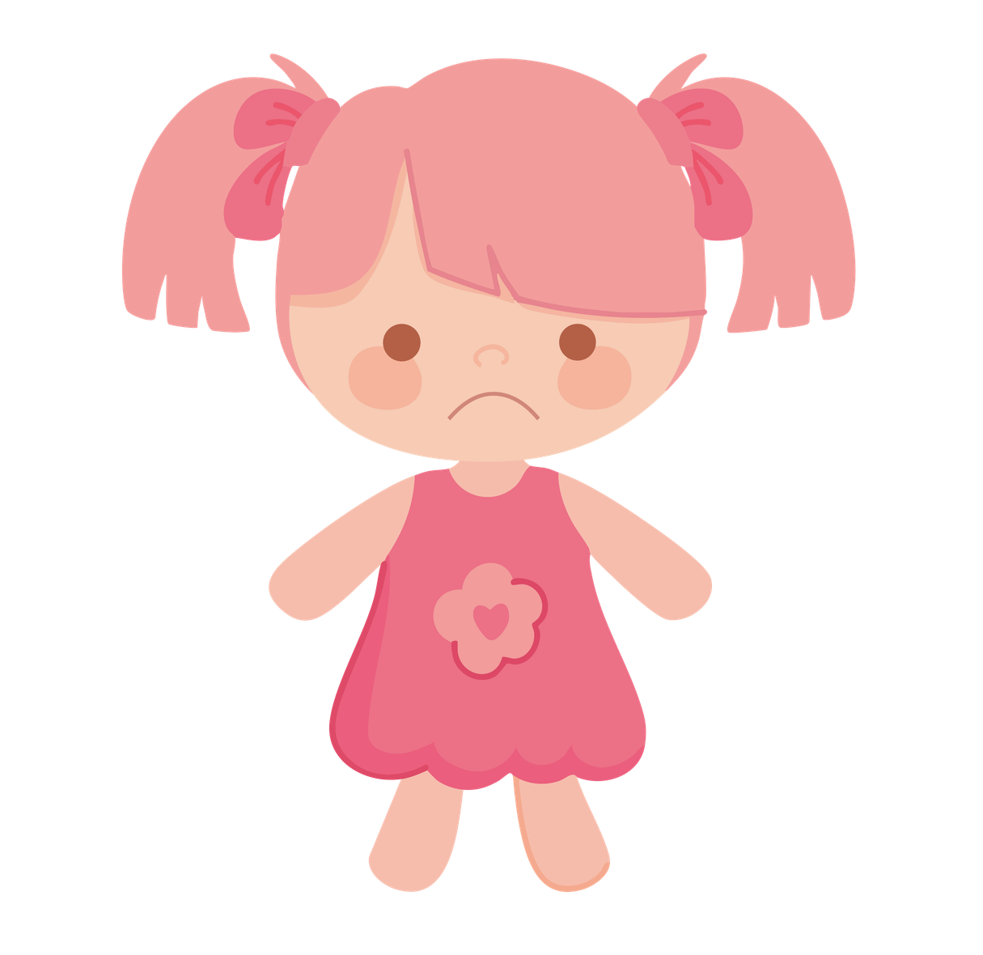



You're no good at all!
Tomorrow we'll kick your ass!
You are so stupid!
Everyone laughs at you!
I hope you're not coming on a trip!
We don't want you here!

Slide 60
There’s nothing wrong with you.
You are enough, just as you are
I’m with you.
Don’t let anyone dim your light.
You have incredible strength.
Your voice matters.

Slide 61
How do you think the doll feels now?
Is it different when the messages seem anonymous or when they come from someone known?
On the internet, negative messages are not easily erased: they are saved, can be forwarded, and reach many people.
Even if it seems like a game, they have real consequences.

Slide 62
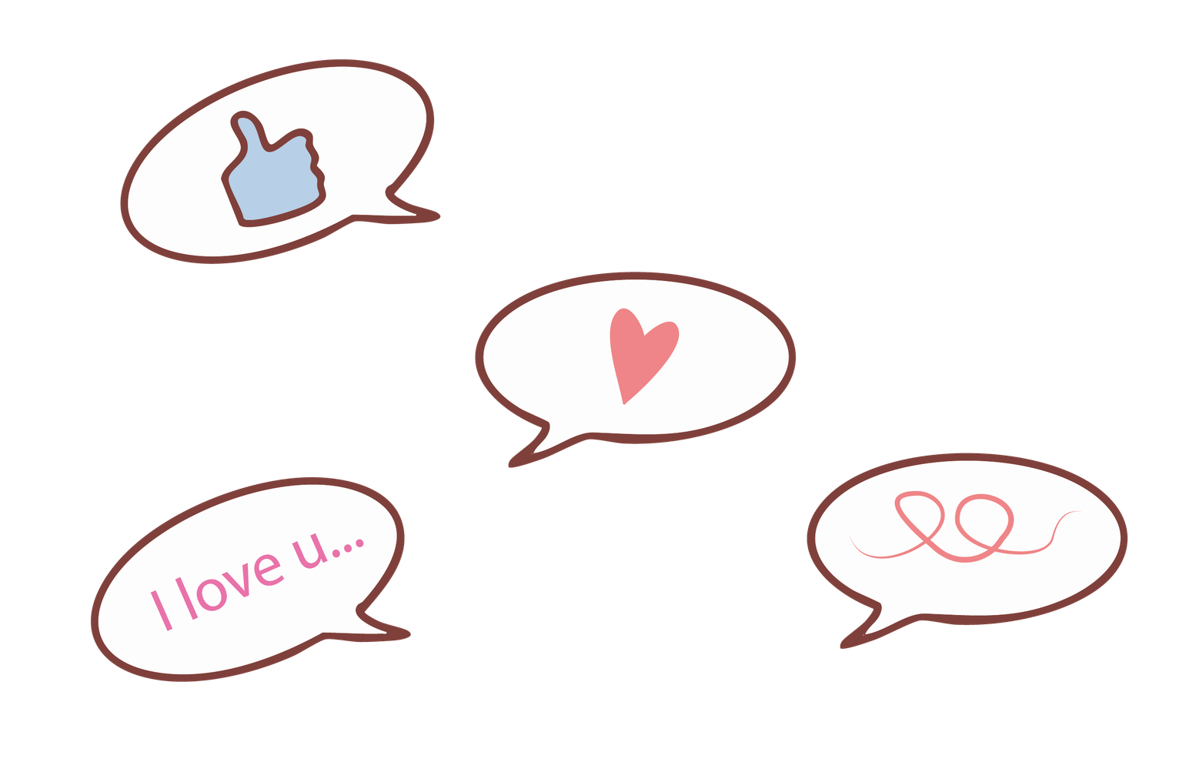
What did you notice in yourself when saying negative messages?
And when saying positive ones?
What do we learn from this about how we use our phones or social networks?
Just like in this game, on the internet messages are repeated and spread quickly. They can hurt or they can help. Each of us decides what kind of message we want to share.
Remember: words have power; they can hurt or they can care.

Slide 63
Activity 2.6
Debate
Golden Rules on the Internet
(STOP – BLOCK – TELL)

Slide 64
Materials:
  Blackboard or flipchart to write down the rules.
  Cards or slides with the three key words: STOP – BLOCK – TELL.
  (Optional) Examples of fictional screenshots of chats or social networks.
What we will do:
We will talk about what to do when someone bothers you online.
What can we do if we receive unpleasant messages or see that someone else receives them?”
We already saw how messages can cause harm on the internet.

Slide 65
STOP
Don’t join in or laugh at hurtful messages.
Ignoring hurtful behavior is the first step to stop it.
Walk away or close the chat.
Don’t reply — silence is powerful.
You don’t have to answer mean words with more words.

Slide 66
BLOCK
Block the person who’s bothering you online.
Remove or unfollow them on social media.
Don’t give them more chances to hurt you — block and move on.
Protect your space and your peace.
You’re in control of who can contact you.

Slide 67
TELL
You’re not alone; asking for help is brave.
Sharing what happened helps you stay safe.
Talk to an adult you trust — a teacher, parent, or school counselor.
Tell someone, even if you think it’s small — it matters.
Speak up so others can help you solve it.

Slide 68
A group starts sharing jokes about you.
They send you annoying messages, even if you ask them to stop.
Someone shares your number without permission.
Someone records a video of you without permission and uploads it to networks.
A group starts laughing at you as you enter the room.
They make fun of the way you dress or speak.

Slide 69
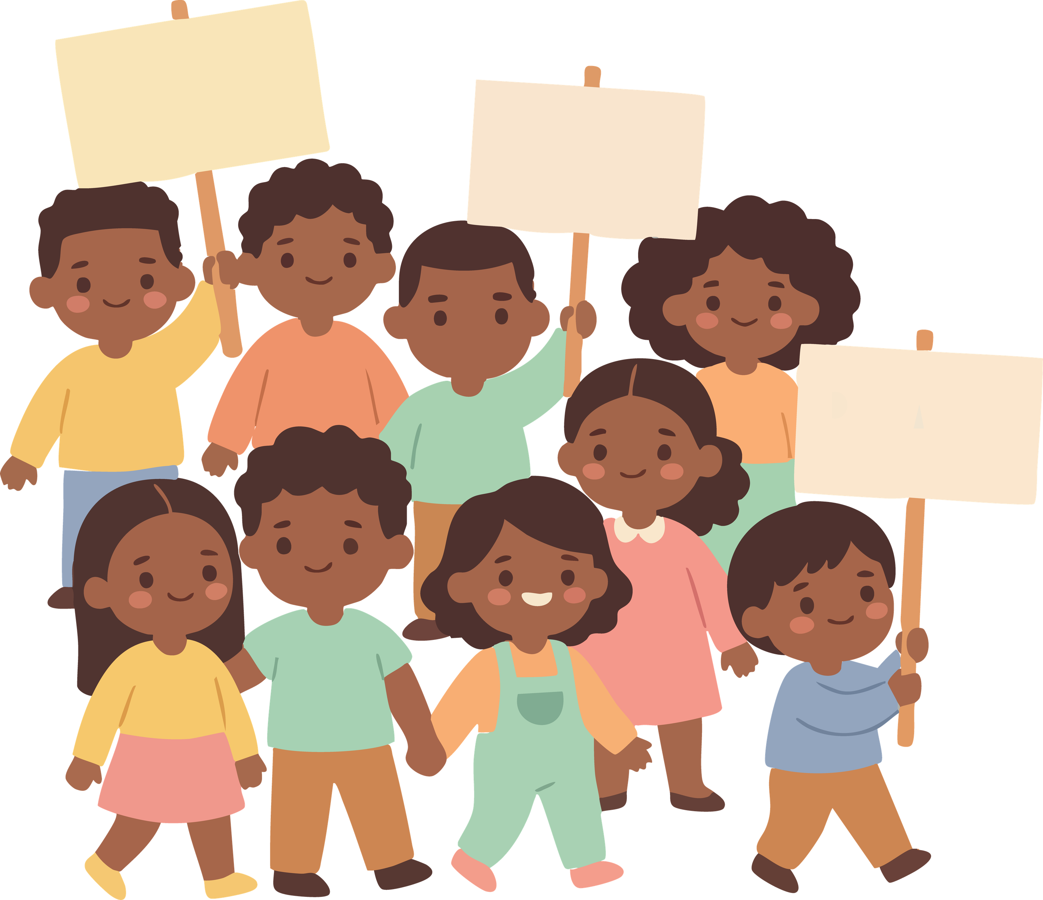
None of us has to endure cyberbullying. There is always something we can do: stop, block, and tell. The faster we act, the less harm it can cause.
STOP
BLOCK
TELL
Remember: asking for help is not tattling, it is protecting yourself.

Slide 70
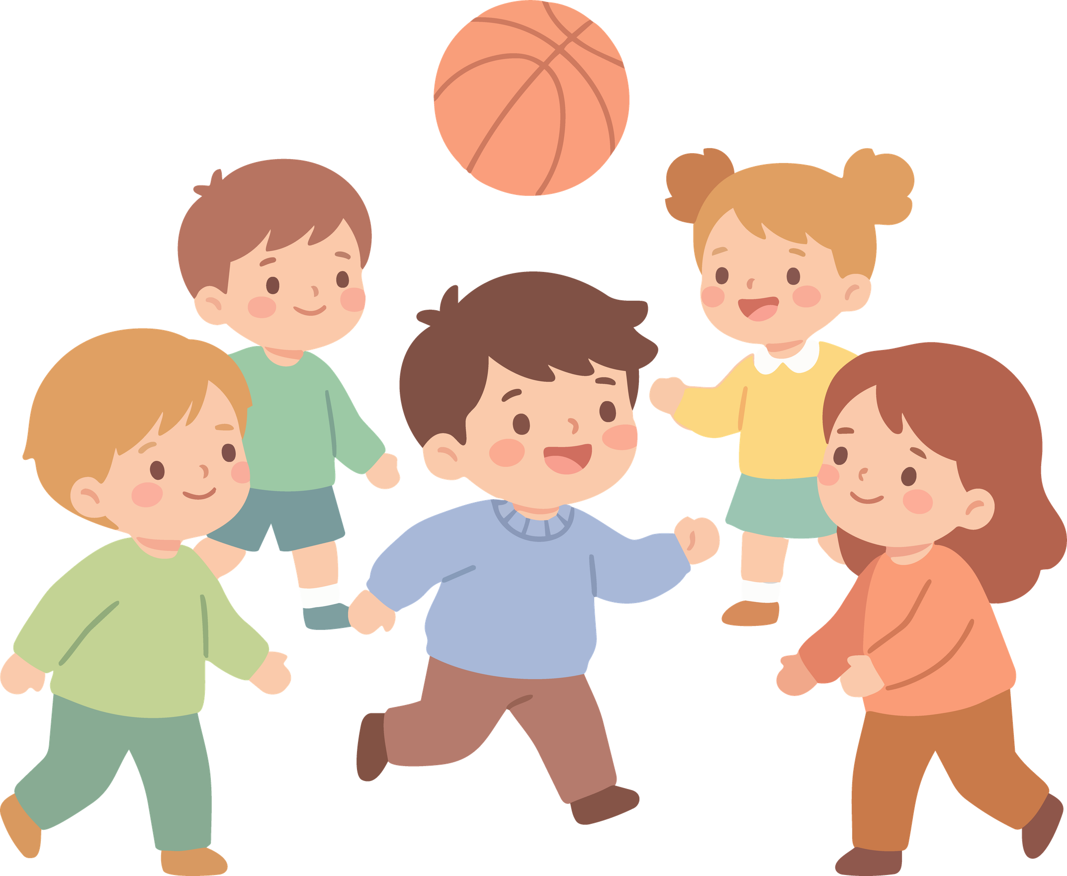

Slide 71
Activity 2.7
Anti-Bullying Strategies
Class Agreement

Slide 72
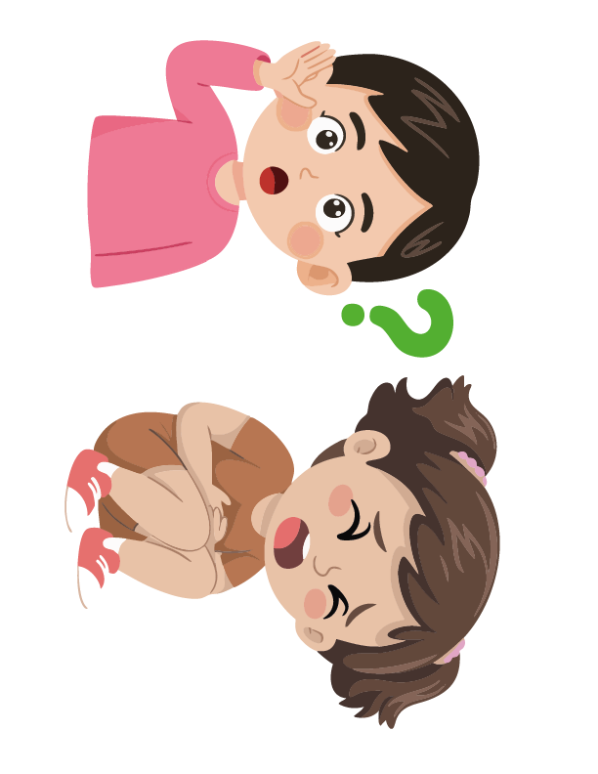
Materials:
  Blackboard or flipchart.
  Large poster board or mural.
  Colored markers.
  (Optional) Small cards so each student can write a proposal.
What we will do:
We will write a class commitment against bullying and cyberbullying.
We have already seen what bullying and cyberbullying are, and how they affect people.
Now let’s think together:
What can we do as a class to make sure this doesn’t happen or to stop it if it does?

Slide 73
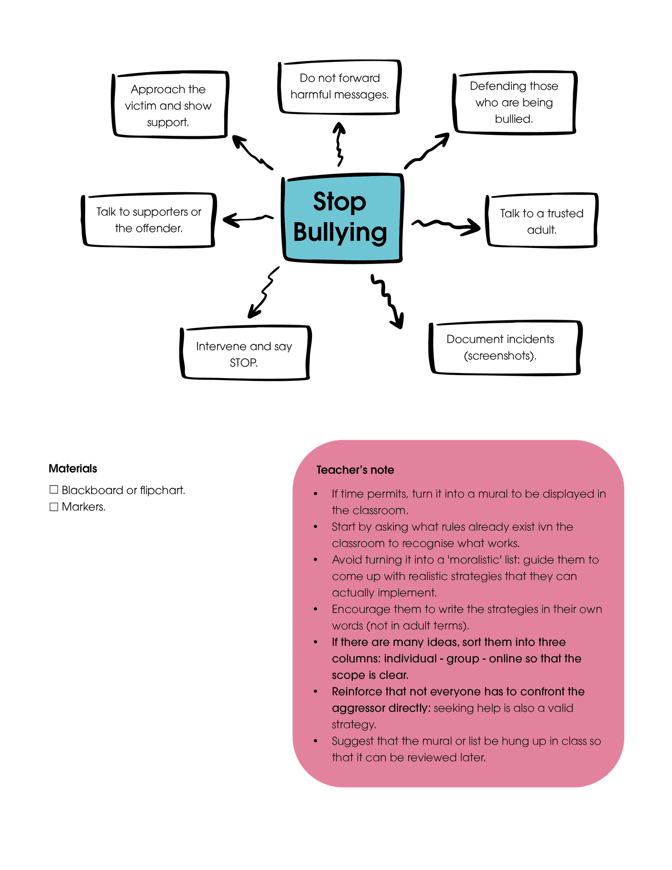
What each individual can do
What the class can do.
What to do on the internet
Remember: Asking for help is not tattling, it is protecting yourself

Slide 74
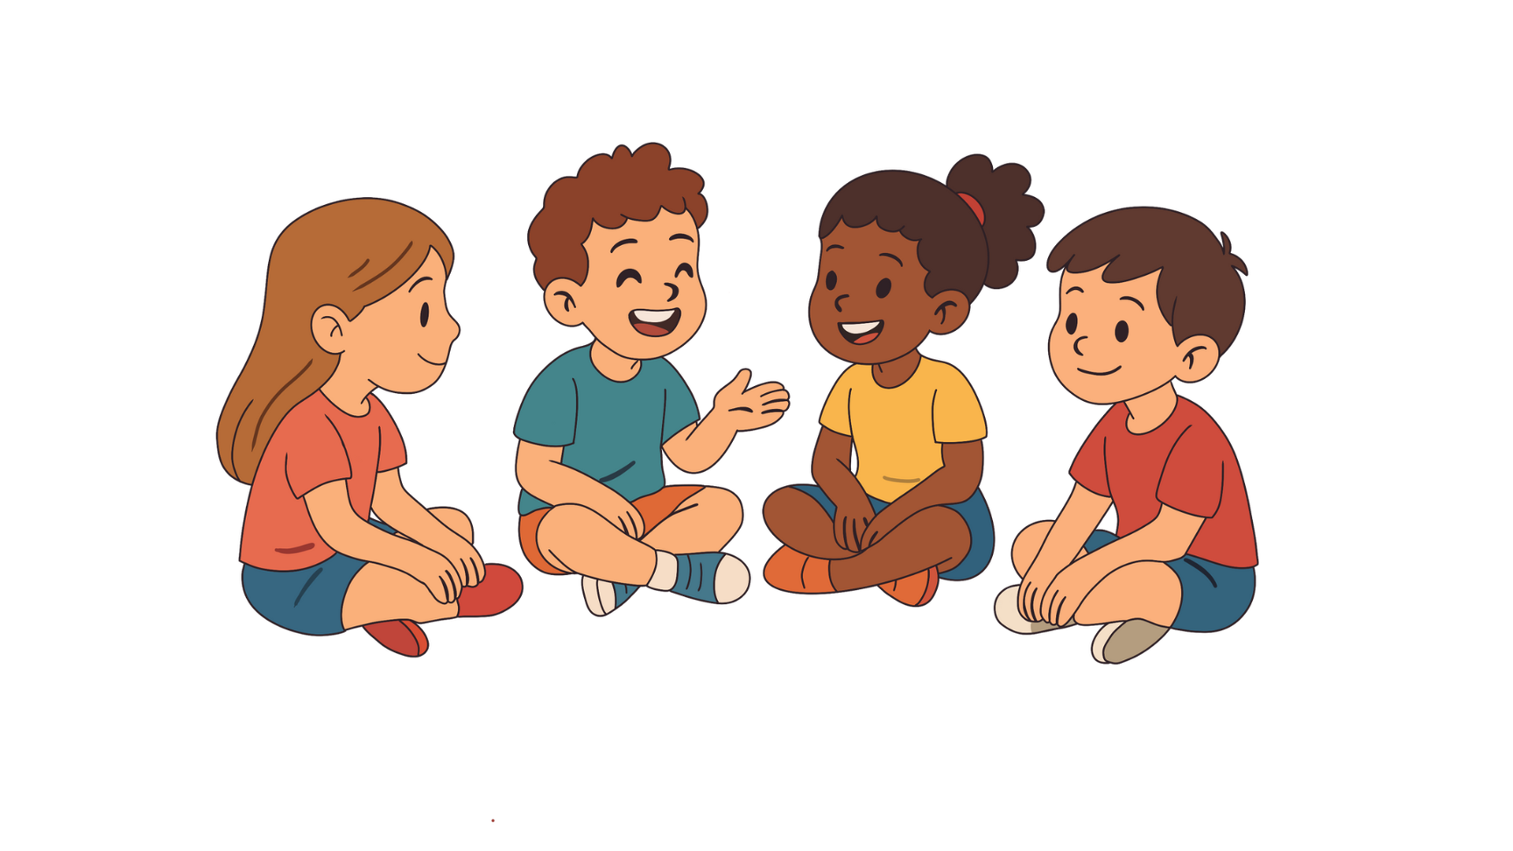
“Bullying is not just one person’s problem; it is everyone’s challenge. As a class, we commit to taking care of each other and offering support.”
Remember: as a group, we are all responsible for taking care of each other.

Slide 75
Activity 2.8
Closing Circle
Self-love Cards​

Slide 76
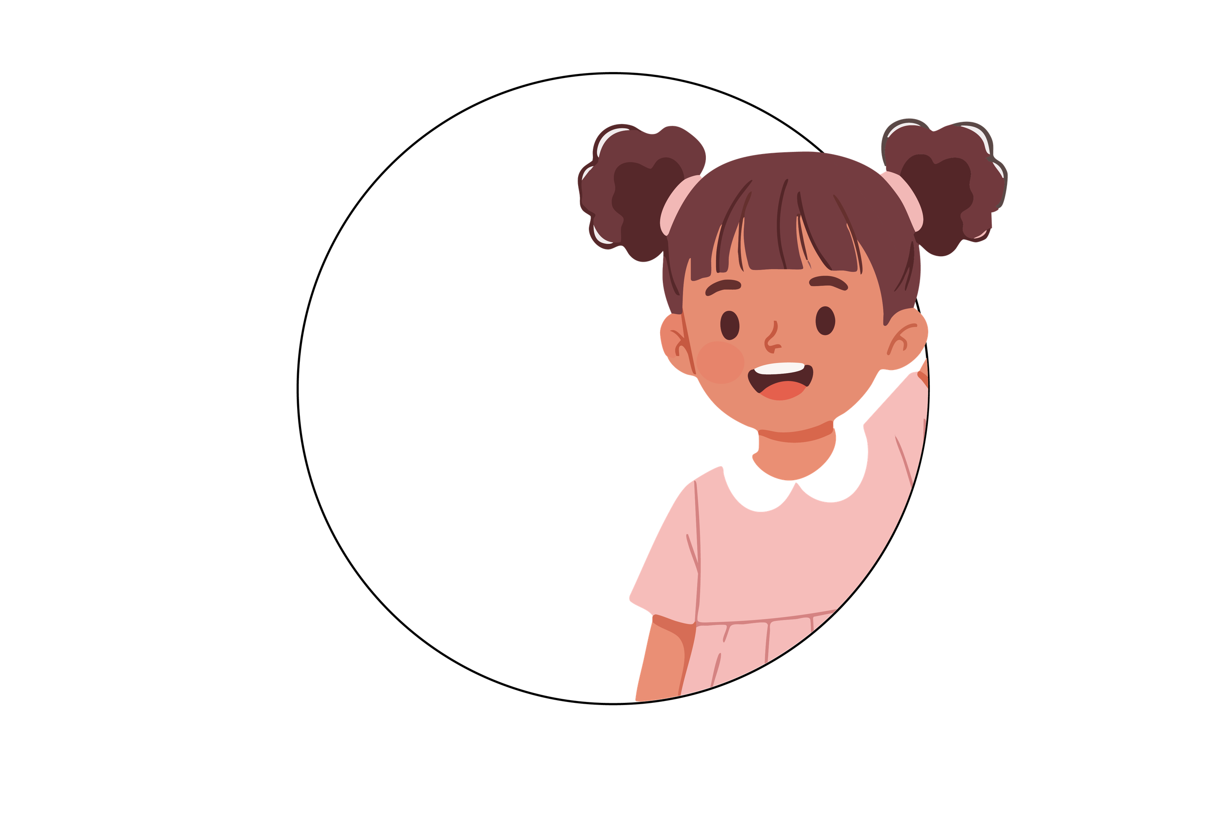
Materials:
  One circular card or self-love card per student.
  Colored markers.
  (Optional) Tape to hang the cards on the classroom wall.
What we will do:
Each student will write a positive message for themselves and share it if they wish.

Slide 77
Circulate around the classroom, passing the cards from hand to hand
You are very brave
Everyone writes a positive message on each other's card.
I love your hair
I’m Lisa
I’m a Good friend
First write you name and a quality of yours
You are very funny
You are kind

Slide 78
Just as words can hurt, they also have the power to make us feel good and unite us as a group. Let’s remember to use our words to build and support

Slide 79
Complementary activities
The Anonymous Message Box

Slide 80

Materials:
  A decorated box or mailbox (physical or virtual).
  Small slips of paper.
  Pens or pencils.
What we will do:
Anyone can use it anonymously to leave messages about how they feel, something unfair they have seen, or to share advice or a positive message

Slide 81
Complementary activities
The Web of Trust

Slide 82

Materials:
  A ball of yarn or string.
  Enough space for the group to form a circle.
What we will do:
Form a circle and, throwing aball of yarn, and say a positive quality or a supportive message to a classmate.
Remember: when we are connected and support each other, the class is stronger.

Slide 83
Module closing
The most important thing: support each other, respect each other, and build a safe class.
Each one has a role so that no one feels alone.
Bullying and cyberbullying are not games. With our words and actions, we can cause harm… or we can care.

Slide 84


