Slide 1
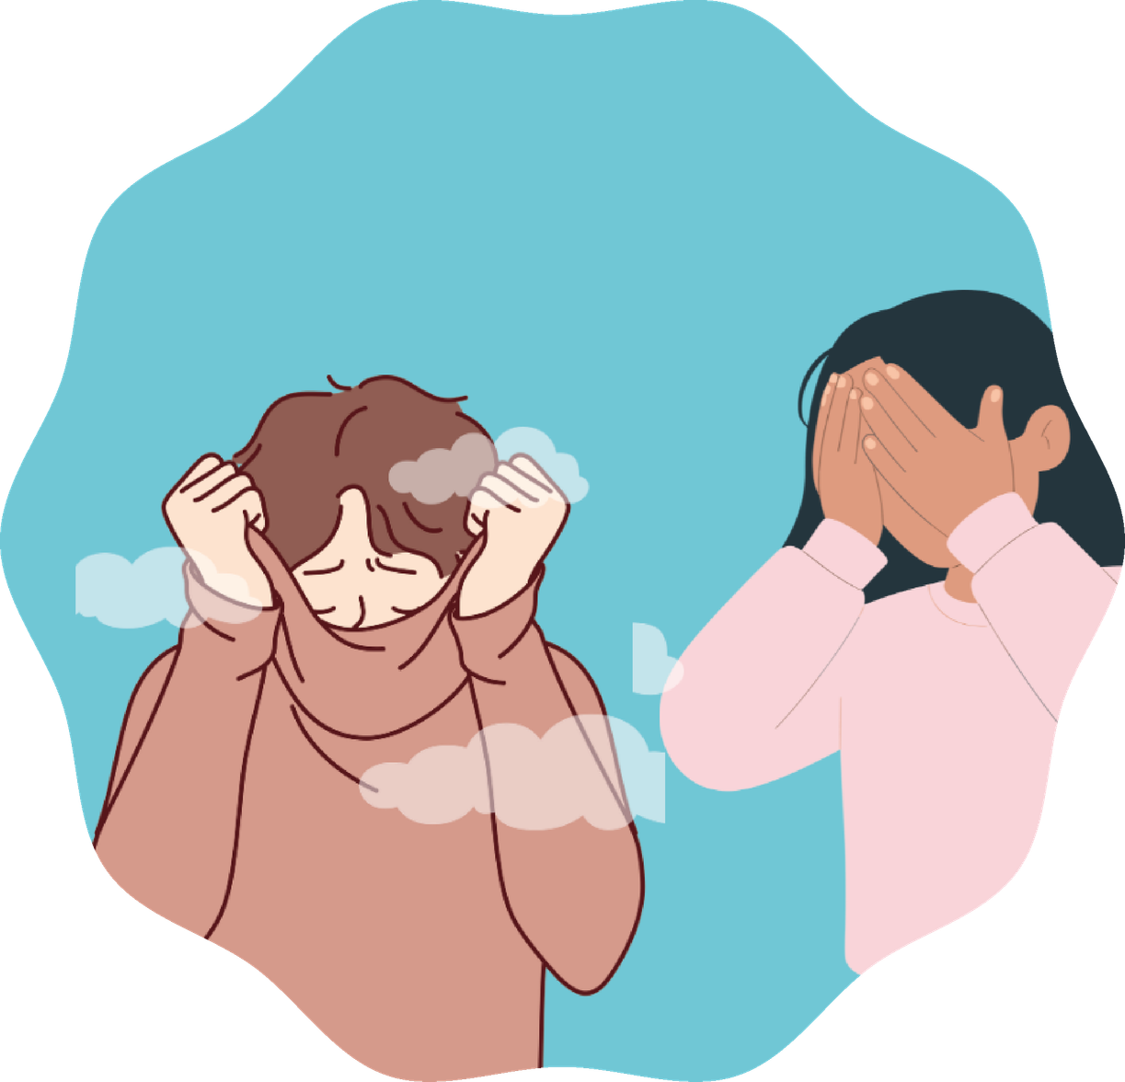


Module 6:
Shame
Understand, name, and transform
Secondary school

Slide 2
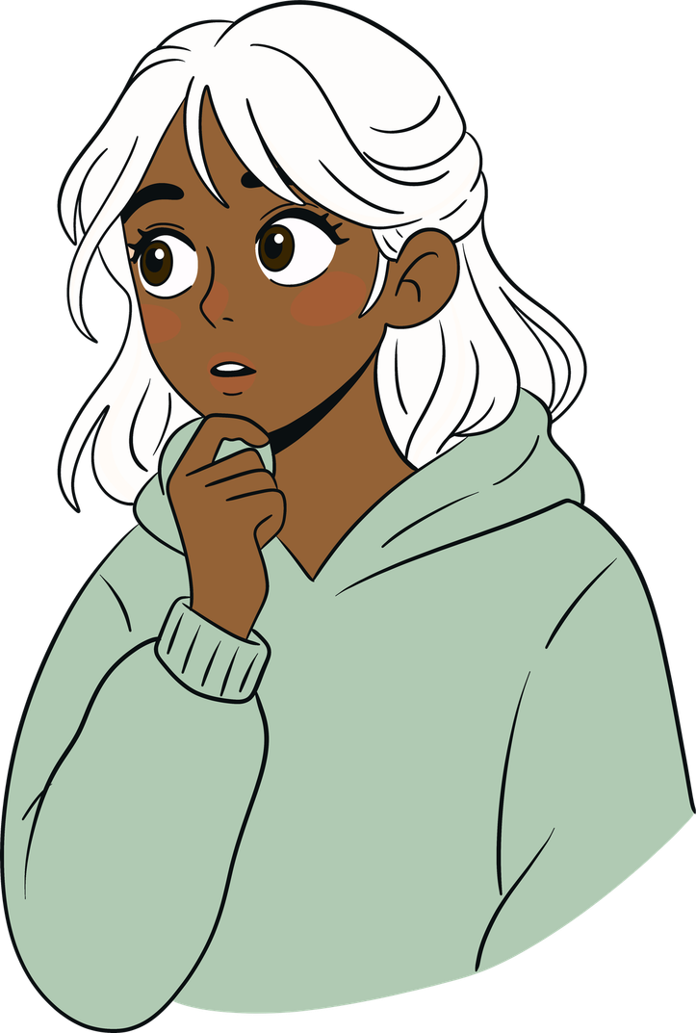
Let’s talk about it openly
Shame is an emotion we all experience, even if almost no one wants to admit it. It appears when we think: “I am not enough” or when we believe others are judging us or that we have done something “wrong”.
Today we will explore it more closely.

Slide 3
Shame triggers (Stephan Marks)
  Feeling excluded or set aside
  Feeling defenceless or exposed (for example on personal or intimate topics)
  Not feeling recognised or seen
  Acting against one’s own values or norms
  Feeling shame because of other people’s behaviour

Slide 4
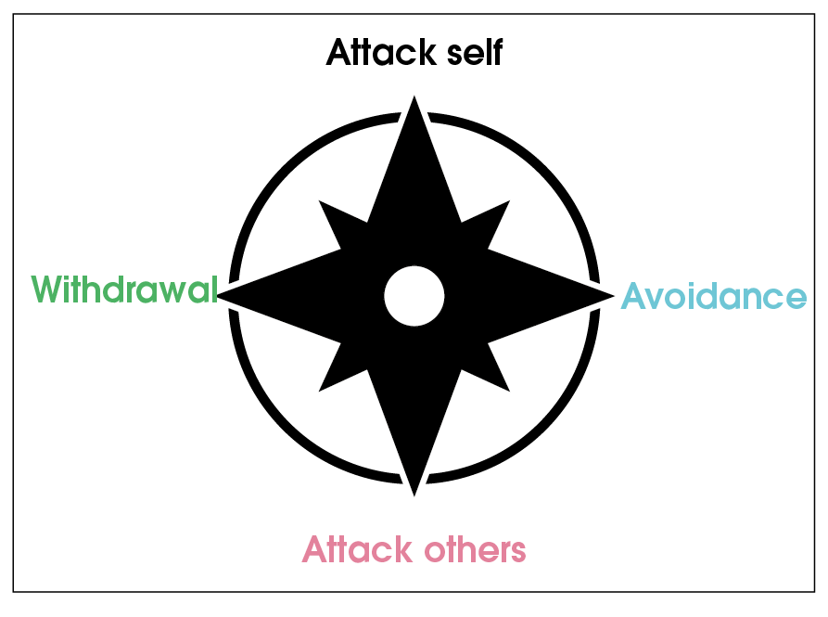
The shame compass
Donald Nathanson
When people feel shame, they often react in different ways. Nathanson describes four main directions:
  Withdrawal: withdrawing, hiding, or trying to become invisible.
  Avoidance: joking, distracting yourself, or minimising what happened.
  Attacking others: blaming someone or drawing attention to yourself to divert it.
  Attacking yourself: criticising or punishing yourself internally.

Slide 5
The shame compass
Donald Nathanson
“When we understand shame, it stops controlling us.”
– Inspired by Brené Brown

Slide 6
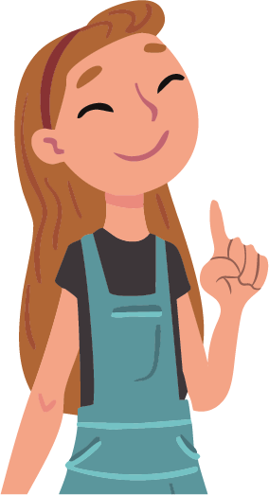
Goals
01
Understanding what shame is and why it arises.
02
Recognising how it manifests in the body and mind.
03
Recognising the situations that trigger it, such as embarrassment, exclusion, or not feeling seen.
04
Normalise it: everyone experiences it, you are not alone.
05
Learning to respond better when it appears.
06
Promoting respect and empathy within the group.
07
Finding ways to support each other so that the class is a place where no one feels ashamed.

Slide 7
Phase 1
Introduction “The individuality of shame”

Slide 8


Materials:
  Red and green cards
  List of situations
  Whiteboard or flipchart + markers
What do we do?
We will talk about situations that can trigger shame.
We will read some phrases and raise the red card (yes) or the green card (no).
Then we will see where we agree and why each person experiences these situations differently.

Slide 9
01
Falling over in front of my friends
02
Someone reacting to one of my social media posts
03
Making a mistake when reading aloud in class
04
Being the only one not invited to a party
05
Getting a bad grade in a subject I usually do well in
06
Speaking in front of others
07
Someone seeing my messy room

Slide 10
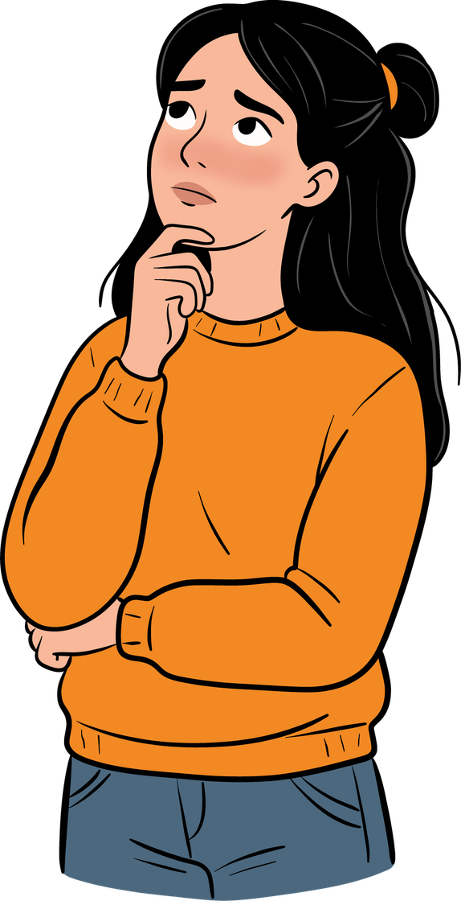
Do we agree on the same situations?
Why do some things trigger more shame than others?
Remember
  Every person experiences shame for different reasons.
  Shame is not “bad”. It helps us understand how we feel around other people.
  Talking about what we feel helps us handle it more calmly.

Slide 11
Phase 2
Development
“Understanding shame”

Slide 12
Materials:
  Whiteboard or projector
  Coloured markers
  Patterns on:
    Shame triggers (Stephan Marks)
    Shame compass (Donald Nathanson)
What do we do?
  We will see what shame is, how it shows up, and what it is for.
  We will learn what triggers it and how we normally react.
  In pairs, we will think about a situation of shame and see which reaction fits best.
Shame triggers
(Stephan Marks)
  Feeling excluded or set aside
  Feeling defenceless or exposed (for example on personal or intimate topics)
  Not feeling recognised or seen
  Acting against one’s own values or norms
  Feeling shame because of other people’s behaviour

Slide 13
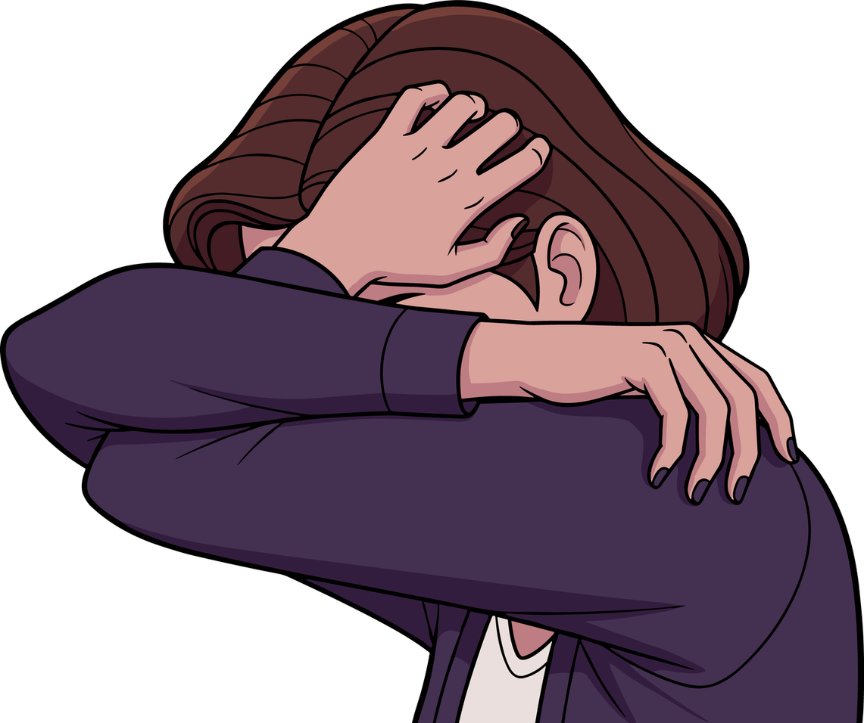
What is shame?
A natural emotion that arises when we feel we might be judged or might lose the group’s acceptance.
How it shows up:
It is painful: you feel small, you hide, and you wish you could disappear.
What it is for:
It makes us aware of how other people’s thoughts influence us and helps us reflect on how we act.

Slide 14
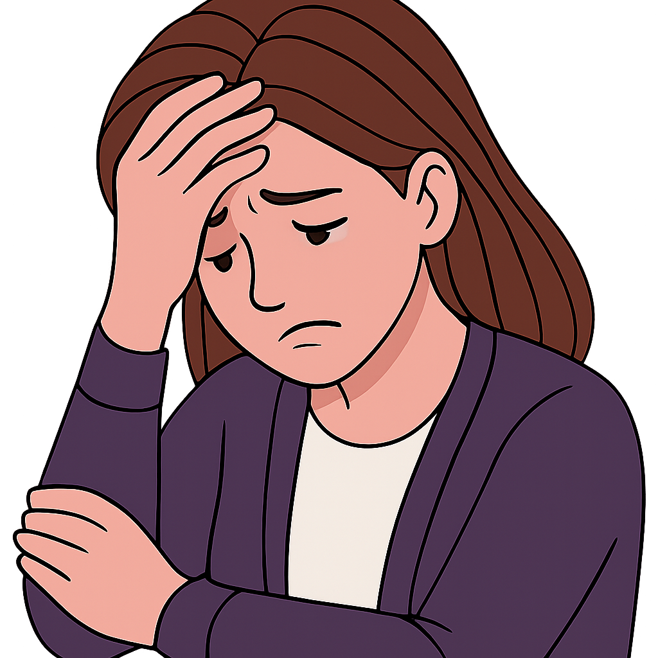
Shame triggers (Stephan Marks)
  Feeling excluded or set aside
  Feeling defenceless or exposed (for example on personal or intimate topics)
  Not feeling recognised or seen
  Acting against one’s own values or norms
  Feeling shame because of other people’s behaviour

Slide 15
The shame compass
Donald Nathanson
Shame is an emotion
good or bad?
Which of these reactions is most familiar to you?
Which reaction, in your opinion, helps most to improve relationships?
  Withdrawal: withdrawing, hiding, or avoiding being seen.
  Avoidance: joking, distracting yourself, or minimising what happened.
  Attacking others: blaming someone or mocking them to divert attention.
  Attacking yourself: criticising or punishing yourself internally.
Remember
  We cannot avoid feeling shame, but we can choose what to do with it.
  When we understand it better, it stops controlling us so much and we can take better care of ourselves and others.

Slide 16
Phase 3
Consolidation “Recognising and understanding shame”

Slide 17
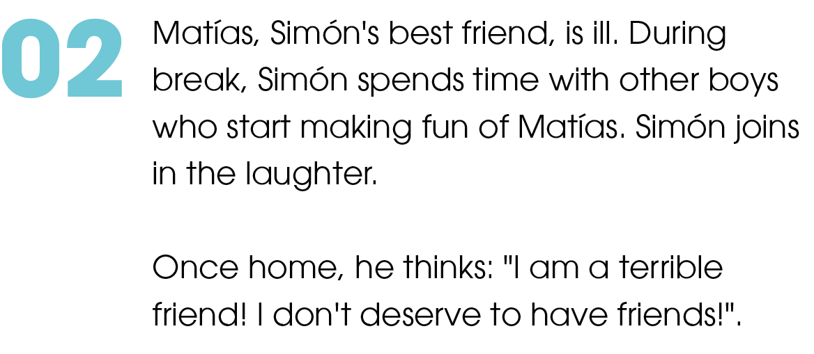
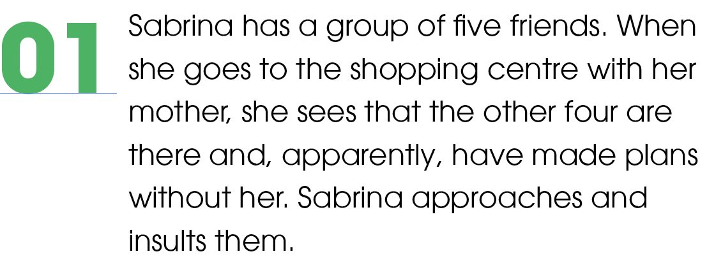
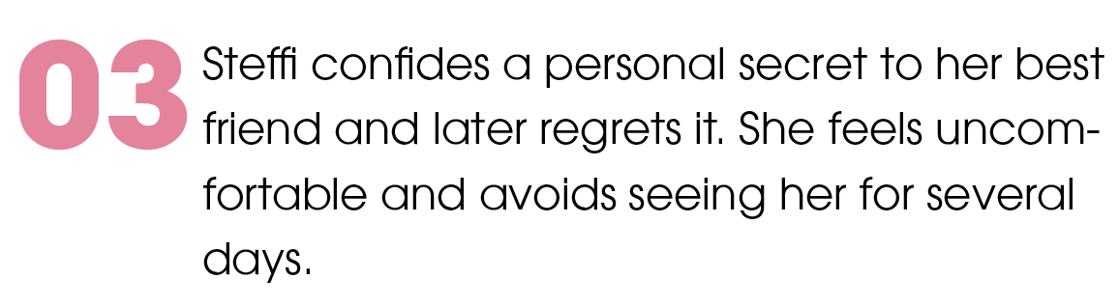
Materials:
  Cards or sheets with examples
  The visible shame compass
  Whiteboard or markers
What do we do?
  We will work in groups to analyse different situations.
  We will identify what triggers shame and how the person reacts.
  Then we will think about more empathetic alternatives.

Slide 18
What do we analyse in groups?
Each group will identify:
What is the shame trigger?
What kind of reaction comes up?
What more empathetic or helpful response could there have been?

Slide 19
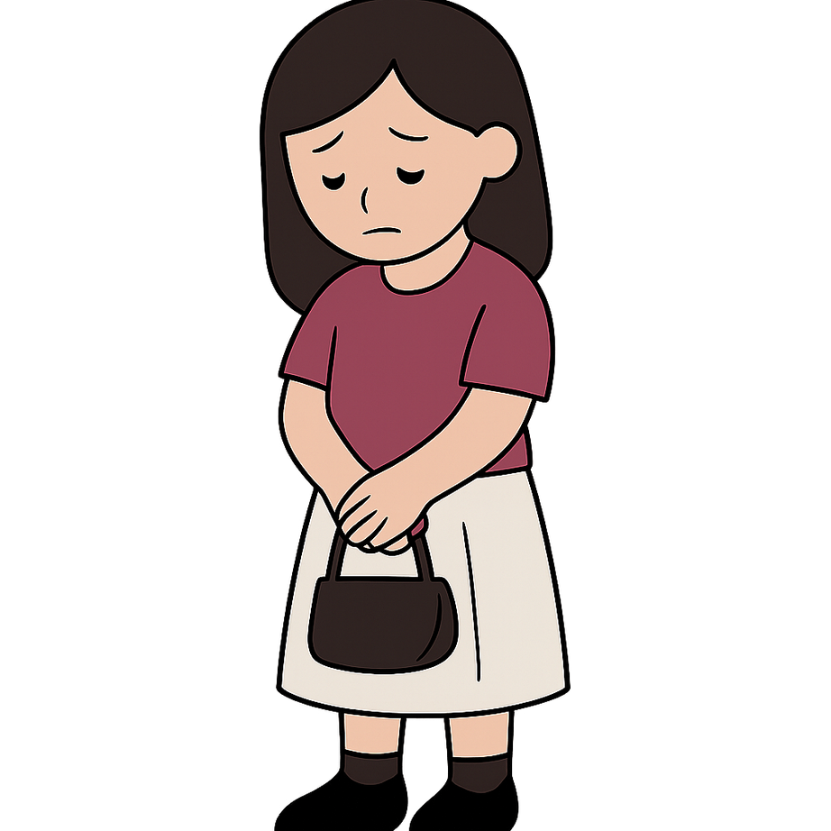
“We will analyse each case to understand what triggers shame and what reaction comes up. Then we will see what other response would have been healthier or more respectful.”
01
Sabrina has a group of five friends. When she goes to the shopping centre with her mum, she sees that the other four are there and apparently did not invite her. Sabrina approaches them and insults them.
Trigger
Behaviour
Marginalisation
Exclusion
Attacking others

Slide 20
02
Matías, Simón’s best friend, is ill. During the break, Simón is with other students who start making fun of Matías. Simón laughs.
When he gets home, he thinks: “I am a bad friend! I do not deserve friends”.
Trigger
Behaviour
Acting against one’s own values
Attacking yourself

Slide 21
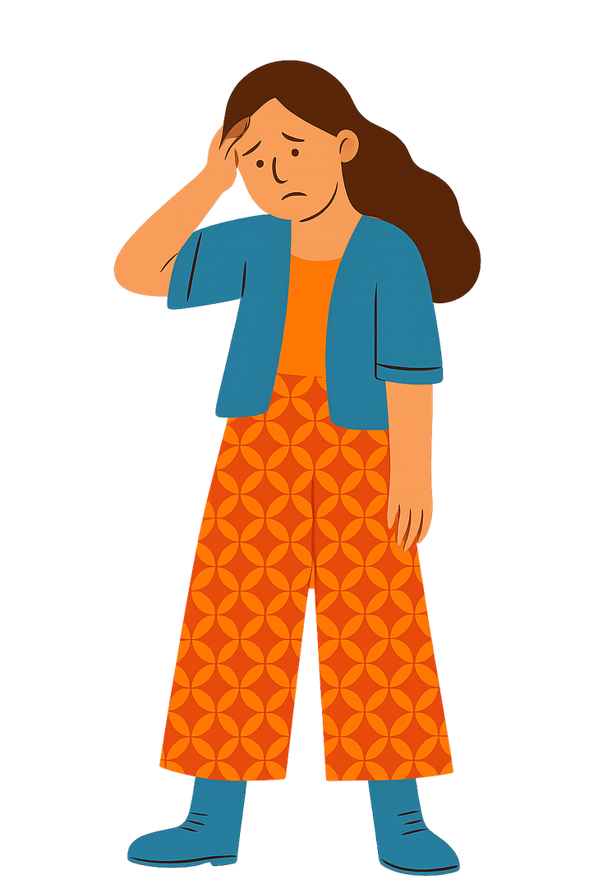
03
Steffi tells a personal secret to her best friend and then regrets it. She feels uncomfortable and avoids seeing her for several days.
Trigger
Behaviour
Feeling defenceless or exposed
Avoidance

Slide 22
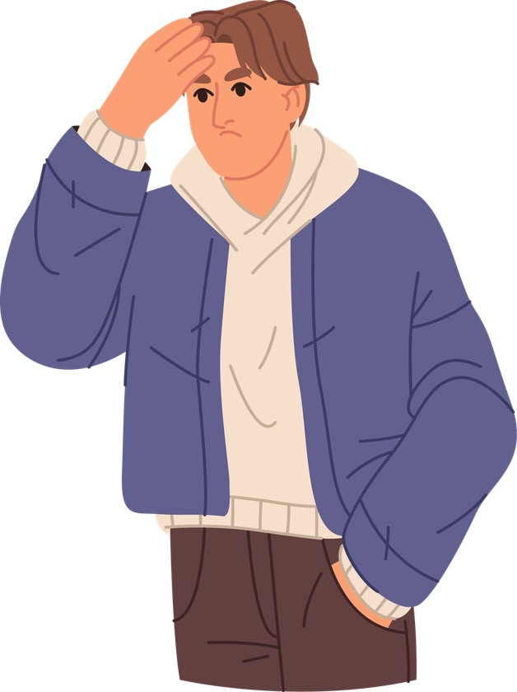
04
Lukas gets an excellent grade in maths. When he gets home, he wants to tell his mum, but she is on the phone and does not listen to him. Lukas retreats to his room for the rest of the day.
Trigger
Behaviour
Not feeling recognised
Withdrawal

Slide 23
Phase 4
Conclusion
“Shame at school and prevention”

Slide 24
Materials:
  Wallpaper or large cardboard
  Coloured markers
  Cards with questions
  Poster: “How can we create a school without shame?”
What do we do?
  We will reflect on how shame arises in school life.
  We will work in groups to develop ideas and create a poster with concrete proposals to improve how we get along.
Exposure
Public mistakes
Comparisons

Slide 25
01
We think about school situations in which shame can emerge and write them on a sheet or a post-it note.
02
We create a poster with three columns:
Situations that trigger shame
How they make us feel
What can we do to improve
  Oral presentations
  Comparisons between students
  Teasing or comments
  Making a mistake in public
  Social networks
  Sad
  Nervous
  Angry
  Insecure
  Anxious
  Ashamed
  Practising before a presentation with a friend or a family member
  Remembering that mistakes are part of learning
  Asking a teacher for help when something is wrong
  No comparisons: everyone learns at their own pace

Slide 26
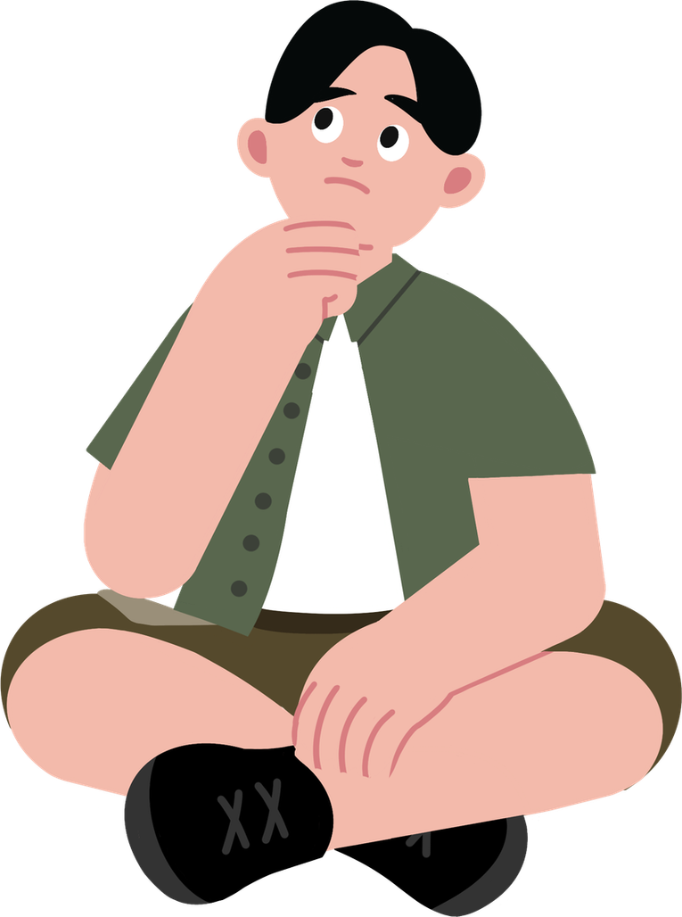
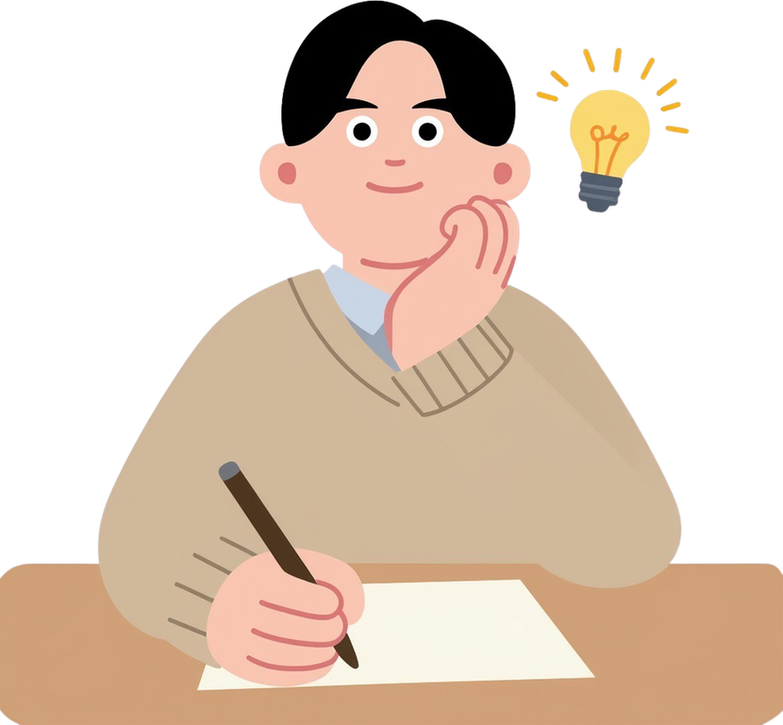
We answer the following questions:
What patterns do we recognise?
What can we change as a group?
What do I need to feel calmer when I feel shame?

Slide 27
Additional activity
Anonymous stories about shame

Slide 28
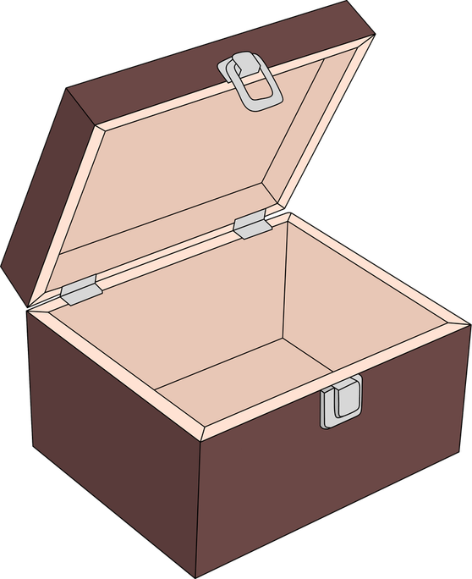

Materials:
  Small sheets or cards
  A box or a large envelope to collect the stories
  Whiteboard and markers
  (optional) label: “Things that unite us”
What do we do?
  We anonymously write a situation (real or invented) in which someone might feel shame
  We put all the sheets in a box, read some of them aloud, and discuss why this situation can trigger shame and what might help this person
Remember
  Everyone has felt shame at least once. If we share it (even anonymously), we understand each other better and learn to treat each other with more respect.

Slide 29
Additional activity
The shame traffic light

Slide 30
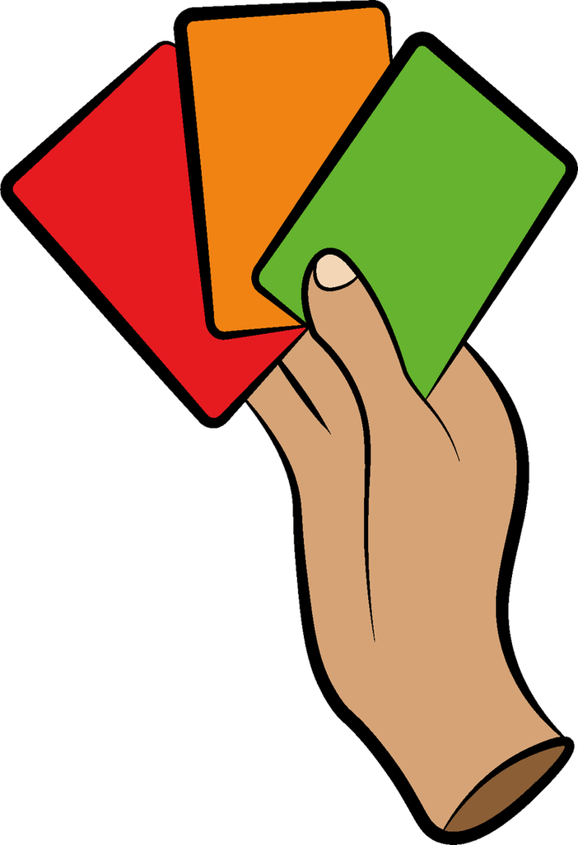
Materials:
  Cards: red, yellow, green
  List of situations
  Space to move around
What do we do?
  We use an “emotion traffic light” to show how much shame different situations can trigger
  We read some phrases and each person raises the card that best represents the intensity they feel
Remember
  Everyone has felt shame at least once. If we share it (even anonymously), we understand each other better and learn to treat each other with more respect.

Slide 31
01
I would feel ashamed if I forgot my part during a group presentation.
  Red: high
  Yellow: medium
  Green: little or not at all
02
I would feel ashamed if my parents commented something embarrassing on my posts.
03
I would feel ashamed if I tripped getting off the bus in front of the whole school.
04
I would feel ashamed if friends found my personal drawings or writings.
05
I would feel ashamed to speak in front of others or to make a mistake reading aloud.
06
I would feel ashamed if I were not accepted by my friends.
Remember
  Everyone experiences shame in their own way. There are no “right” levels of intensity: all are valid.

Slide 32
Additional activity
Mural

Slide 33
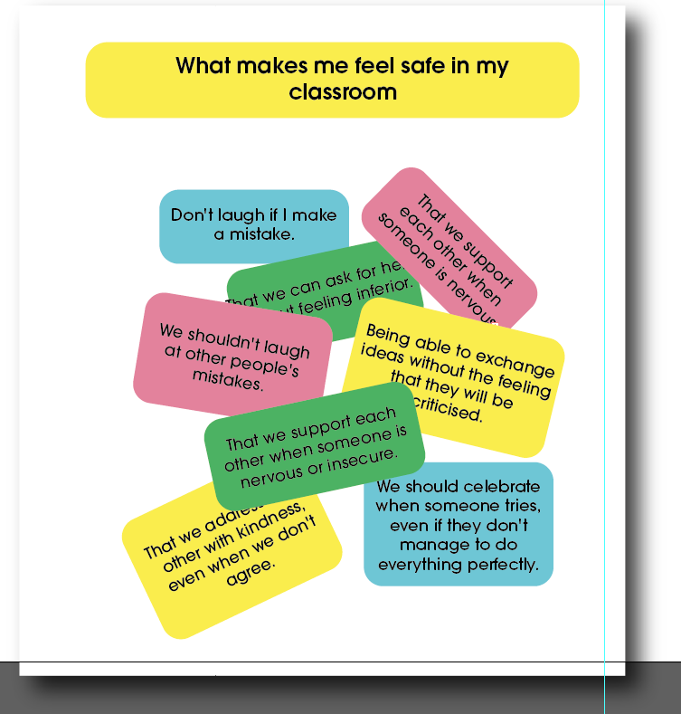
Materials:
  Cardboard or wallpaper
  Post-it notes
  Coloured markers
  Poster: “What helps me feel safe in my class”
What do we do?
  We reflect on things that help us feel good and respected in class
  Each student writes an idea or draws something on a card
  We stick all the cards on a poster and group them by theme: respect, empathy, collaboration
Remember
  This mural shows how we want to relate to each other as a group.
  It is a shared commitment to create a class where no one feels ashamed of being who they are.

Slide 34
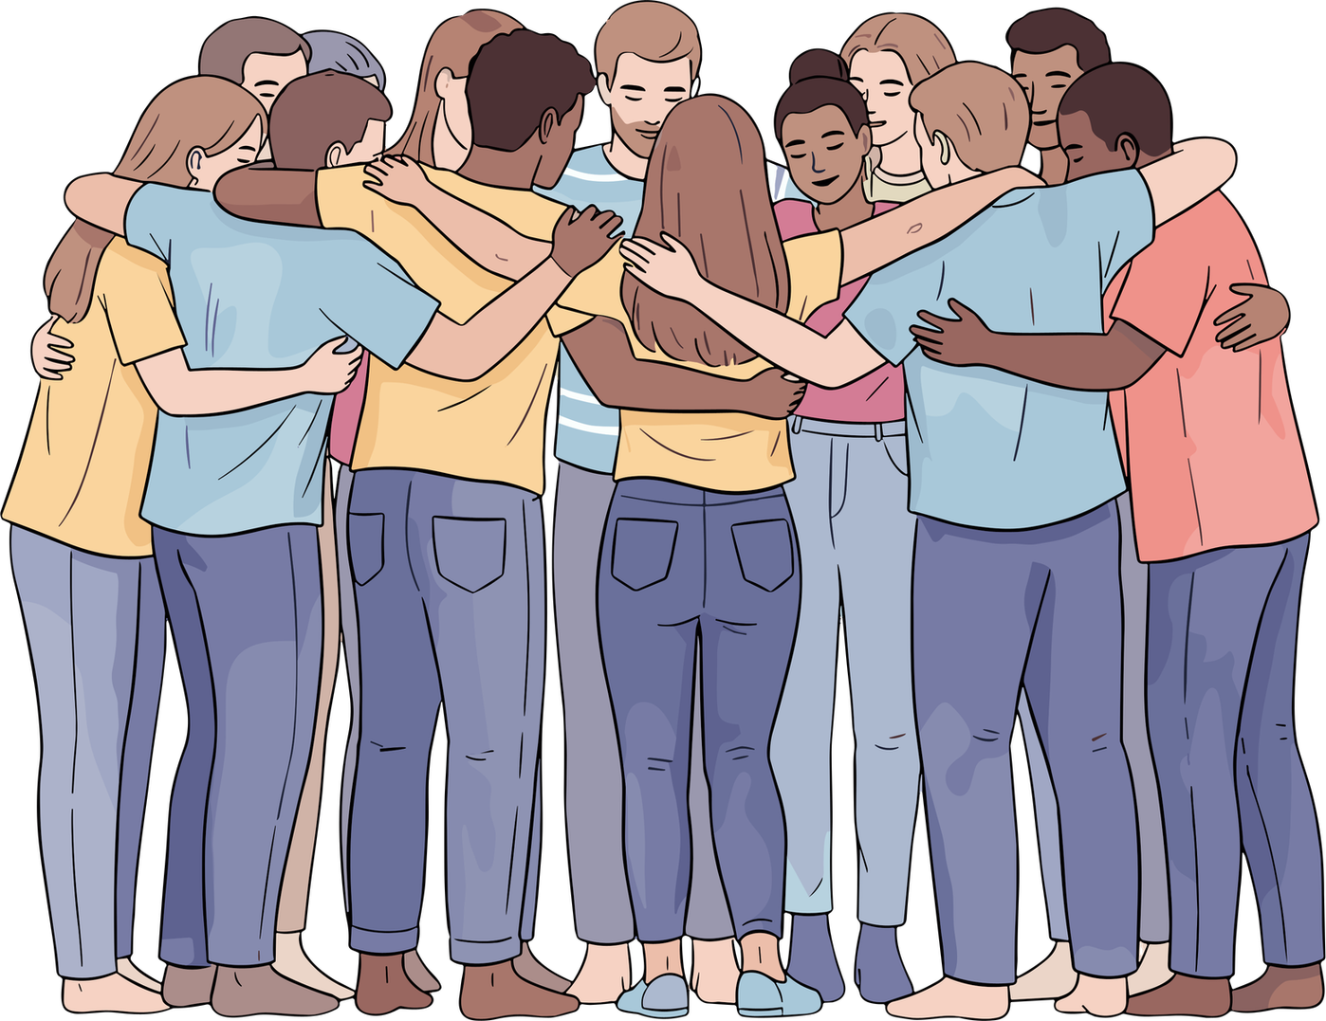
Shame does not define you. Understanding it helps us manage it more calmly and treat each other better.
Today we have seen that everyone experiences shame at some point and that each person lives it differently.
When we talk about it, we understand it better.
And when we treat each other with respect, no one needs to hide how they feel. Thank you for helping to create a braver, more respectful class.

Slide 35


