Slide 1

Module 8:
Digital Media Use and Mental Health
Primary School

Slide 2
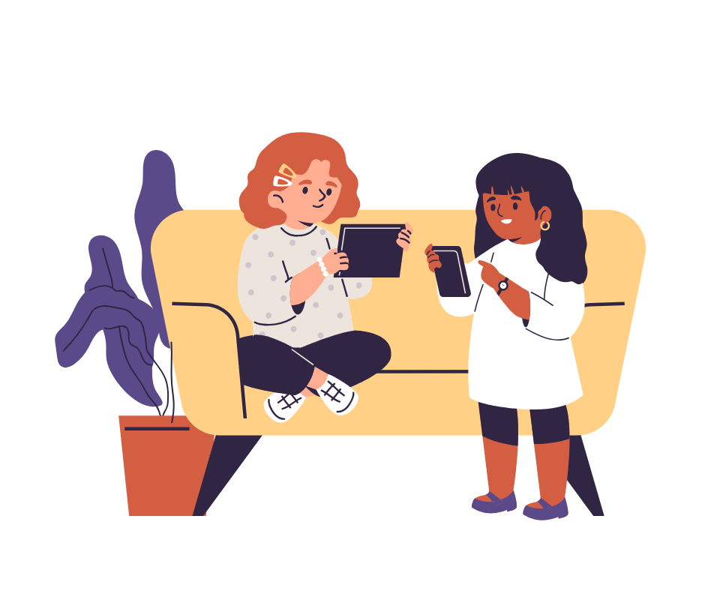
Why learn this module?
Digital media such as phones, tablets, video games and social networks can help you play, learn and stay in touch with others.
But they can also affect your sleep, your concentration and your emotions.
Here we will discover how to use them so they make us feel good, taking care of our health and our time.

Slide 3
Objectives
01
Reflect on how you use digital media
02
Discover which things are positive and which are less so
03
Learn why it is important to take breaks from screens
04
Find ways to use them in a balanced way
05
Develop healthy habits to feel better

Slide 4
Which media do you use every day?
What role do media play in your life?
What do you like to do with them?
What things make you feel not so good while using them?
What activities do you like to do without screens?

Slide 5
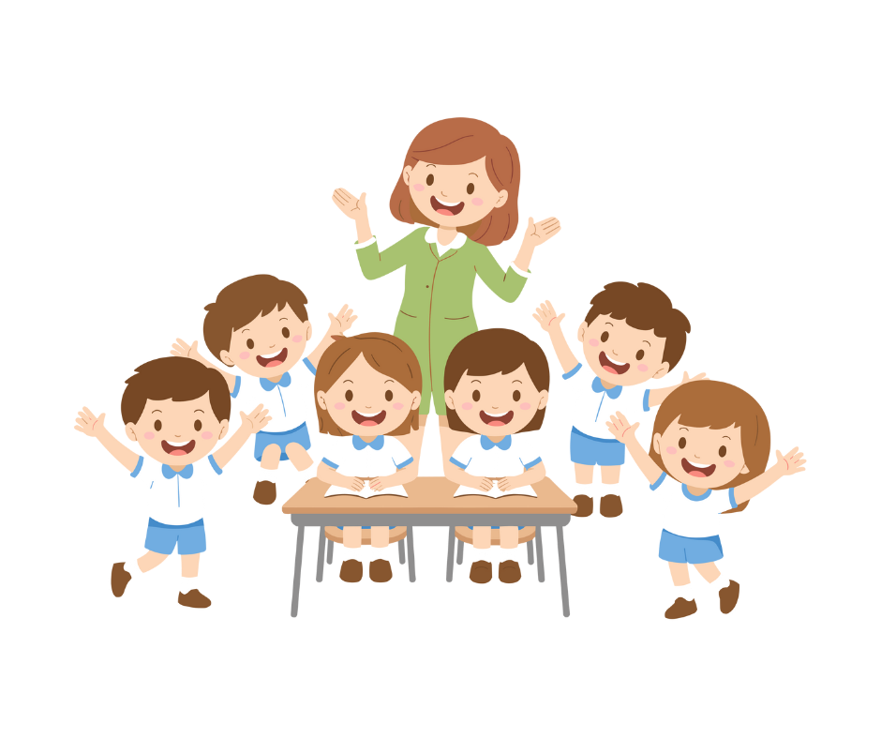
Let's talk together about how media influence our wellbeing.

Slide 6
Day 1
Rights in the World
Activity 1.1
Digital Media and Wellbeing

Slide 7
Materials
  Symbolic objects
  Chairs in a circle
  Blackboard
What will we do?
We talk about how digital media influence your life.
Each object helps us reflect and share experiences.

Slide 8
It leads us to reflect on the times and habits of device use.
It symbolizes time management and breaks in media use.
It encourages discussion about activities without digital media.
It refers to healthy sleep and screen-free moments.
It represents activities outside the Internet.

Slide 9
Is this activity healthy?

Slide 10
Is this activity healthy?

Slide 11
Is this activity healthy?

Slide 12
Which digital media do you use every day?

Slide 13
Activity 2.2
Dice Game – Emotions Linked to Media

Slide 14
Materials
  Media dice
  Emotions dice
  Blackboard
What will we do?
We roll the dice and each combination serves to tell real experiences.
Together we observe which positive and negative emotions media evoke in us.

Slide 15
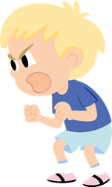


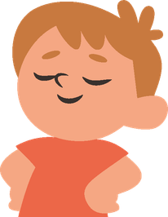
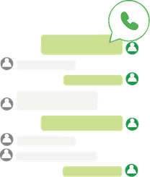
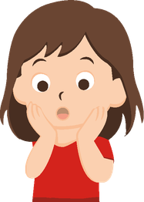
We roll the dice and each combination serves to tell real experiences.
Watching videos about injustices makes me angry.
+
=
Dancing and listening to music makes me feel really good.
+
=
It surprises me to talk with someone who is very far away.
+
=

Slide 16
Day 2
Healthy Use of Digital Media
Activity 2.1
Digital Media Usage Time

Slide 17
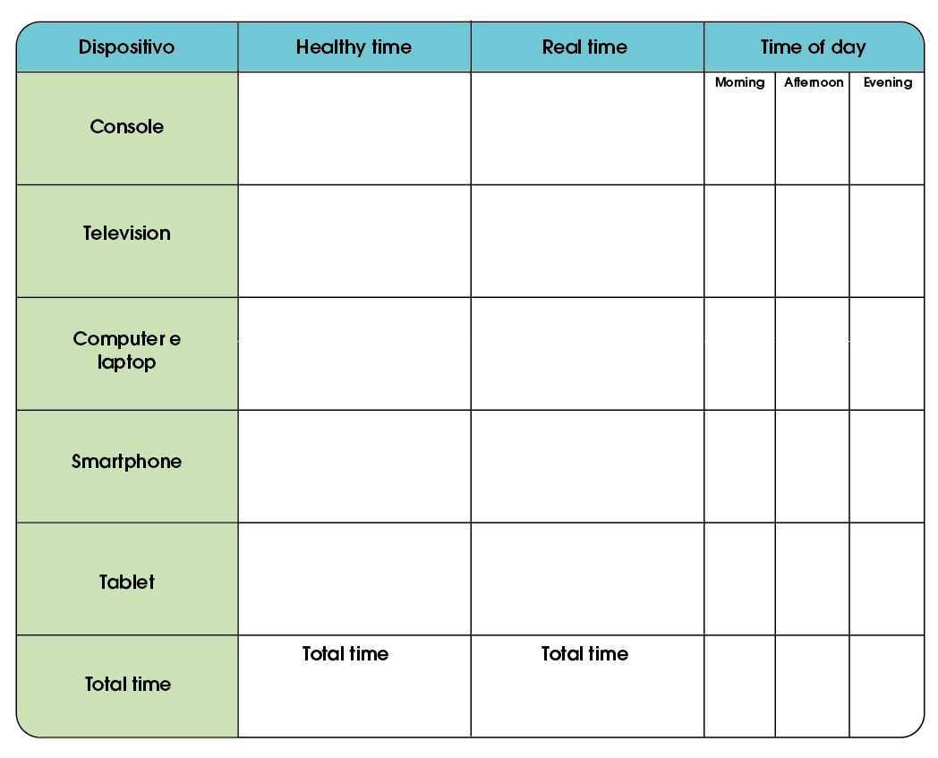
When and for how long do you use your tablet or your phone every day?
Materials
  Chairs in a circle
  Blackboard
  Optional: wall poster
What will we do?
We reflect on when and for how long we use phones or tablets.

Slide 18
Mutually agreed
2h
X
30 minutes
X
15 minutes
X
1h
X
Total time

Slide 19
Activity 2.2
Dice Game – Media Emotions

Slide 20
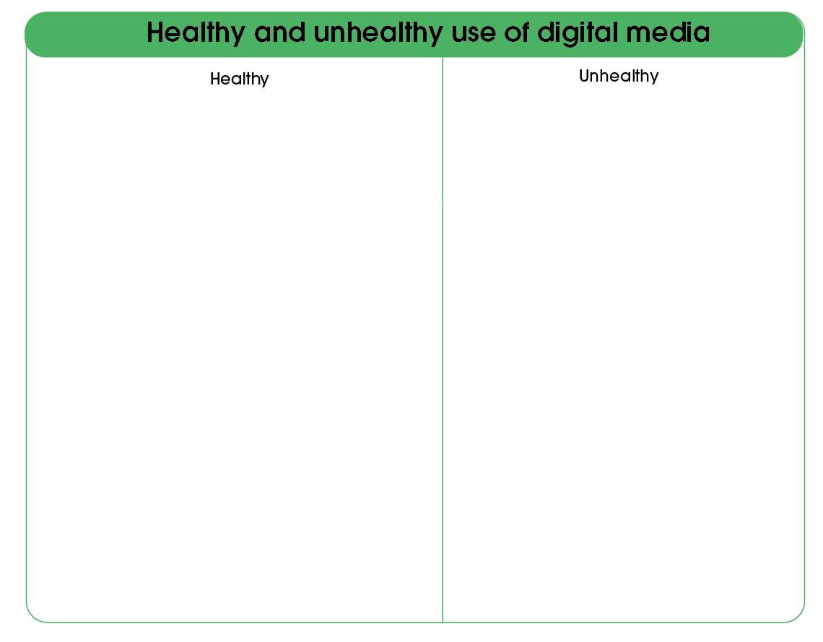
Materials
  Situation cards
  (Optional) weights board and labels for “healthy” and “unhealthy”
What will we do?
In small groups we classify different digital media usage situations.

Slide 21
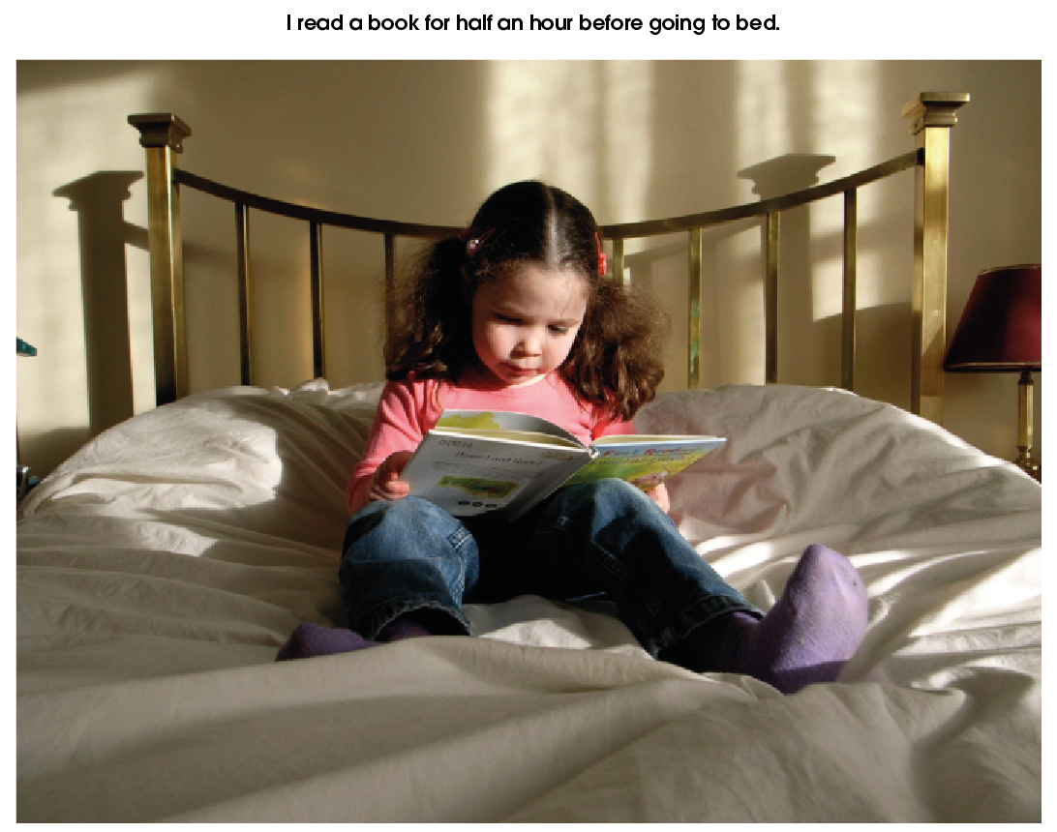

Slide 22
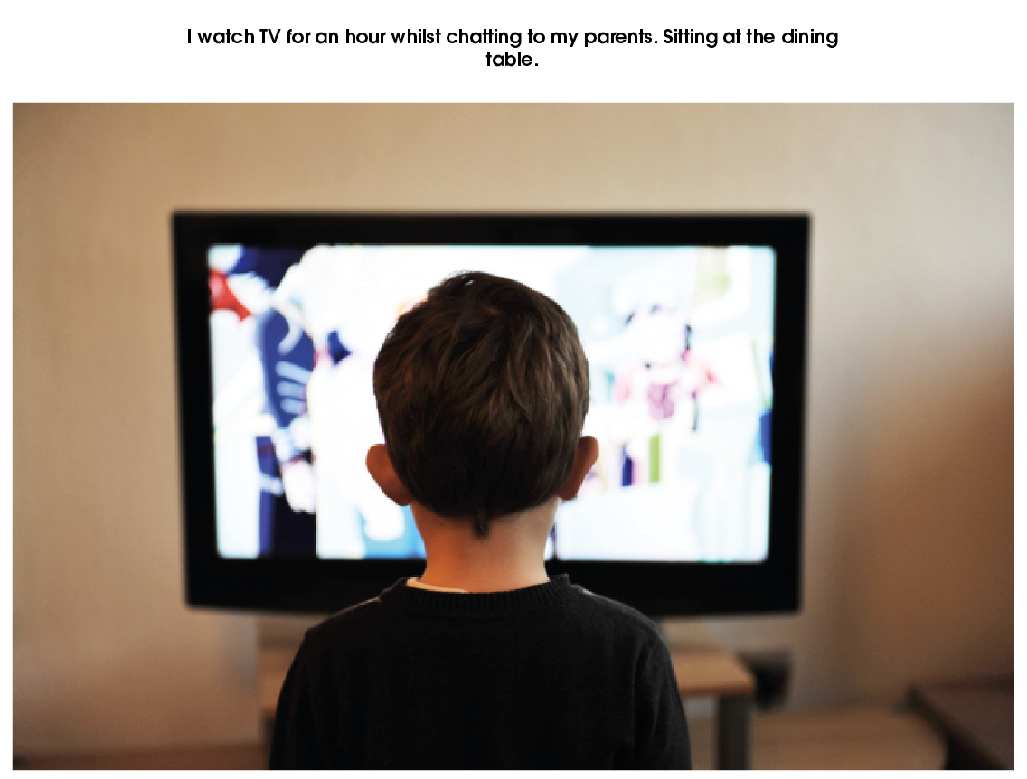

Slide 24
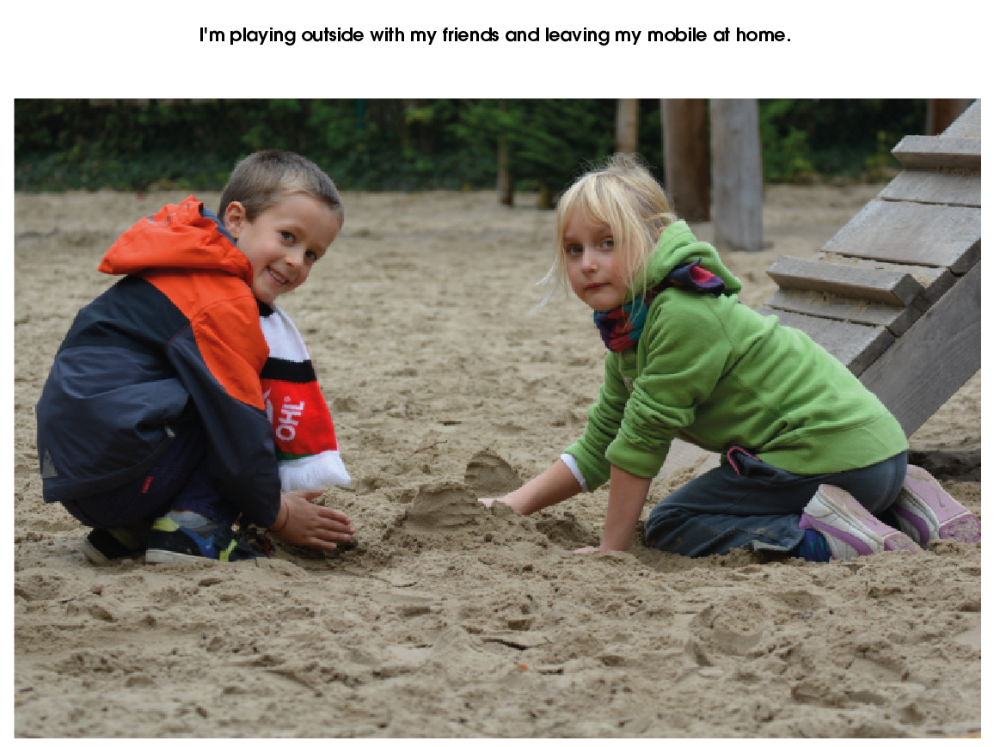

Slide 25

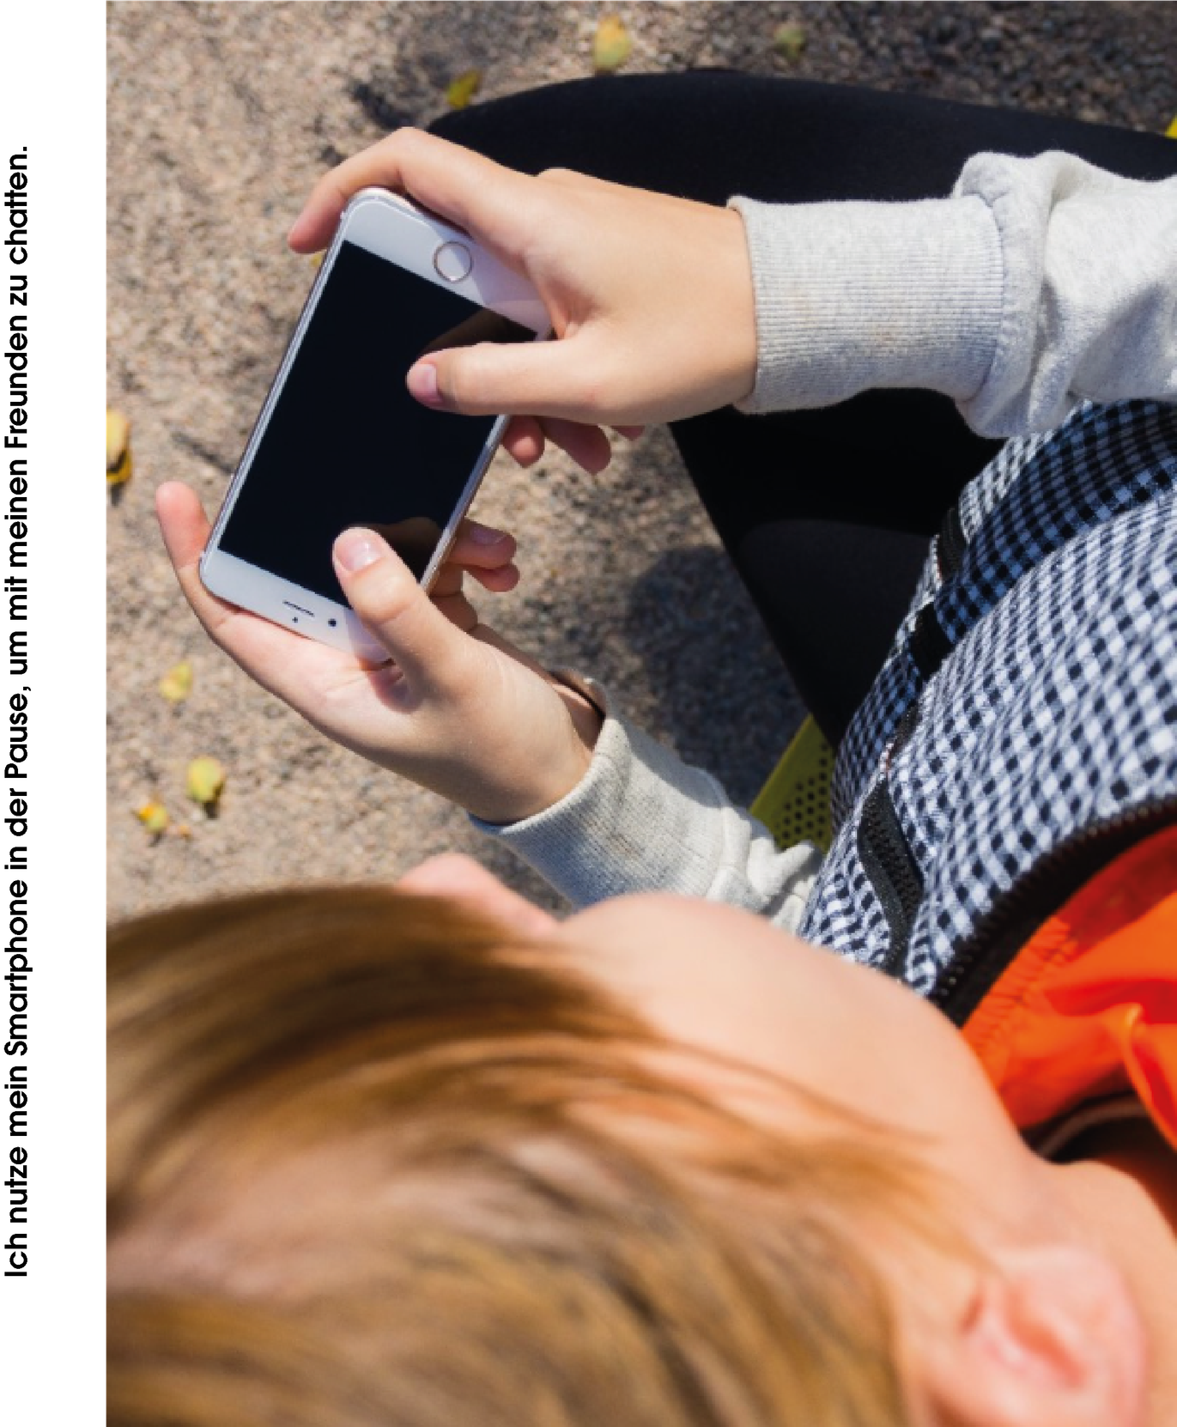

Slide 26
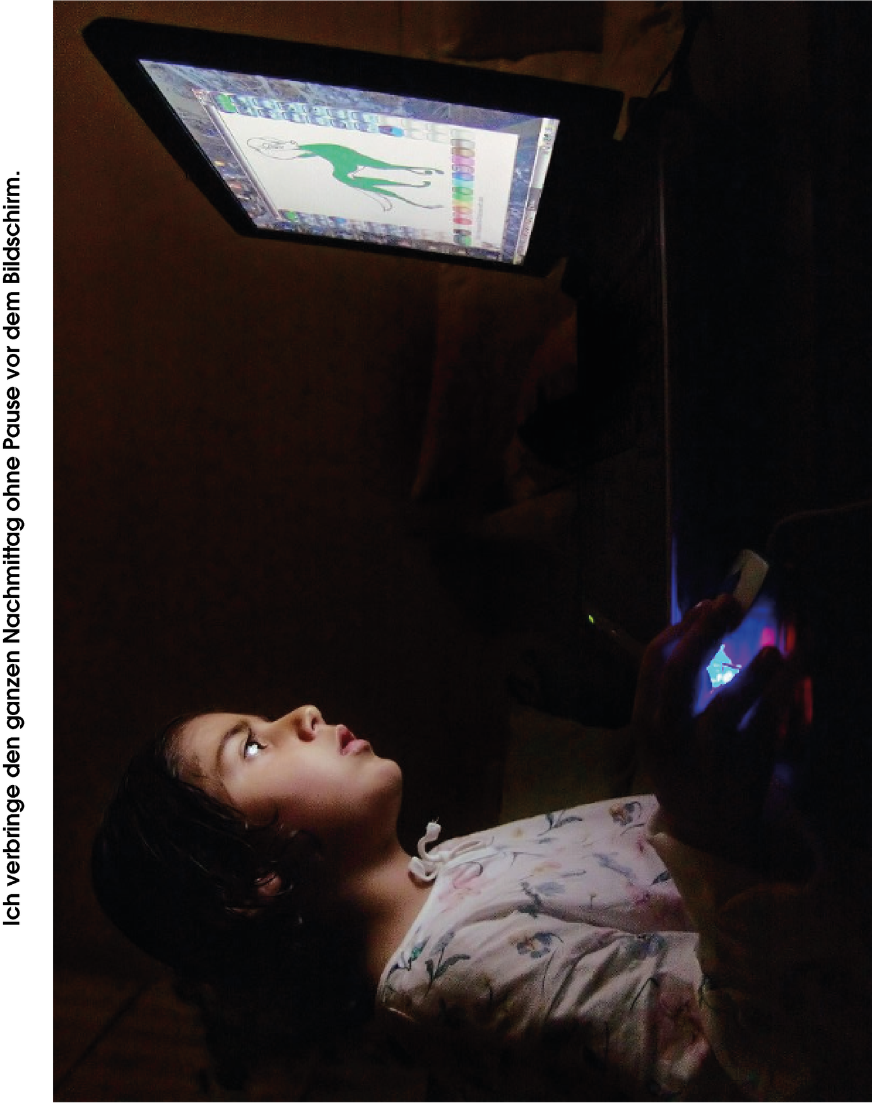

Slide 27
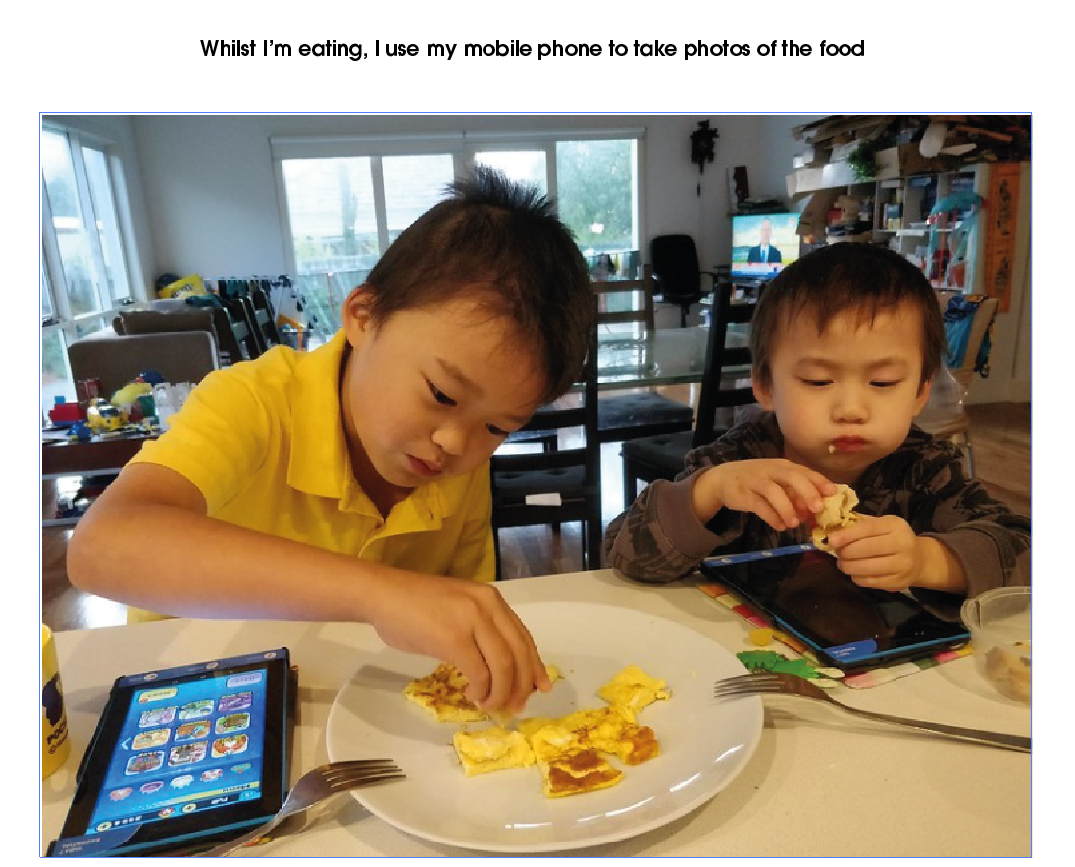

Slide 28
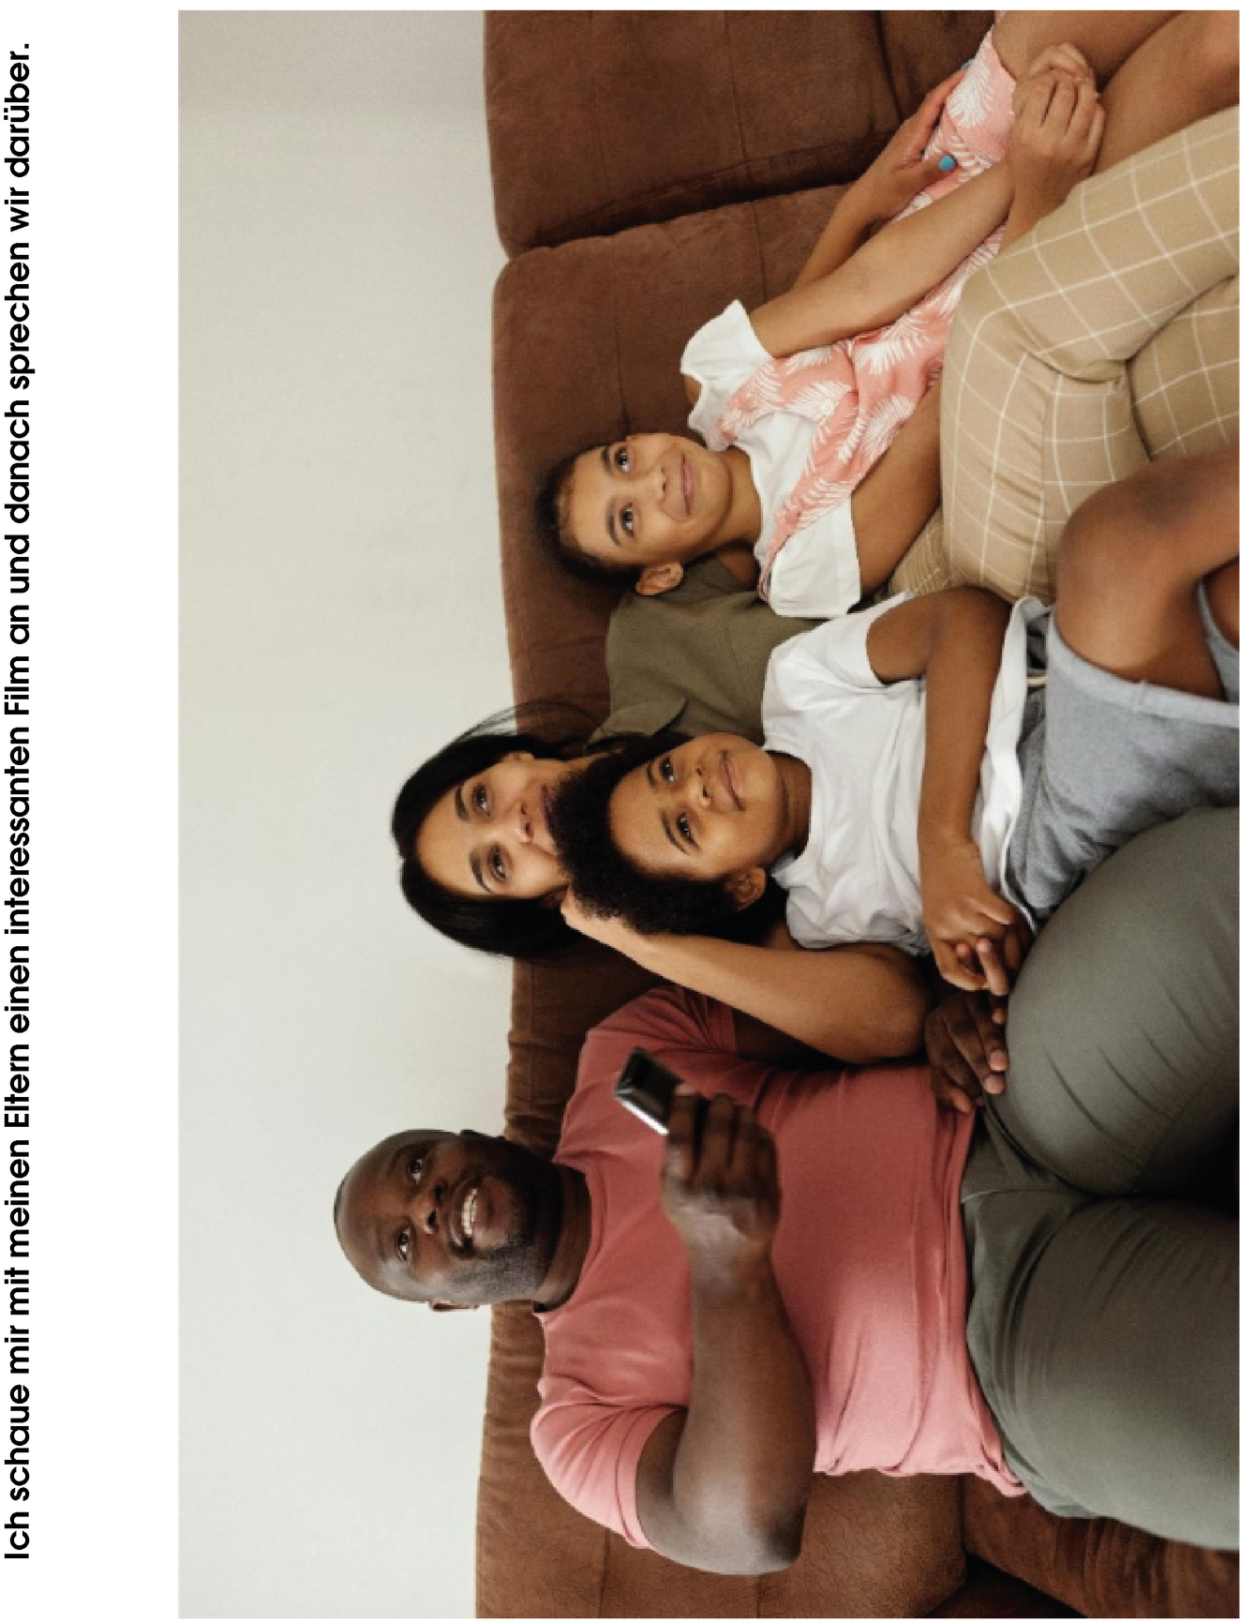

Slide 29
Day 3
Reflection and Healthy Media Habits
Activity 3.1
Media Experiences

Slide 30
Materials
  Chairs arranged in a circle or semicircle
  Blackboard and markers / chalk
What will we do?
We share experiences about how we use media and how they make us feel.
When and how do you use communication media and how do you feel about it?

Slide 31
How many hours do you spend in front of a screen?
What do you do when you are not using them?
Time
What happens when you spend a lot of time online?
What could you do to rest more?
  Balance is also part of wellbeing.

Slide 32
Which rules exist?
Which ones help you feel better?
Our Digital Rules
Which rules do you find difficult to follow?
Which new rules would you suggest?
  Balance is also part of wellbeing.

Slide 33
Activity 3.2
Media-Free Zones and Times

Slide 34
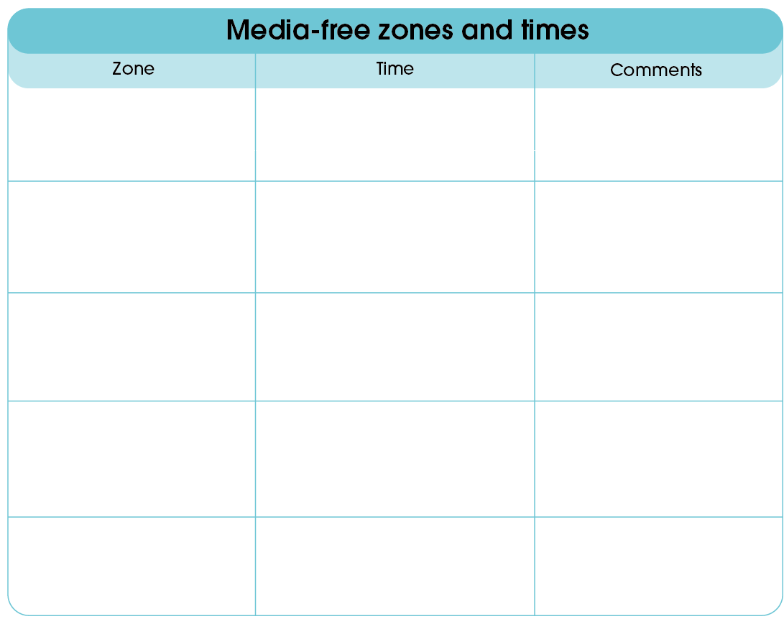
Materials
  Cardboard
  Markers
  Adhesive tape
  Blackboard
  (Optional) print “Media-Free Zones and Times”
What do we do?
In groups we create posters with proposals for media-free zones and times.

Slide 35
Dining Area
13:00 – 15:00
A moment to eat in peace.
So we can concentrate and learn better, we put away phones and tablets.
During
Class
When arriving at school
Before we go home
  Time to organise ourselves, reflect on the day and say goodbye without phones.
The first and last 15 minutes of the day
  A place to relax, breathe and unwind without screens.
When arriving at school
  Whenever we need it

Slide 36
Activity 3.2
Final Reflection and Personal Commitment

Slide 37
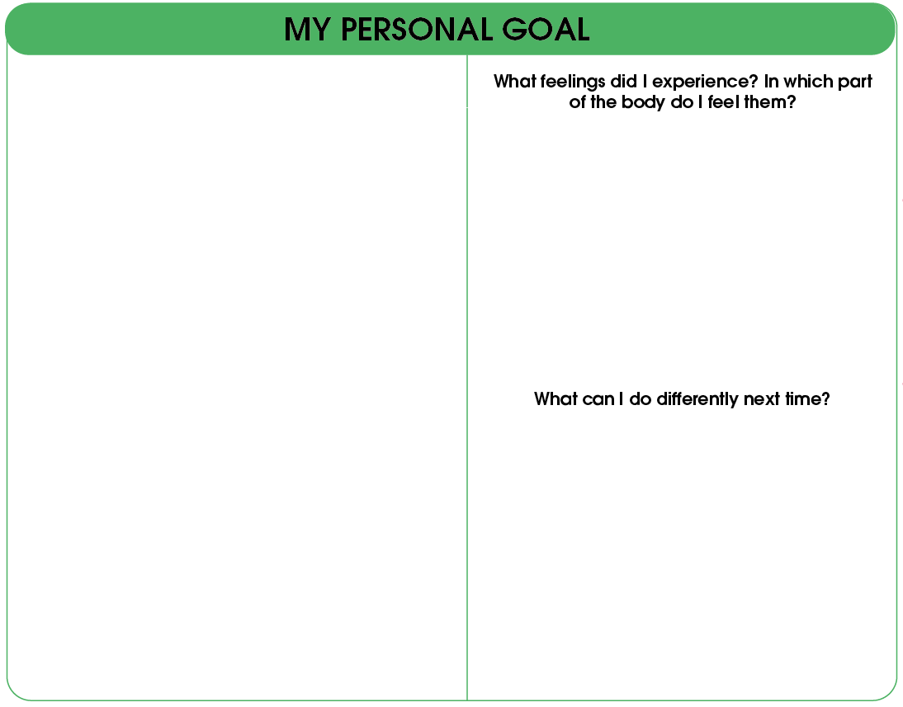
Materials
  Cardboard
  Markers
  Adhesive tape
  Blackboard
  (Optional) print “My personal goal”
What do we do?
In groups, we create posters with proposals for screen-free zones and times.

Slide 38
We think about a personal goal.
You can draw it, write it, or use stickers.
My goal is…
  Joy 😊
  Anxiety 😬
  Anger 😡
  Tiredness 😴
  Eyes
  Head
  Stomach
  Hands
  Use my phone only when I need it
  Avoid screens before going to sleep
  Take breaks when using screens
  Stay calm when it's time to put away the tablet
  Spend more time playing without screens
  Use the internet respectfully
  Ask an adult for help when something makes me feel uncomfortable
The next time I use screens, I can…
  Stop when I feel tired
  Give a heads-up before putting away the device
  Respect the agreed time limit
  Choose appropriate games
  Find another activity when I'm bored

Slide 39
Think and answer…
What have I learned about my relationship with digital media?
What emotion do I want to feel when I use them?
What can I do to improve my digital habits?
Digital media are part of my life, but I get to decide how to use them.

Slide 40
Complementary Activities
Activity 4.1
Digital Media Diary

Slide 41
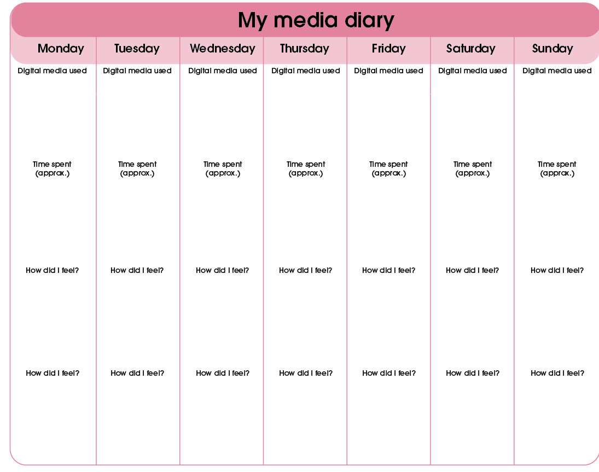
Materials
  Diary template
  Pencils
  Markers
What do we do?
For one week, we record which media we use, how much time we spend on them, and how they make us feel.

Slide 42
For one week, we record:
  Which medium I used
  How long I used it
  How I felt
Tablet
Phone
TV
Music
Video games
Video games
Tablet
30 m
30 m
15 m
1 h
30 m
40 m
15 m
Happy
Nervous
Angry
Tired
Sad
Irritated
Cheerful

Slide 43
Complementary Activities
Activity 4.2
Theater on Digital Situations

Slide 44

Materials
  Situation cards
  Open space in the classroom
What do we do?
In groups, we act out scenes about digital media use and look for better alternatives for each situation.

Slide 45
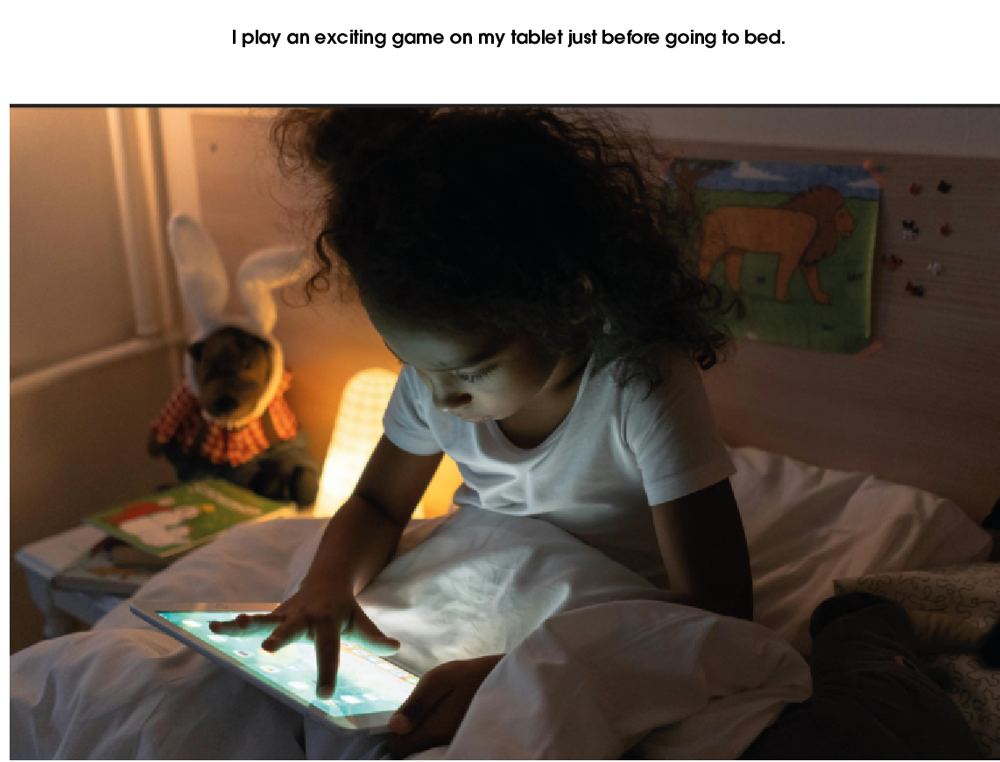

Slide 48
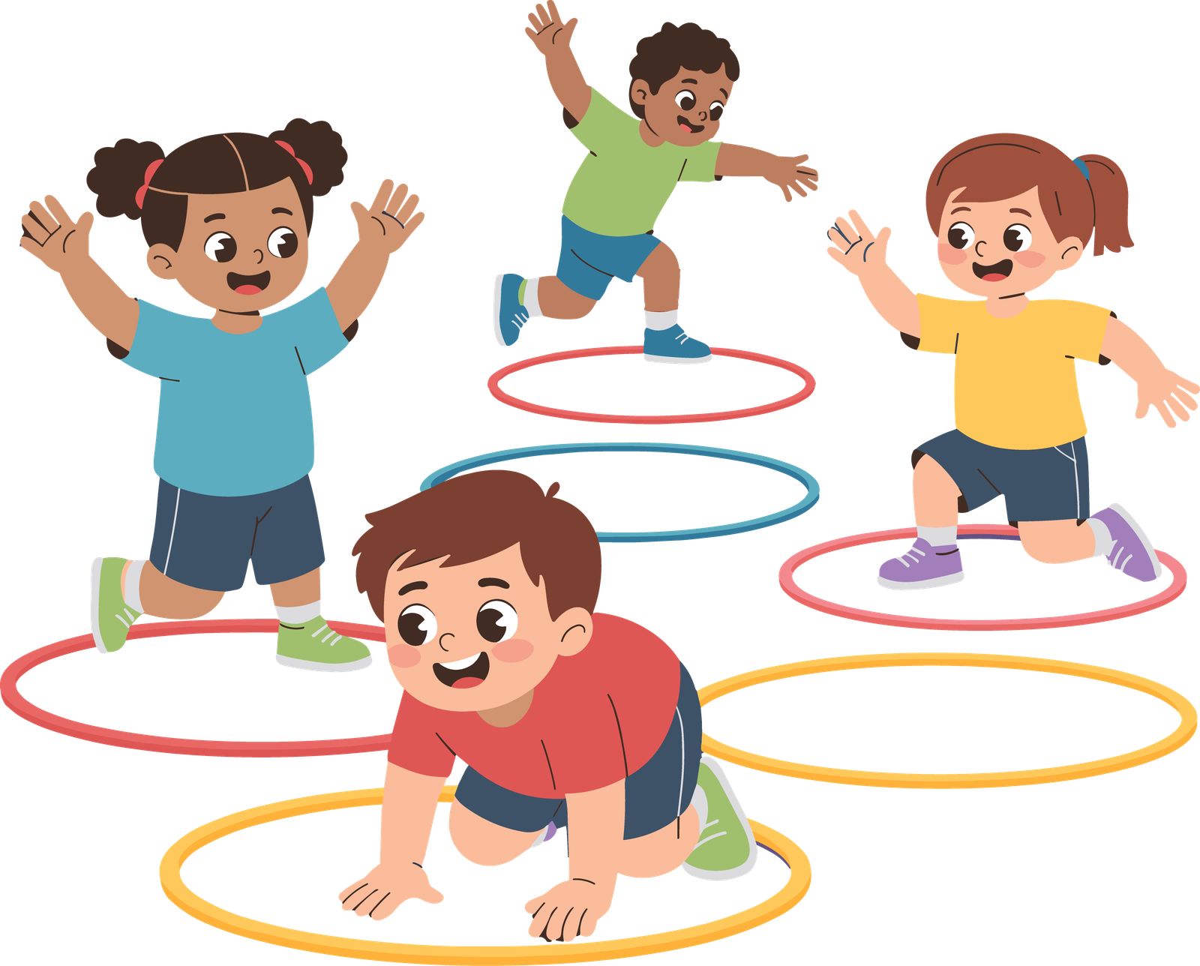
Digital media are part of your life,
but you can learn to use them in a way that's good for you.
Everyone can find their own balance between screens and screen-free activities.
The most important thing: pay attention to your sleep, your time, and your emotions.

Slide 49


