Slide 1

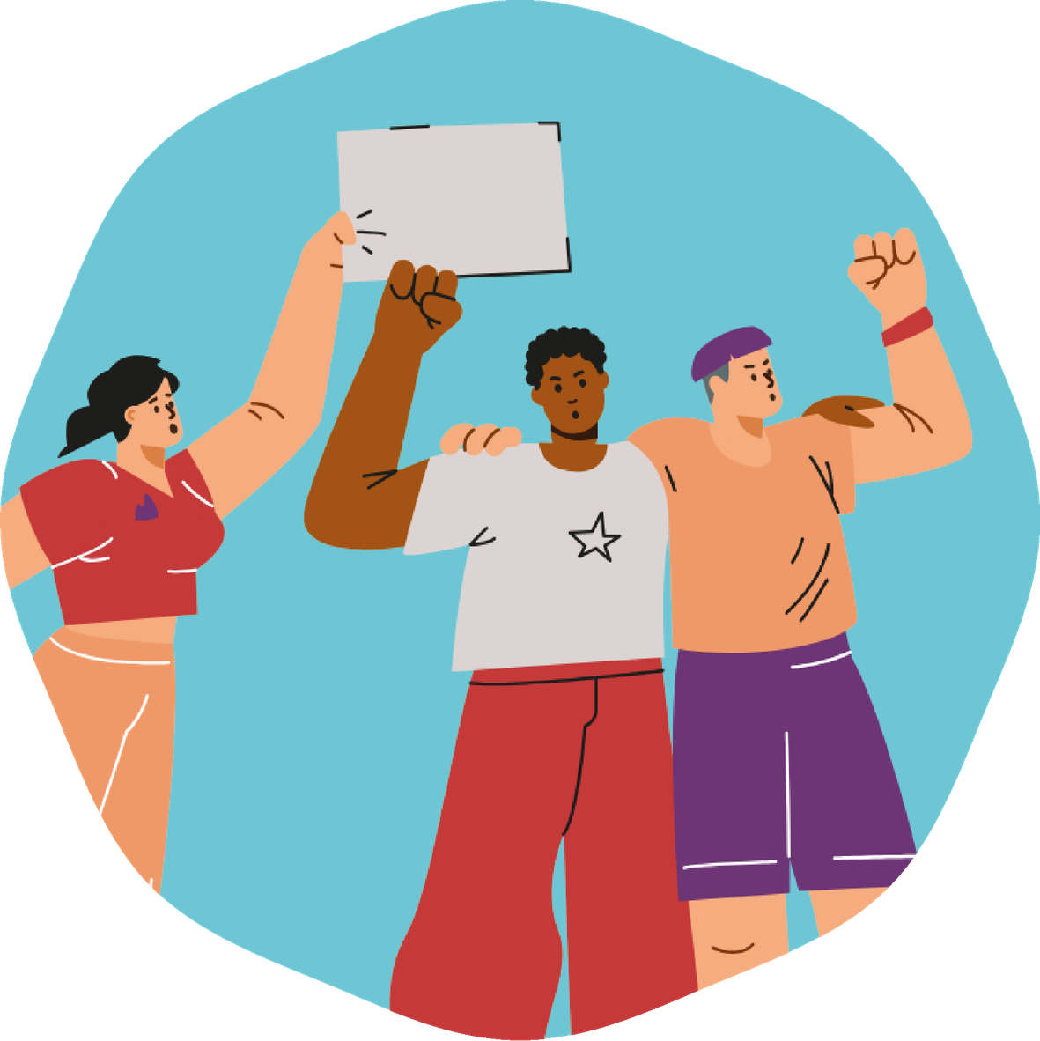
Module 9
Children's Rights
What rights do I have? How are they experienced in my environment and in the world?
1st and 2nd year of lower secondary school

Slide 2
Today we will explore:
01
What rights do we have as young people
02
How they are experienced at school and in the world
03
What we can do to protect them

Slide 3
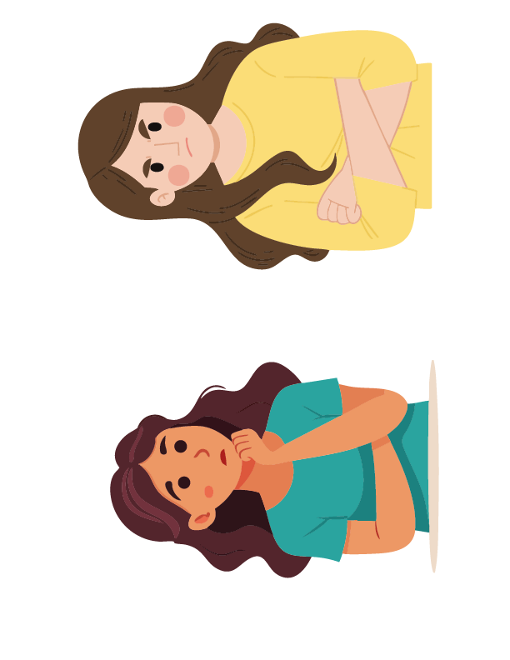
In this module
  No one judges, no one laughs at others.
  Every opinion is valid.
  You can participate or listen.
  We respect experiences and emotions.

Slide 4
Day 1. Discovering Rights
Activity 1.1
Hidden Image and Critical Reading

Slide 5
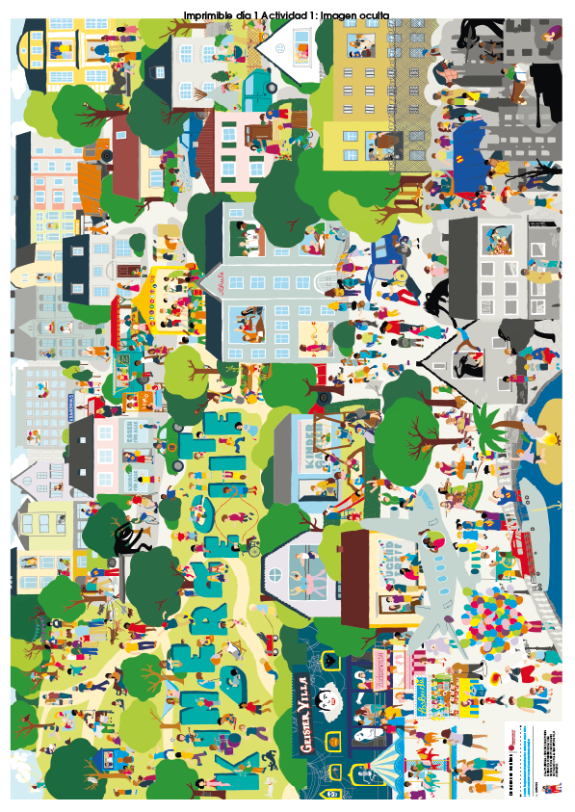
What will we do?
  Observe the image in silence.
  Share first impressions and emotions.
  Recognize inequality, pressure, or fair treatment.
  Connect the scene with real experiences.
If you were in this scene, how would you feel?

Slide 6
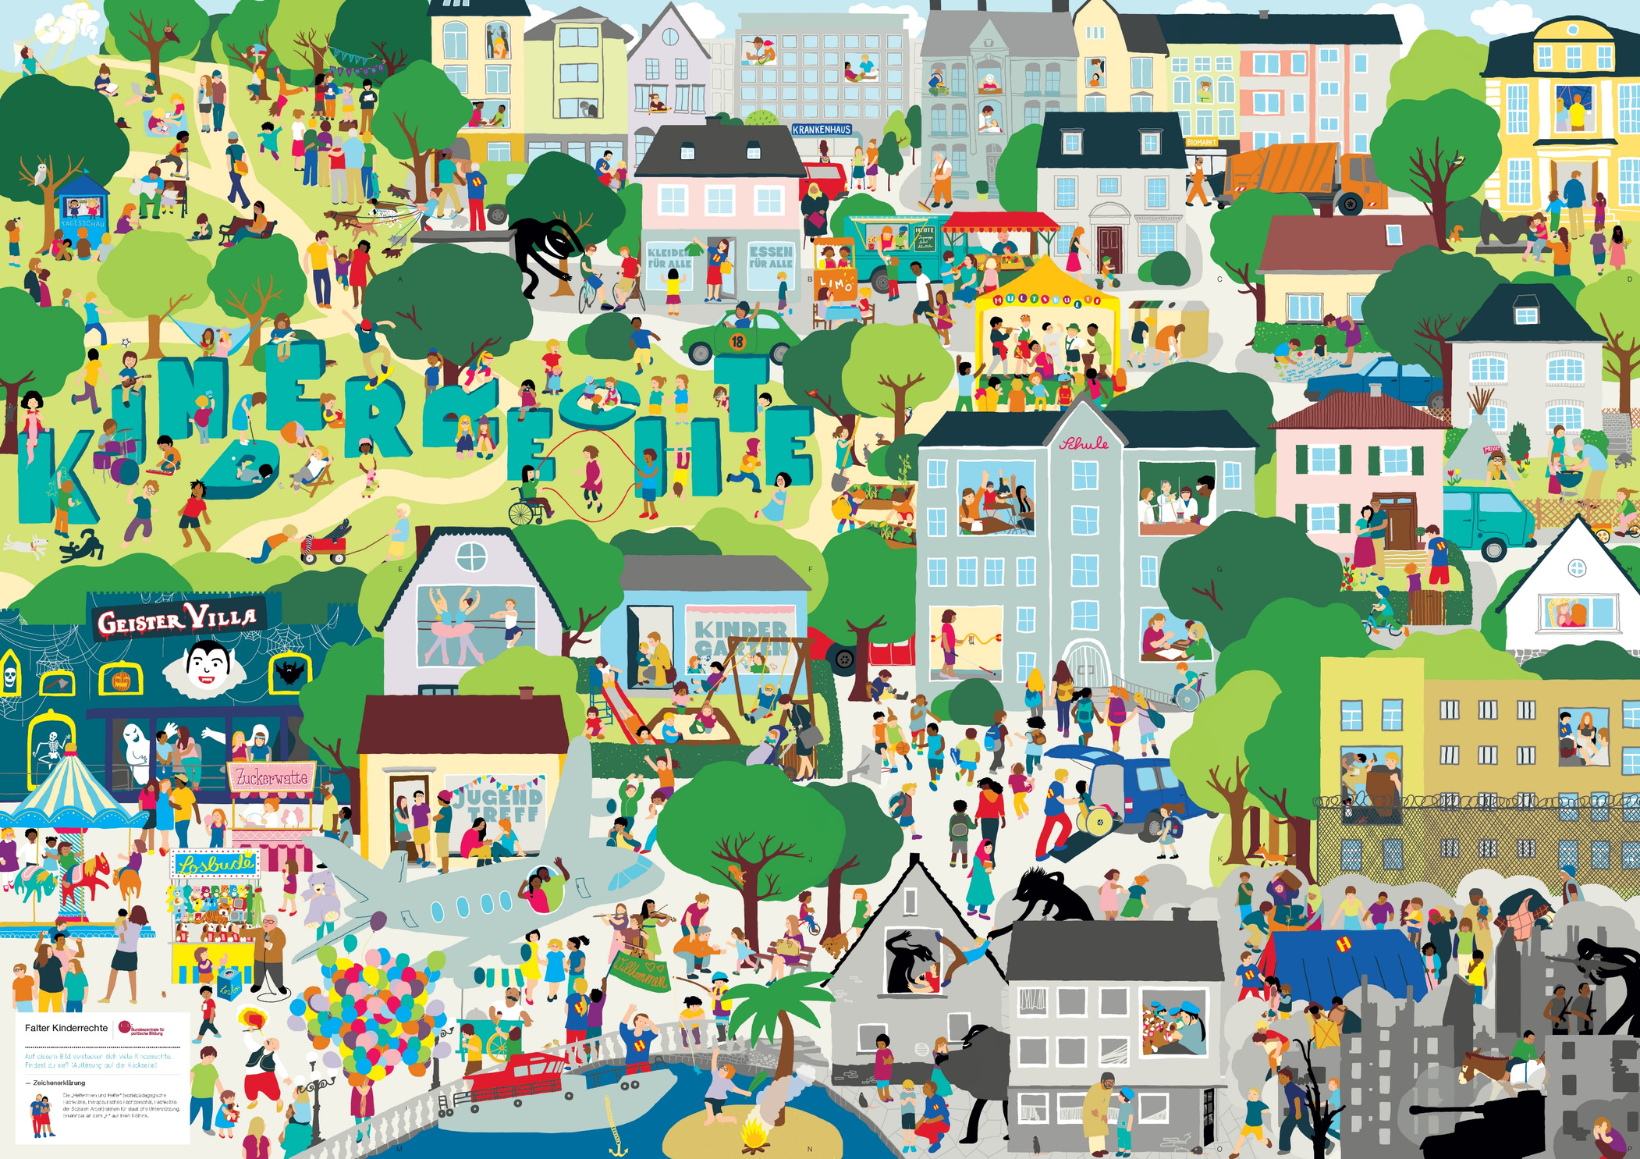

Slide 7
Activity 1.2
Let's identify rights in the scenes

Slide 8
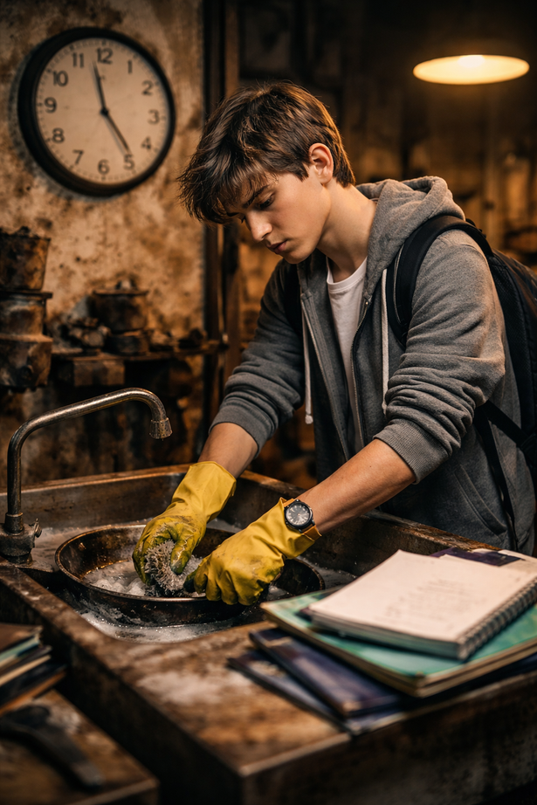
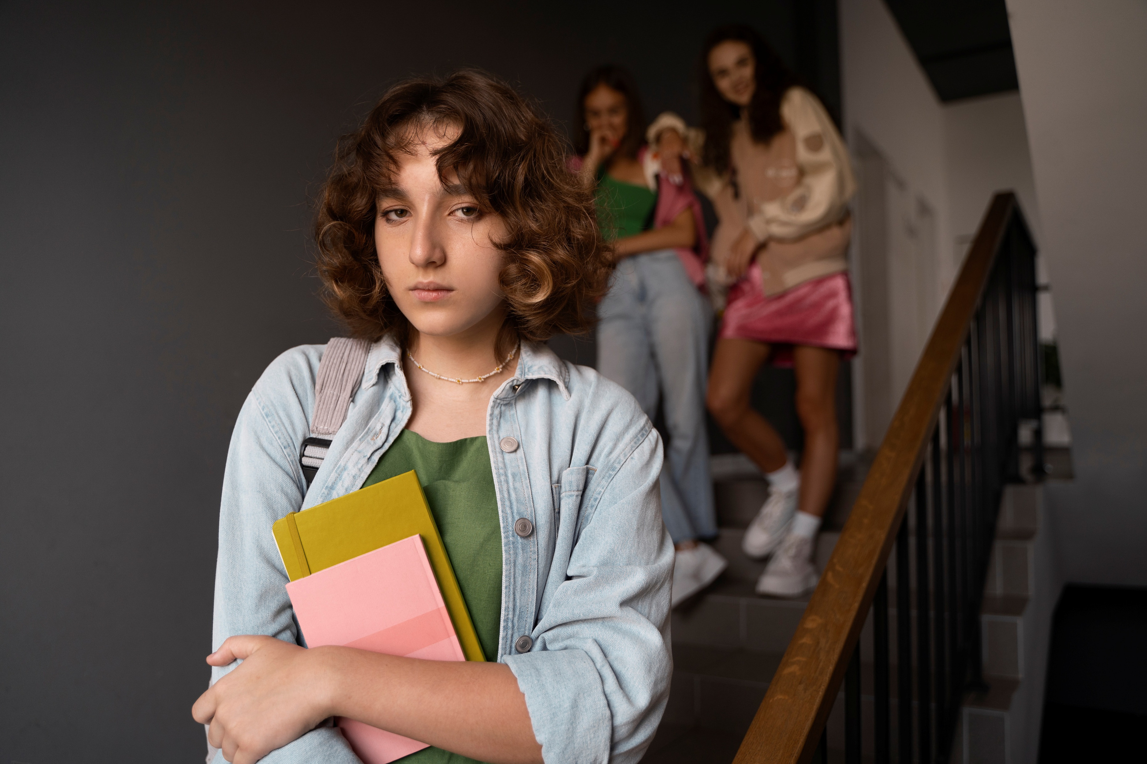
Materials
  Visible list of rights
  Blackboard or continuous sheet
What will we do?
  Analyze real images.
  Identify which right might be involved.
  Support it with visual evidence.
  Discuss in pairs and then as a group.

Slide 10
Which right is being violated?
What should change so that this right is respected?
Who could intervene and how?

Slide 11
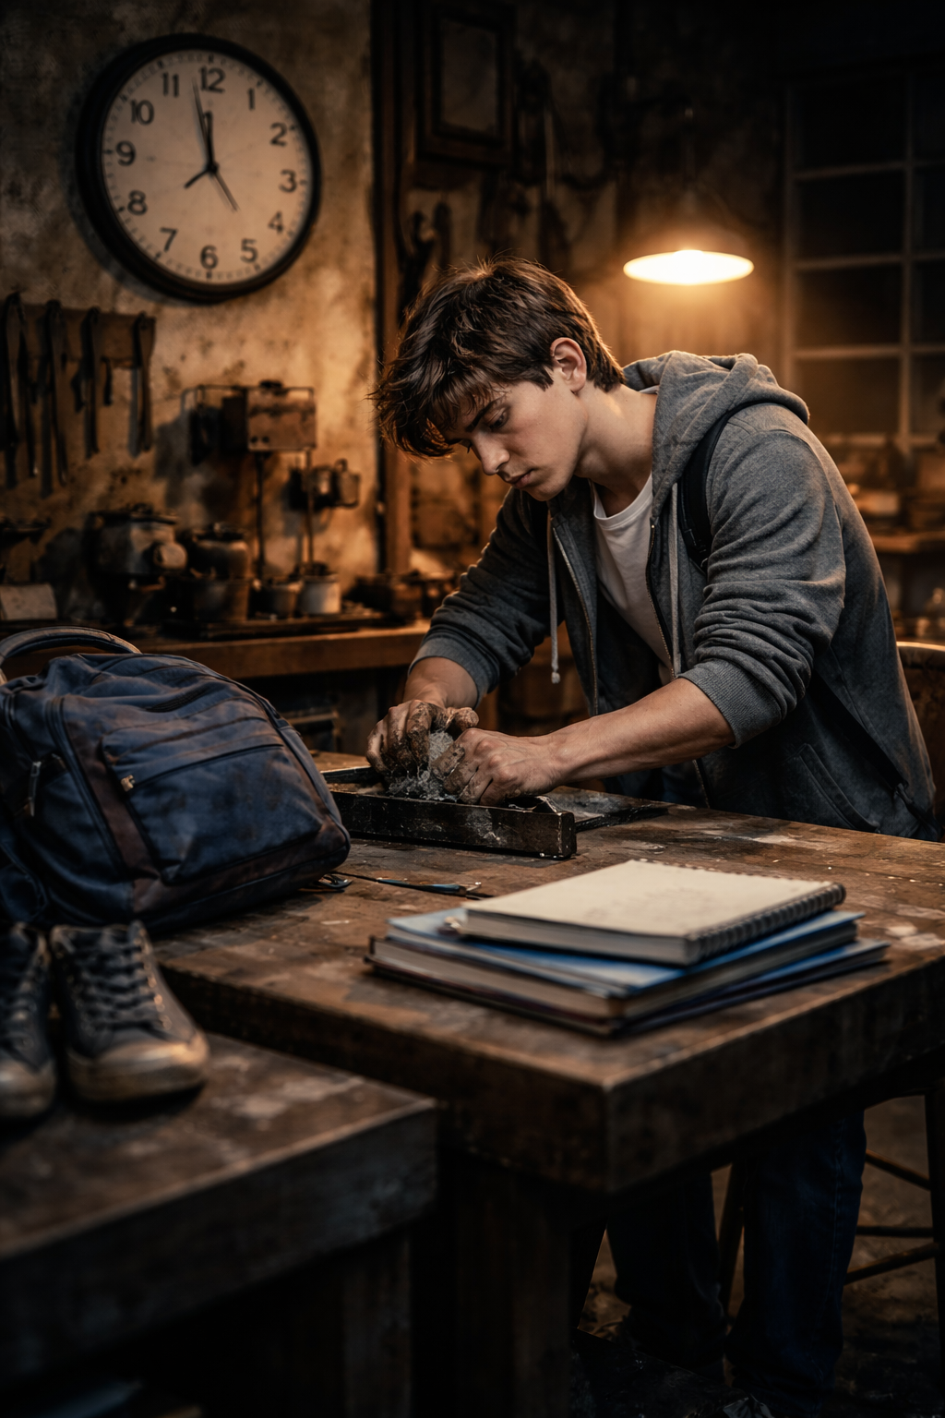
Which right is being violated?
What should change so that this right is respected?
Who could intervene and how?

Slide 12
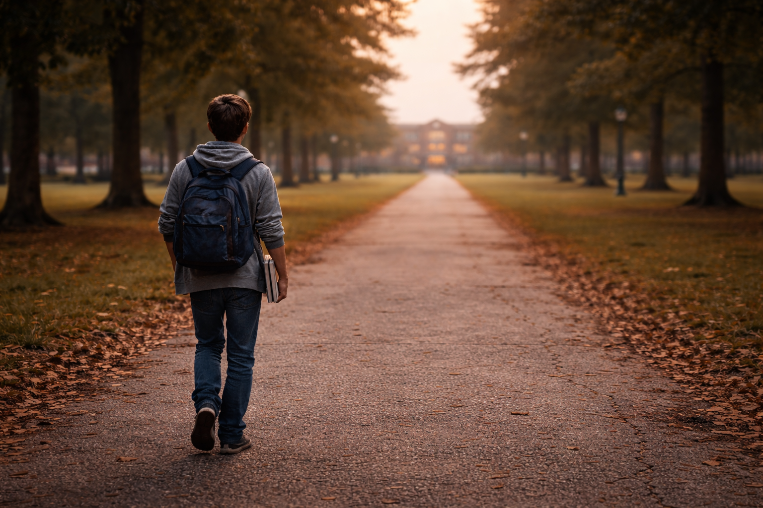

Slide 13
Which right is being violated?
What should change so that this right is respected?
Who could intervene and how?

Slide 14
Activity 1.3
Ethical Dilemmas of Daily Life

Slide 15

Which option would be the fairest and why?
Materials
  Cards with dilemmas
  Blackboard to collect ideas
What will we do?
  Read real-life dilemmas from young people's lives.
  Identify the right involved.
  Explore options and consequences.
  Conduct a brief structured debate.

Slide 16
01
Which rights are involved?
  Equality / non-discrimination
  Participation
  Fair and inclusive education
In the class, the same people are always chosen to represent the group and others are never given the opportunity.
02
Where does the ethical conflict arise?
  The same people are always favored.
  The principle of justice is violated.
  Exclusion becomes normalized.
03
What options would the person involved have?
  Express how they feel.
  Ask directly for an opportunity.
  Seek support.
  Reflect together on the situation.

Slide 17
01
Which rights are involved?
  Respect and personal dignity
  Equality and non-discrimination
  A safe environment
  Moral and emotional integrity
They make "jokes for fun", but always about the same person, and they are no longer funny.
They make "joke" jokes, but always about the same person and they are no longer funny.
02
Where does the ethical conflict arise?
  One-sided jokes.
  The harm is justified by saying it's "just a joke".
  One's own amusement is put above the well-being of a specific person.
03
What options would the person involved have?
  Clearly state that it bothers them.
  Ask for support.
  Remove themselves from the situation.
  Request mediation.

Slide 18
01
Which rights are involved?
  Equal opportunities
  Education
  Non-discrimination
  Fair treatment
A student falls behind in their work because they do not have access to the same resources as others.
02
Where does the ethical conflict arise?
  The same result is expected from everyone without considering that not everyone starts from the same conditions.
  The responsibility for the delay is attributed solely to the student, without considering the context.
03
What options would the person involved have?
  Clearly state that it bothers them.
  Ask for support.
  Remove themselves from the situation.
  Request mediation.

Slide 19
Day 2. Rights in the World
Activity 2.1
Questions that foster global awareness
«What would happen if...?»

Slide 20
How would your day change if this were really the case?
Materials
  List of "What would happen if...?" questions
  Blackboard or continuous sheet
What would happen if you couldn't express yourself? What would you think?
What would happen if you couldn't go to school?
What will we do?
  Present real scenarios of global inequality.
  Discuss how our lives would change in these situations.
  Identify consequences, rights involved, and emotions.
What would happen if no one made important decisions for your life?
What would happen if there were no adult to take care of you when you are ill?

Slide 21
What would happen if you couldn't express what you think because it would be dangerous?
Consequences for your life
What emotions would arise?
Right violated
Right to freedom of opinion
  You would remain silent out of fear, even when something is unjust.
  You would not be able to defend yourself or others.
  Your participation at school and in society would be limited.
  Fear
  Sadness
  Frustration
  Powerlessness
The ability to say what one thinks, without fear, is a fundamental right.

Slide 22
What would happen if other people made important decisions for you?
Right violated
Consequences for your life
What emotions would arise?
Right to be heard
  You would feel like you have no control over your life.
  You might follow paths you don't want or that don't represent you.
  Your self-confidence would diminish.
  It would be harder for you to learn to make decisions and take on responsibilities.
  Fear
  Sadness
  Frustration
  Powerlessness
  Anger
  Insecurity
All people, especially children and young people, have the right to have their opinions taken into account.

Slide 23
What would happen if you couldn't go to school every day?
Right violated
Consequences for your life
What emotions would arise?
Right to education
  You would have fewer opportunities for the future.
  You might lose motivation to learn.
  You would learn less and could fall behind.
  It would be harder for you to keep up with the class.
  Worry
  Sadness
  Shame
  Insecurity
All children and young people have the right to a regular and quality education.

Slide 24
Activity 2.2
Real Stories from the World

Slide 25
Which part of this story struck you the most?
Materials
  Stories from B2.3
  Analysis sheets
  Visual vocabulary of rights (optional)
Amina works in a factory to support her family.
Bangladesh
Sofía is discriminated against because she speaks a different language.
Bolivia
What will we do?
  Read real stories of young people from other countries.
  Identify the main problem and the right violated.
  Analyze causes, consequences, and emotions.
  Share conclusions as a group.
Lucas cannot play outside due to violence in his neighborhood.
Brazil

Slide 26
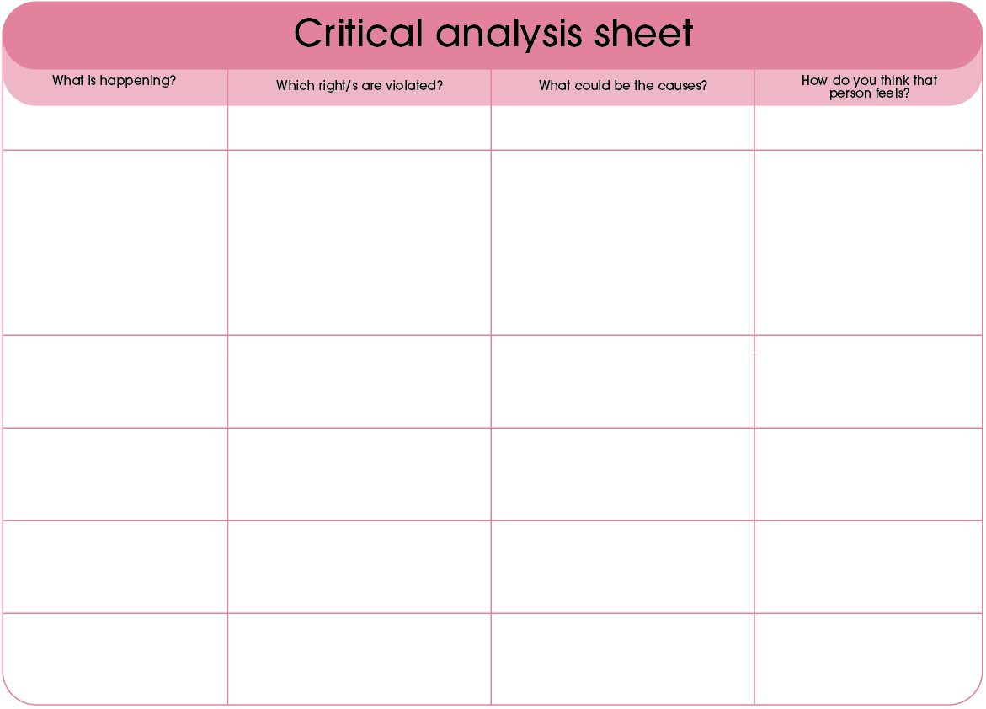
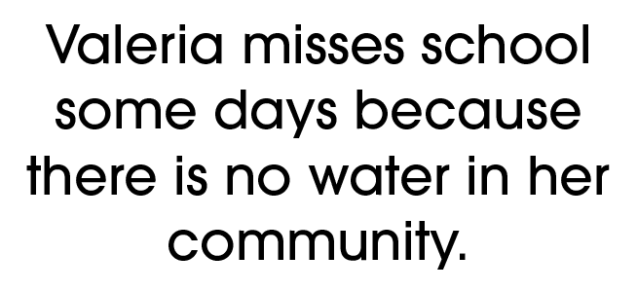
Valeria cannot go to school on some days
  Right to education
  Right to equal opportunities
  Right to health
  Right to water
  Water scarcity
  Insufficient infrastructure
  Lack of public investment
  Great distance from supply points
  Unequal distribution of resources
  Worried
  Frustrated
  Sad
  Powerless

Slide 27
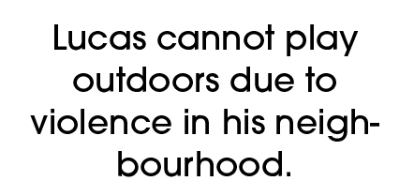
Lucas cannot go outside or use public spaces to play due to violence in his neighborhood
  Right to safety and protection
  Right to rest and play
  Right to child development
  Right to health
  Violence in the neighborhood
  Lack of public safety
  Absence of safe recreational and play spaces
  Social inequality and poverty
  Low presence of community programs
  Fear
  Sadness
  Frustration
  Insecurity

Slide 28
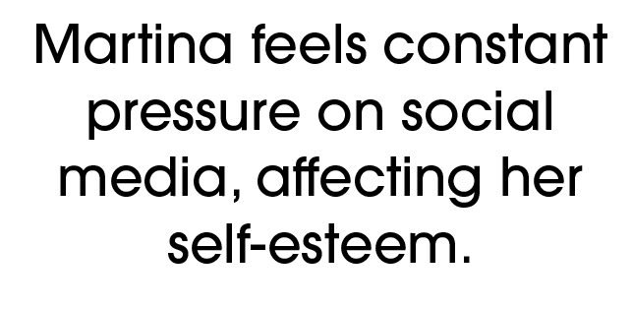
Martina is under constant pressure on social media, which negatively affects her self-esteem and emotional well-being
  Right to emotional well-being and mental health
  Right to dignity and respect
  Right to personal development
  Right to a safe environment
  Constant comparison
  Social pressure
  Negative comments or criticism
  Lack of digital and emotional literacy
  Algorithms that reinforce stereotypes
  Fear
  Stress
  Sadness
  Insecurity

Slide 29
Day 3. Support Network
Activity 3.2
Our School with More Rights

Slide 30
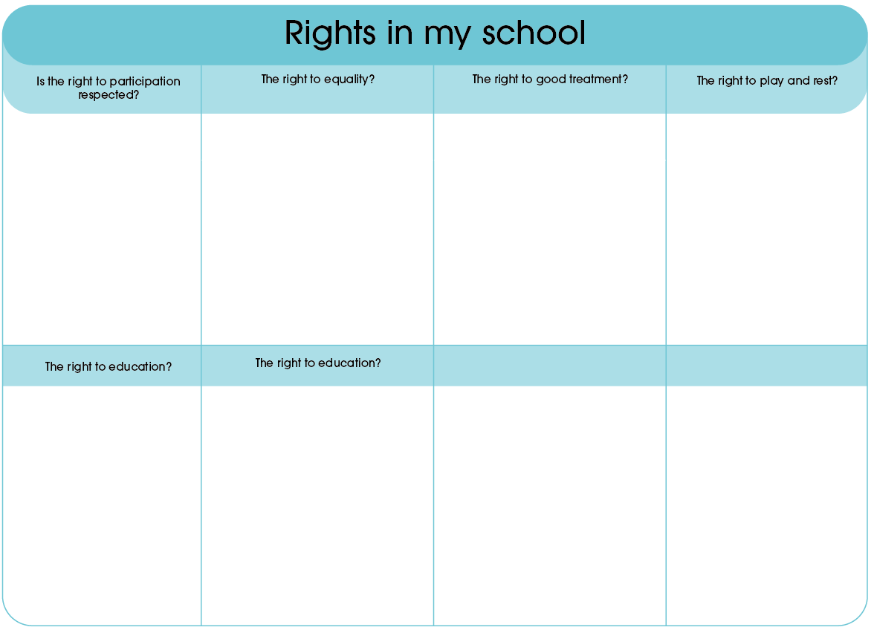
What can we ourselves change to improve this right?
Materials
  Large cardboards / posters
  Template with 4 sections (Right / Problem / Action / Impact)
  Markers, colors, stickers
What will we do?
  Design real student-led projects.
  Propose concrete, simple, and achievable actions.
  Create creative posters.
  Present projects in 1–2 minutes.

Slide 31
What solution would truly be useful?
What can students do without depending entirely on adults?
What would we need for this to work?

Slide 32
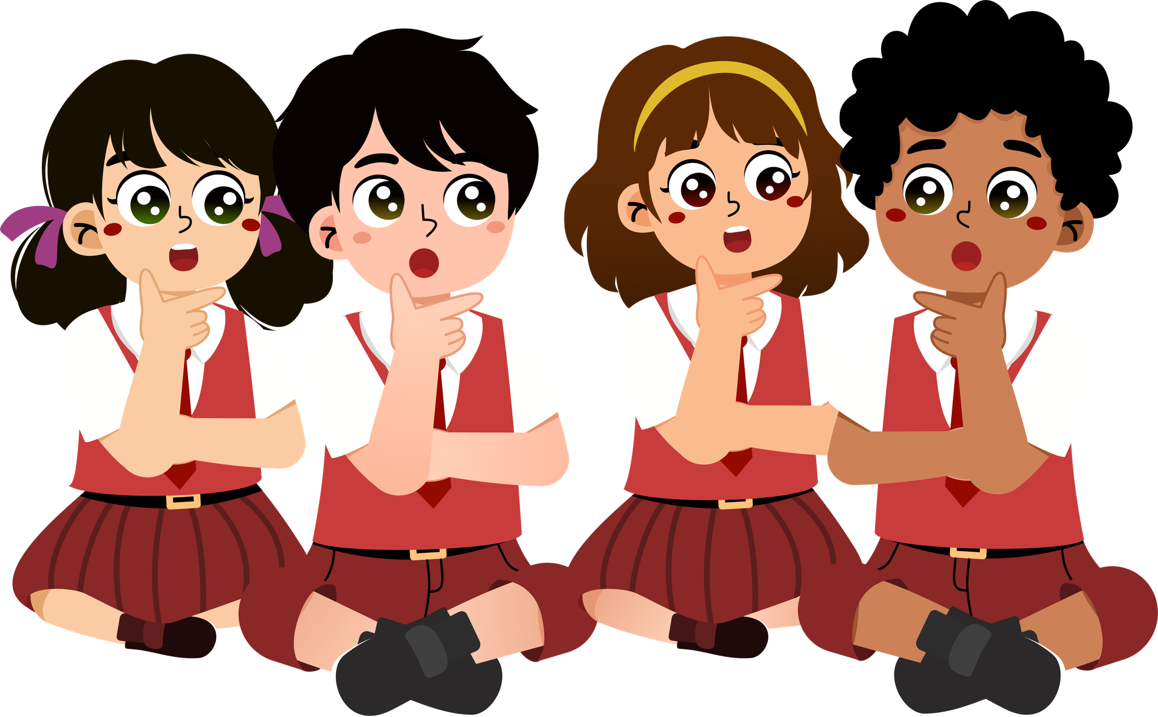
What obstacles might we encounter?
Who would benefit from this action?

Slide 33
Let's create a poster
Right to be heard
  Chosen right
  Identified problem
  Proposed action
  Expected impact
  Group slogan or phrase
Sometimes:
  Decisions are made without listening to others.
  Some opinions are ignored or dismissed.
  People are afraid to speak for fear of mockery or punishment.
  The same people always speak.
Solutions:
  Listen without interrupting when someone speaks.
  Respect all opinions, even if you disagree.
  Introduce speaking rules in the class or group.
  Encourage those who speak less.
Use your imagination and make it your own.
  Expected impact:
  Everyone feels valued and respected.
  The group environment improves.
  There is more participation and better ideas.
  Trust and mutual respect grow.
“Speaking and listening unites us.”

Slide 34
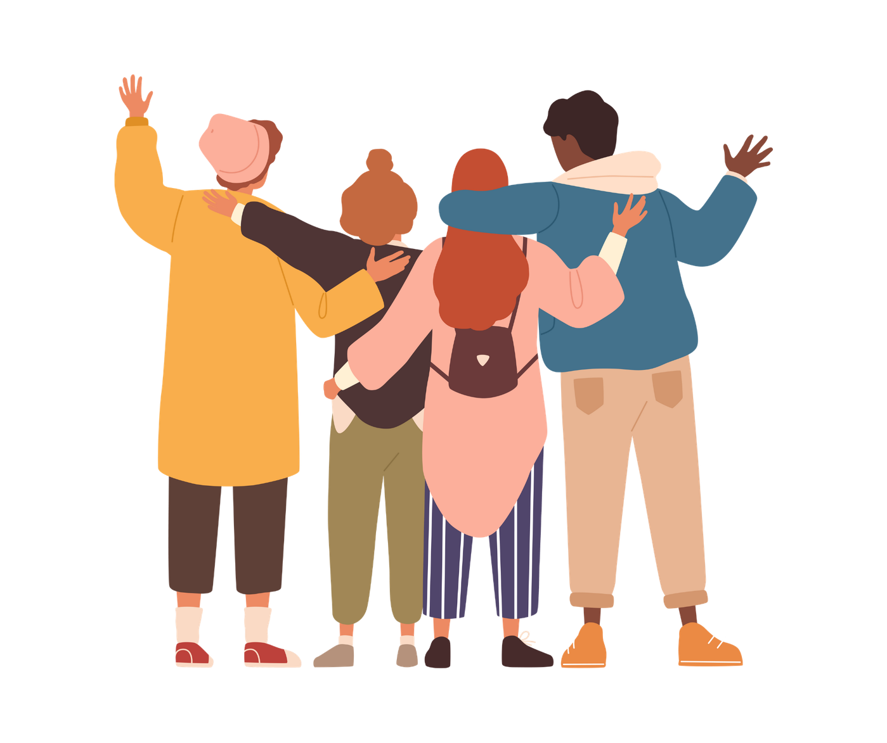
Remember
Rights live in:
  Our decisions
  How we treat others
  How we defend justice
You have the power to make sure they are respected.

Slide 35


