Slide 1
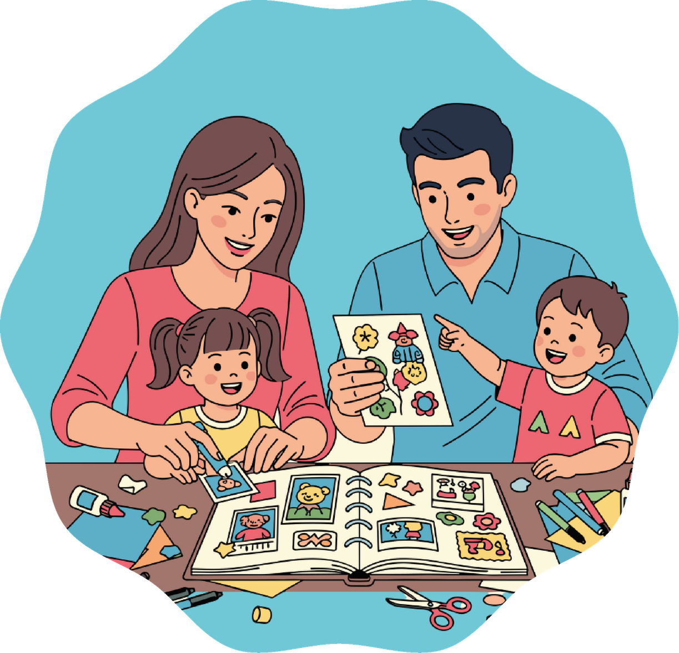

Module 7
Children with Parents with Mental Illness
Understanding before judging.
Primary School Activities

Slide 2
Activity 1.1
Illnesses that can be seen and illnesses that cannot be seen

Slide 3


Slide 4



Slide 5



Slide 6

What do these situations have in common?
They are visible. They affect the body.

Slide 7

Can someone be ill even if it cannot be seen?
Sometimes people feel very unwell inside, in their thoughts or emotions.
Sometimes a person may feel very sad for a long time, feel constant fear, or have difficulty concentrating. This cannot be seen like a wound or a fever, but it is still an illness.

Slide 8
Mental illnesses exist and can be treated, like other illnesses.
01
It influences thoughts and emotions.
02
It can last quite a long time.
It is not weakness
It is no one’s fault
03
It can be treated.
You can ask for help
04
It requires support.

Slide 9
Activity 1.2
Leo’s story

Slide 10
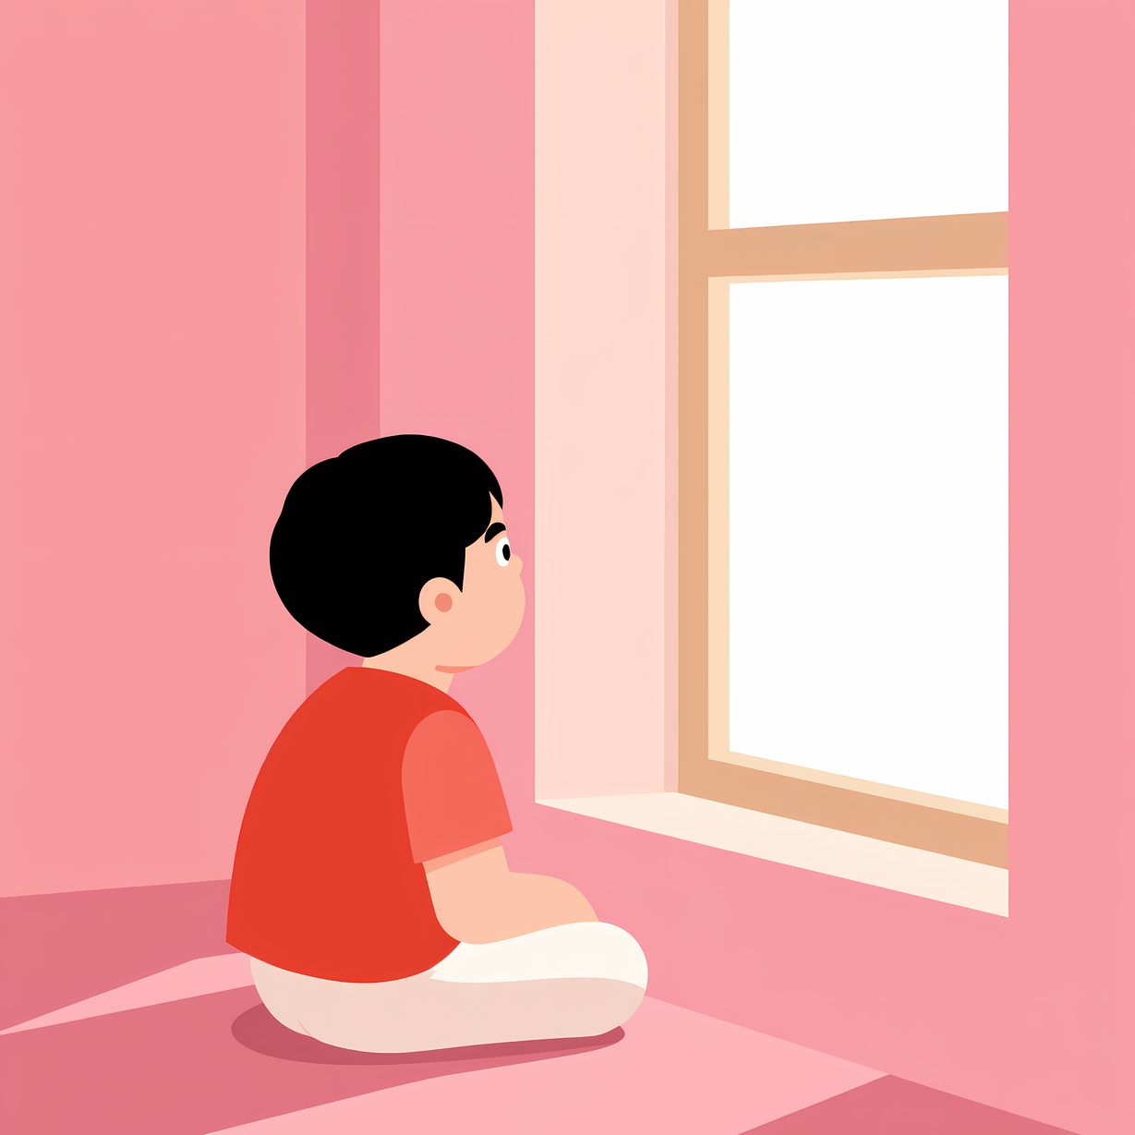
Leo’s Story
When an adult does not feel well inside
Leo is 9 years old.
For some time, he has noticed that his dad is different.
Sometimes he is very quiet.
Other times he seems tired even though he has not done anything special.
They used to play together on weekends.
Now Leo’s dad often says he has no energy.
Leo does not really understand what is happening and starts asking himself questions:
Did I do something wrong?
Is he angry with me?
Could I help more at home?

Slide 11
Leo’s Story
When an adult does not feel well inside
Leo’s dad has an illness called depression.
It is an illness that affects thoughts and emotions.
It is not Leo’s fault.
And it can be treated with help.
How do you think Leo feels?
What might he be thinking?
What could help him?

Slide 12
Leo’s Story
When an adult does not feel well inside
Leo’s dad has an illness called depression.
It is an illness that affects thoughts and emotions.
It is not Leo’s fault.
And it can be treated with help.
01
It is not the child’s fault.
02
Children should not have to solve adults’ problems.
03
Talking to a trusted person can help.

Slide 13
Activity 1.3
What can help? — Let’s build a support network

Slide 14
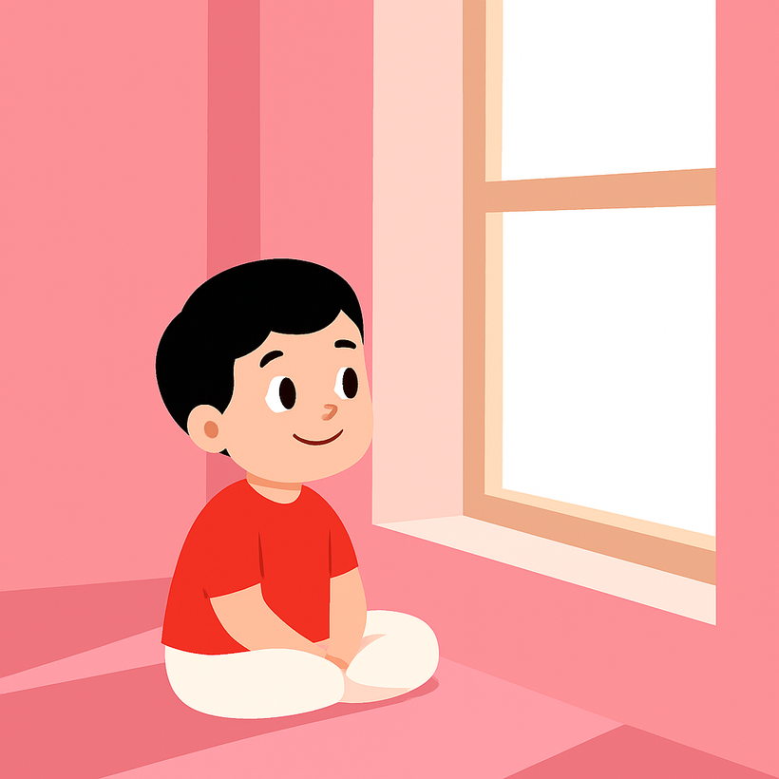
Let’s think together and remember
How do you think Leo feels?
What could help him?

Slide 15
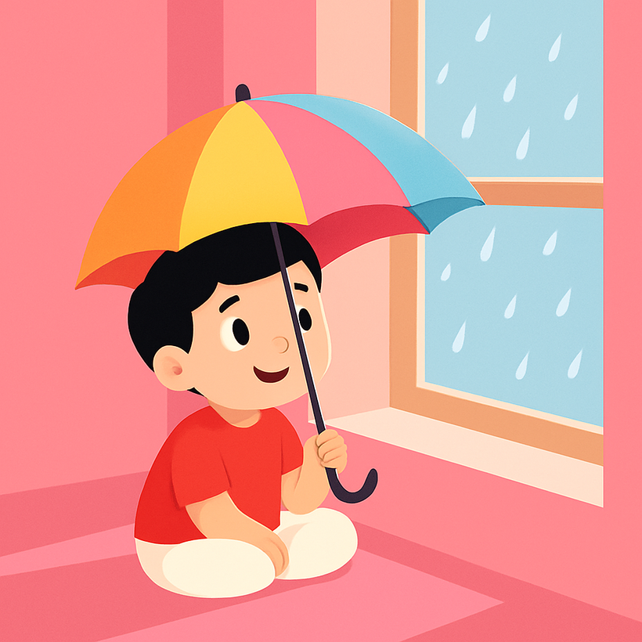
01
When an adult is unwell inside, it is not the child’s fault.
02
Children should not have to solve adults’ problems.
03
Talking to a trusted person can help.
What can help Leo?

Slide 16
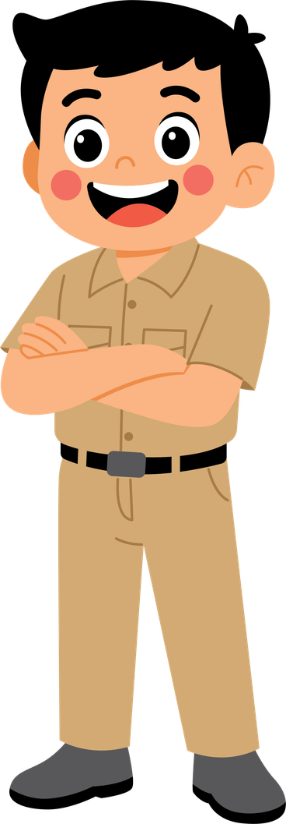

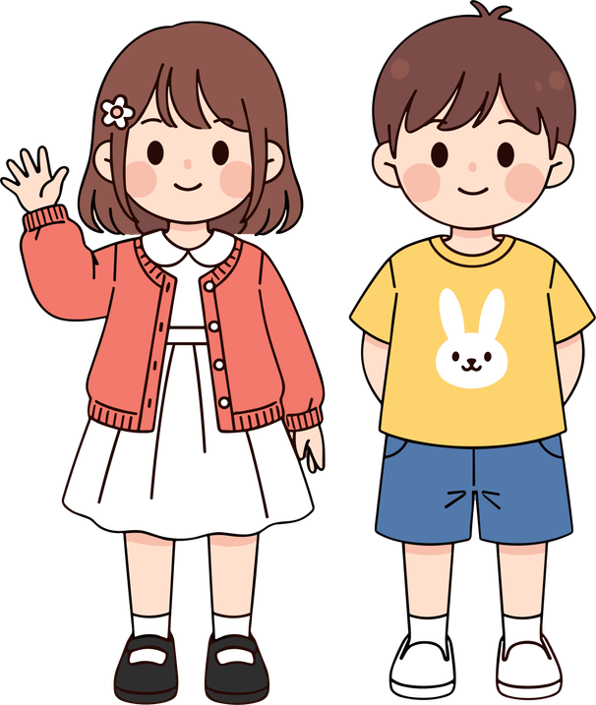
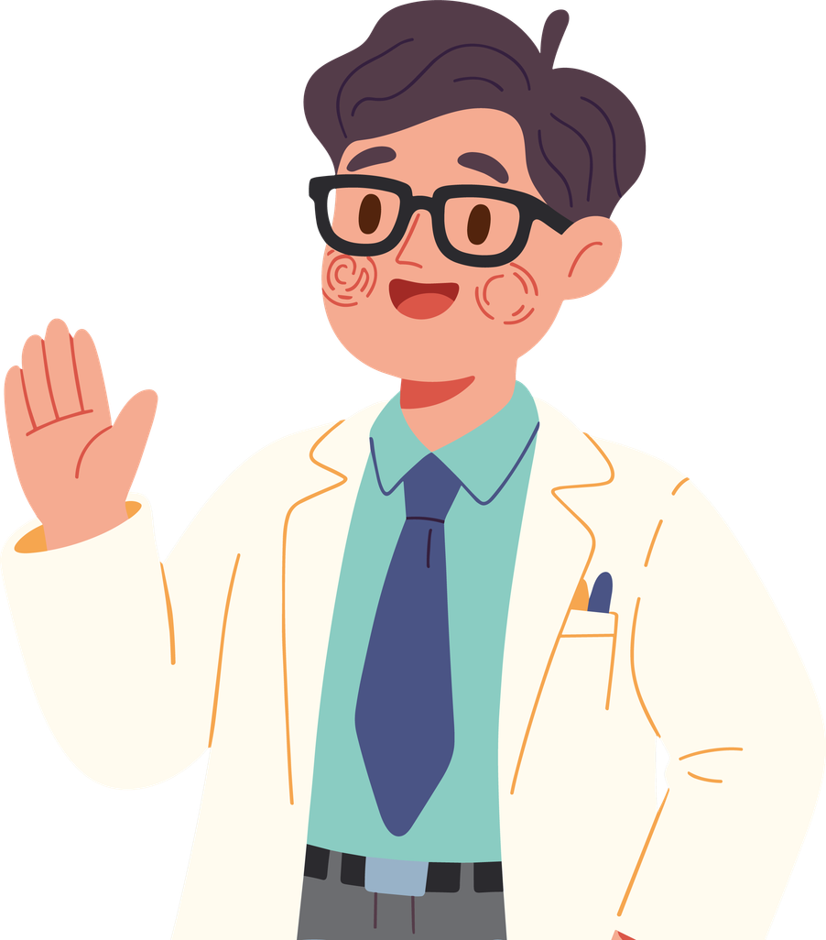

Slide 17
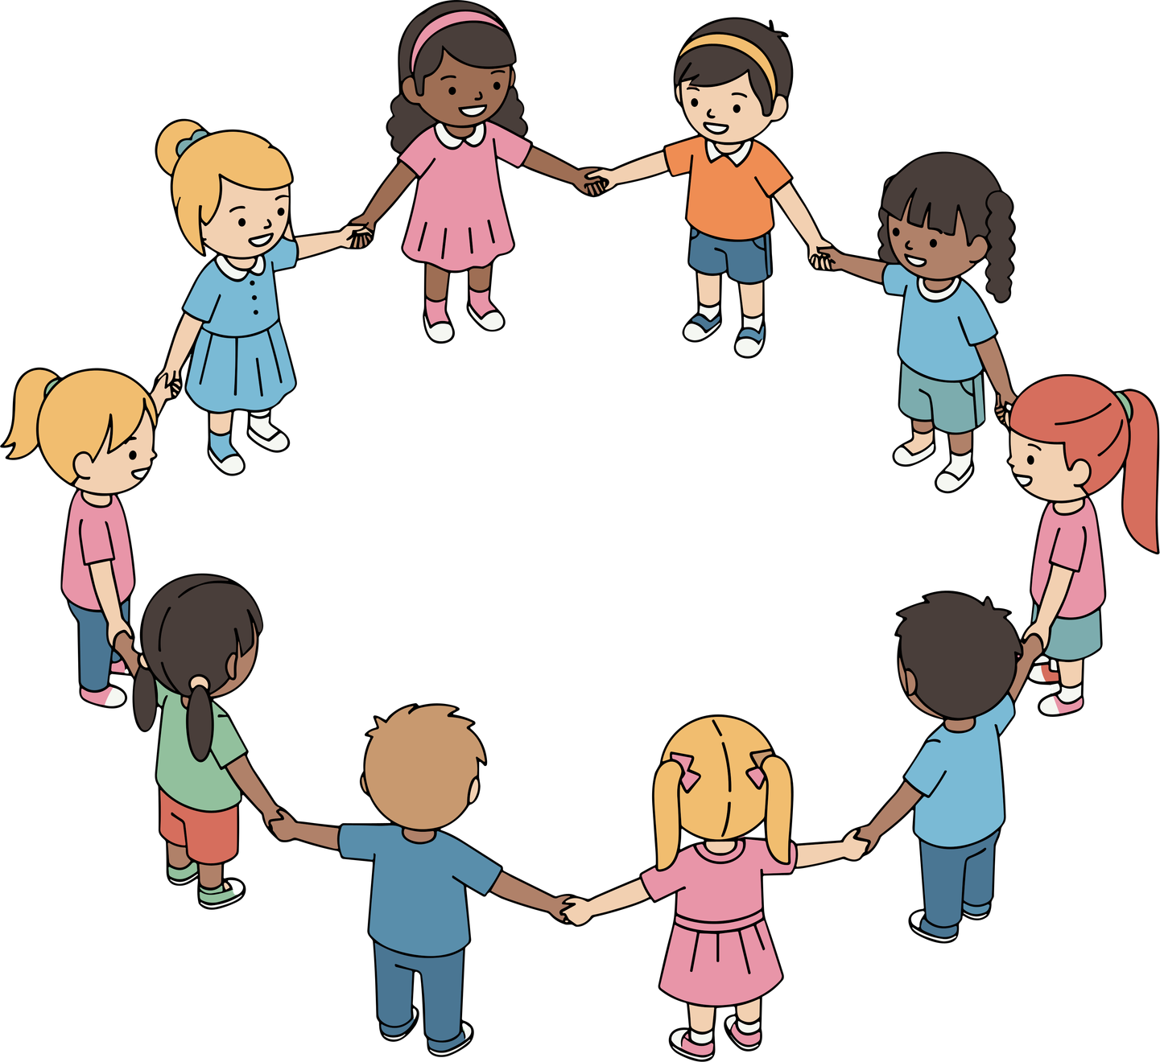

01
Asking for help is something courageous.
02
You do not have to solve adults’ problems.
03
There is always someone who can listen.

Slide 18
Activity 1.4
What is important to remember

Slide 19
Mental illnesses exist.
They are not the children’s fault.
Adults can receive help.
Children should not have to solve adults’ problems.

Slide 21
You are not alone.
There is always someone who can listen.
Asking for help is something courageous.
Support is always
available.
If you have any questions, you can write them down without including your name.

Slide 22
Complementary Activity
Activity 2.1
Myths and truths

Slide 23
Mental illnesses
are rare.
A child is to blame if their father or mother is sad.
MYTH
MYTH

Slide 24
People with depression can receive help.
If something cannot be seen, it is not an illness.
FACT
MYTH

Slide 25
Asking for help is a sign of weakness.
MYTH

Slide 26
Complementary Activity
Activity 2.2
Helpful phrases

Slide 27
Leo is worried because his dad has no energy.
What could a friend say to help him?
Helpful phrases
Phrases that do NOT help
  It’s not your fault.
  I’m here if you want to talk.
  We can ask for help together.
  You don’t have to do everything alone..
  Nothing is happening.
  It will surely pass.
  Don’t think about it.

Slide 28
María is sad because her friends did not want to play with her.
What could a friend say to help her?
Helpful phrases
Phrases that do NOT help
  It’s normal to feel this way.
  Thank you for telling me.
  Do you want me to stay with you for a while?
  You always do the same thing.
  It’s your fault.
  If you had been more careful, it wouldn’t have happened.

Slide 29
David is worried because his mom is ill.
What could a friend say to help him?
Helpful phrases
Phrases that do NOT help
  What you feel is important.
  I’m listening.
  It’s not your fault.
  I’m here for you.
  It will pass.
  Stop thinking about it.
  Don’t cry.
  You have to be strong.

Slide 30


